Slide 1
Attracting Gen Z and Millennials to your Community

Slide 2
Notes:
Alabama Mountain Lakes
Thank you so much for joining us in discussion of attracting Gen Zers and Millennials to your community and organization and how to keep them. We are delighted to see you here today. As you know, the labor force is constantly shifting, changing, churning – let’s see if we can make sense of it all and put things in perspective of how to capture the best talent. Our desire is that you can hopefully take back what you hear today to your hometown to raise visitation, receipts and goodwill even more in your local communities.
Before we dive in, let’s recognize a couple of people. Bill Geist and Terri White are some of the foremost voices in travel and tourism. Because of their efforts they have raised the discourse and visibility of travel across the United States. Tourism today would not be where it is at without the foresight and insights provided by these two. Terri and Bill, thank you for all you do for the DMO community. If you get a chance, take the time to talk with them before they leave.
Also let’s take a moment to thank those who have put on today’s program. All of us in this room put on events at one time or another – and as you know, it is never easy. Hence, let’s take the time to thank the staff of Alabama Mountain Lakes. Please stand so we can recognize you.
Tami Reist
Angie Pierce
Penne Beasley
Melea Hames
Thereasa Hulgan
Randa Hovater
Craig Johnston
Karen Beasley
Leslee Herrington
Mickie Collier
Jerry Yarbrough
If you have the opportunity, please thank each of the staff individually for hosting a tremendous day of learning and networking.

Slide 3
Baby Boomers
1946-1964
60-78
Generation X
1965-1981
43-59
Millennials
1982-1997
27-42
Notes:
Let’s refresh our memories on how we divide the generations.

Slide 4
Gen Z
1998 - 2012
12 - 26

Slide 5
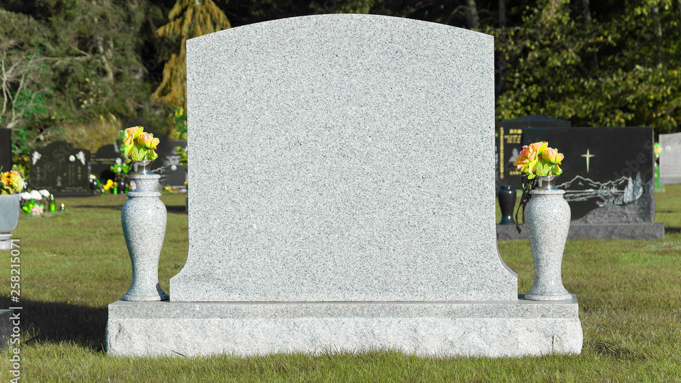
Brat summer
2024 - 2024

Slide 6
Communication Patterns
Baby Boomer – Give me the bottom line.
Gen X – Keep it real. Leave me alone.
Millennial – Keep it interactive.
Gen Z – Text me. Don’t call me.
Notes:
Baby Boomer – Give me the bottom line. I’ve been around sixty years.
Gen X – Keep it real. Tell me the situation but don’t tell me everything is hunky dory. Leave me alone.
Millennial – Keep it interactive.
Gen Z – Text me. Keep it short and on the screen. Don’t call me.

Slide 7
Labor Force
Notes:
So why are we talking about generations today? Because our labor force is changing and changing rapidly.

Slide 8
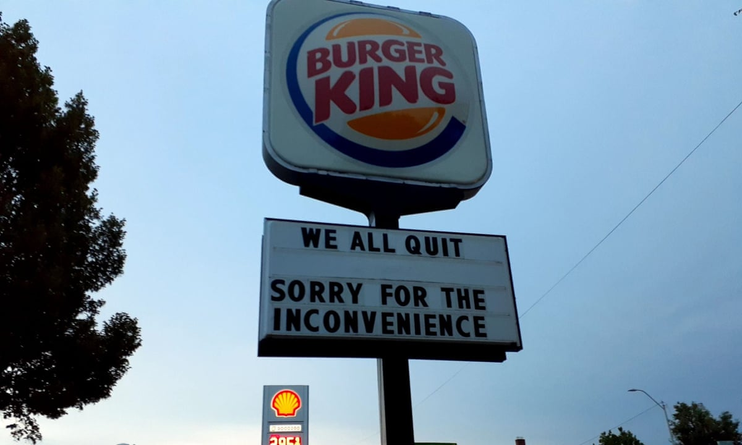
The great resignation
67%
2000
63%
2019
62%
2024
60%
2020
Work Force Participation Rate
Notes:
https://www.wsj.com/articles/the-great-resignation-started-long-ago-economy-pandemic-labor-force-participation-workforce-men-mothers-stimulus-welfare-11658440164
But 3.25 million Americans have left the workforce—labor-force participation among Americans 16 and older is 62.2%, down from 63.4% in February 2020.
Several factors are at work. The chamber notes that Americans have added $4 trillion to their savings accounts since early 2020. They had more money and less to spend it on, thanks to “enhanced unemployment benefits, stimulus checks, and not being able to go out.” The extra few hundred dollars a week from enhanced unemployment “led to 68% of claimants earning more on unemployment than they did while working.”
Labor-force participation for both sexes, he notes, peaked in 2000 at 67%. We’re now 5 points lower than that.
Difficulty finding good child care also keeps some from the workplace. During the pandemic a lot of child-care providers closed up or scaled back. A lot of working mothers left their jobs during the pandemic and apparently chose not to return. The labor-force participation rate for working mothers went from around 70% to 55% and hasn’t fully snapped back.
The Bureau of Labor Statistics reports that more than 47 million Americans voluntarily quit their jobs in 2021. The shock of the pandemic prompted reflection. Stimulus checks and enhanced unemployment helped make big personal change possible.
It isn’t only the young. Part of the story of job-leaving in America has to do with early retirement. “In 2021, older workers left their jobs at an accelerated rate, and they did so at younger ages.” They felt able to do so because their houses were suddenly worth more, they had retirement accounts, and they were afraid of getting sick.
The work rate for those in their prime working years, 25 to 54, has been declining since the turn of the century. The economic implications are obvious—slower growth, less expansion—and the personal implications are dire.
Staying apart, estranged from life and not sharing a larger mission can create “really tragic long term consequences,” Mr. Eberstadt says. These young people aren’t taking chances, leaving a job to start a small business. They aren’t finding themselves. They aren’t even looking.
https://www.wsj.com/articles/jobs-are-back-baby-but-maybe-not-your-job-11659713477 - Jobs Are Back, Baby, but Maybe Not Your Job
https://www.wsj.com/articles/the-americans-work-after-pandemic-retire-males-age-payments-covid-vaccines-pandemic-income-stimulus-consumer-11662138942

Slide 9
U.S. Workforce growth 2023-2033
0.4%

Slide 10
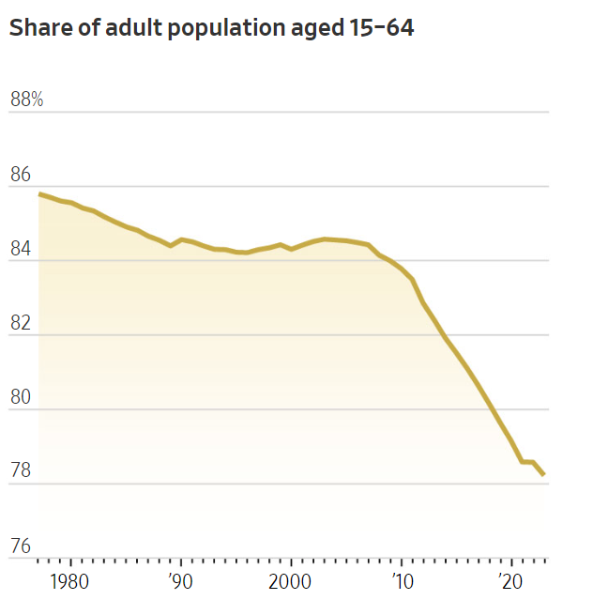
Share of Adult Population
85.5%
15 to 64 year-olds
78.2%

Slide 11
Labor Force in 2025 (in millions)
Notes:
Gen Z has overtaken baby boomers in the workforce this year, with 21 million of them employed full time in the U.S., according to an analysis from job-ranking site Glassdoor. They account for more than a third of all hires and 16.8% of the total workforce, according to payroll and HR data analyzed by ADP Research. The oldest members of Gen Z are 27, three years shy of the big 3-0. The youngest are 12, long from their office years.

Slide 12
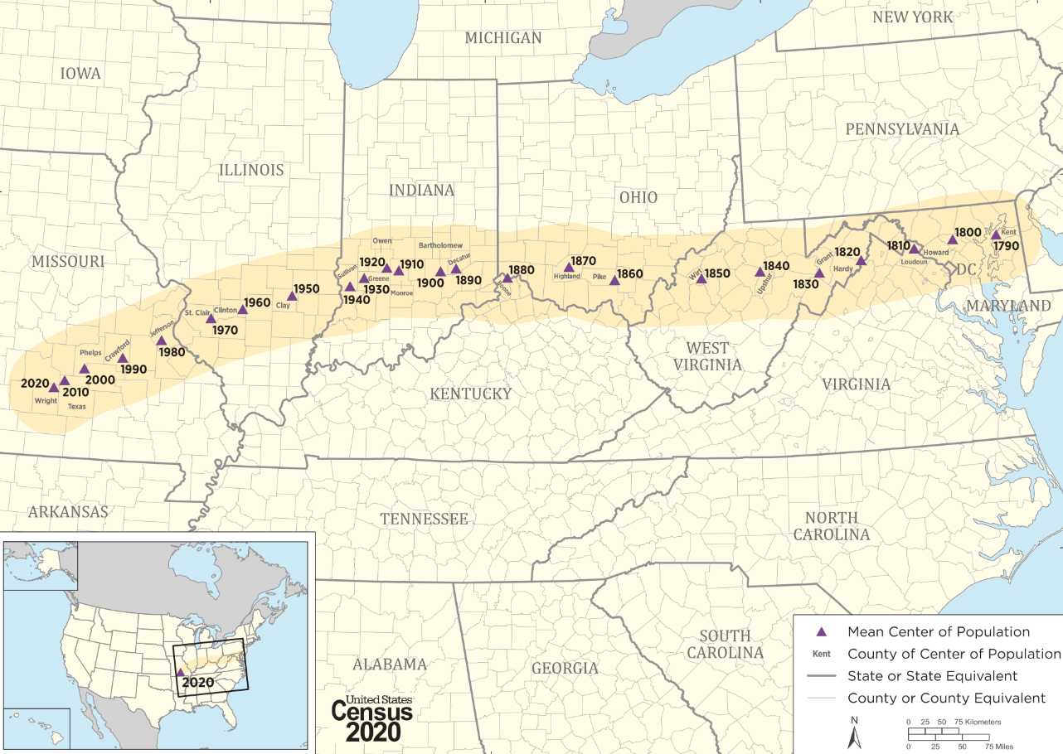
Mean center of US population
Year 1790
HartvilleMO

Slide 13
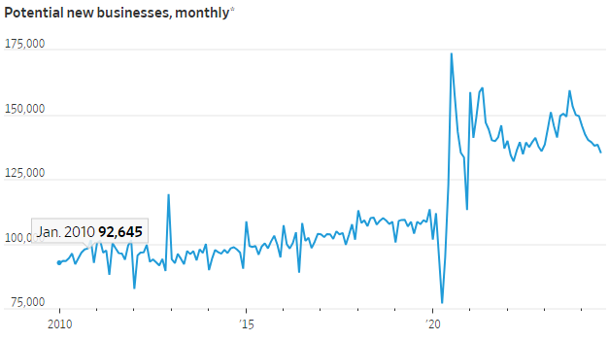
Rise of the Pint-Size Startup is Reshaping the U.S. Economy
135,000
Pandemic
Notes:
Small businesses have long been known as job creators, responsible for more than 60% of net new jobs between 1995 and 2023, according to the Small Business Administration. Much of that growth comes from a small subset of businesses. New business activity has fallen from its early pandemic peak, but remains at elevated levels, according to monthly Census Bureau data through July that captures applications to the Internal Revenue Service for employer identification numbers, an early step in starting a new business.
“The increase in business creation is fantastic news,” said Stanford University economist Nicholas Bloom. “For several decades now, we’ve been worried about a drop in [economic] dynamism.”

Slide 14
DMOs
Notes:
As Bill talked about earlier, tourism is the gateway to introduce people to our destinations. We’ll here are a couple of CVBs that are tackling the labor issues head on.
LA - Career Academy with the goal of increasing equity in career representation by inspiring the youth of historically underserved communities to consider diverse career paths. Each student received a tour of the exhibition hall, met with executive leaders to learn about career opportunities, fostered meaningful connections, and learned about future career day opportunities available within the industry. Over 4,100 people attended the convention, 65% of whom were senior executives.
Moreover, Los Angeles’s Career Academy bridges the connections between students and meeting planners looking to authentically impact Los Angeles. While the convention was not hospitality-focused, the bureau brought students together with senior-level executives at technology companies, and this can make the connection between other sectors and hospitality. The academy highlights the connection between youth engagement in choosing career paths and where they see themselves represented.
Austin - Founded in 2019, the mission of the Visit Austin Foundation (VAF) is to develop and promote education, job training, and career opportunities within the hospitality and tourism sector. The foundation has several key objectives in helping to close the labor shortage gap and increase engagement--particularly with the youth. By offering mentorships and scholarships, the foundation hopes to attract young people to the tourism and hospitality industry, and to educate the public about a wide range of career opportunities within the industry. Additionally, the foundation has provided resources for providing careers in hospitality including the Austin Tourism Insider Hospitality Training Program. The training program is intended to support the community’s tourism and hospitality employees, including new hires, and residents who are passionate about Austin and hospitality. Through a one-day course, employees learn expert knowledge about Austin’s tourism assets, improve their confidence in making recommendations that help to elevate the visitor experience, ignite their passion for the industry, and build a deeper sense of connection within the community.

Slide 15
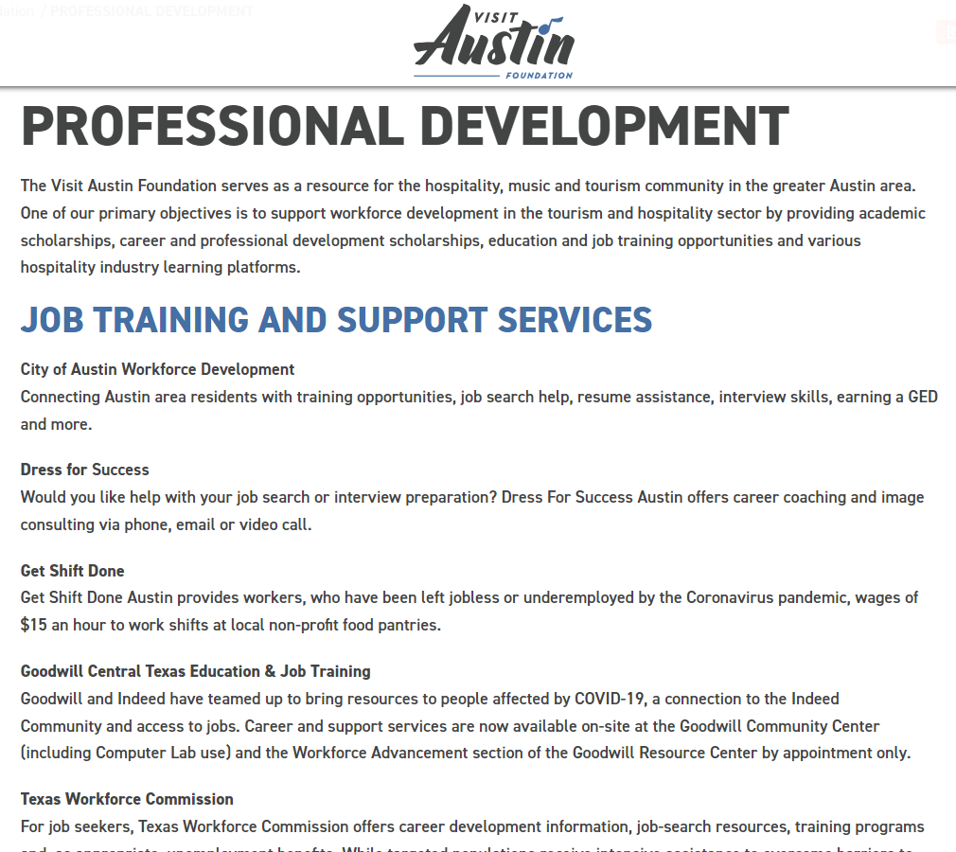

Slide 16
Notes:
We have general engagement. We have built relationships with state colleges and universities and especially those graduating in industries that have a major prescene in Madison County. We actively manage those relationships. We also take groups of employers to targeted schools. We look to target those students that were home during Christmas break and tell them about working in HSV. We host a college and career fair during their winter break. We examine those firms that are hiring entry level talent. But we try to management the expectations; i.e. you are not going to five someone with five-years of experience with all the certifications you want. We target four year degree Gen Zers at job fairs and have high school career fair to connect them here.
Next, we create an environment of how they wish to reside in your community. We start to inform them while they are still in school. We get them together with a company with a company that looks like them. We try to help them build a community with each other and with Huntsville companies.
We try to get them to know their community on their own, by offering professional networking opportunities. We have young professional groups that can engage them: Young Professionals networking, Rotary Club.
How do you have a community that is attracting people of a certain generation? Not just work here but live where they are. We created a strategic vision of attracting people who are young. We have seen a lot of growth in our urban environment. We have growth in Mid-City. We make accessible natural resources – bike trails, hiking, the city is intentional about hearing the voice of the young people. Sustainability is top of mind. In our Strategic efforts, music is an economic driver as it is different than the traditional space or biotech. We create a space to make it exciting for artists. We want a high caliber of talent.
They built relationships with state colleges and universities and especially those graduating in industries that have a major presence in Madison County. We actively manage those relationships. They took groups of employers to targeted schools.
They targeted students that were home during Christmas break and told them about working in HSV; they hosted a college and career fair during their winter break. We examine those firms that are hiring entry level talent.
They tried to manage the expectations; i.e. you are not going to five someone with five years of experience with all the certifications you want. We target four year degree Gen Zers at job fairs and have high school career fair to connect them here.
Next, they created an environment of how the Gen Zer wished to reside in your community. We start to inform them while they are still in school. We get them together with a company with a company that looks like them. We try to help them build a community with each other and with Huntsville companies.
offering professional networking opportunities. We have young professional groups that can engage them: Young Professionals networking, Rotary Club.
We asked them to get to know their community on their own.
How do you have a community that is attracting people of a certain generation? Not just work here but live where they are. We created a strategic vision of attracting people who are young. We have seen a lot of growth in our urban environment. We have growth in Mid-City.
We make accessible natural resources – bike trails, hiking.
The city is intentional about hearing the voice of the young people. Sustainability is top of mind. In our Strategic efforts, music is an economic driver as it is different than the traditional space or biotech. We create a space to make it exciting for artists. We want a high caliber of talent.

Slide 17
Notes:
It has to be authentic and genuine; it takes a lot of time. The genuineness of the work of the community is paying off – we had to work at it. 1. a more vibrant downtown – hence, they created Downtown Huntsville, Inc. We had a master plan for Research Park where it is a live work play community and to create a sense of place. It started 10 years ago. We have made a concerted effort with music and the music industry over the last 3 years; we did a music audit which was never done before in the U.S. Huntsville built a strategy for near and long term. Intentionally we want to be the choice of early talent. You cannot a destination for young talent overnight without being ungenuine. It must be a long term. “Are you genuine in wanting me there?”
Tagline: “A Smart Place” – asmartplace.com. We created content to consider living here. They created a “Live Here” page – how cool Huntsville is. We are right for most people – it is a privilege to communicate that way. You want to keep what is genuine about your community true. Don’t be something you are not. There is a spot for most people here.
The CVB is a huge and important partner. A person came here as a tourist, they came for a space camp and became a resident. You never know someone’s first encounter with a community will be. Partnering across the community is crucial and made that success. With the CVB, the Chamber shares resources and content with them. We have a great working relationship with HMCCVB. I can reach out anytime. The growth of sports is very intentional. It helps the CVB bring in sporting events. It reduced barriers when we have great communication. Those relationships stay top of mind.

Slide 18
meaning
membership
sense of purpose

Slide 19
Emphasizing Purpose and Impact
Flexible and Hybrid Work Environments
Quality of Life
Educational and Professional Development Opportunities
Tech and Innovation Hubs
Strong Digital Presence and Engagement
Notes:
Attracting Gen Z Talent
Communities are using a variety of strategies to attract Gen Z talent, focusing on what this generation values in their professional and personal lives. Here are some key approaches:
1. **Emphasizing Purpose and Impact**
- **Purpose-Driven Work**: Gen Z values jobs that align with their personal values and have a positive impact on society. Communities are promoting opportunities for meaningful work, such as roles in sustainability, social justice, and community development.
- **Community Involvement**: Offering ways for Gen Z to get involved in local causes, volunteer opportunities, and civic engagement activities helps attract them to areas where they feel they can make a difference.
2. **Flexible and Hybrid Work Environments**
- **Remote Work Options**: With many Gen Z workers prioritizing work-life balance and flexibility, communities that support remote or hybrid work environments are more appealing. Offering co-working spaces, strong digital infrastructure, and tech-friendly environments is key.
- **Creative Workspaces**: Communities are also investing in modern, collaborative workspaces that appeal to Gen Z’s preference for creative and dynamic environments.
3. **Affordable Living and Quality of Life**
- **Affordable Housing**: High living costs can deter young talent from moving to or staying in certain areas. Communities that offer affordable housing options, especially in urban areas, are more likely to attract Gen Z.
- **Vibrant Social Scene**: A strong focus on entertainment, arts, culture, and nightlife can make a community more attractive to younger generations. Communities are investing in music venues, cultural festivals, and diverse dining options.
- **Green Spaces and Wellness**: Parks, trails, and recreational areas that support an active lifestyle are important for Gen Z, who value health and wellness.
4. **Educational and Professional Development Opportunities**
- **Access to Education**: Proximity to universities and access to continuous learning opportunities, such as workshops, seminars, and professional development courses, are highly attractive to Gen Z.
- **Networking and Mentorship**: Communities that foster strong networking opportunities and mentorship programs can help Gen Z feel supported in their career growth.
6. **Tech and Innovation Hubs**
- **Innovation Ecosystems**: Communities with thriving tech scenes, startup ecosystems, and innovation hubs are particularly appealing to Gen Z, who are often interested in entrepreneurial ventures and cutting-edge industries.
- **Support for Entrepreneurs**: Offering resources, such as incubators, accelerators, and funding opportunities, can attract Gen Z talent interested in starting their own businesses.
7. **Strong Digital Presence and Engagement**
- **Active Social Media Engagement**: Communities that actively engage with Gen Z through social media, showcasing their culture, opportunities, and lifestyle, can effectively attract young talent.
- **Online Resources**: Comprehensive websites, virtual tours, and digital resources that highlight what the community has to offer are crucial in appealing to tech-savvy Gen Z.
By aligning these strategies with the values and expectations of Gen Z, communities can successfully attract and retain this new generation of talent.

Slide 20
Diversity
Notes:
Diversity is the watchword for Gen Z: Diversity matters to them through many dimensions, not just isolated to race and gender but also related to identity and orientation. Companies that can better represent the spectrum of differences in their external branding/marketing are much more likely to diversify their talent pipelines.
**Diversity and Inclusion**
- **Inclusive Communities**: Gen Z places a high value on diversity and inclusion. Communities that are known for being welcoming to all, regardless of background, race, gender, or sexual orientation, are more likely to attract Gen Z talent.
- **Diverse Workforces**: Promoting workplaces with diverse teams and inclusive practices also helps in attracting this generation.

Slide 21
Gen Z observations
Notes:
So now that we’ve hired them, how do we help them?
Here are some observations we’ve witnessed with Gen Zers.

Slide 22
Observations of Zers
They ask for more money, vacation, the moon. The audacity!
Solution: Micromanage for a month and then show autonomy. “Maybe in five years.”
They wish to have a voice quicker than earlier generations.
Solution: Everybody has a voice but not everybody has an equal voice. One earns the depth of voice with time.
7 out of 10 young people wish to be an entrepreneur.
Solution: They wish to produce but need help; show them the way. Discuss gig economies within an organization.
Notes:
Do not use “fragile” “snowflakes” “entitled”. Stereotypes are mental shortcuts that do not help anyone. They bring a hacker mindset.
They ask for the moon. “Maybe after ten years!” They are audacious; they ask for more money, autonomy. Micromanage for a month and then show autonomy.
They wish to have a voice quicker than earlier generations. Everybody has a voice but not everybody has an equal voice. You earn the depth of voice along the way.
72% of high school students wish to be an entrepreneur. How about gig economies within an organization. They need help but wish to produce.
Gen Zers test lowers in entitlement: Entitlement is morphing into empowerment. They feel empowered and they are better at saving than Millennials. They look at boomer parents who have not been good at savings.

Slide 23
Authentic Self
Old mantra: Leave personal problems at door
Today: Bring your whole self to work

Slide 24
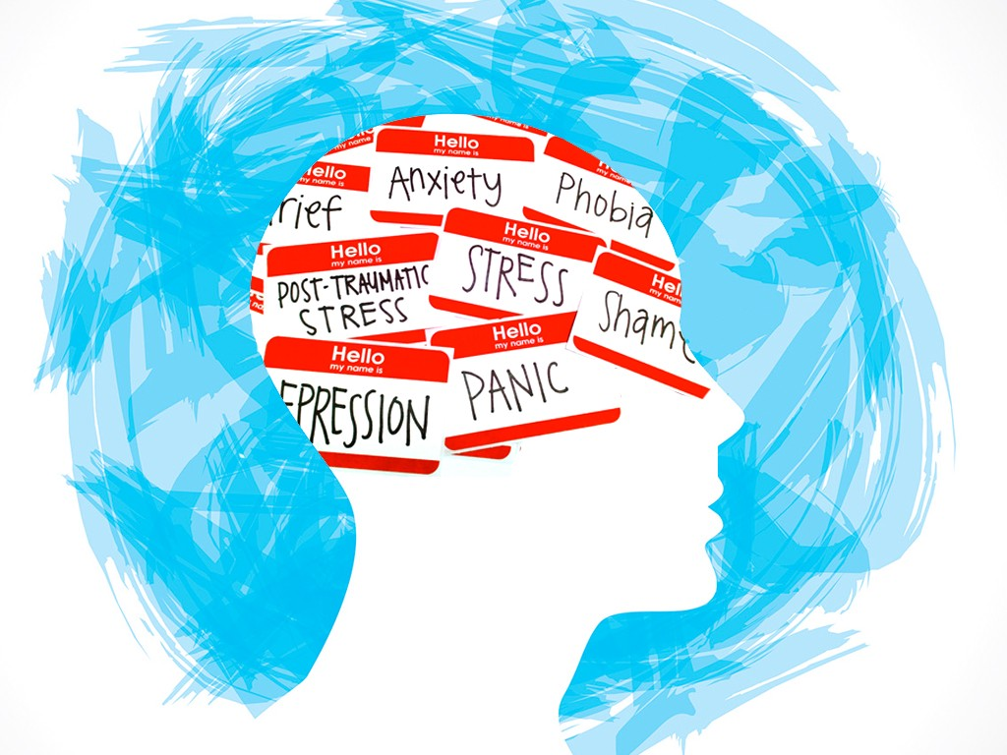
Mental Health
Notes:
Average Gen Zer takes in 10,000 messages a day. Most Gen Zers say they are anxious and overwhelmed. We must lead with better care.

Slide 25
Notes:
She has secured mental-health resources for farmers and is trying to get federal money to test private wells for contamination into the next farm bill. Randy Roecker, 60, a dairy farmer in Loganville, Wis., said he usually supports conservative candidates but will vote for Baldwin, in part because of the mental-health resources she secured. He said he supports her fight to keep the label “milk” off nondairy beverages made of almonds, oats and other alternatives.

Slide 26
Conflict resolution

Slide 27
#1 Concern: Climate Change

Slide 28
Rules for Sustainable Tourism
#1. do no harm
#2. celebrate the place
#3. offer attainable sustainable practices

Slide 29
The subject of affordable housing

Slide 31
Jackson, Wyoming
Notes:
In June of this year, a substantial section of the Teton Pass highway collapsed in a landslide, severing a crucial connection between Jackson, Wyoming and the towns of Victor and Driggs, Idaho. A subsequent detour added 60 miles each way, which added three hours to a round-trip commute. with the median now hovering around $4.5 million, compared with $1.6 million in 2019. The result is insufficient affordable housing in Jackson, which has led it to rely on other, less expensive towns to house its worker population. There are currently 1,543 people registered as waiting for affordable housing. in a first, some Jackson residents are opening their extra rooms and guesthouses to local workers on an as-needed basis, often for free. The Community Foundation of Jackson Hole, a nonprofit that manages philanthropy started its first housing matchmaking program: 41 people, a mixture of full-time and part-time residents, agreed to let people stay in their homes free of charge. The list spiked the first week after the collapse to 76 people who needed housing help.
President of the organization says she wasn’t sure if the homeowners would step up. “You say you want to help but do you really mean it?” she says. But she was happily surprised at the response. “There have been great connections made,” she says. She believes many more homeowners would be willing to open up rooms for commuters if they knew how much it was needed. The landslide drove home how vulnerable Jackson Hole is when it comes to relying on workers.

Slide 34
how important are these to learn about music?

Slide 35
sites used to learn about music

Slide 36
Comfort
Convenience
Costly Experiences
Notes:
https://www.businessinsider.com/what-travelers-splurge-on-for-vacation-trends-2023-11
Many people with disposable income are traveling in style.
They're spending money and travel points on comfort, convenience, and memorable experiences.
Some splurge on fine dining and luxury hotels while others hire photographers to capture the moment.

Slide 37
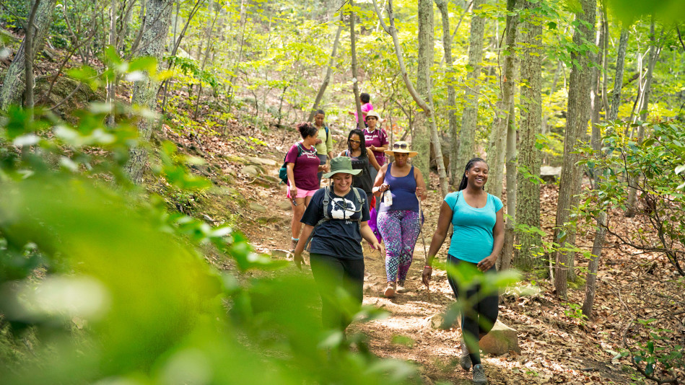
experiences
Notes:
Purchasing a home is not an option for many; however, many are wanting to indulge in experiences.
And the higher end experiences are flying off the rack

Slide 38
wellness
Notes:
Many travelers still want to explore new destinations and have meaningful experiences, but are placing a greater priority on taking care of themselves while they are traveling, says Amanda Al‑Masri, Hilton’s vice president of wellness. The company’s new Signia by Hilton Atlanta has 11 dedicated wellness rooms, which have an air purifier, blackout curtains and aromatherapy from the showerhead, she says.
Other hotel brands, including Tempo, have emphasized new designs, like putting more outlets away from the bed so people are less likely to check their charging phones overnight, she says.

Slide 39
Travel is viewed as a need rather than a want and seen as beneficial to mental health.

Slide 40
Forest bathing
Notes:
Outdoor recreation has proven to be a recession-proof industry and a driving force in the American economy, generating $689 billion in economic output spending and supporting 4.3 million jobs across the country.
https://www.wsj.com/articles/stress-relief-walk-nature-science-11659388504
90% report being stressed. As little as 10 minutes of sitting or walking in nature can decrease one’s heart rate, blood pressure, and cortisol levels. Spending time in nature lowers the activity of our sympathetic nervous system which regulates stress hormones. Added benefit: walking with a loved one further reduces stress by adding the element of social connecting.

Slide 41
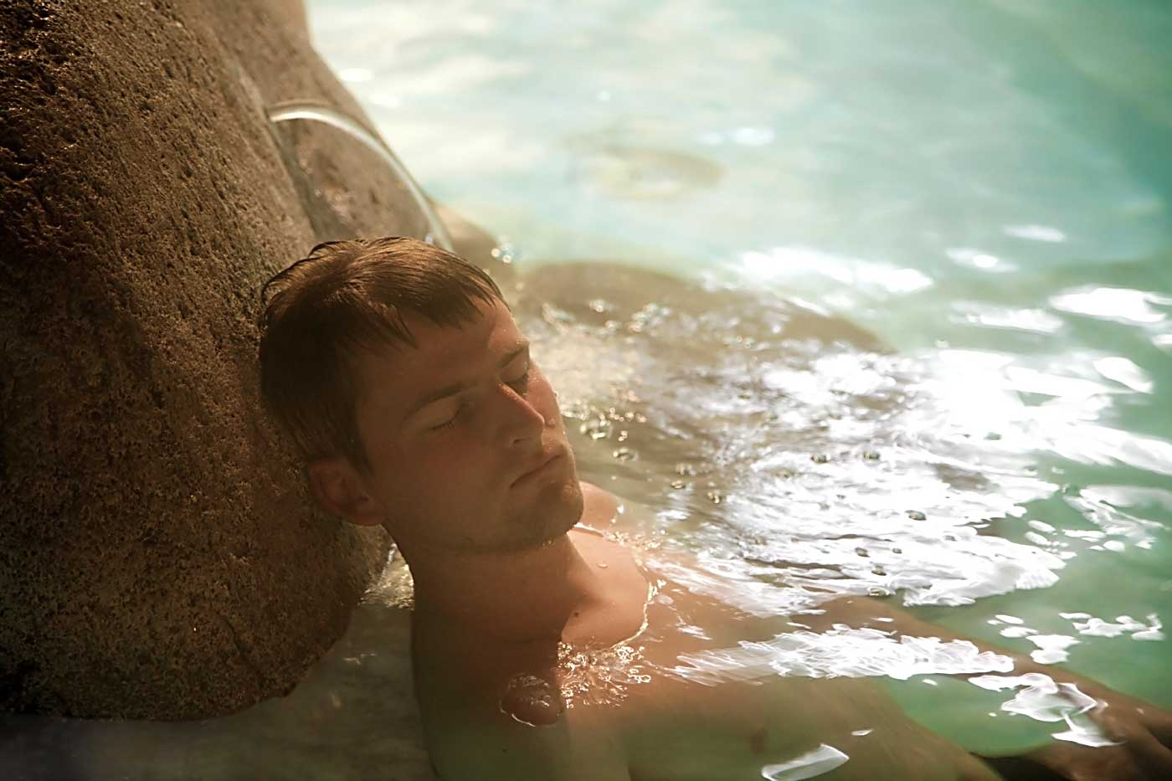
Healing power of water
Notes:
https://www.wsj.com/articles/harness-the-healing-power-of-water-11661207276
Neuroscientists say that spending time near oceans, lakes, rivers and other blue spaces can provide a range of benefits including reducing anxiety, easing mental fatigue and rejuvenating us. A 2019 study found that it takes at least two hours a week in nature to improve our well-being, which can be broken into smaller stretches. A more recent, yet-to-be-published study found that spending a similar amount of time near water has the same benefits, says Mathew White, an environmental psychologist at the University of Vienna who studies the health benefits of water environments and was lead researcher on both studies. Scientists also have found that people who peered into aquariums had lower heart rates and better moods after just 15 minutes.

Slide 42
Travel survey

Slide 43
Please rank these in terms of importance to you when you take a trip? (1 to 5)

Slide 44
What does relaxation mean to you?
No stress
Feeling taken care of
Going with the flow/ not having a lot planned

Slide 45
I use this to help make travel decisions

Slide 46
What’s your usual motivation to attend an event?

Slide 47
What specific travel and hospitality websites do you use?

Slide 48
The platforms I use first to help me make hospitality and travel decisions are

Slide 49
At this stage in life, I prefer to travel with

Slide 50
The most important factor when I make a travel decision is

Slide 51
How are Gen Zers different from other generations when it comes to hospitality decisions?
Difference
We are more aware that vacation is for relaxation and trips are for activities
We know how to look up stuff quickly and book this efficiently. Yet, we are not as financially aware.
We care more about the pictures because of social media platforms like instagram
We care about other people's opinions and experiences to make decisions

Slide 52
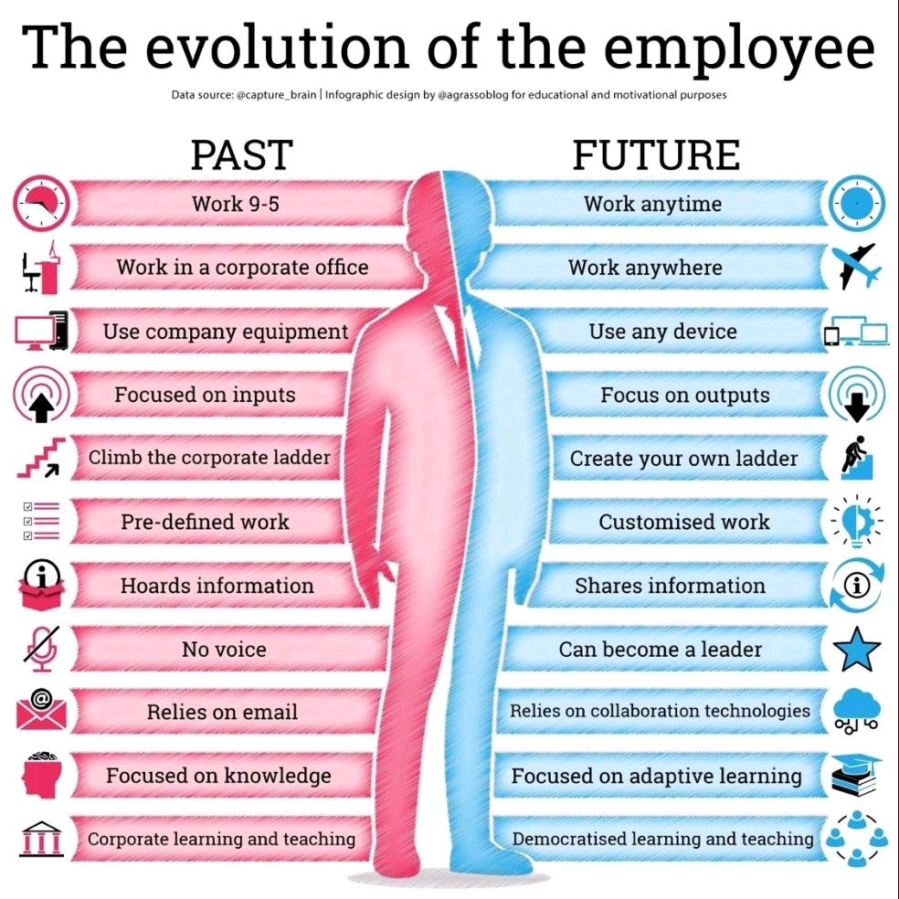
Future Employees
Notes:
Flexibility and empathy
https://www.washingtonpost.com/food/2022/08/15/restaurant-perks-worker-shortage/ - Restaurant perks

Slide 53
solutions
Create a podcast
Focus on value of destination
Be advocates for job openings
Flex time
No working on vacation
Notes:
Residents are waking up to the importance of tourists. They are actually becoming more grateful for the presence of travelers in their community. DMOs – now is the time to do a resident sentiment and business sentiment survey concerning visitors in your community. You can use this information when you ask to steady your budgets or to increase them.

Slide 54
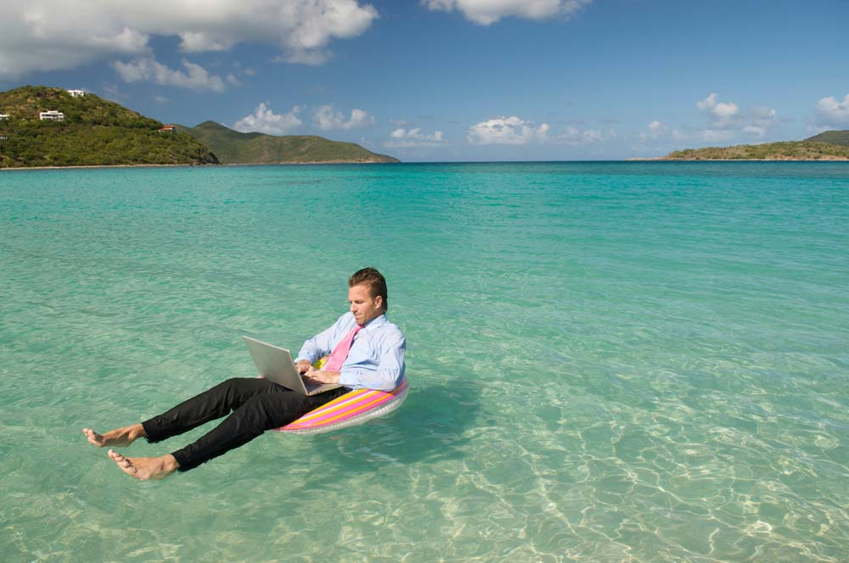
Working on vacation
Notes:
https://www.wsj.com/articles/americans-are-vacationing-more-but-staying-in-work-mode-11659957377
Americans Are Vacationing More, but Staying in Work Mode

Slide 55
When people mention needing more time off, they are saying that they want to make more memories.

Slide 56
Thank you

