Slide 1
using placer.ai to leverage data insights for strategic partner collaboration
Jennifer Green, Director
Jax State Center for Economic Development & Business Research

Slide 2
What is geofencing?
Geofencing is a location-based technology that creates virtual boundaries around specific geographic areas, triggering actions when devices enter or exit these predefined zones. This technology utilizes GPS, RFID, Wi-Fi, or cellular data to establish a geofence, which can vary in size and shape—from a small building to an entire city.

Slide 3
What is Placer.ai?
Placer.ai is a location intelligence platform that provides businesses and organizations with insights into foot traffic and consumer behavior. It leverages advanced analytics and machine learning to help users understand how people interact with physical spaces, enabling better decision-making in various industries, particularly retail and real estate.

Slide 4
Placer.ai

Slide 5
Key features of placer.ai
FOOT TRAFFIC ANALYTICS
Placer.ai offers detailed analytics on foot traffic patterns, allowing businesses to track visitor counts, dwell times, and trends over specific periods. This data can be filtered by time, day of the week, and customer demographics, providing a nuanced view of consumer behavior.

Slide 6
Key features of placer.ai
TRUE TRADE AREA ANALYSIS
The platform helps users identify the "True Trade Areas" (TTA) where customers originate. This analysis is crucial for optimizing marketing strategies and understanding market potential for new locations.

Slide 7
Key features of placer.ai
POINT OF INTEREST (POI) DATA
Placer.ai compiles extensive data on millions of points of interest across the U.S., including stores, restaurants, and other venues. This data is vital for businesses looking to analyze competition and consumer preferences in specific areas.

Slide 8
Key features of placer.ai
CUSTOM SOLUTIONS
The platform allows users to create custom geofences around specific locations to gather tailored insights relevant to their business needs. This feature enhances the ability to analyze localized market dynamics.

Slide 9
Key features of placer.ai
INTEGRATION CAPABILITIES
Placer.ai can integrate with various business intelligence tools and CRM systems, facilitating seamless data exports and enhancing analytical capabilities for users.

Slide 10
Where does Placer.ai source its data?
Placer.ai does not collect location data directly from consumers. Instead, this data is obtained from hundreds of partner mobile applications that collect data from mobile devices. We partner with a wide range of companies who have apps across various different categories (i.e., coupons, travel, games, etc.), which altogether generate a diverse panel of more than 25 million monthly average users from which we collect our data. Placer.ai’s partners ensure compliance with all privacy laws and regulations in their data collection practices.
Utilizing this data, Placer.ai leverages machine learning and advanced algorithms to accurately estimate visits to locations across the United States.

Slide 11
Examples of projects we’ve conducted
Flagg Mountain, Weogufka, AL
Cherokee Rock Village, Cherokee County, AL
Hugh S. Branyon Backcountry Trails, Gulf Shores, AL
Gulf State Park, Gulf Shores, AL
Various Downtown Festivals across Alabama
Calhoun County, AL Recreation Trails
Chief Ladiga Trail
Coldwater Mountain Bike Trails
Camp McClellan Horse Trails
McClellan Multi-Use Trails

Slide 12
Data uses
Identify and grow sponsors for an event
See past attendance to gauge current usage
Quantify how “shutting down” an amenity can impact visitation
Determine how many local and non-local visitors a site might have

Slide 13
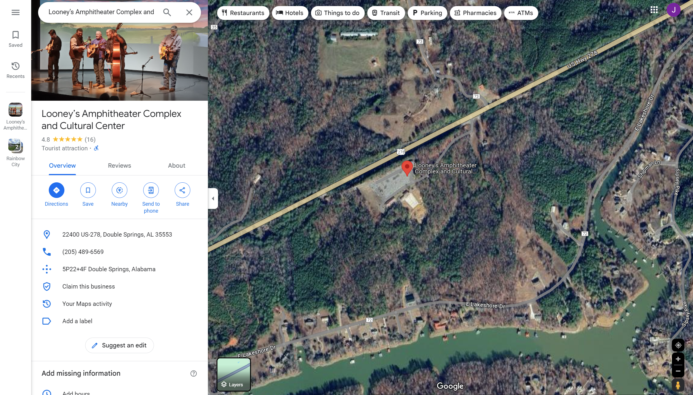
Looney’s tavern – Winston county

Slide 14
Looney’s tavern – point of interest (POI)

Slide 15
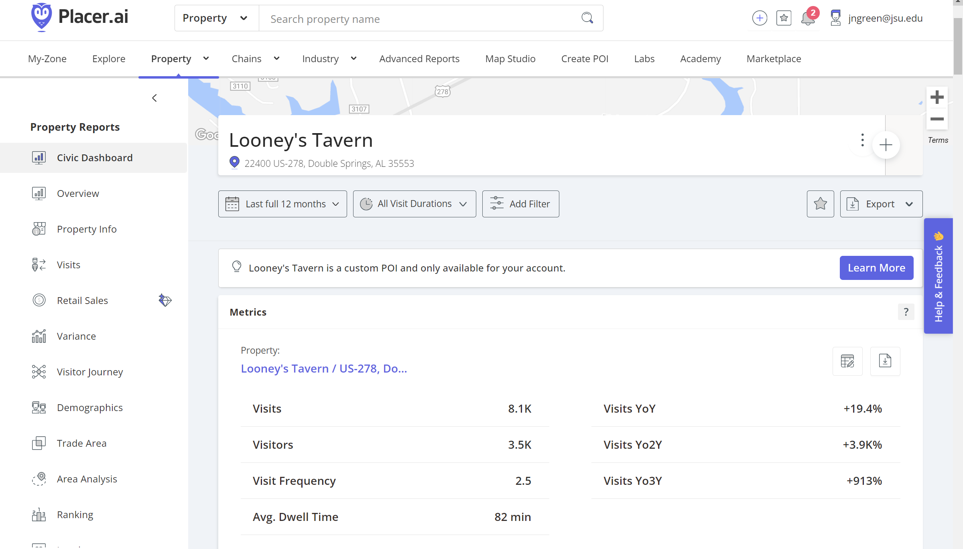
Visit metrics = all durations

Slide 16
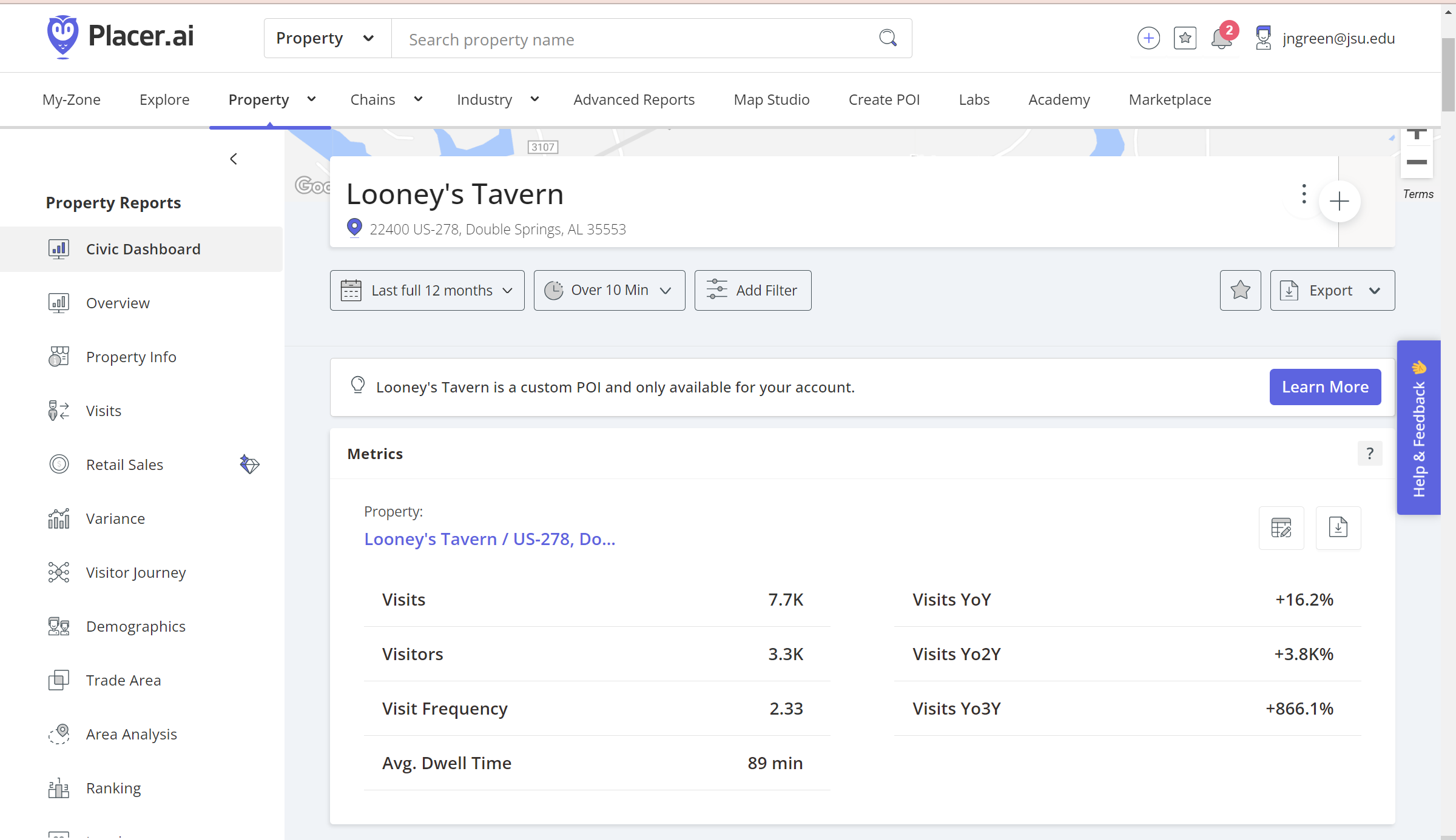
Visit metrics = over 10 mins

Slide 17
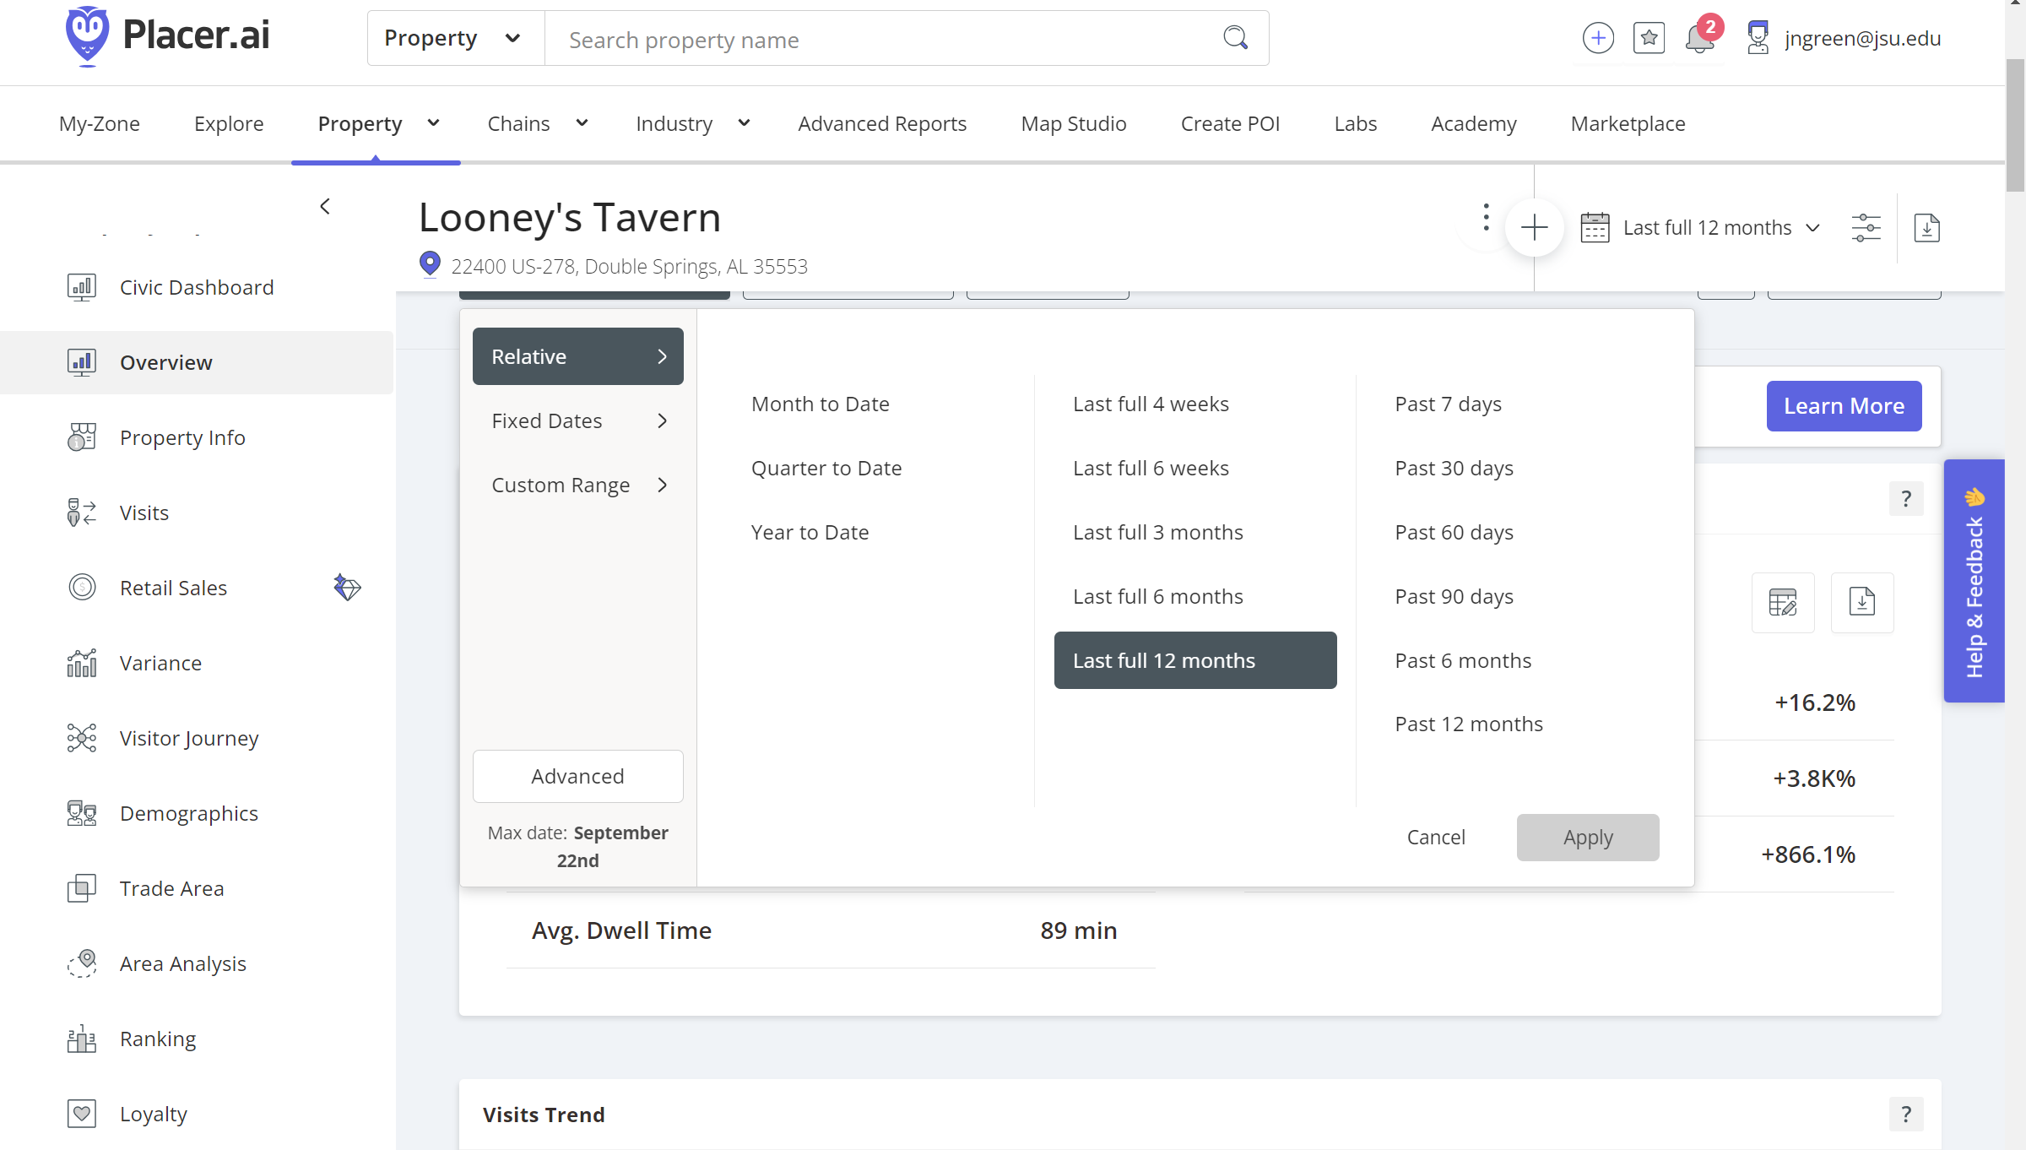
Visit metrics

Slide 18
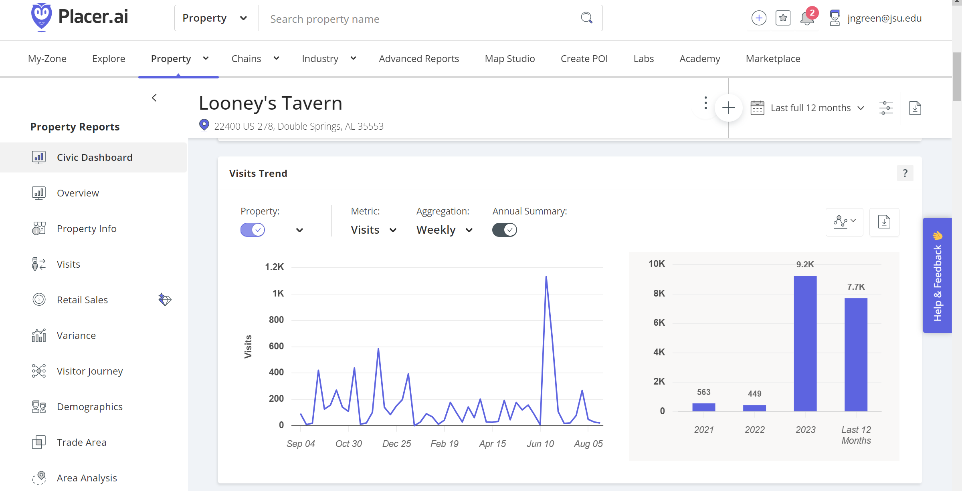
Visits trend

Slide 19
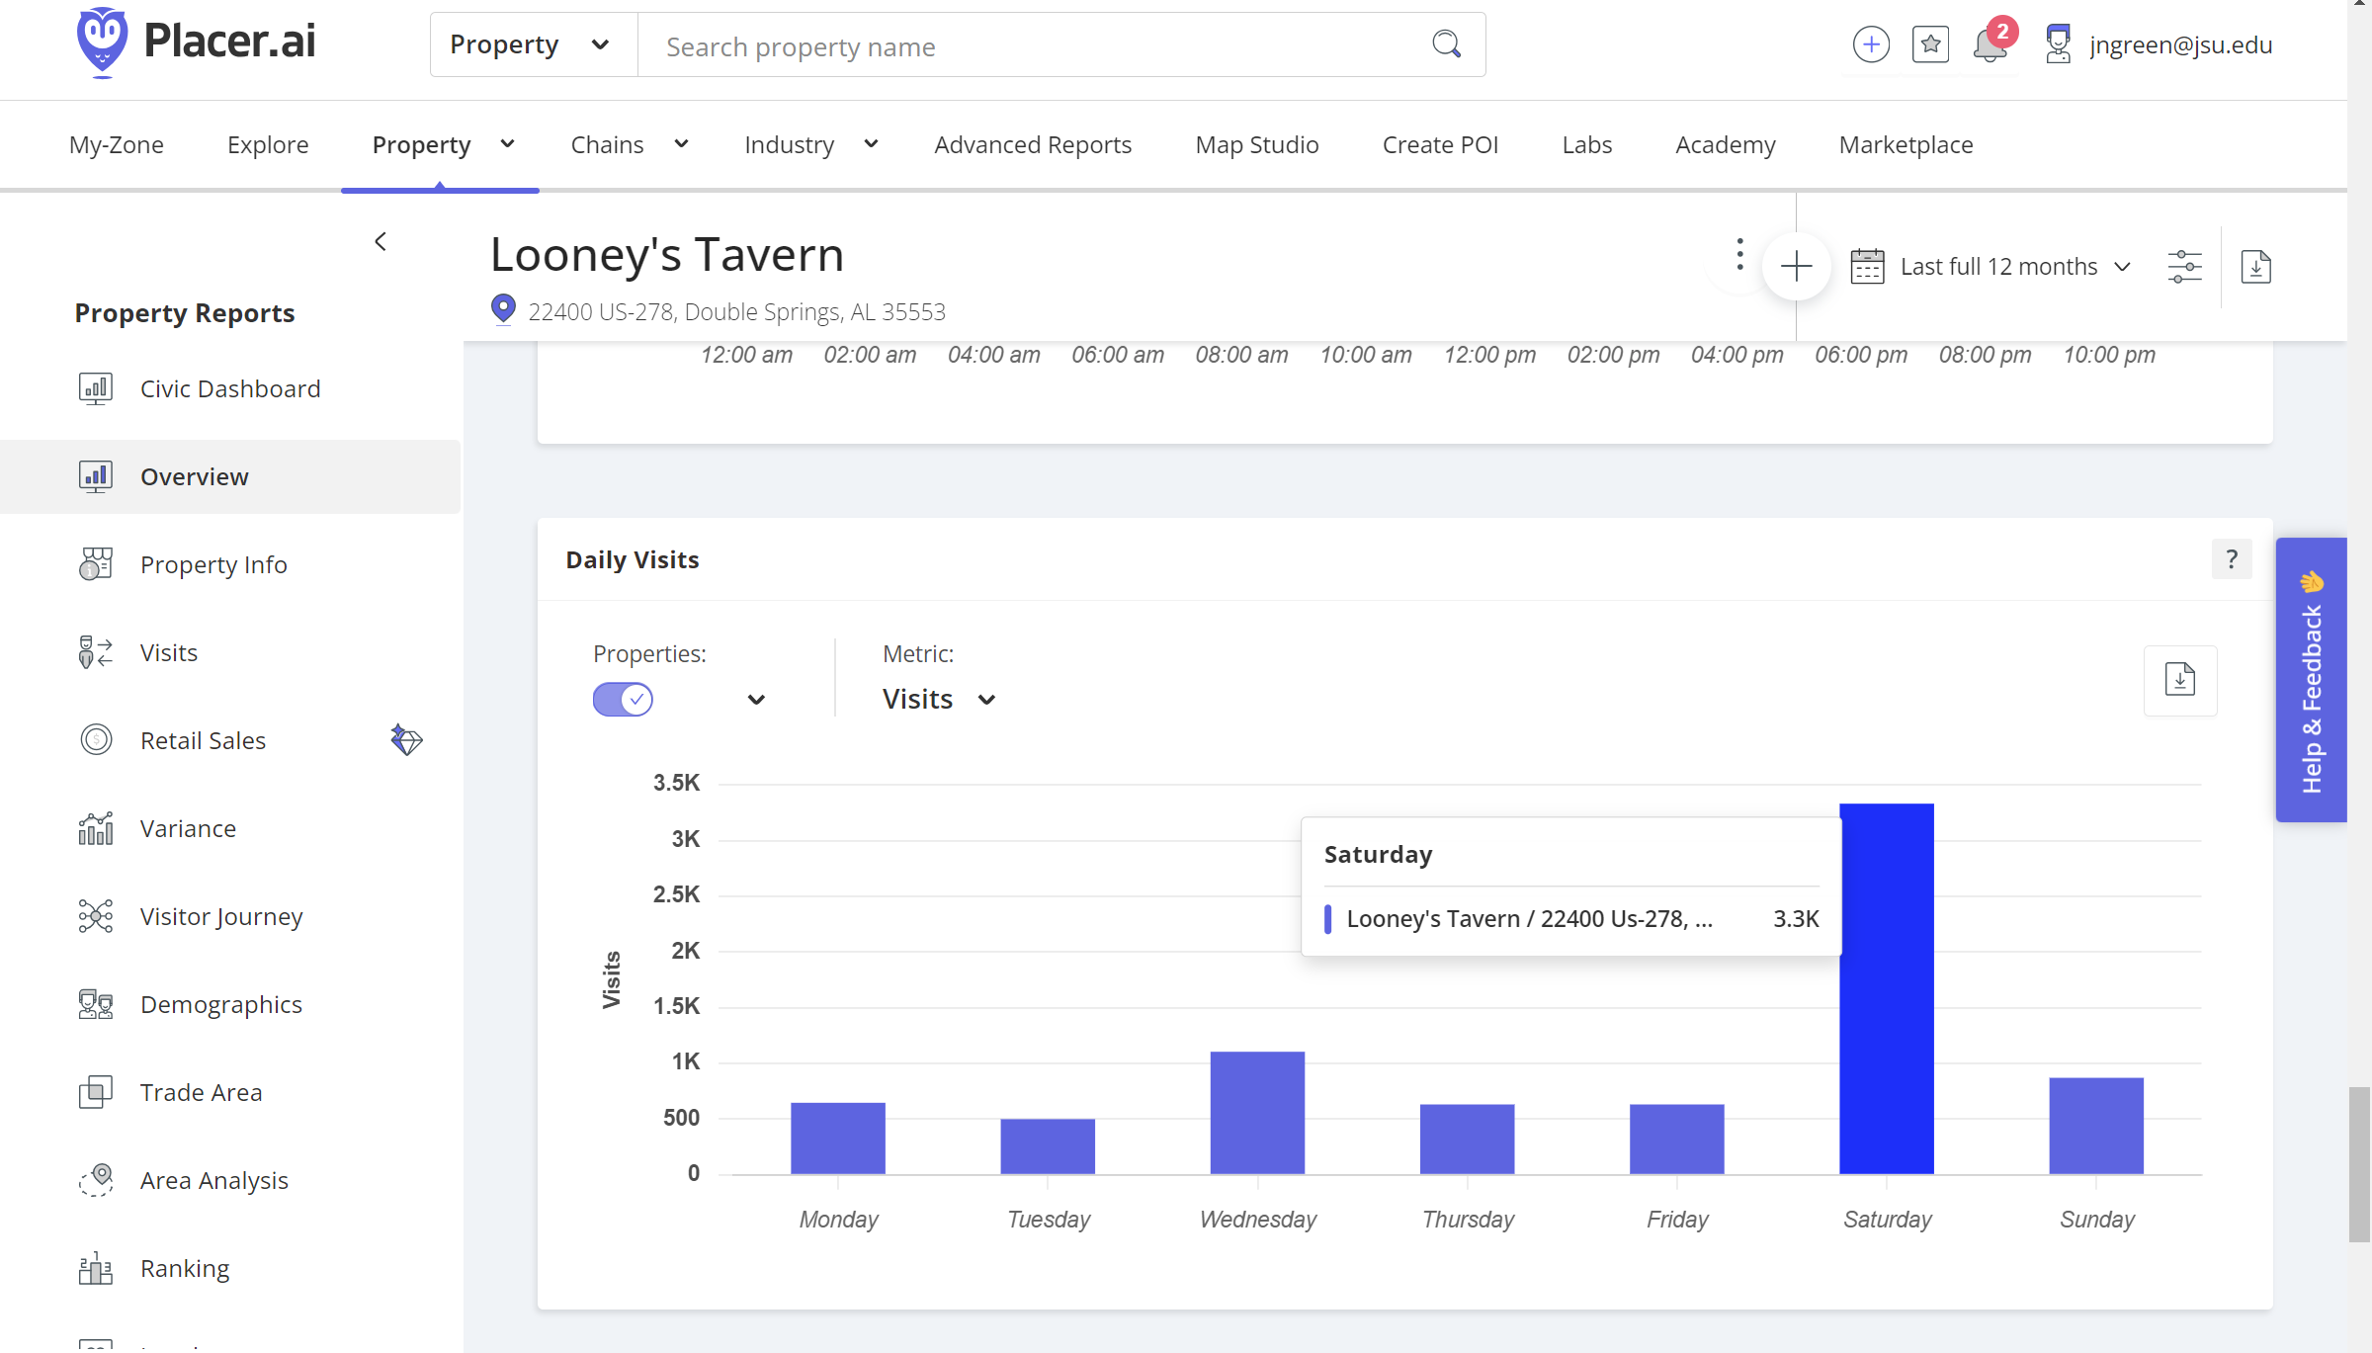
Daily visits

Slide 20
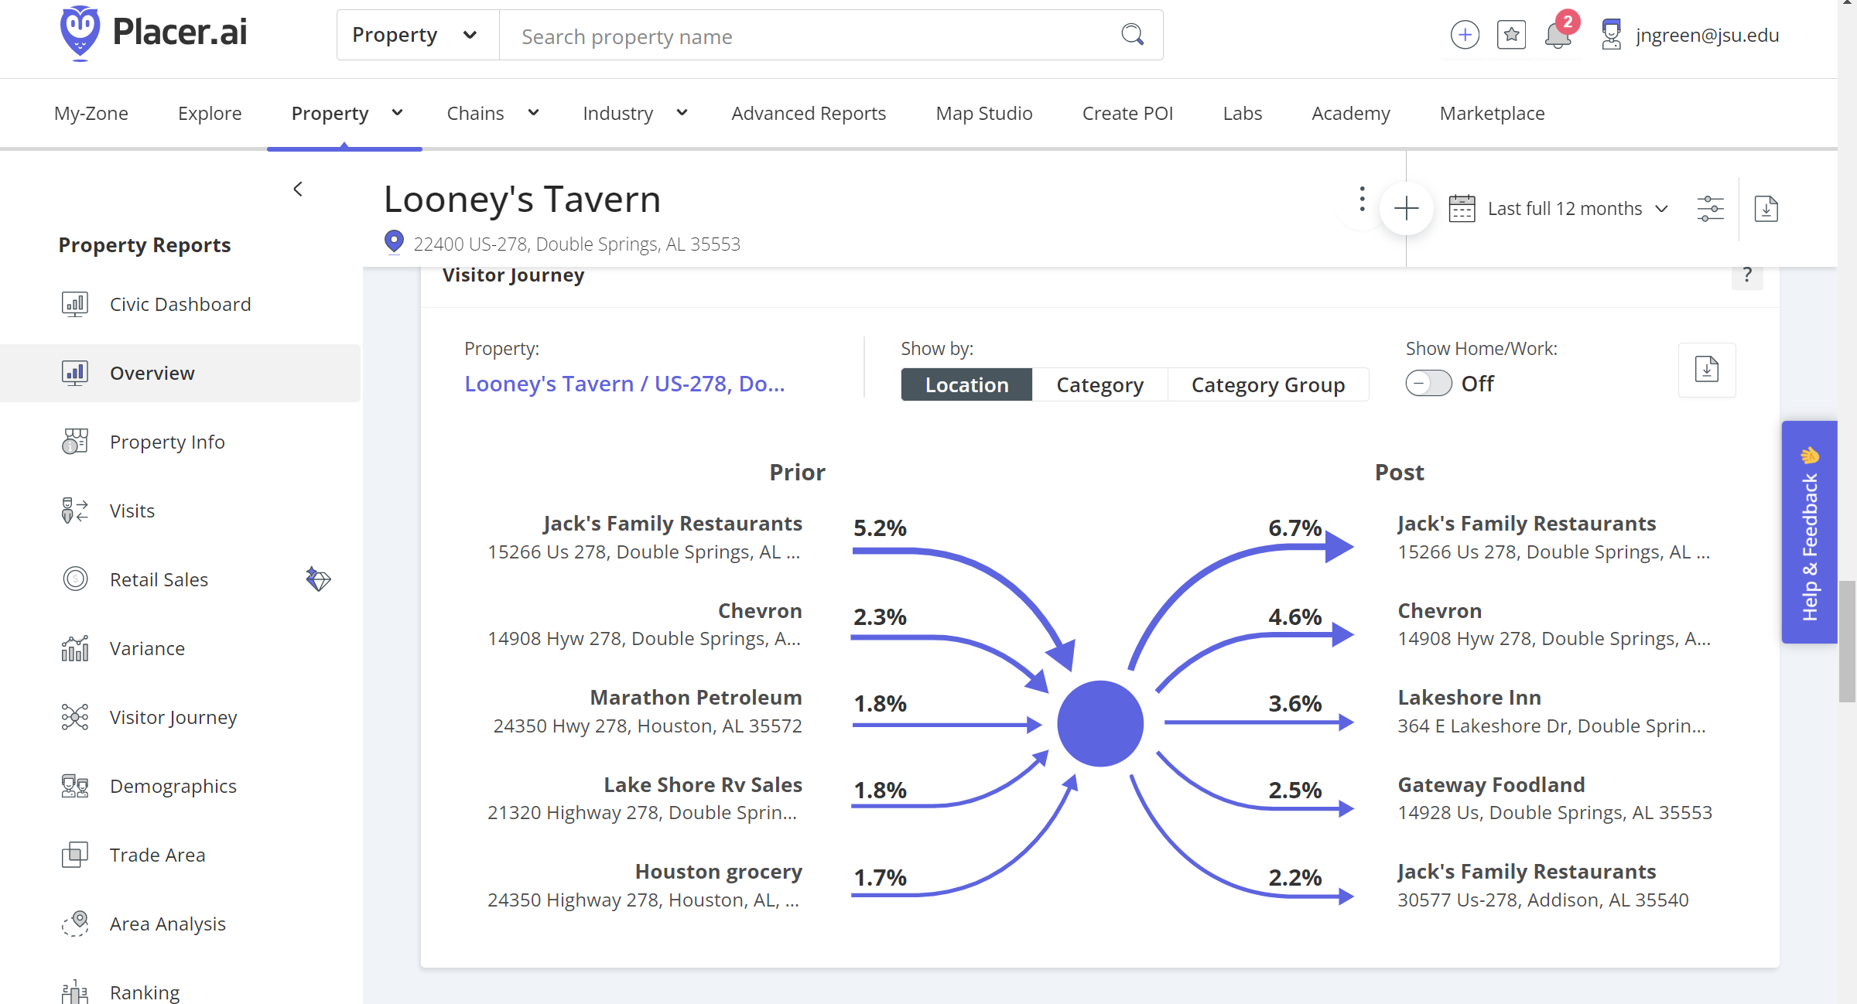
Visitor journey

Slide 21
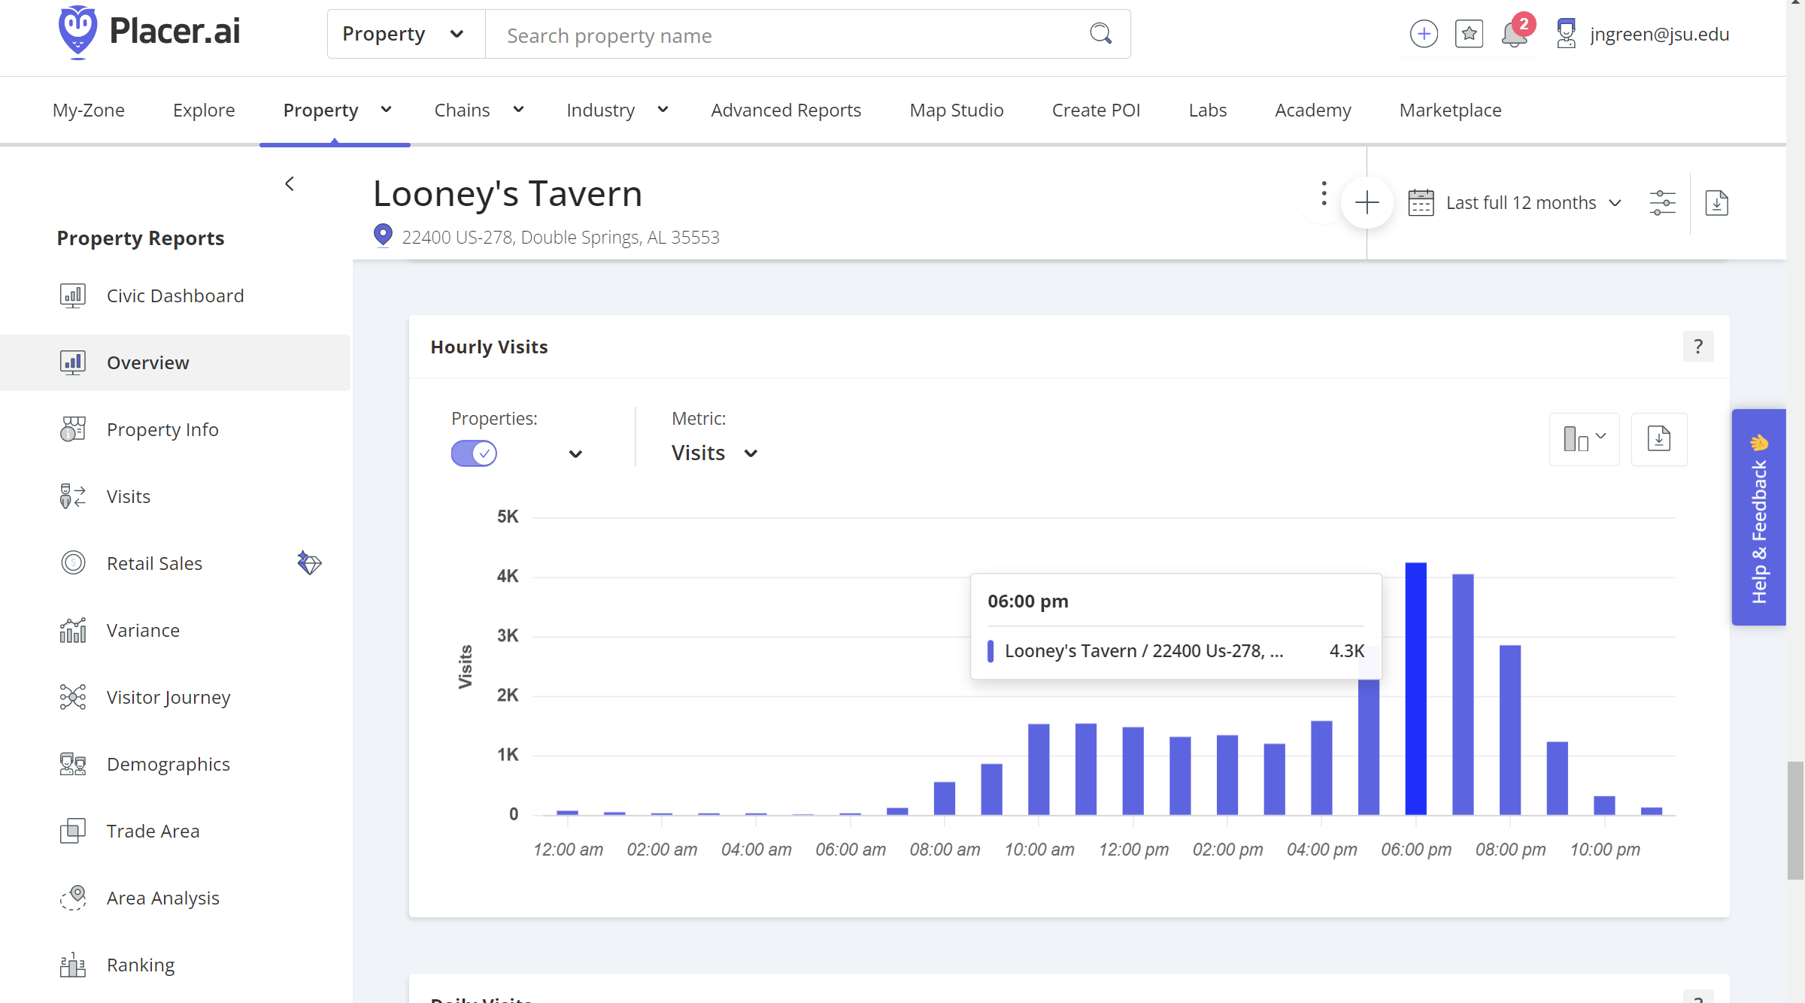
Hourly visits

Slide 22
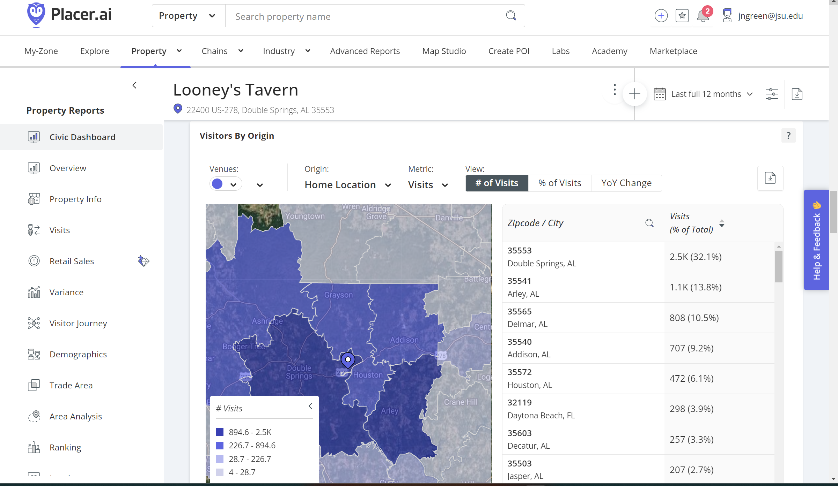
Visitor origination

Slide 23
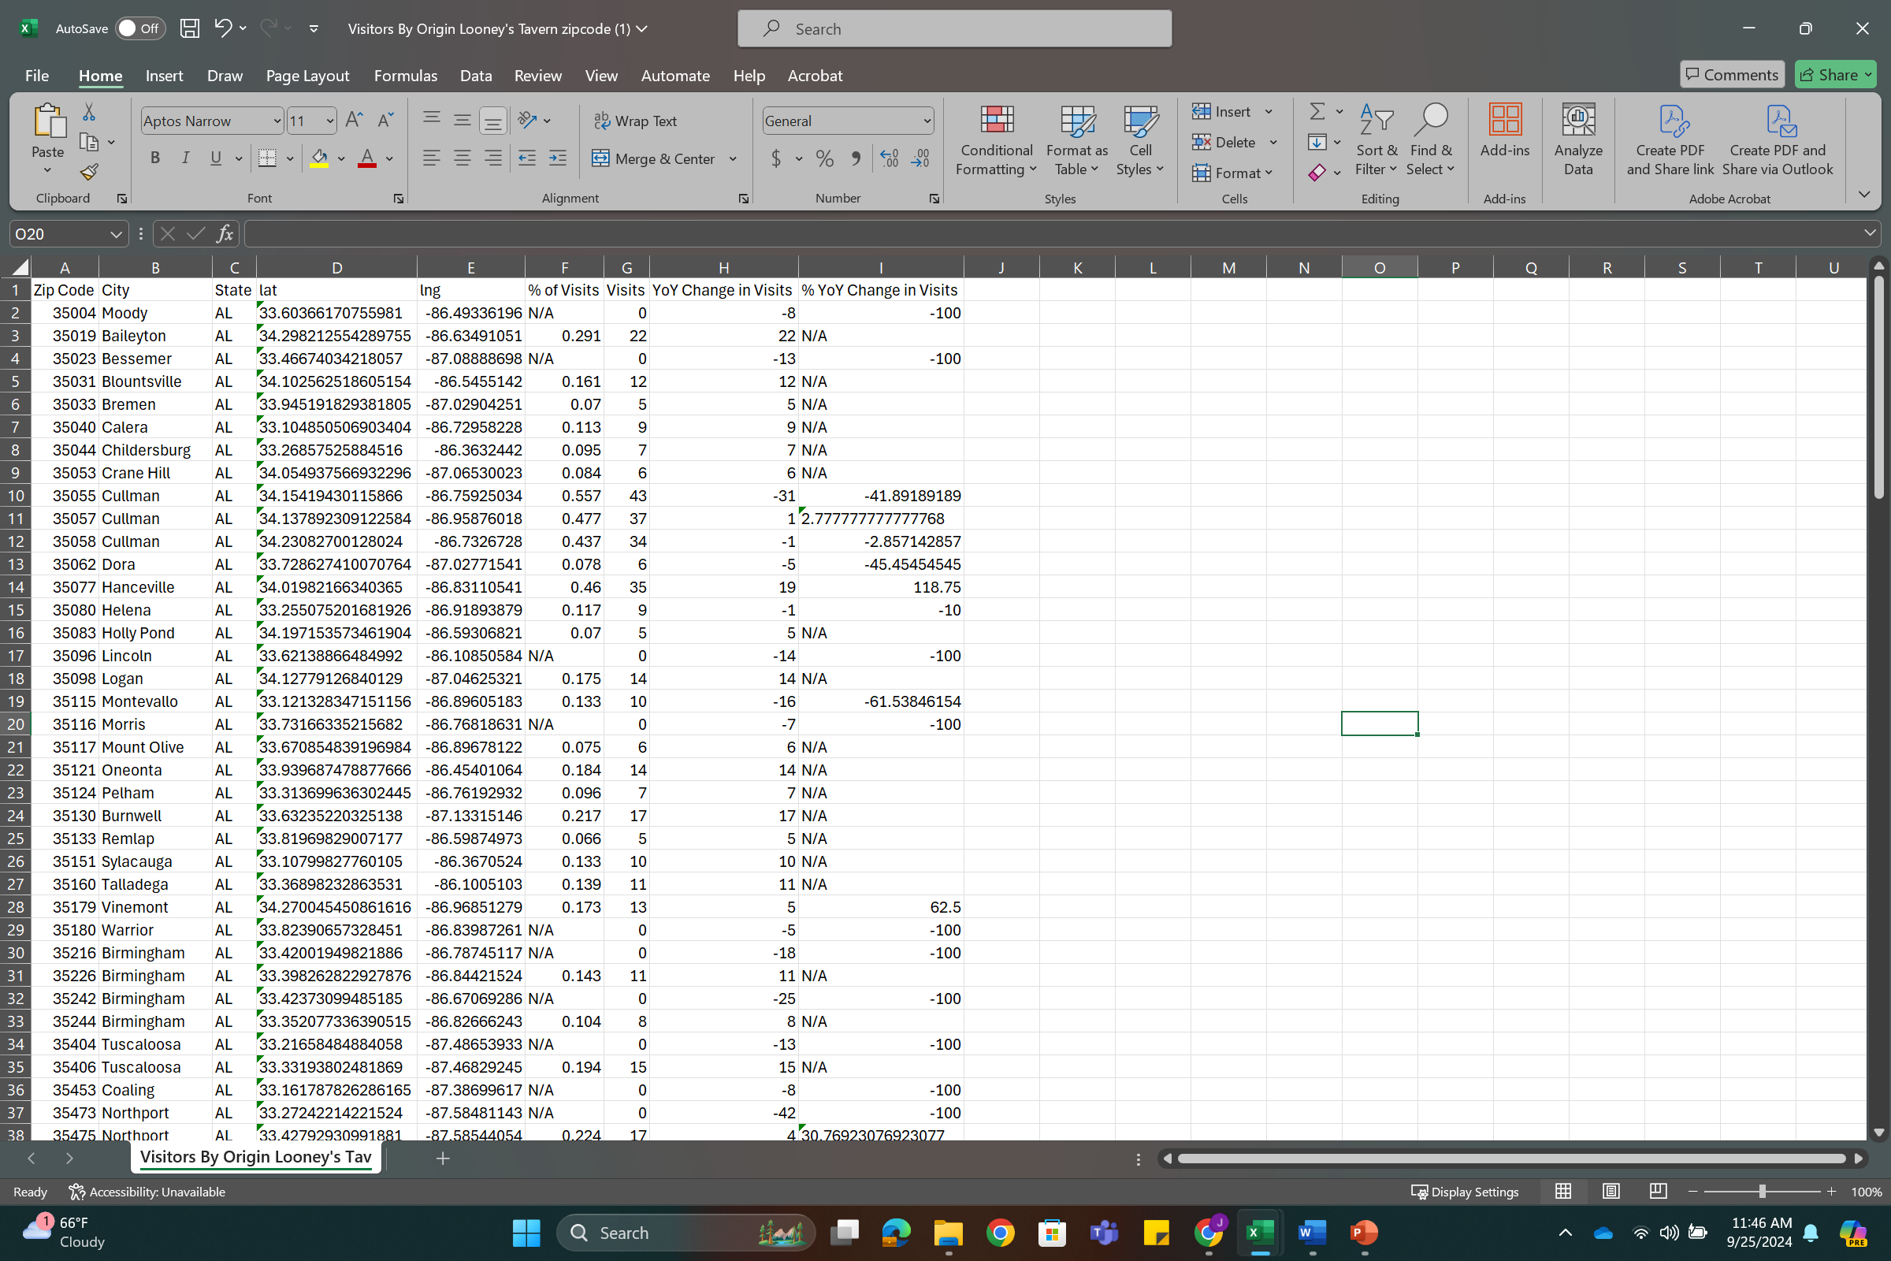
Visitor origination

Slide 24
Visitor origination
Of the 7.7 thousand visits….
7,260 were from Alabama
315 were from Florida
13 were from Georgia
53 were from Mississippi
And 72 were from Tennessee

Slide 25
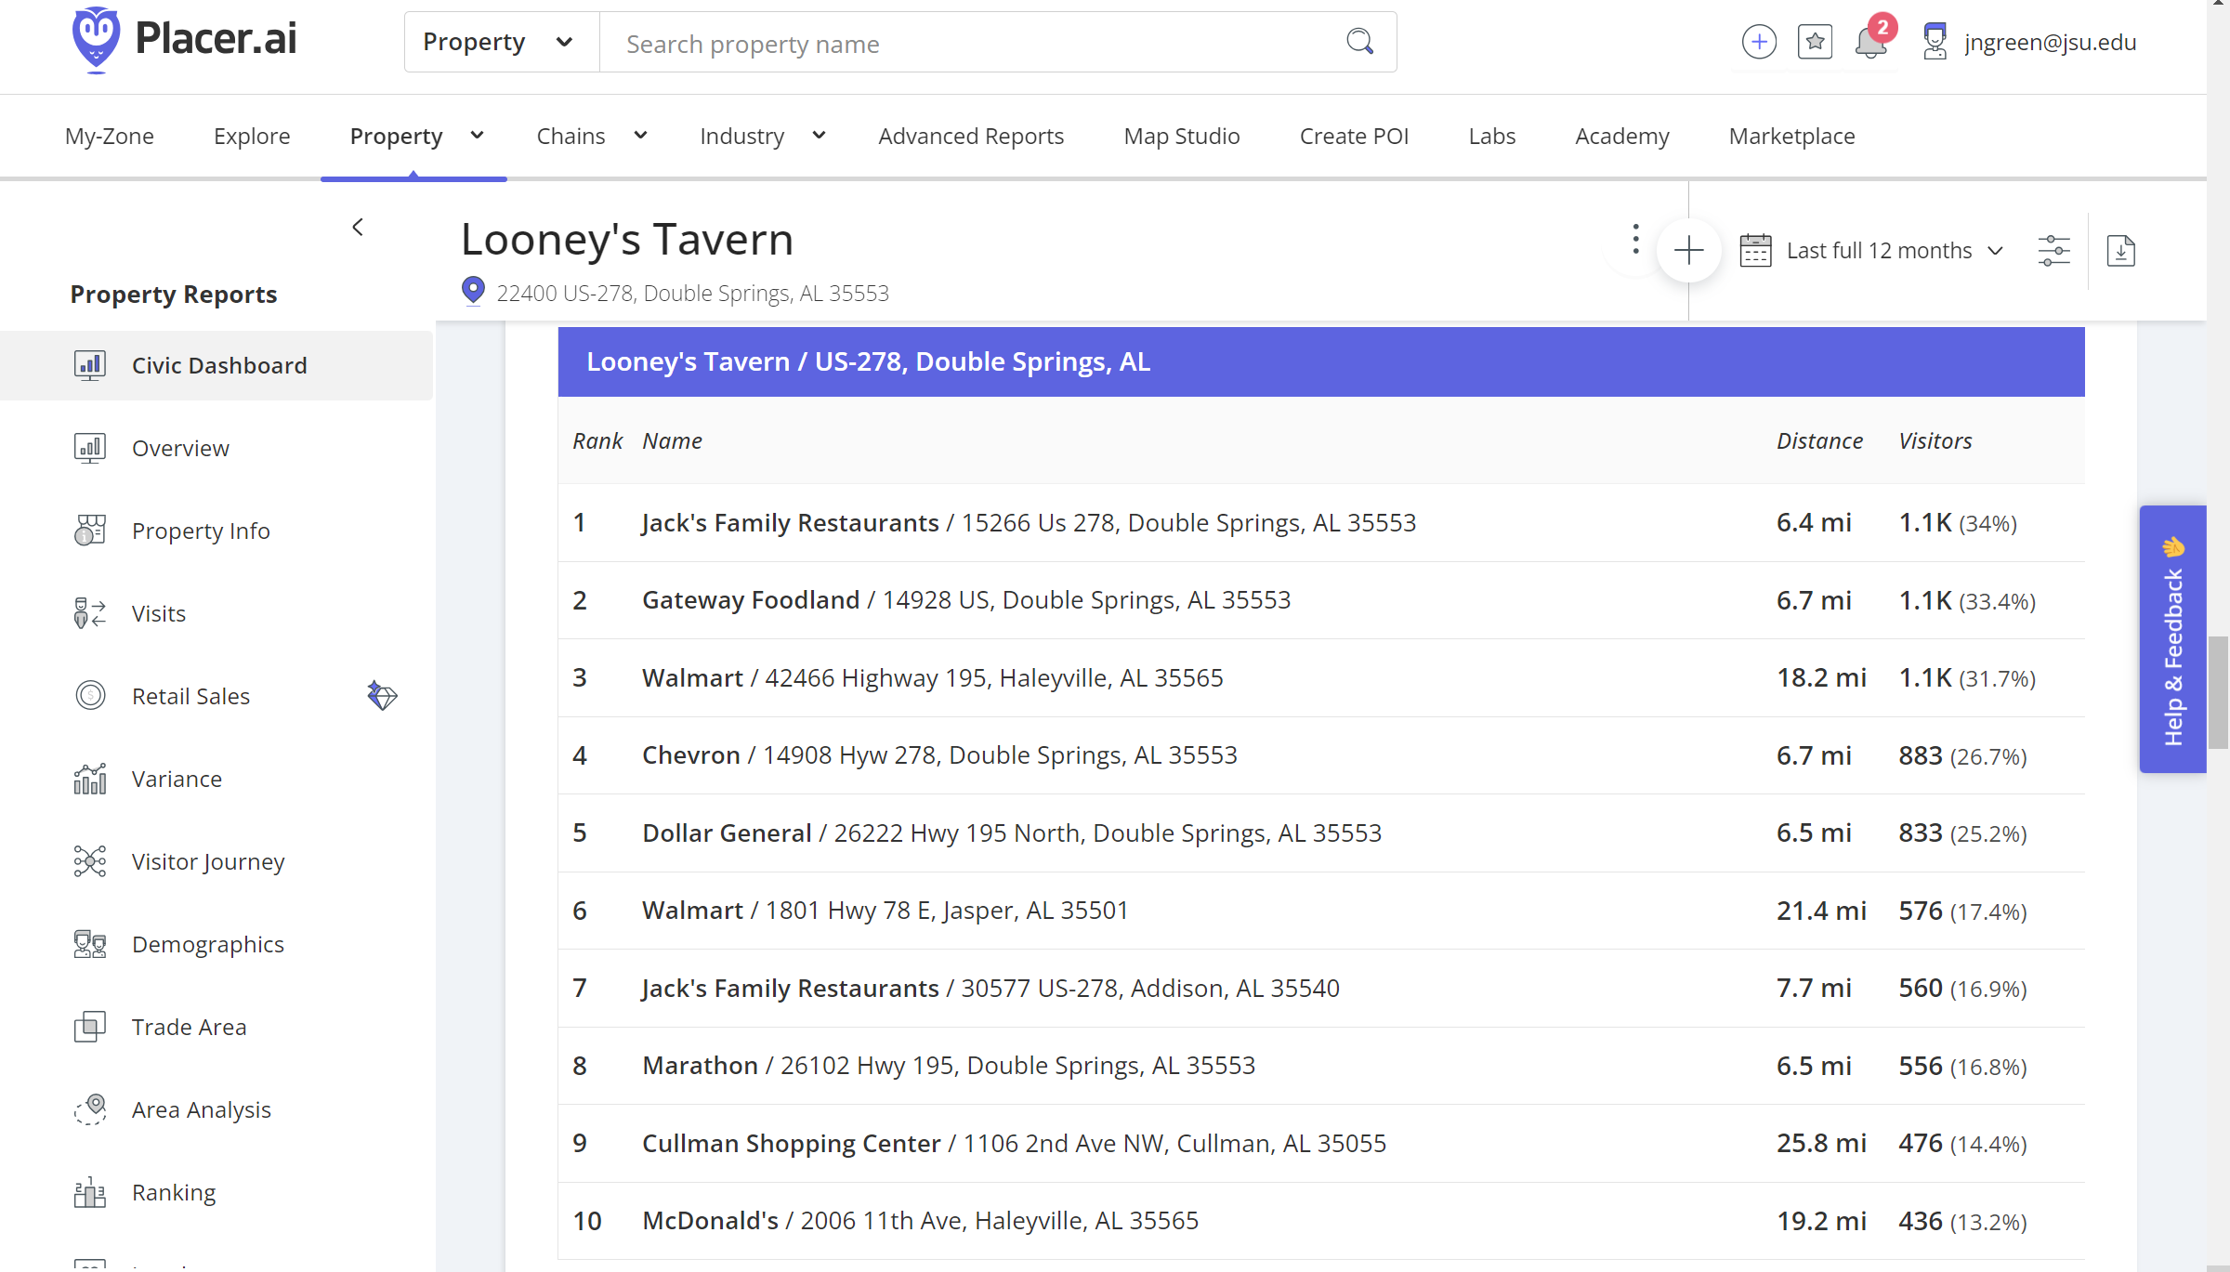
Favorite places

Slide 26
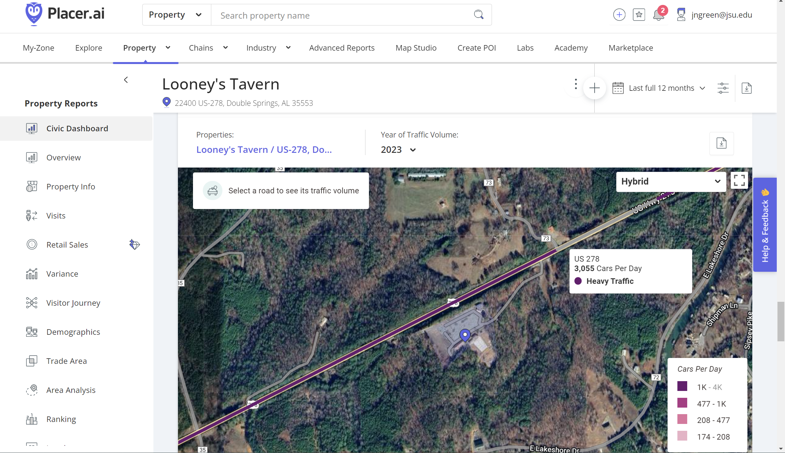
Traffic volume

Slide 27
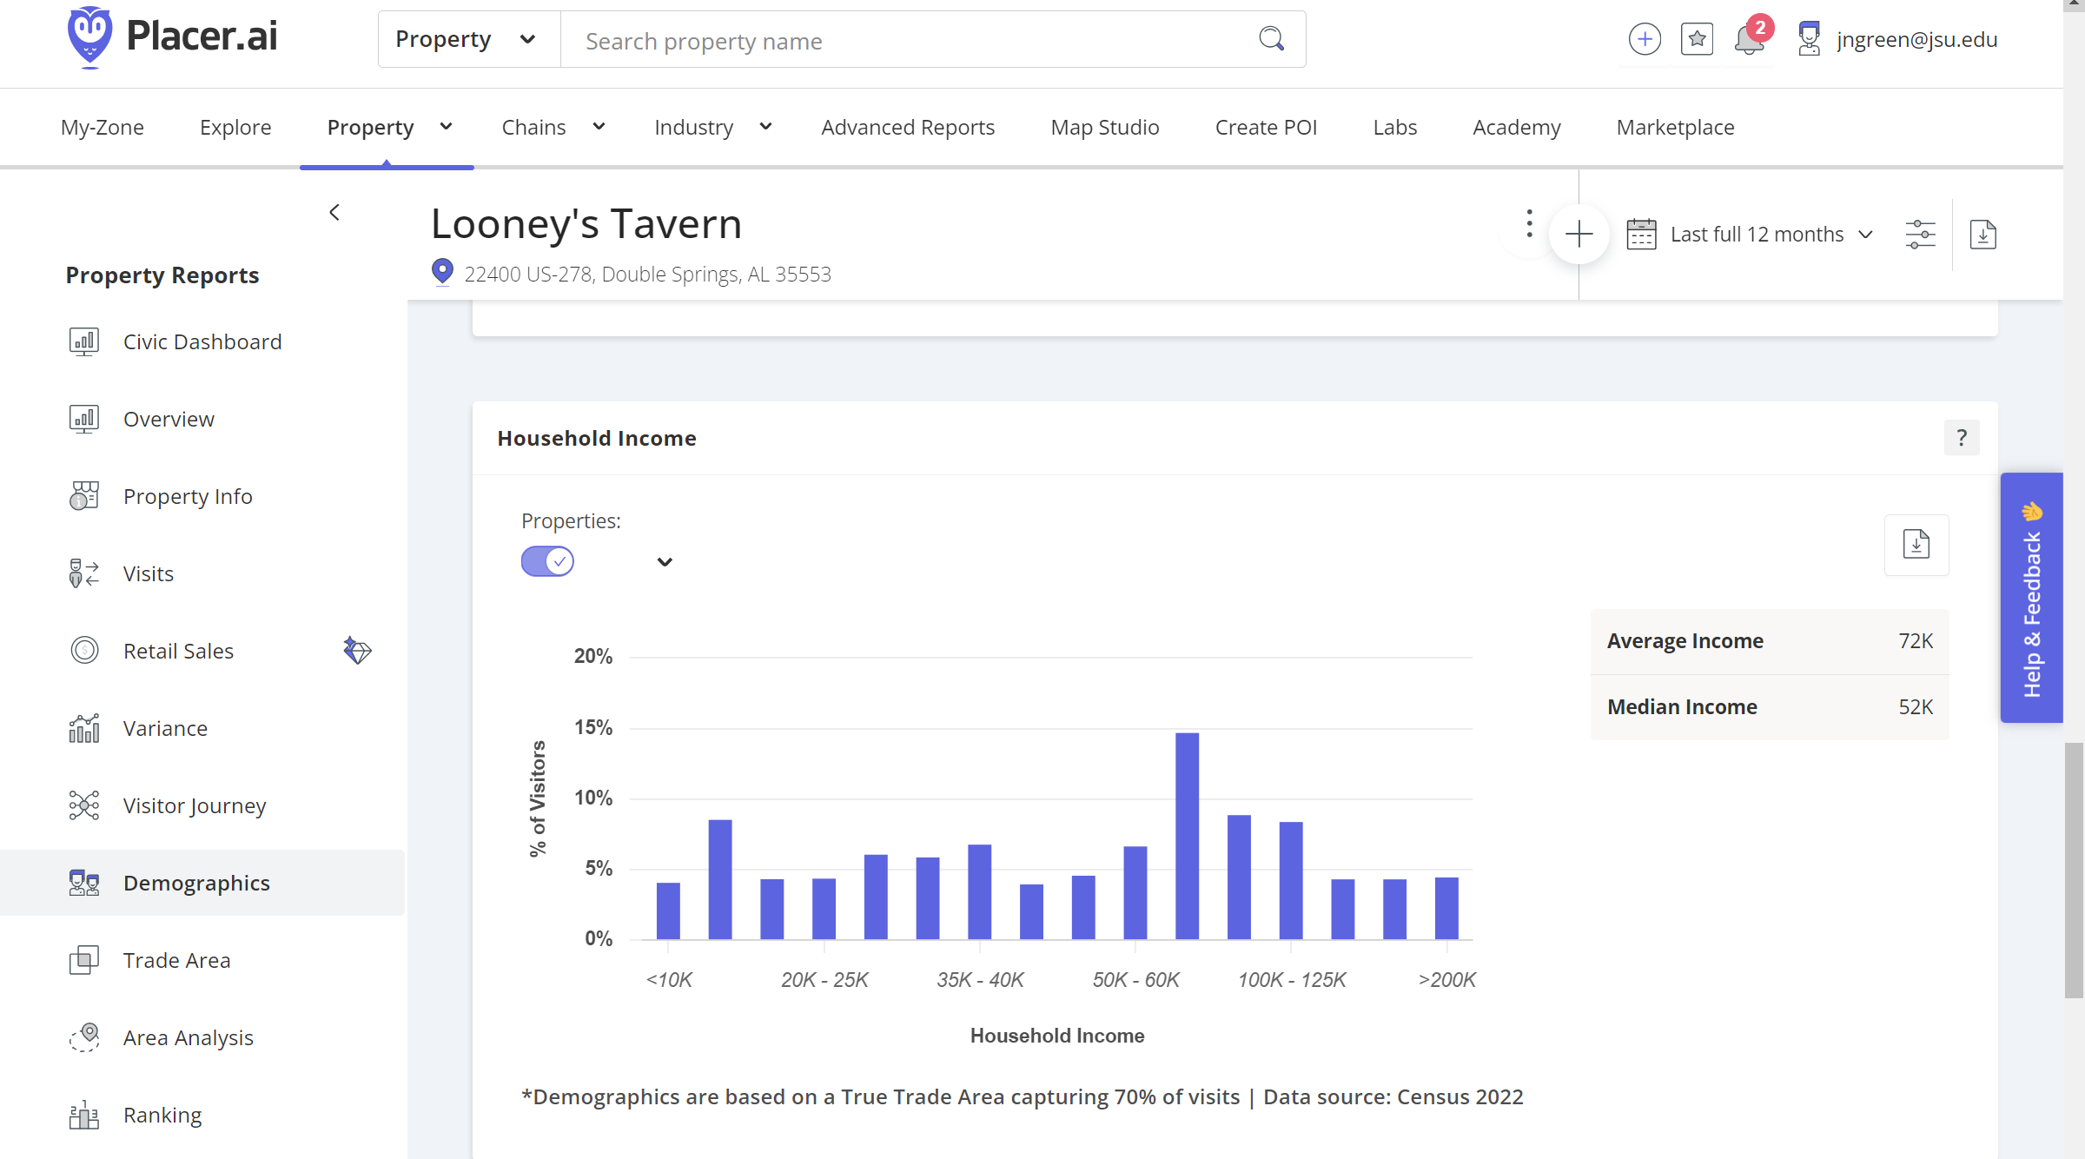
Demographics - Household income

Slide 28
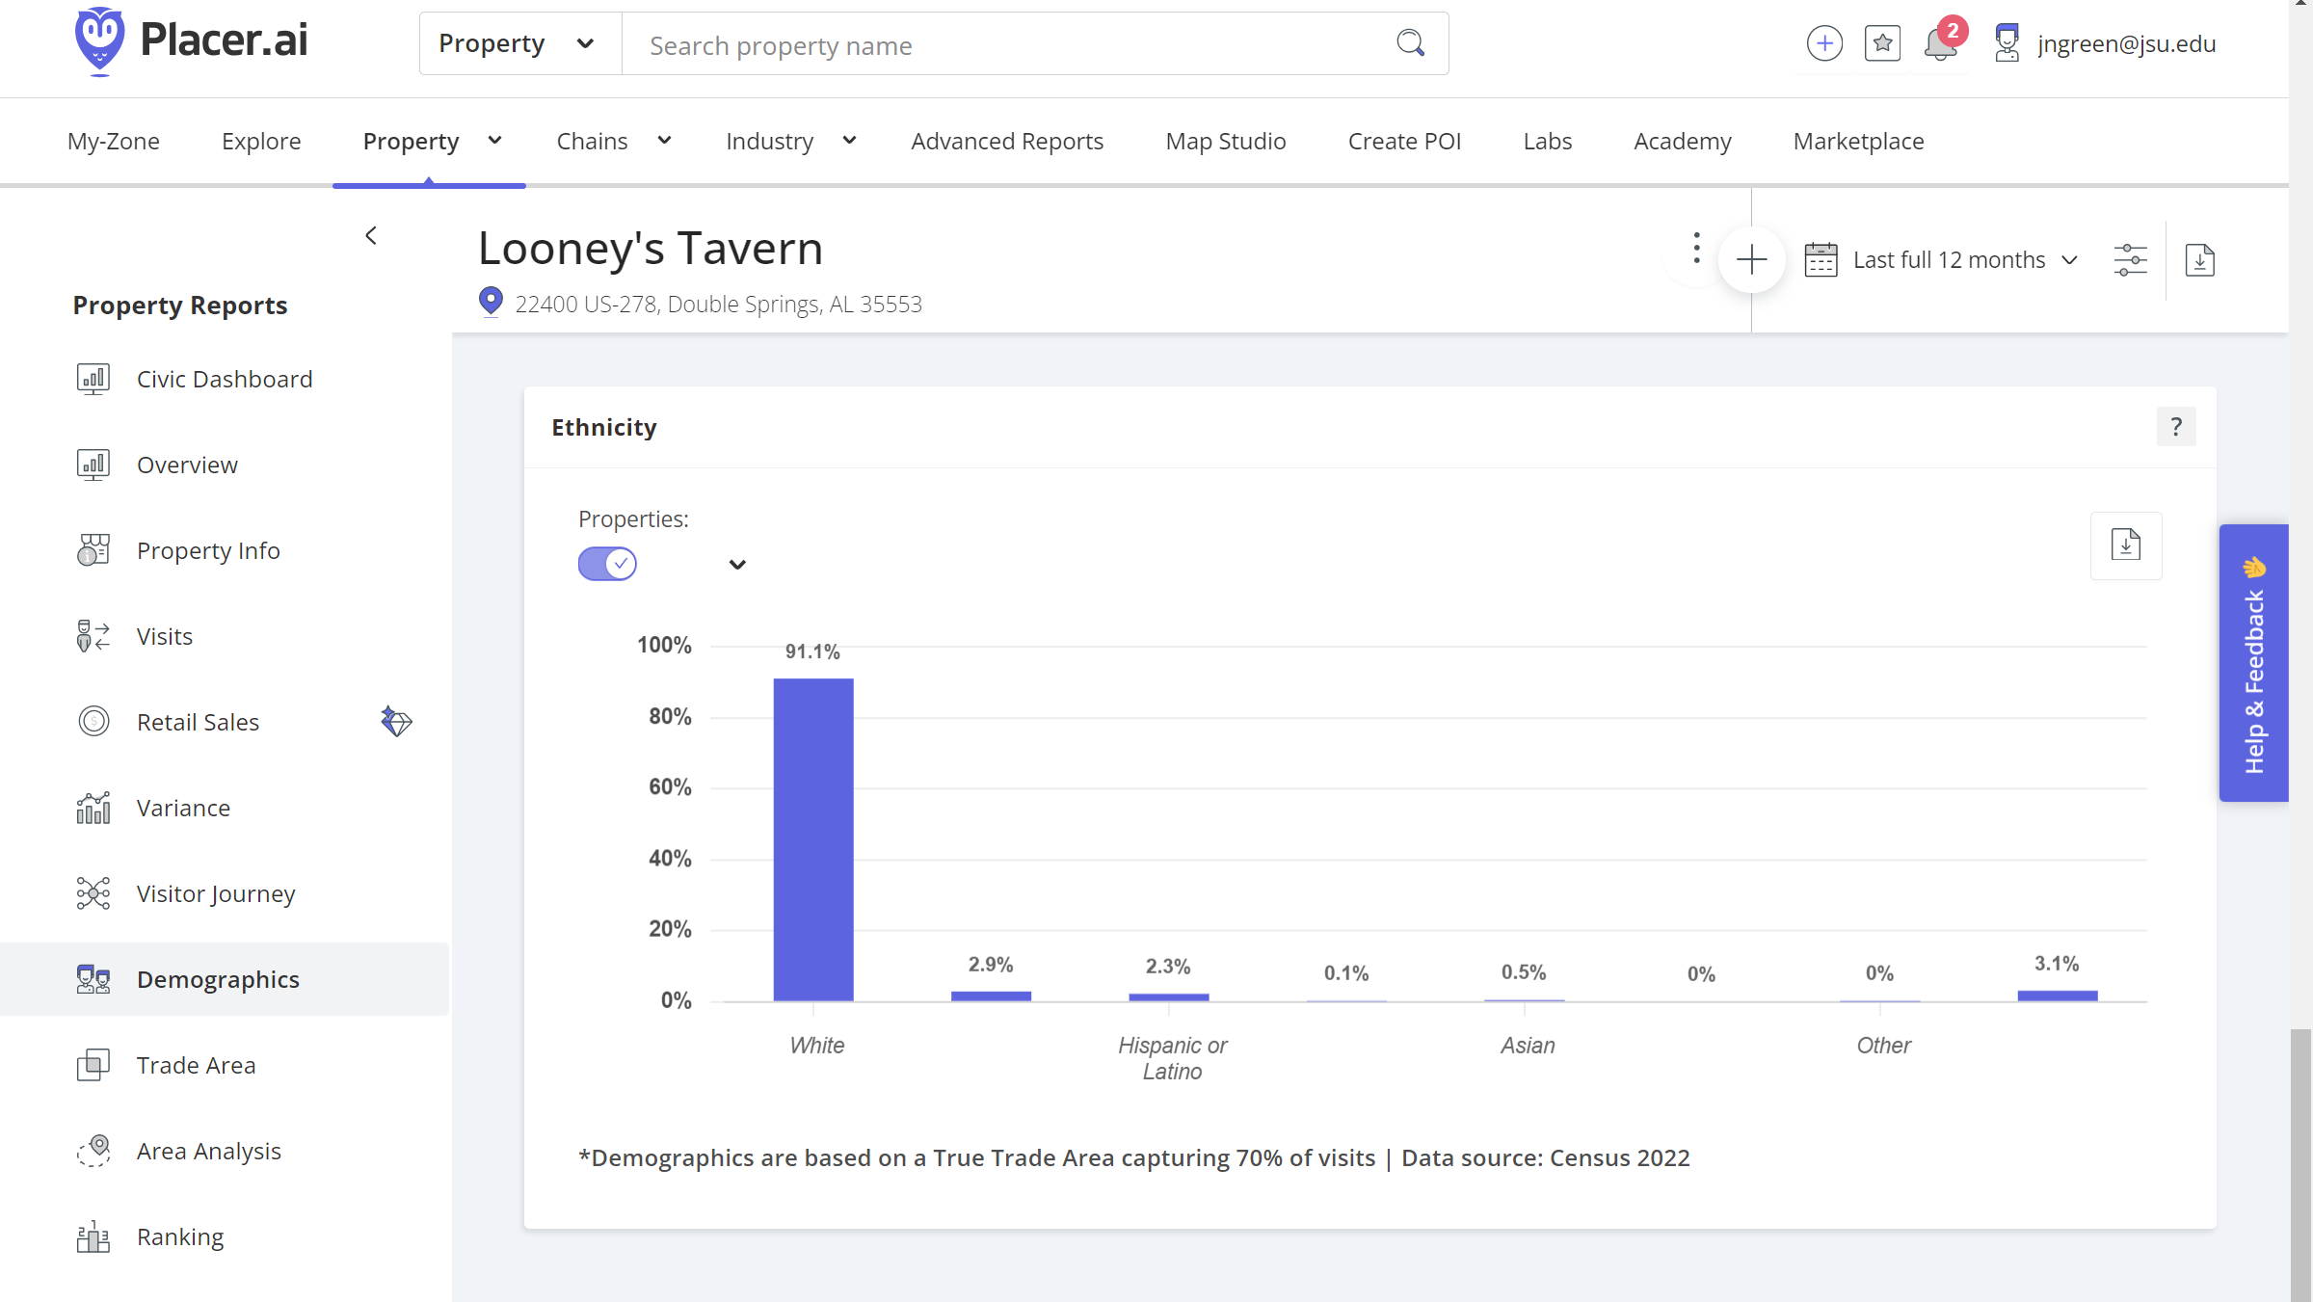
Demographics - race

Slide 29
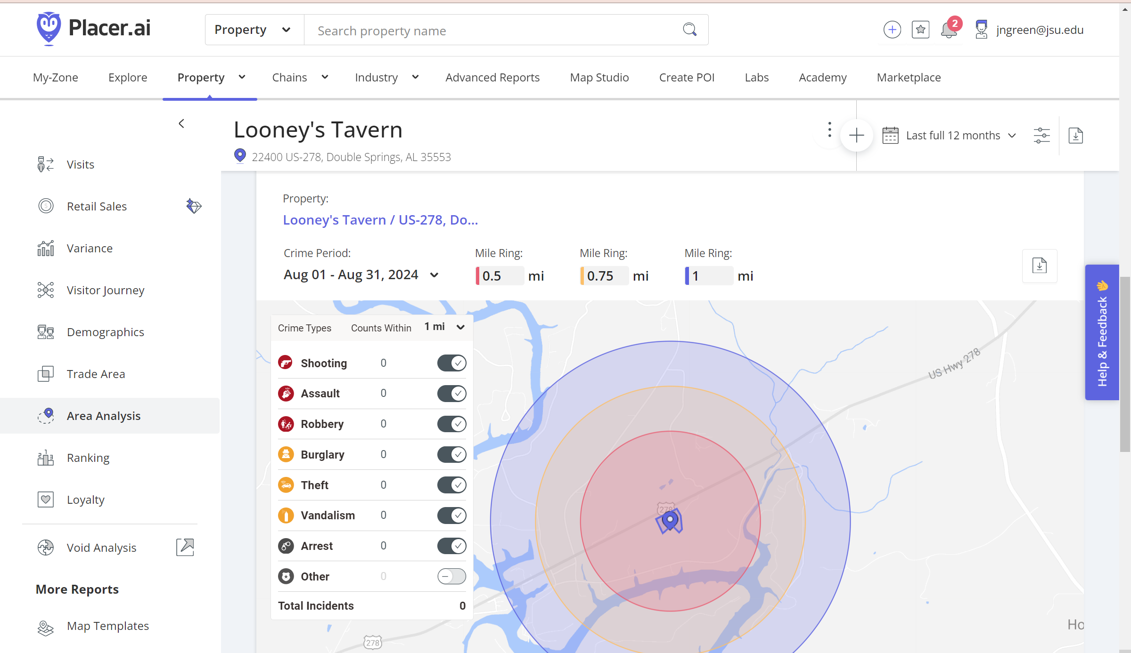
Area crime report

Slide 30
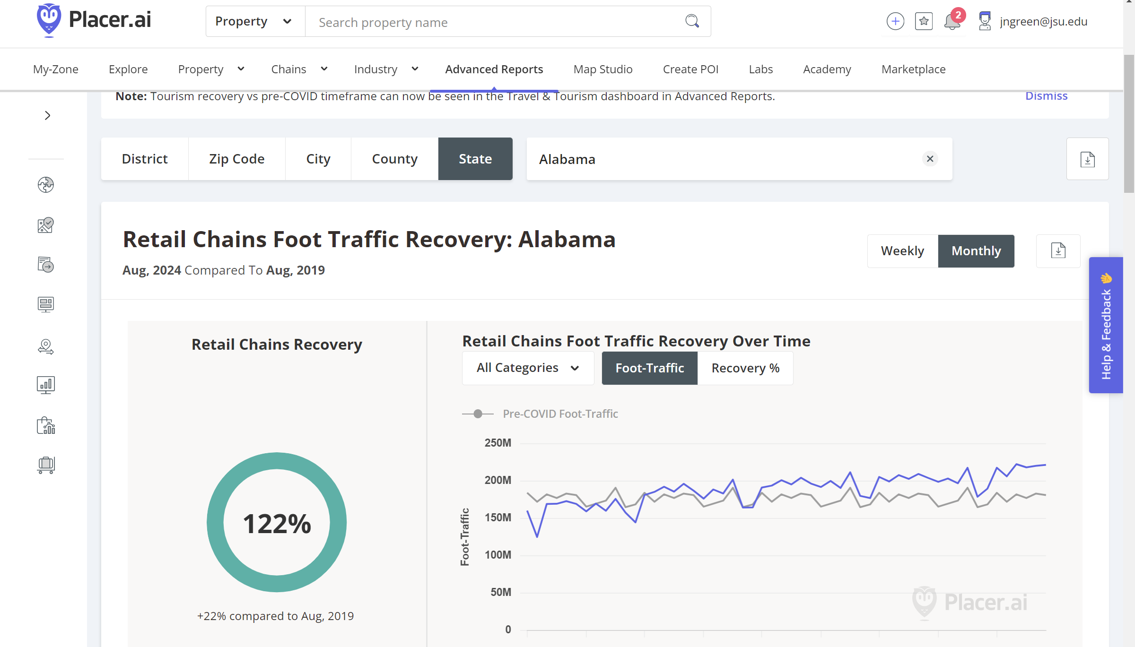
Retail foot traffic recovery - alabama

Slide 31
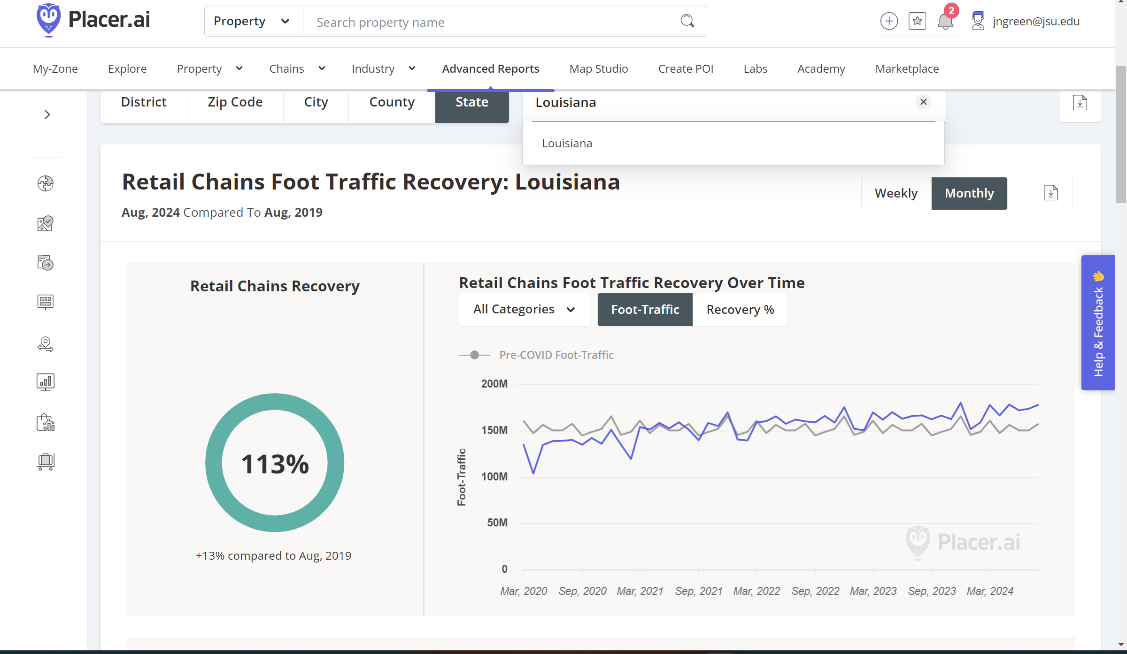
Retail foot traffic recovery - louisiana

Slide 32
T&TDashboard_PROD
Decatur, AL August 2023 – July 2024
Tourism and Travel Dashboard

Slide 33
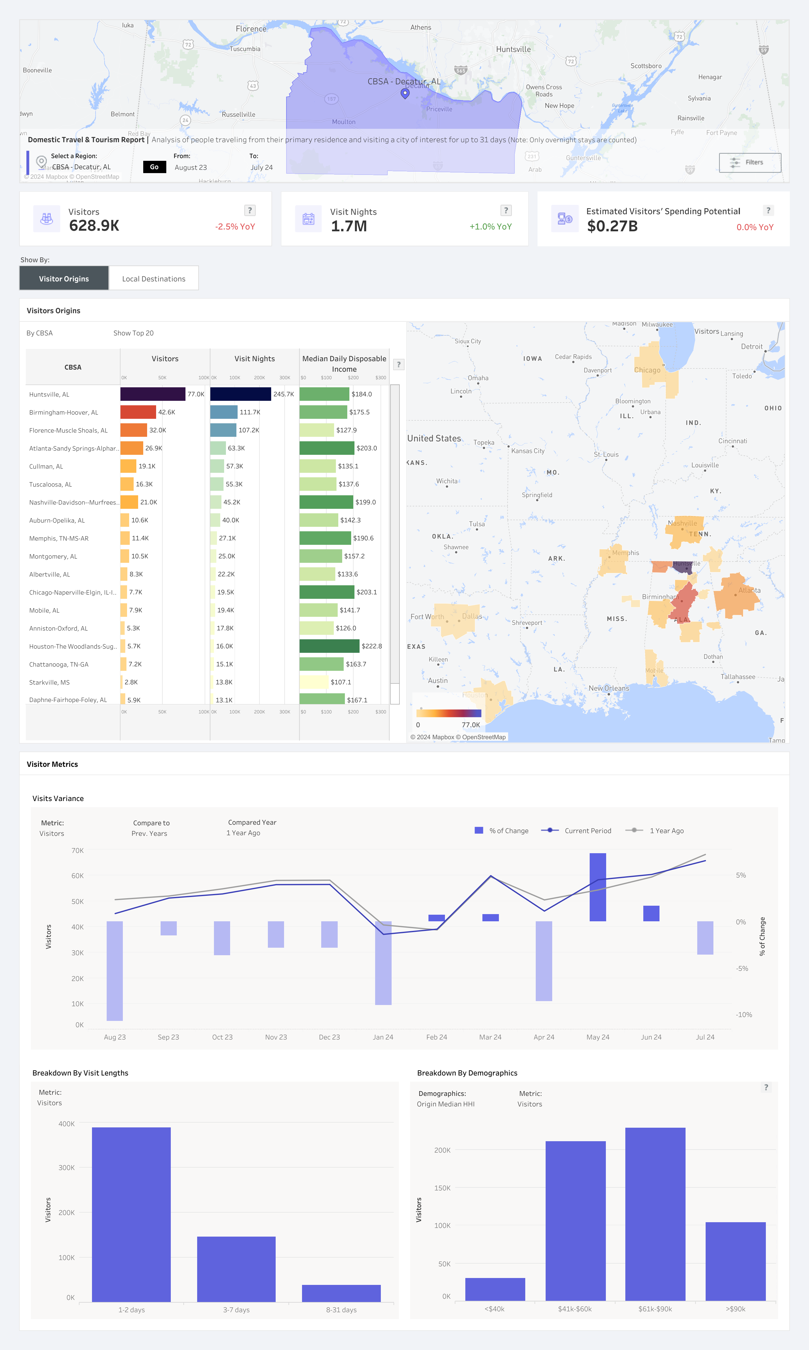

Slide 34
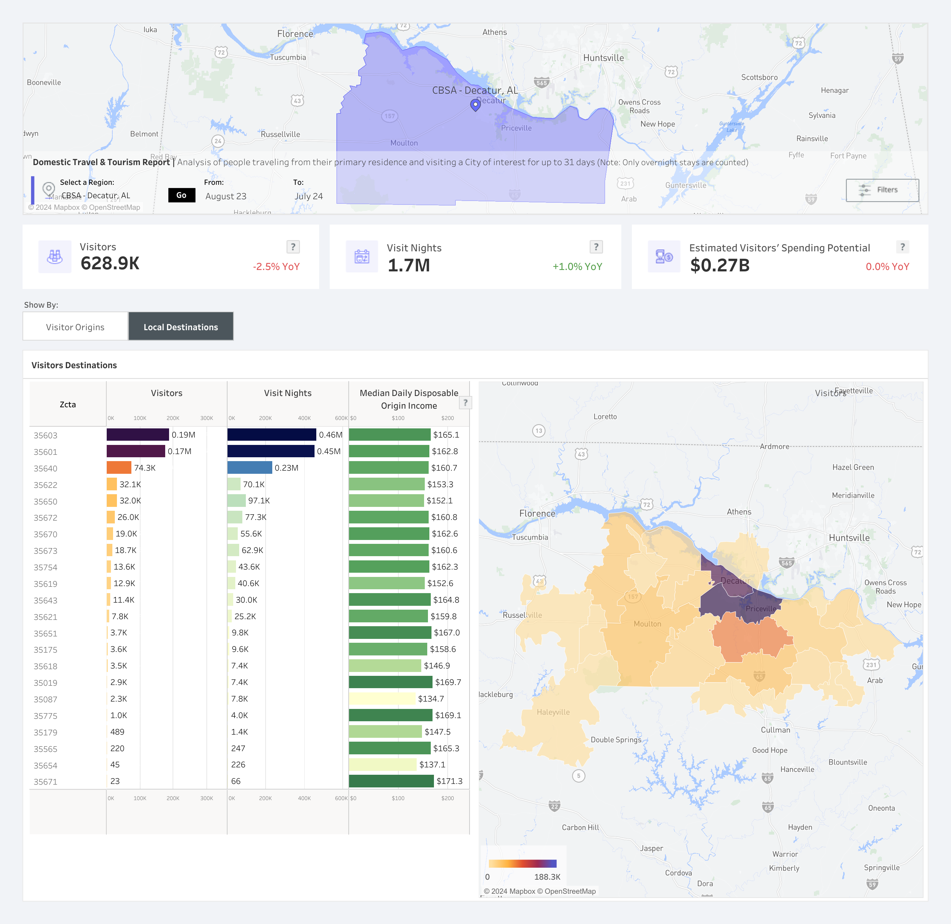

Slide 35
Research limitations
Current geofencing technology can not capture international visitors due to international cell carrier laws.

Slide 36
Questions?
Jennifer Green, MBA, MSGIST
Director
Jacksonville State University
Center for Economic Development & Business Research
jngreen@jsu.edu

