Slide 1
3rd QUARTER 2023-2024
PRESIDENT’S REPORT TO THE
AMLA BOARD OF DIRECTORS
(Time span covered April thru June 2024)
July 23, 2024
Little Brick Church
Oneonta, AL
ALABAMA MOUNTAIN LAKES TOURIST ASSOCIATION

Slide 2
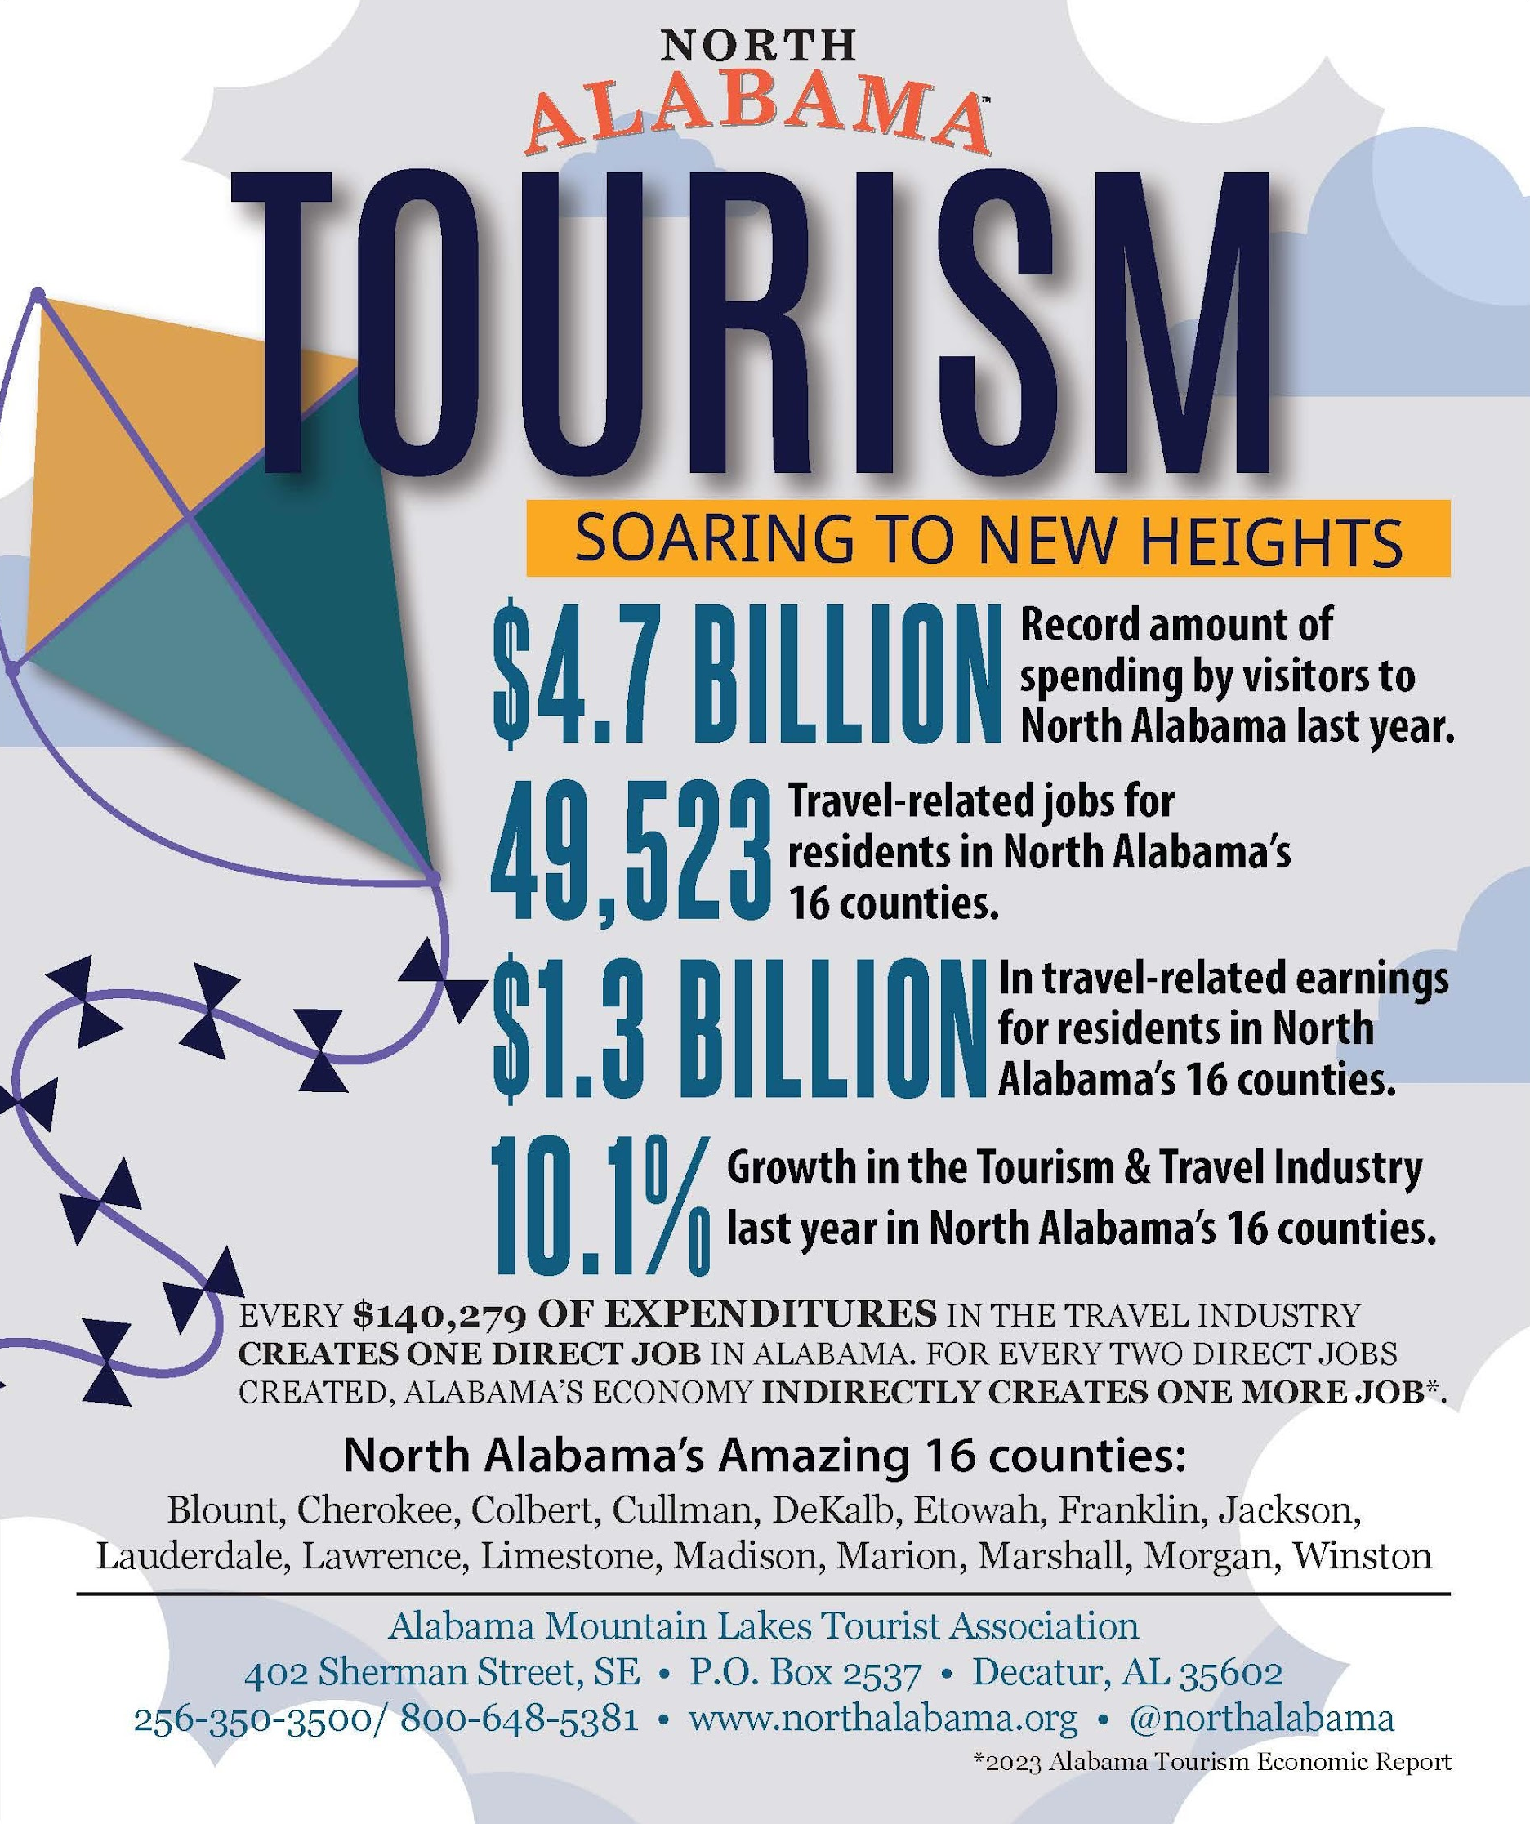
ECONOMIC IMPACT
ALABAMA MOUNTAIN LAKES TOURIST ASSOCIATION

Slide 3
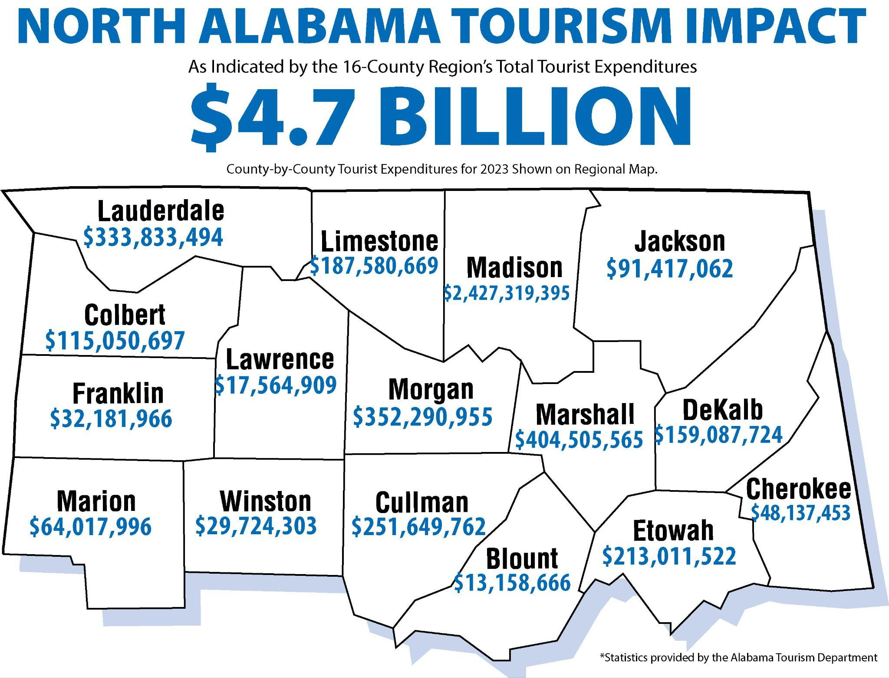
ECONOMIC IMPACT
ALABAMA MOUNTAIN LAKES TOURIST ASSOCIATION

Slide 4
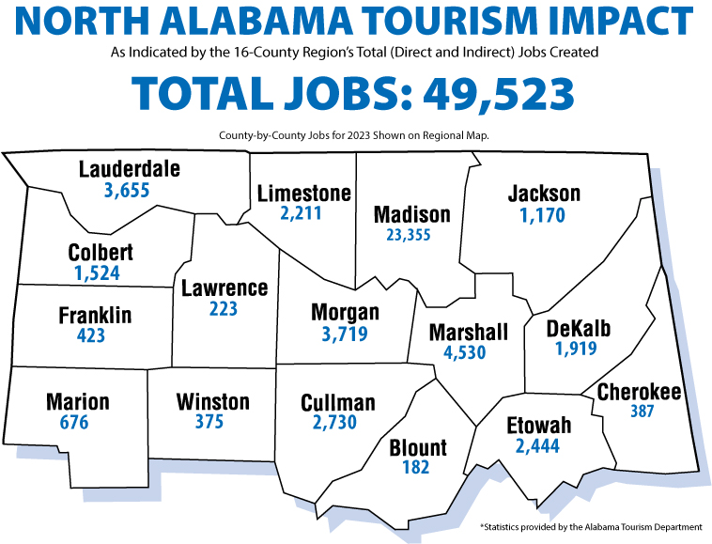
ECONOMIC IMPACT
ALABAMA MOUNTAIN LAKES TOURIST ASSOCIATION

Slide 5
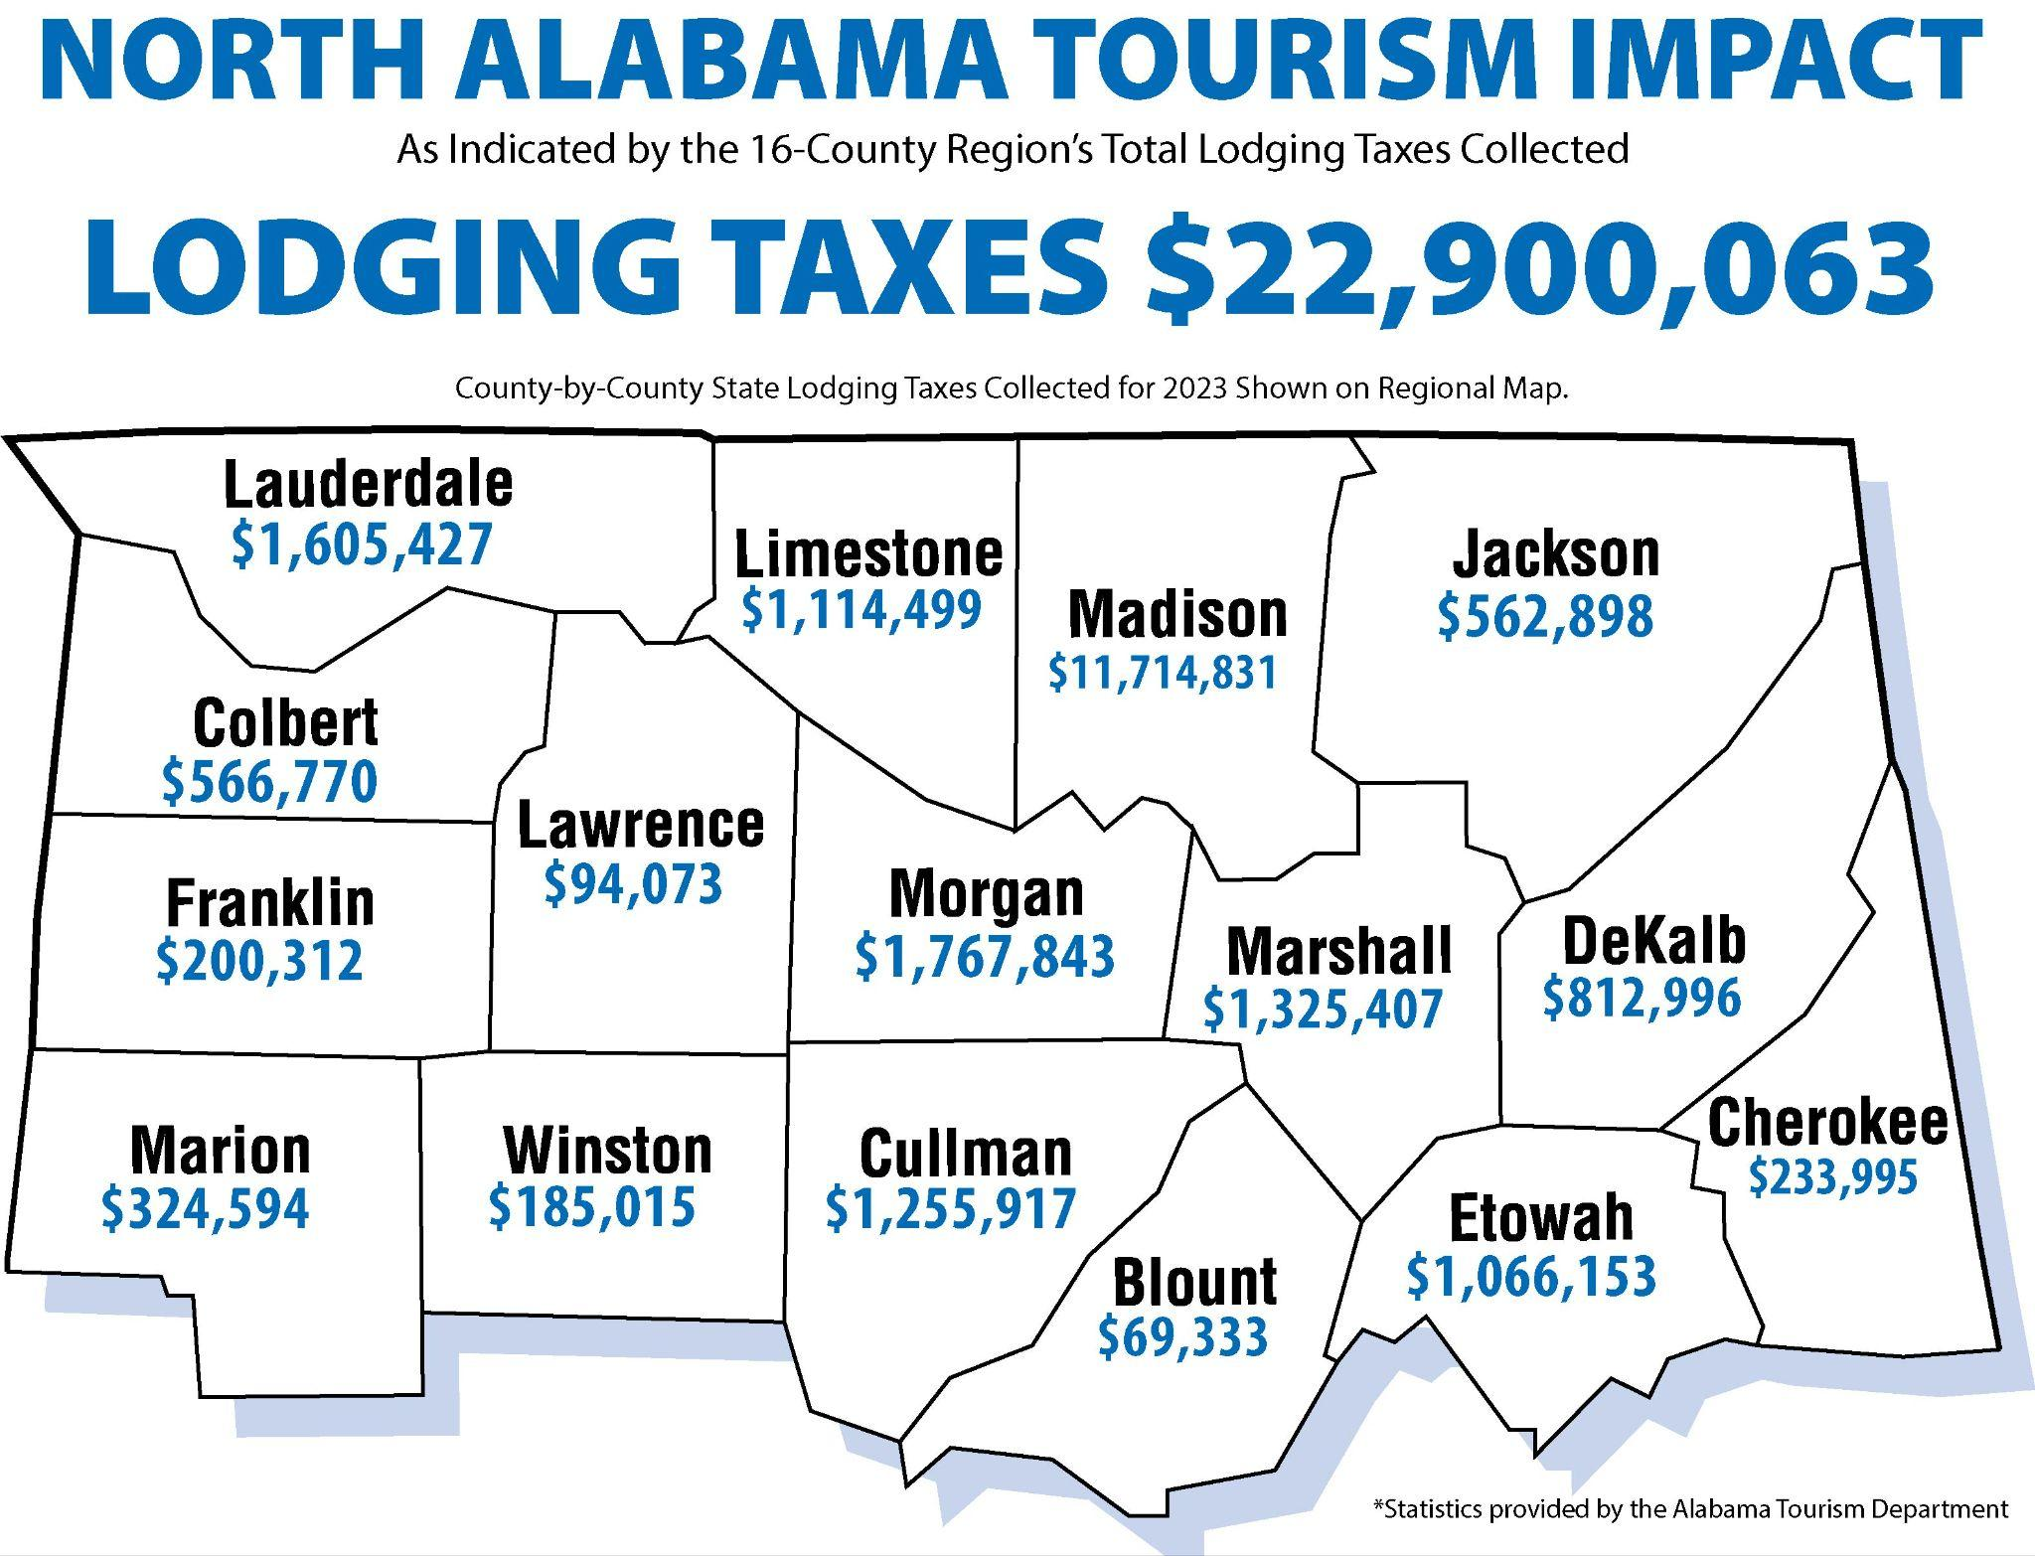
ECONOMIC IMPACT
ALABAMA MOUNTAIN LAKES TOURIST ASSOCIATION

Slide 6
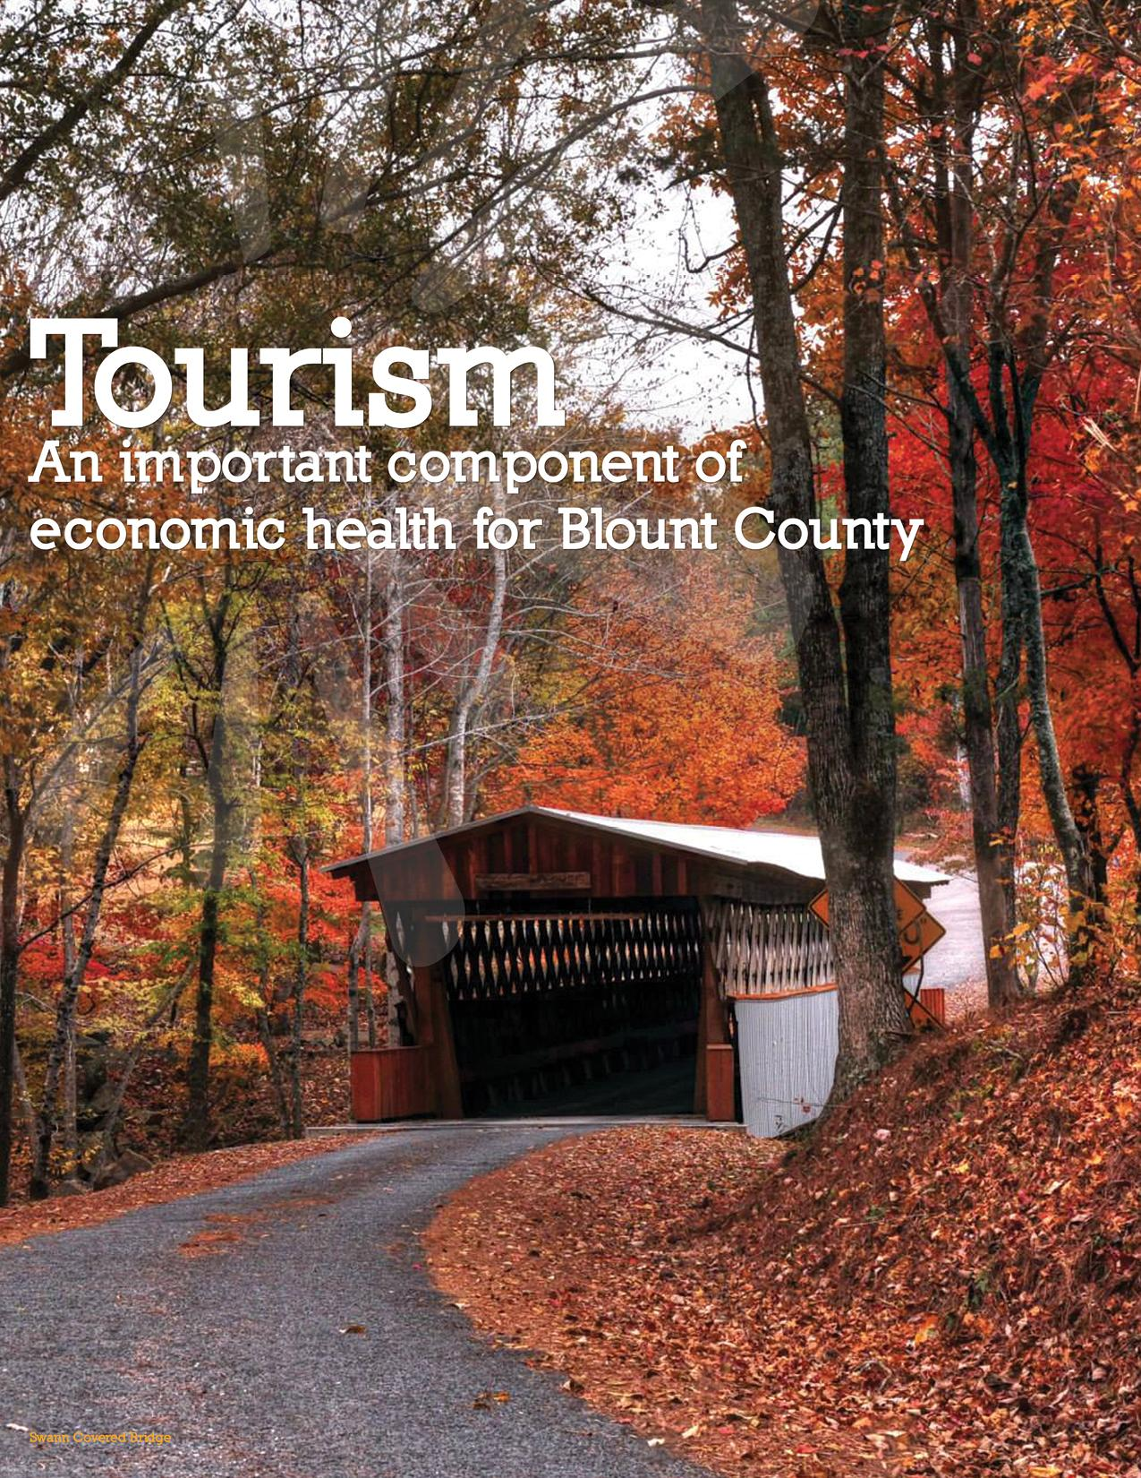
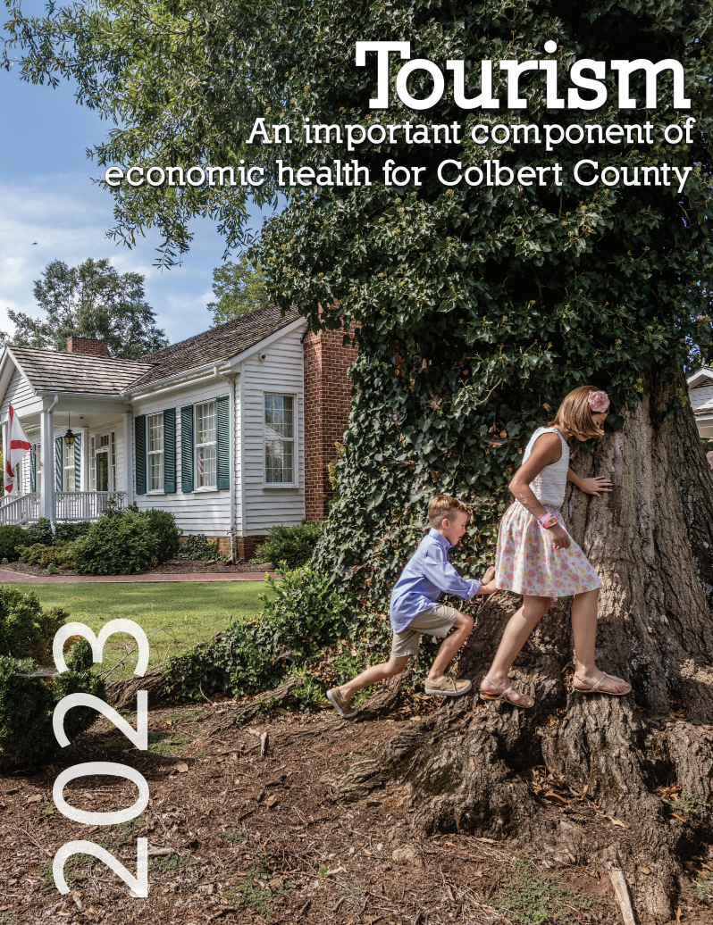
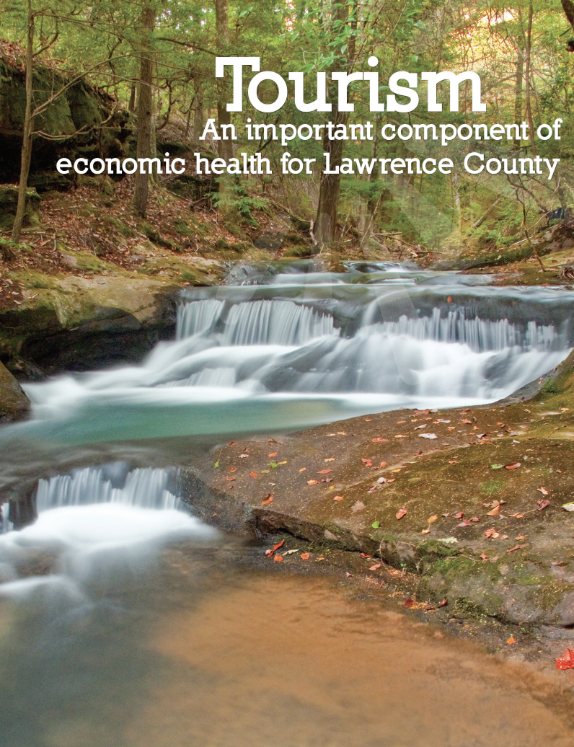
ECONOMIC IMPACT
ALABAMA MOUNTAIN LAKES TOURIST ASSOCIATION

Slide 7
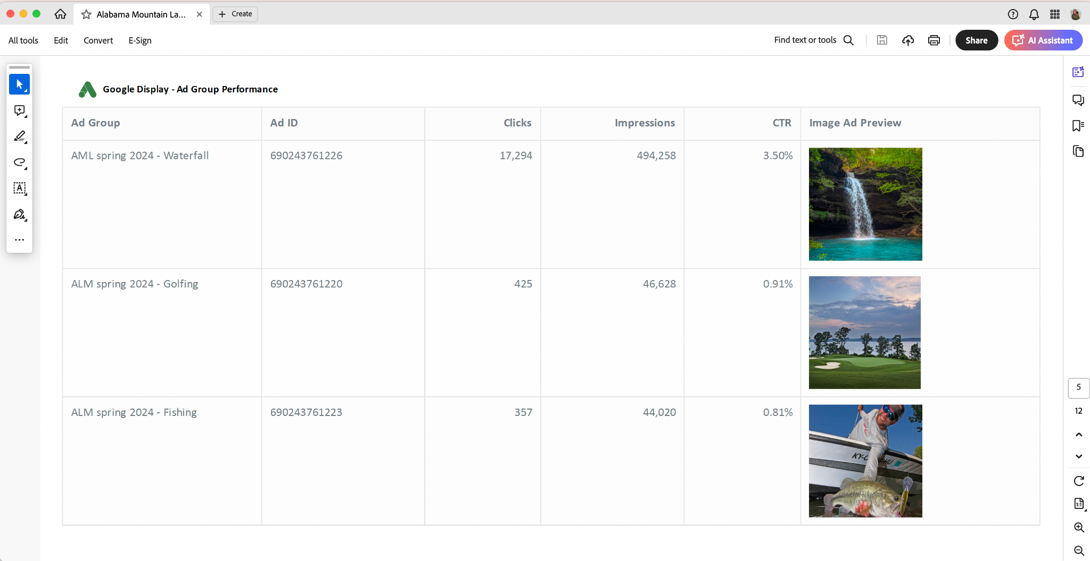
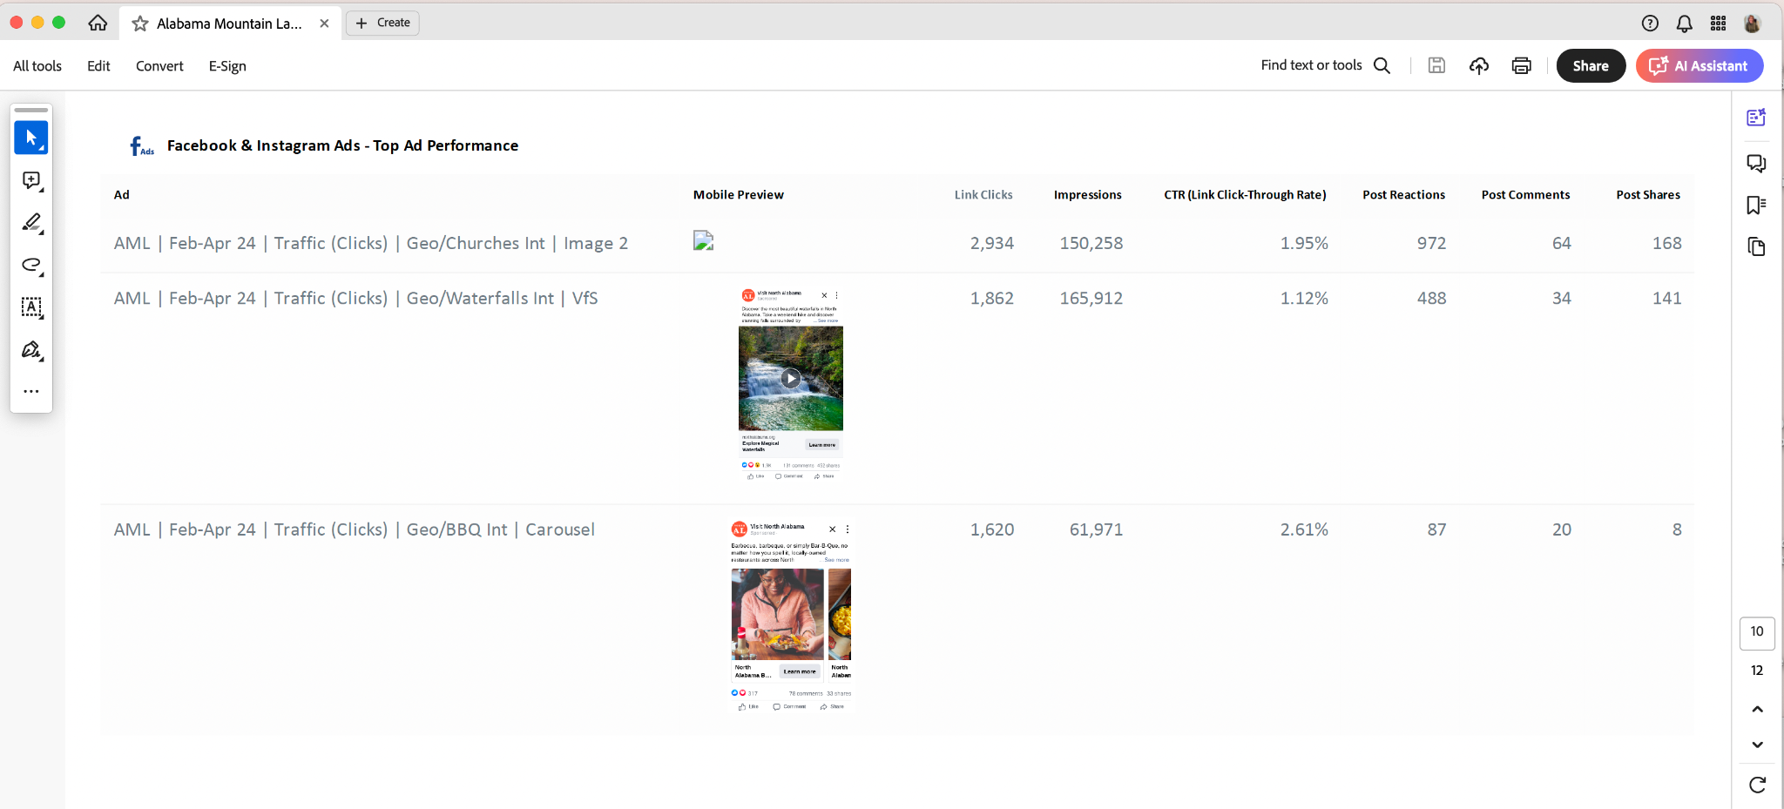
PRINT AND INTERNET ADVERTISING
Digitals Ads through Compass Marketing
ALABAMA MOUNTAIN LAKES TOURIST ASSOCIATION

Slide 8
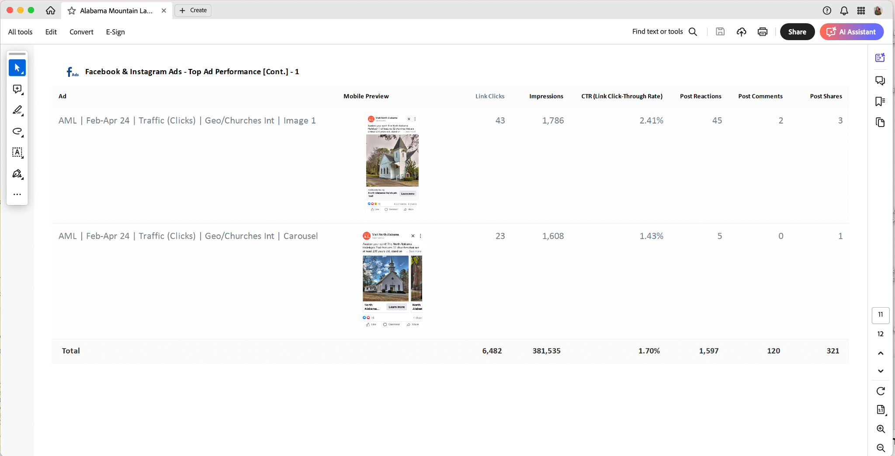
PRINT AND INTERNET ADVERTISING
Digitals Ads through Compass Marketing
ALABAMA MOUNTAIN LAKES TOURIST ASSOCIATION

Slide 9
PRINT AND INTERNET ADVERTISING
KAYAK ANGLER AND
PADDLING MAGAZINE
DIGITAL NEWSLETTER AND
WEBSITE ADS
March thru May, 2024
ALABAMA MOUNTAIN LAKES TOURIST ASSOCIATION

Slide 10
PRINT AND INTERNET ADVERTISING
The North Alabama Bridal Directory
Print and Digital Advertisement
ALABAMA MOUNTAIN LAKES TOURIST ASSOCIATION

Slide 11
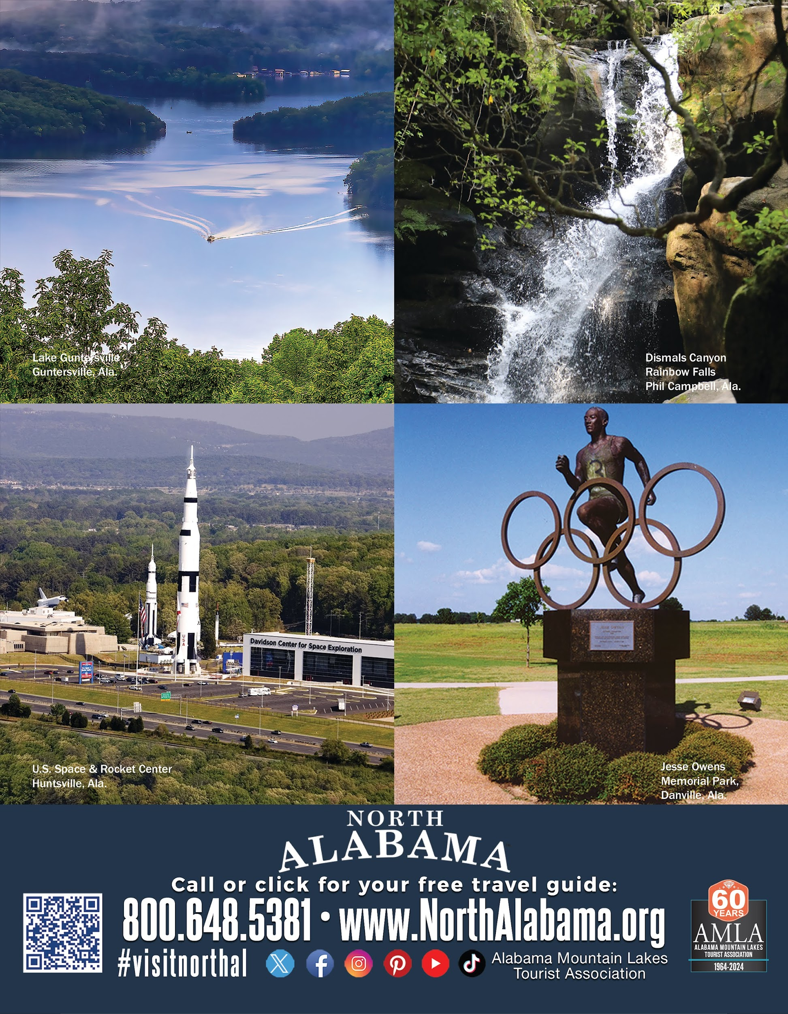
PRINT AND INTERNET ADVERTISING
ALABAMA LEAGUE OF MUNICIPALITIES MAGAZINE
Full Page Ad, March, 2024
ALABAMA MOUNTAIN LAKES TOURIST ASSOCIATION

Slide 12
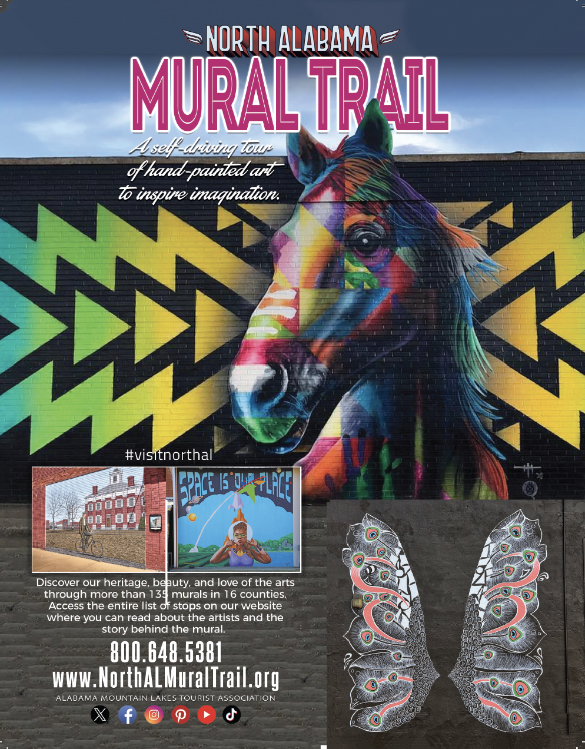
PRINT AND INTERNET ADVERTISING
Explore Decatur Morgan County Publication
March 2024 Advertisement
ALABAMA MOUNTAIN LAKES TOURIST ASSOCIATION

Slide 13
PRINT AND INTERNET ADVERTISING
Alabama Living
Full-Page Ad April Edition
ALABAMA MOUNTAIN LAKES TOURIST ASSOCIATION

Slide 14
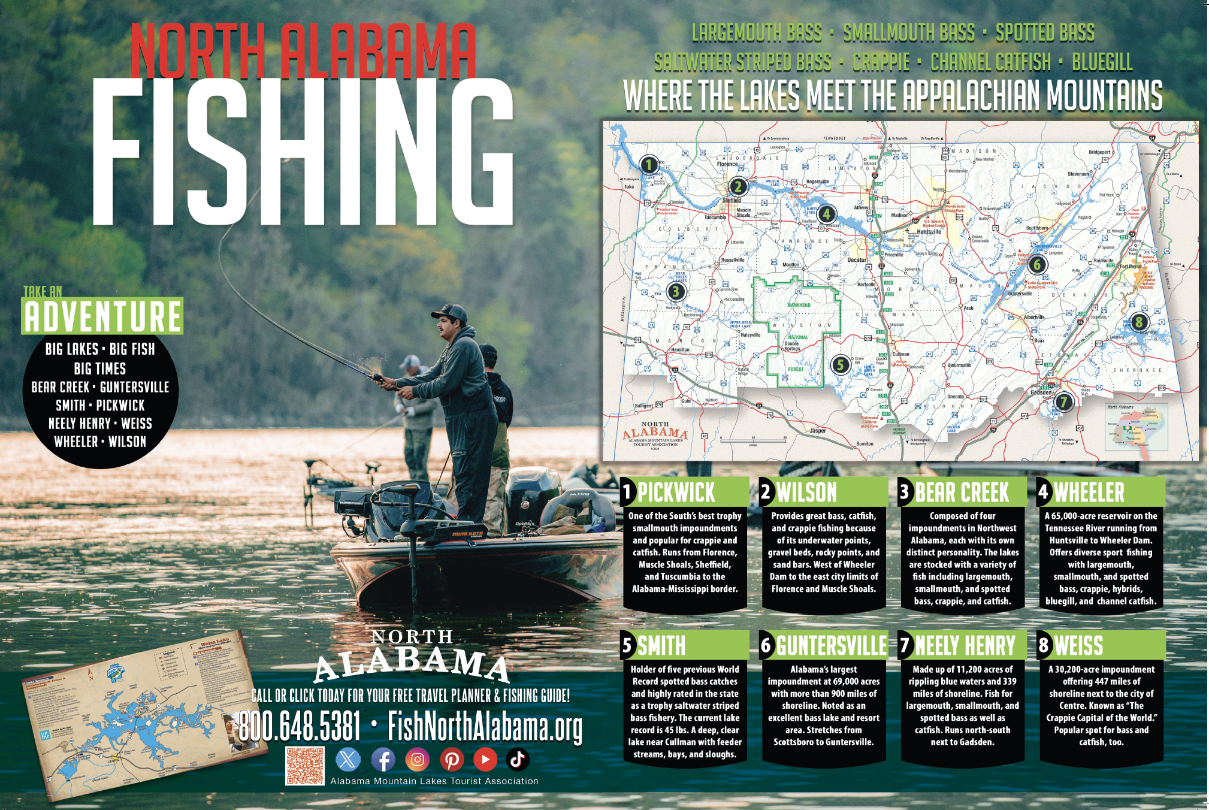
PRINT AND INTERNET ADVERTISING
ALABAMA LIVING MAGAZINE (June Issue)
Two-page spread- Fishing
ALABAMA MOUNTAIN LAKES TOURIST ASSOCIATION

Slide 15
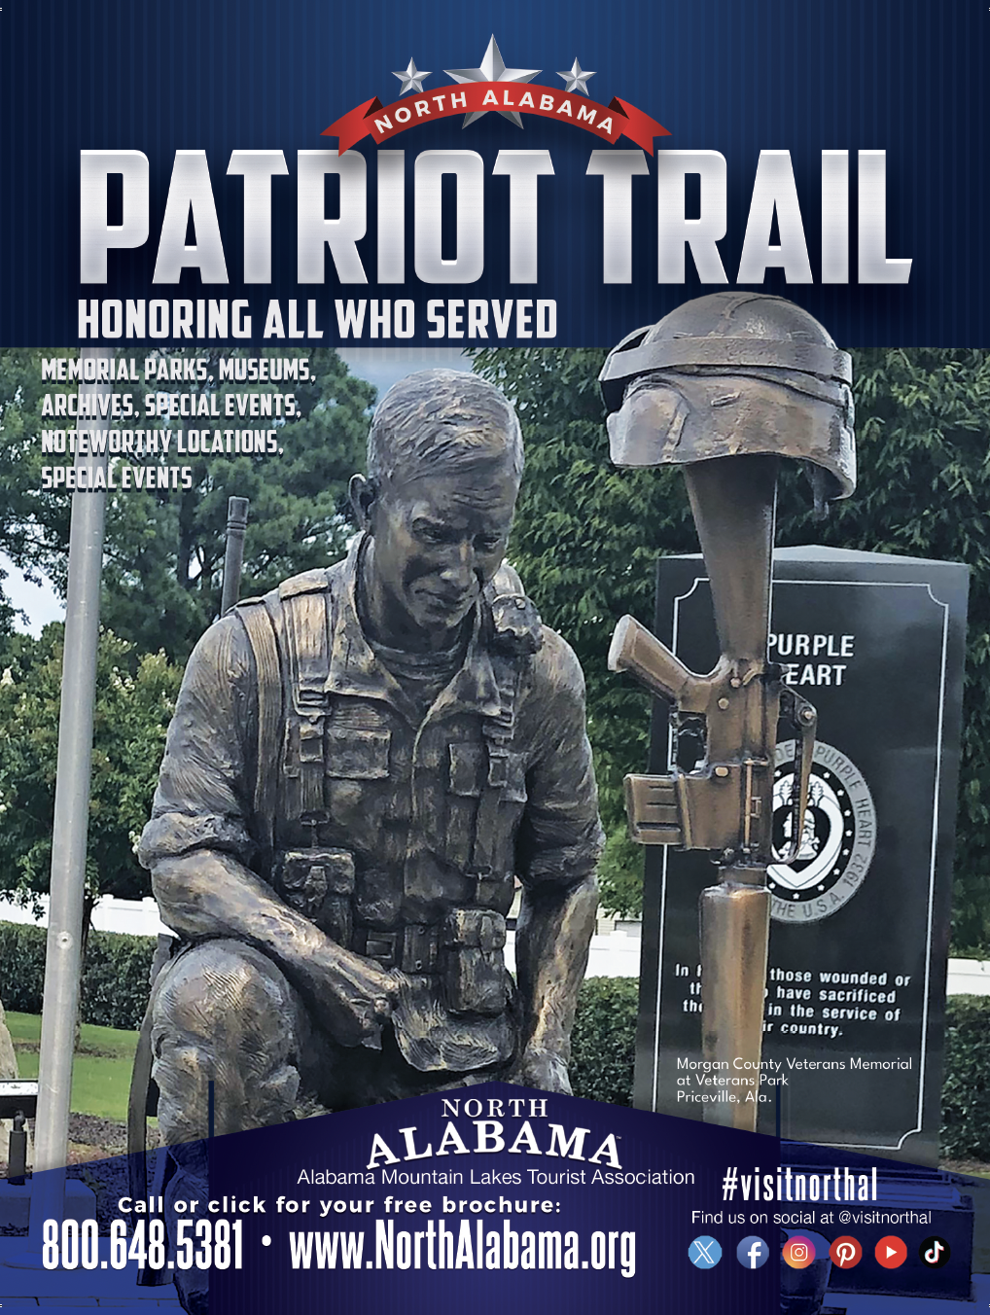
PRINT AND INTERNET ADVERTISING
ALABAMA LIVING MAGAZINE
Patriot Trail Full-Page Ad
June 2024 Edition
ALABAMA MOUNTAIN LAKES TOURIST ASSOCIATION

Slide 16
PRINT AND INTERNET ADVERTISING
HYDROFEST PROGRAM
June, 2024
ALABAMA MOUNTAIN LAKES TOURIST ASSOCIATION

Slide 17
INTERNET MARKETING
UNEXPECTED ADVENTURES PODCAST
ALABAMA MOUNTAIN LAKES TOURIST ASSOCIATION

Slide 18
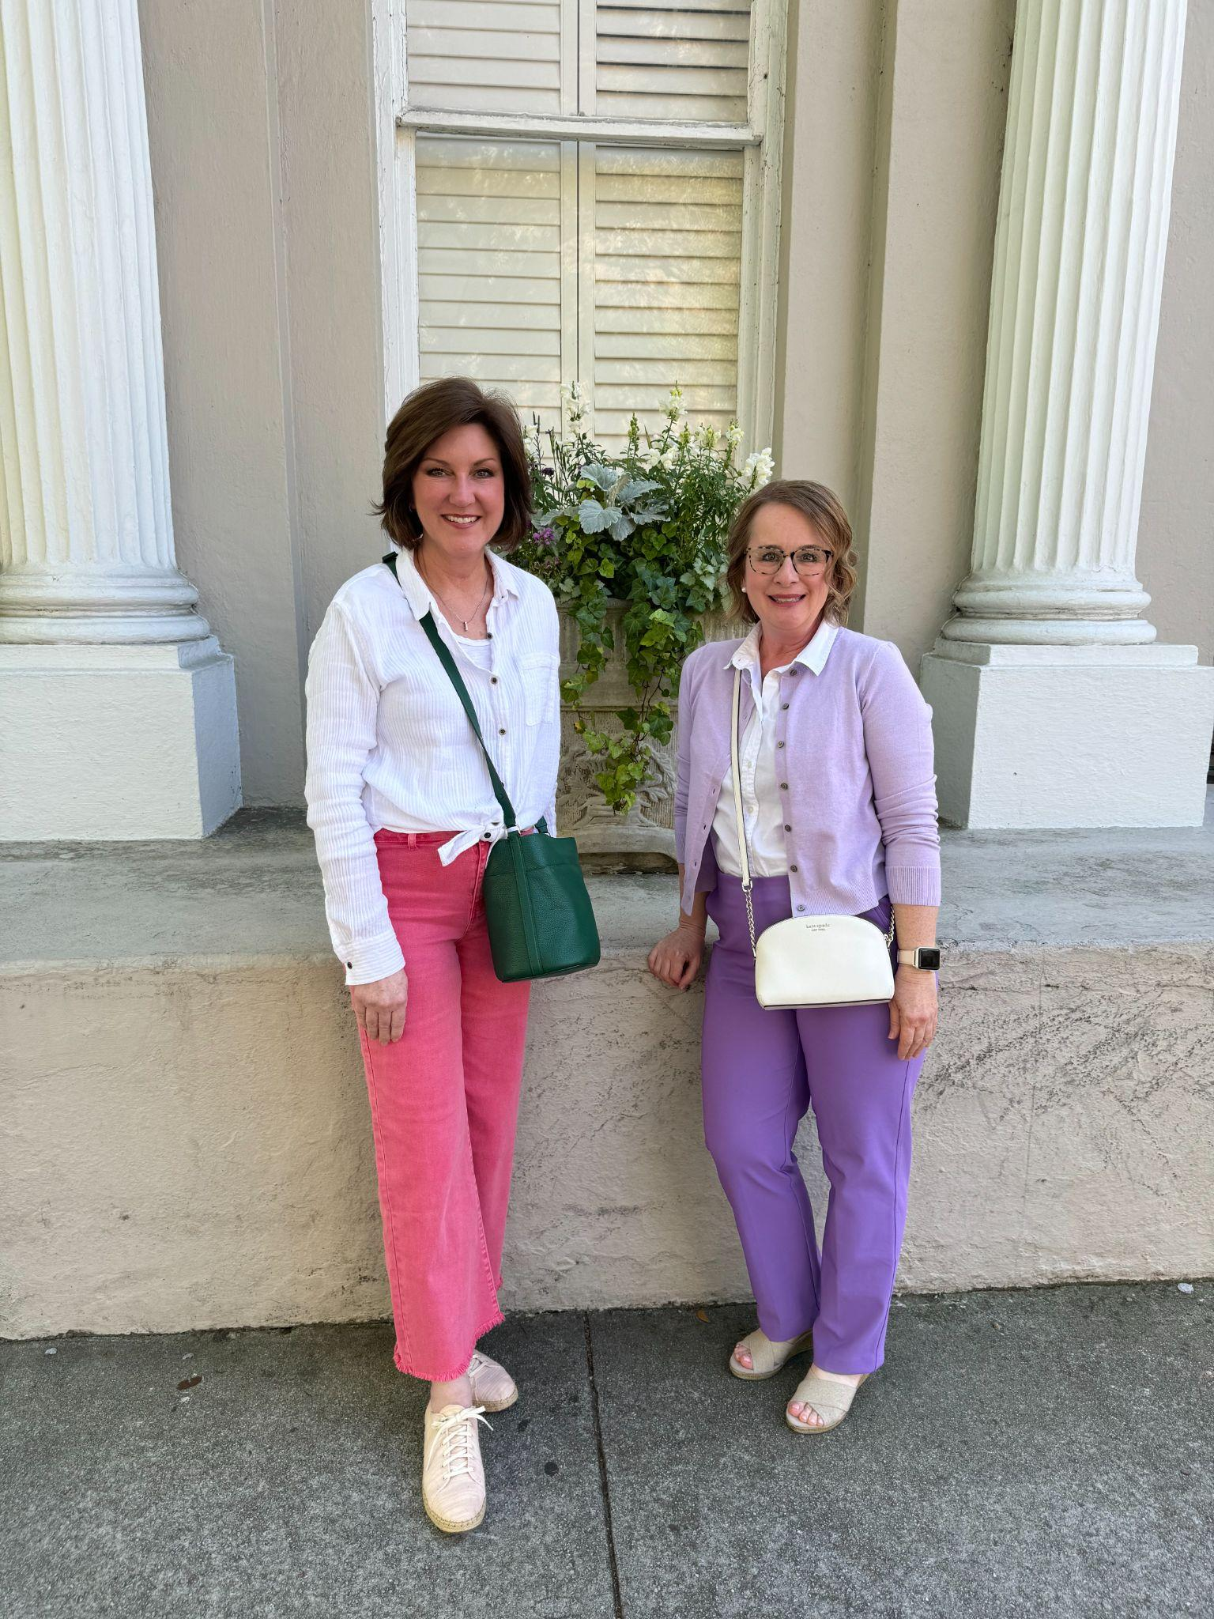
LOCATION MARKETING
Karen and Melea at Travel South Global Summit in Charleston
April, 2024
ALABAMA MOUNTAIN LAKES TOURIST ASSOCIATION

Slide 19
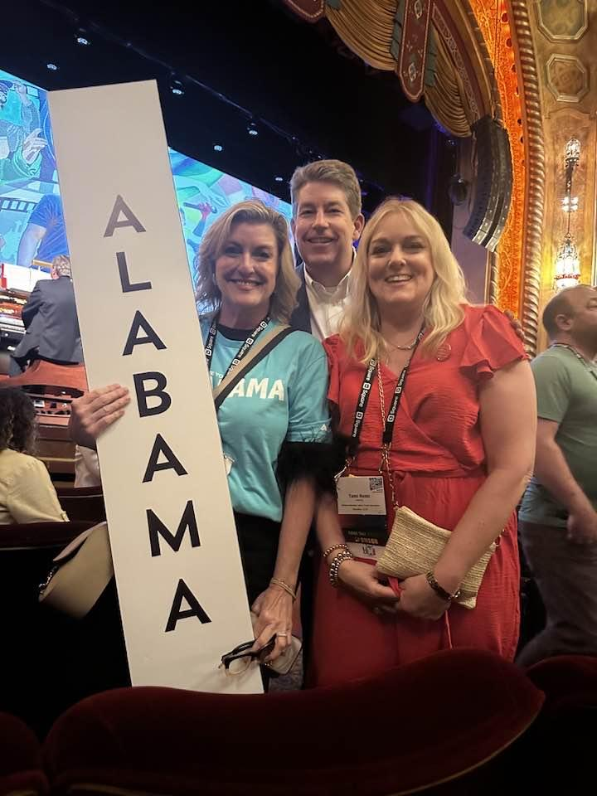
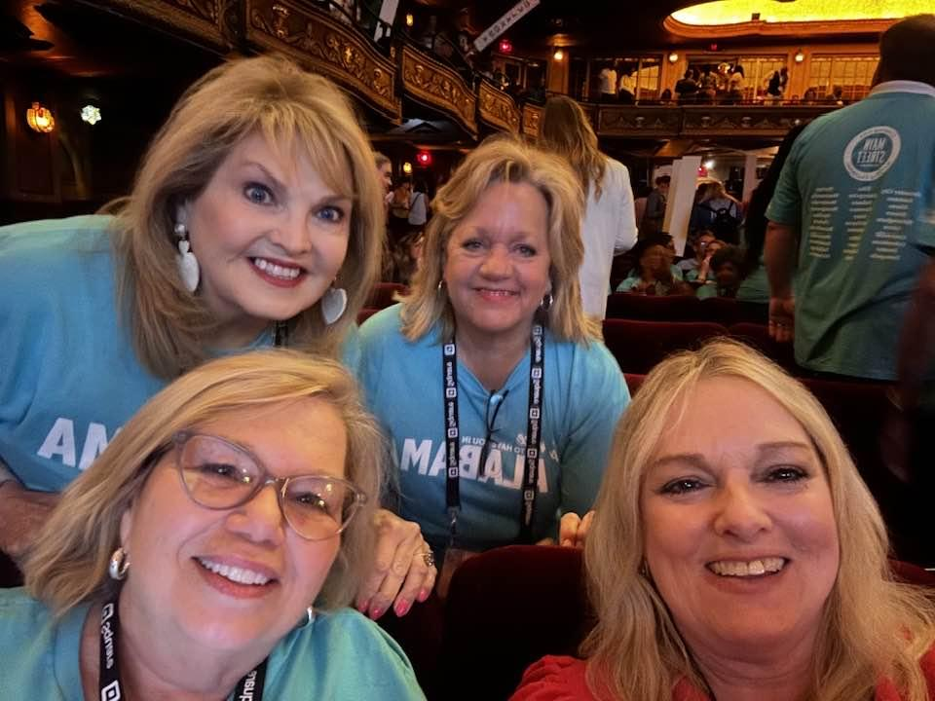
LOCATION MARKETING
Main Street Conference
May 6-8, 2024, Birmingham, AL
ALABAMA MOUNTAIN LAKES TOURIST ASSOCIATION

Slide 20
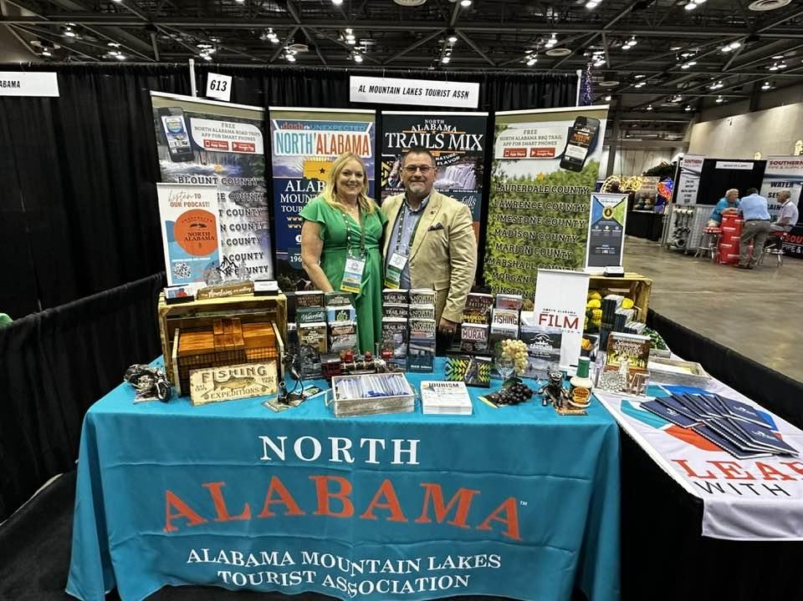
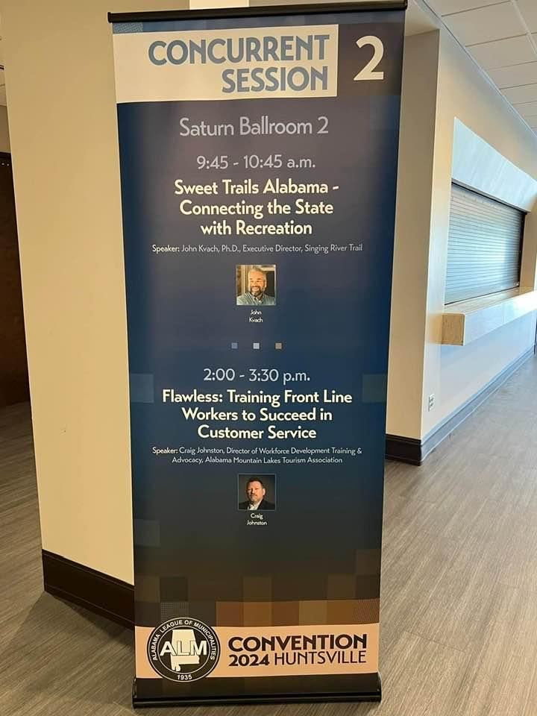
LOCATION MARKETING
Alabama League of Municipalities 2024 Convention
May 15-18, 2024, Huntsville, AL
ALABAMA MOUNTAIN LAKES TOURIST ASSOCIATION

Slide 21
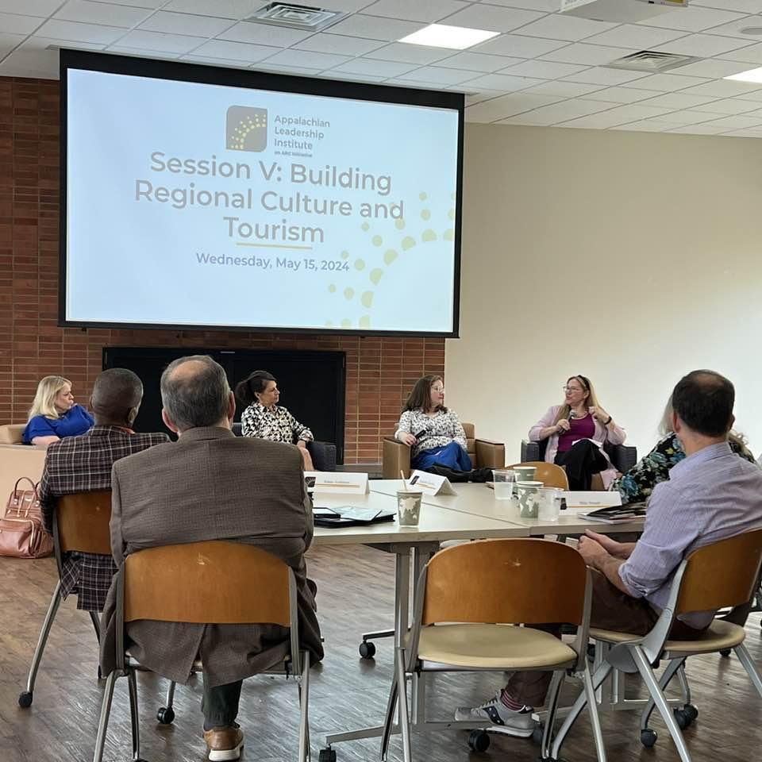
LOCATION MARKETING
Tami speaks on Appalachian Leadership Institute on Building Regional and Cultural Tourism
May 15, 2024, Berea, KY
ALABAMA MOUNTAIN LAKES TOURIST ASSOCIATION

Slide 22
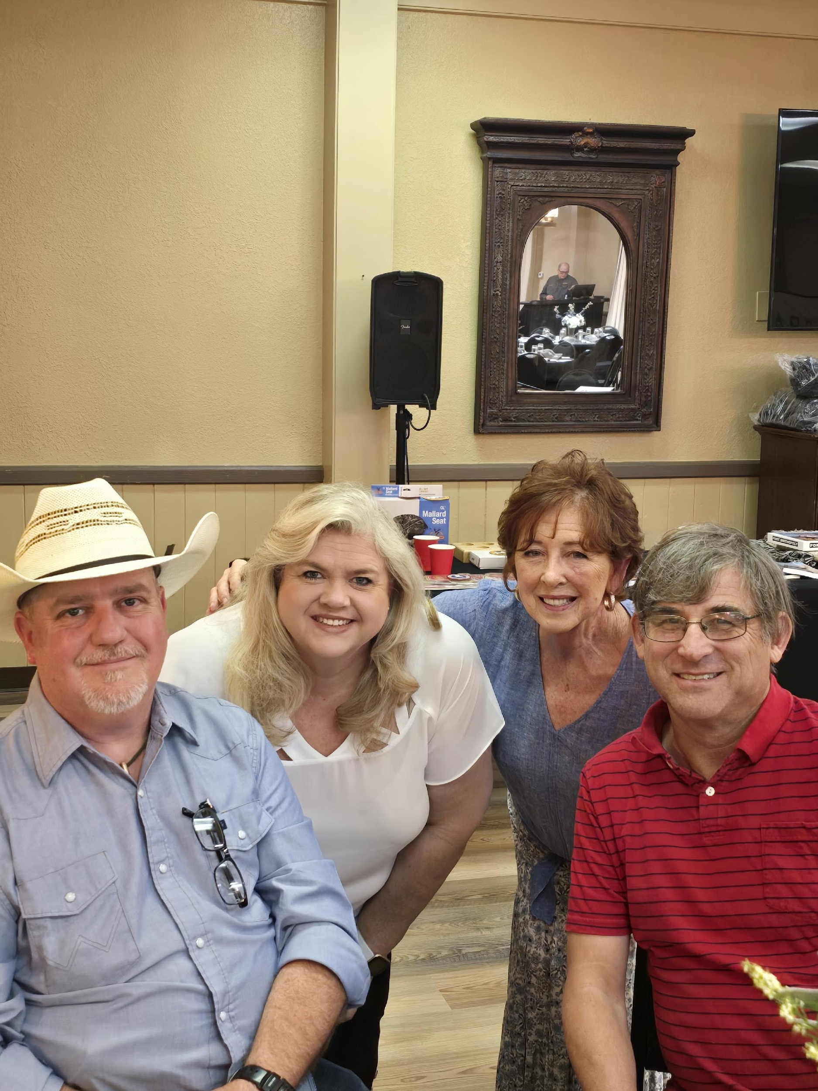
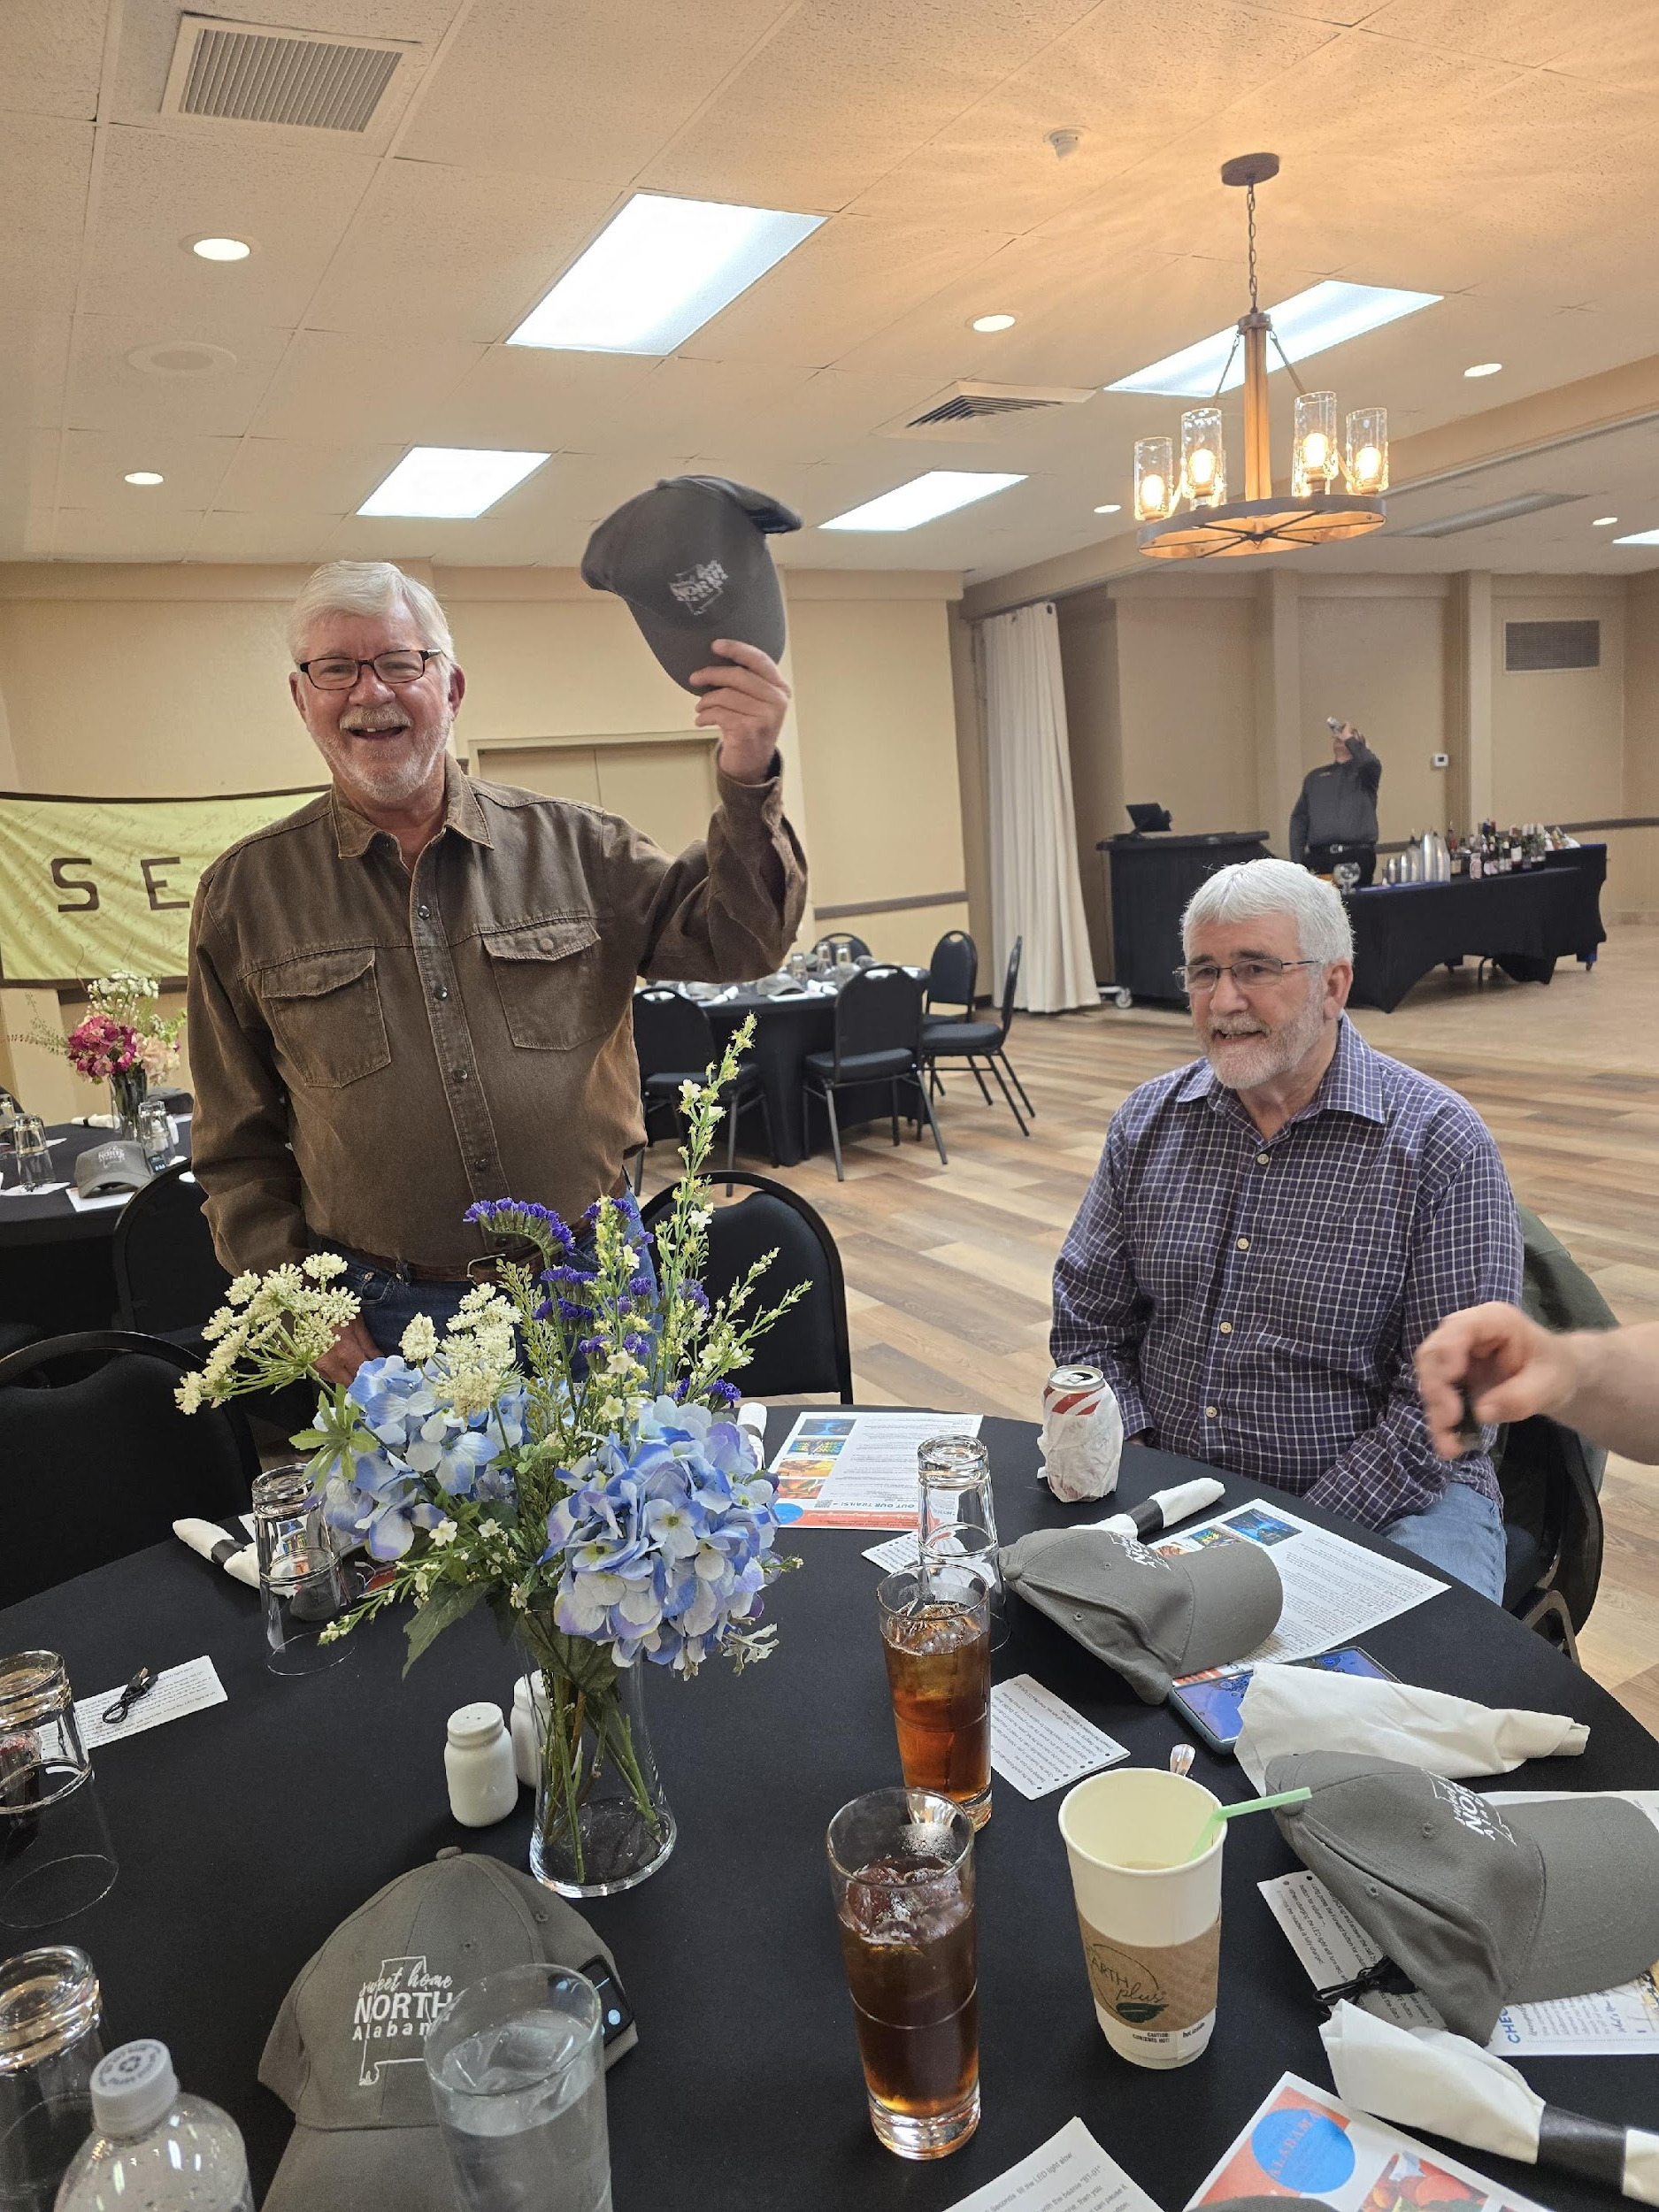
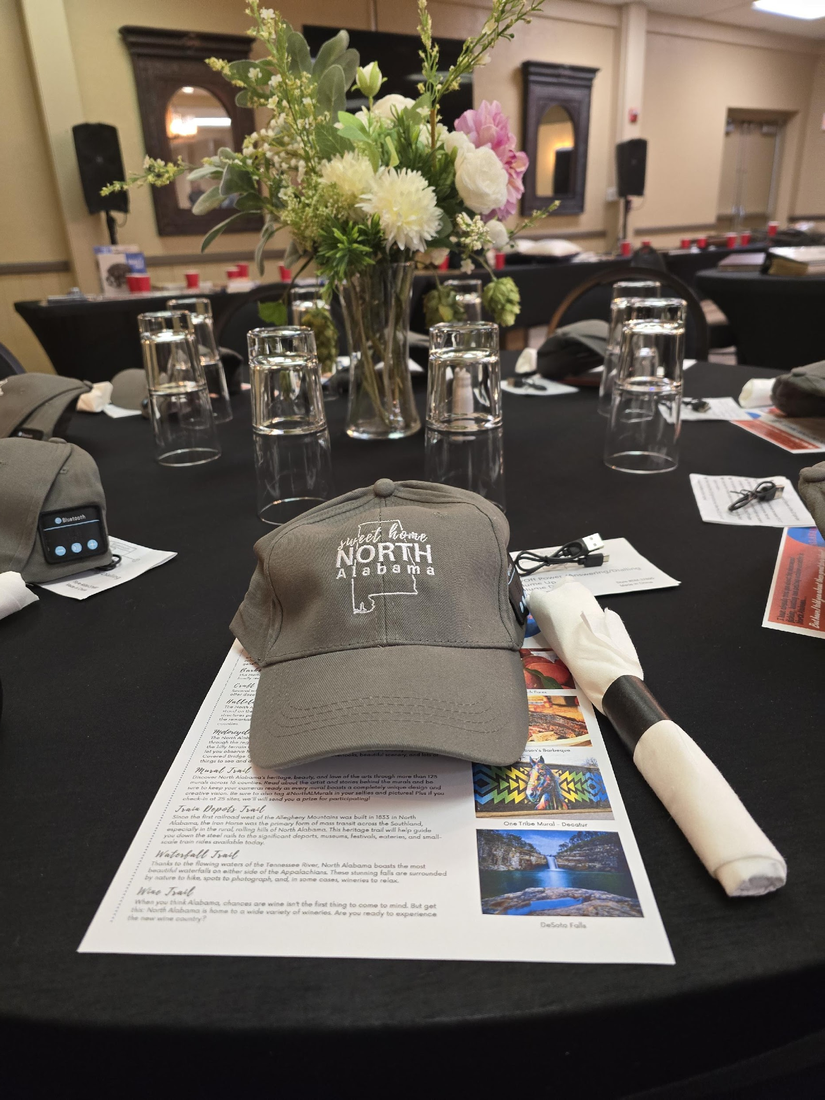
LOCATION MARKETING
AMLA hosted a dinner for OJEFA
(Outdoor Journalist Education Foundation of America)
May 16-19,2024, Fontana, NC
ALABAMA MOUNTAIN LAKES TOURIST ASSOCIATION

Slide 23
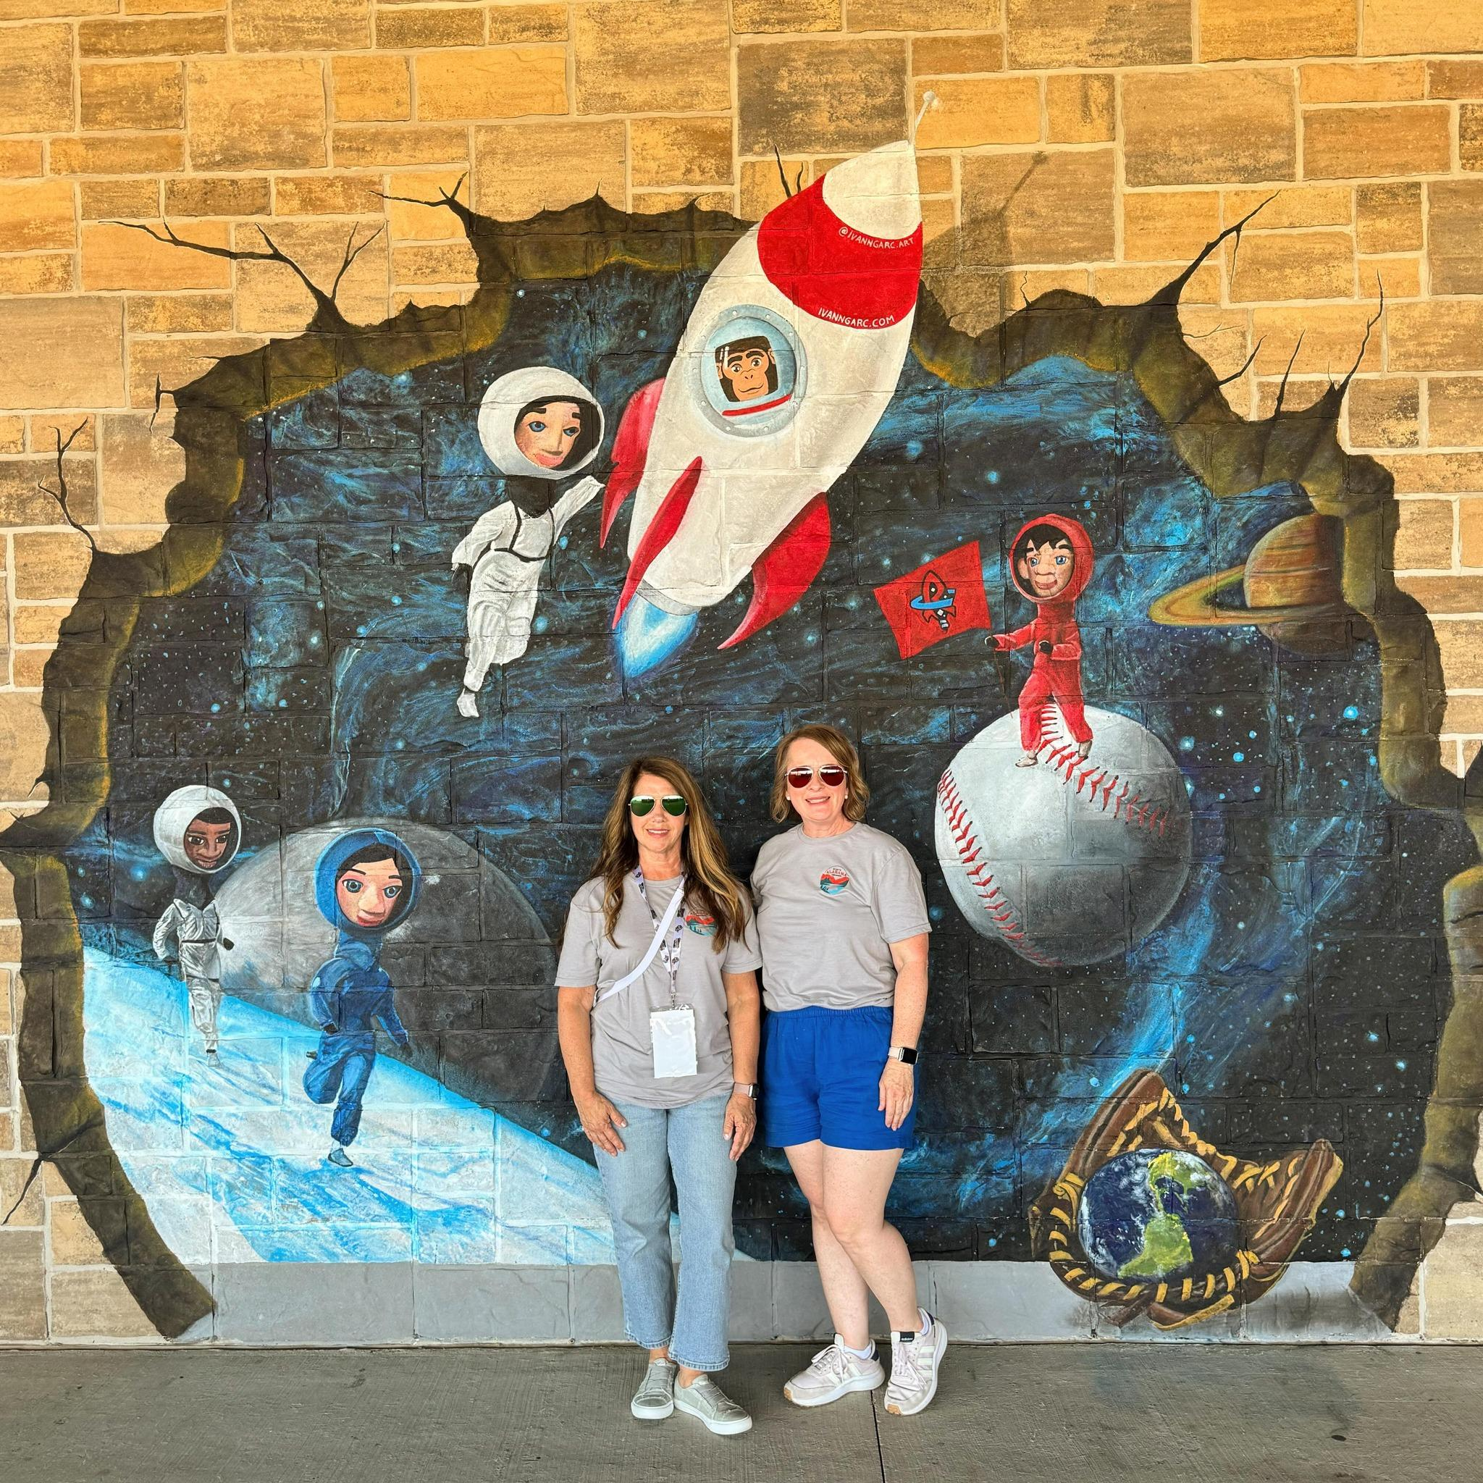
LOCATION MARKETING
Melea and Penne passed out swag at the Trash Panda’s game
May 21, 2024, Madison, AL
ALABAMA MOUNTAIN LAKES TOURIST ASSOCIATION

Slide 24
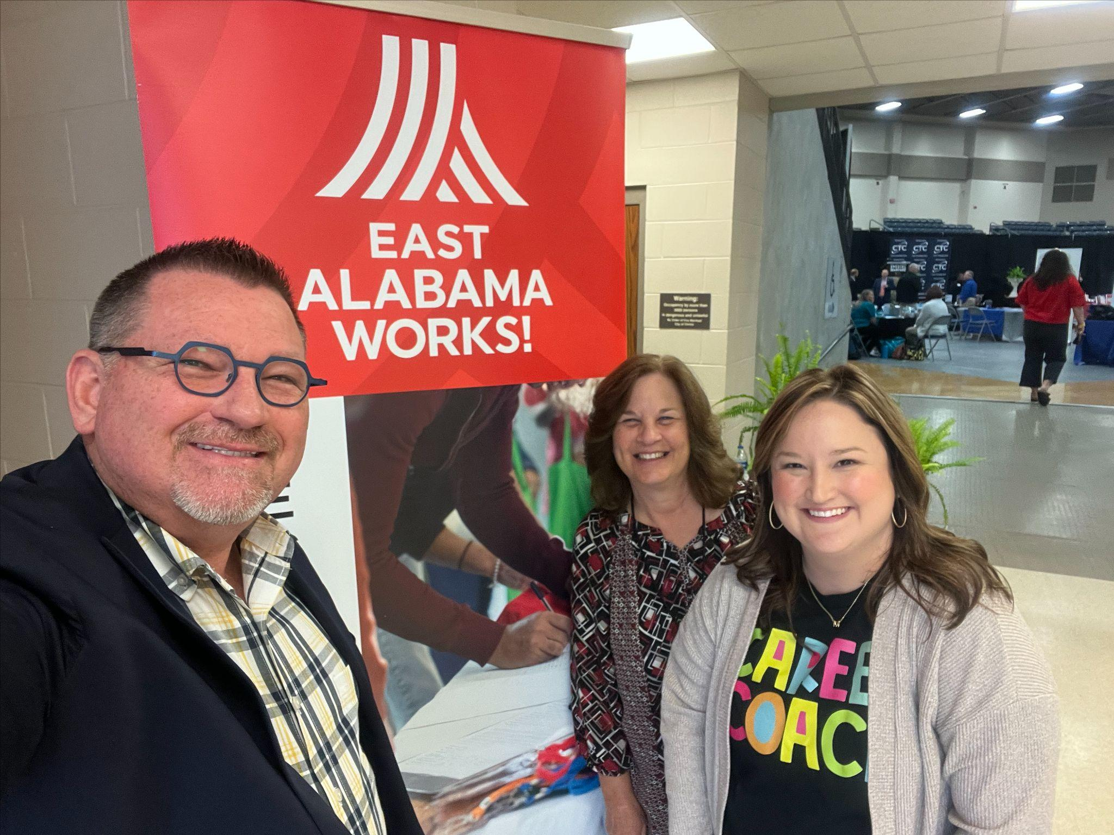
LOCATION MARKETING
World of WORKS (WOW) – Etowah, East AL works
ALABAMA MOUNTAIN LAKES TOURIST ASSOCIATION

Slide 25
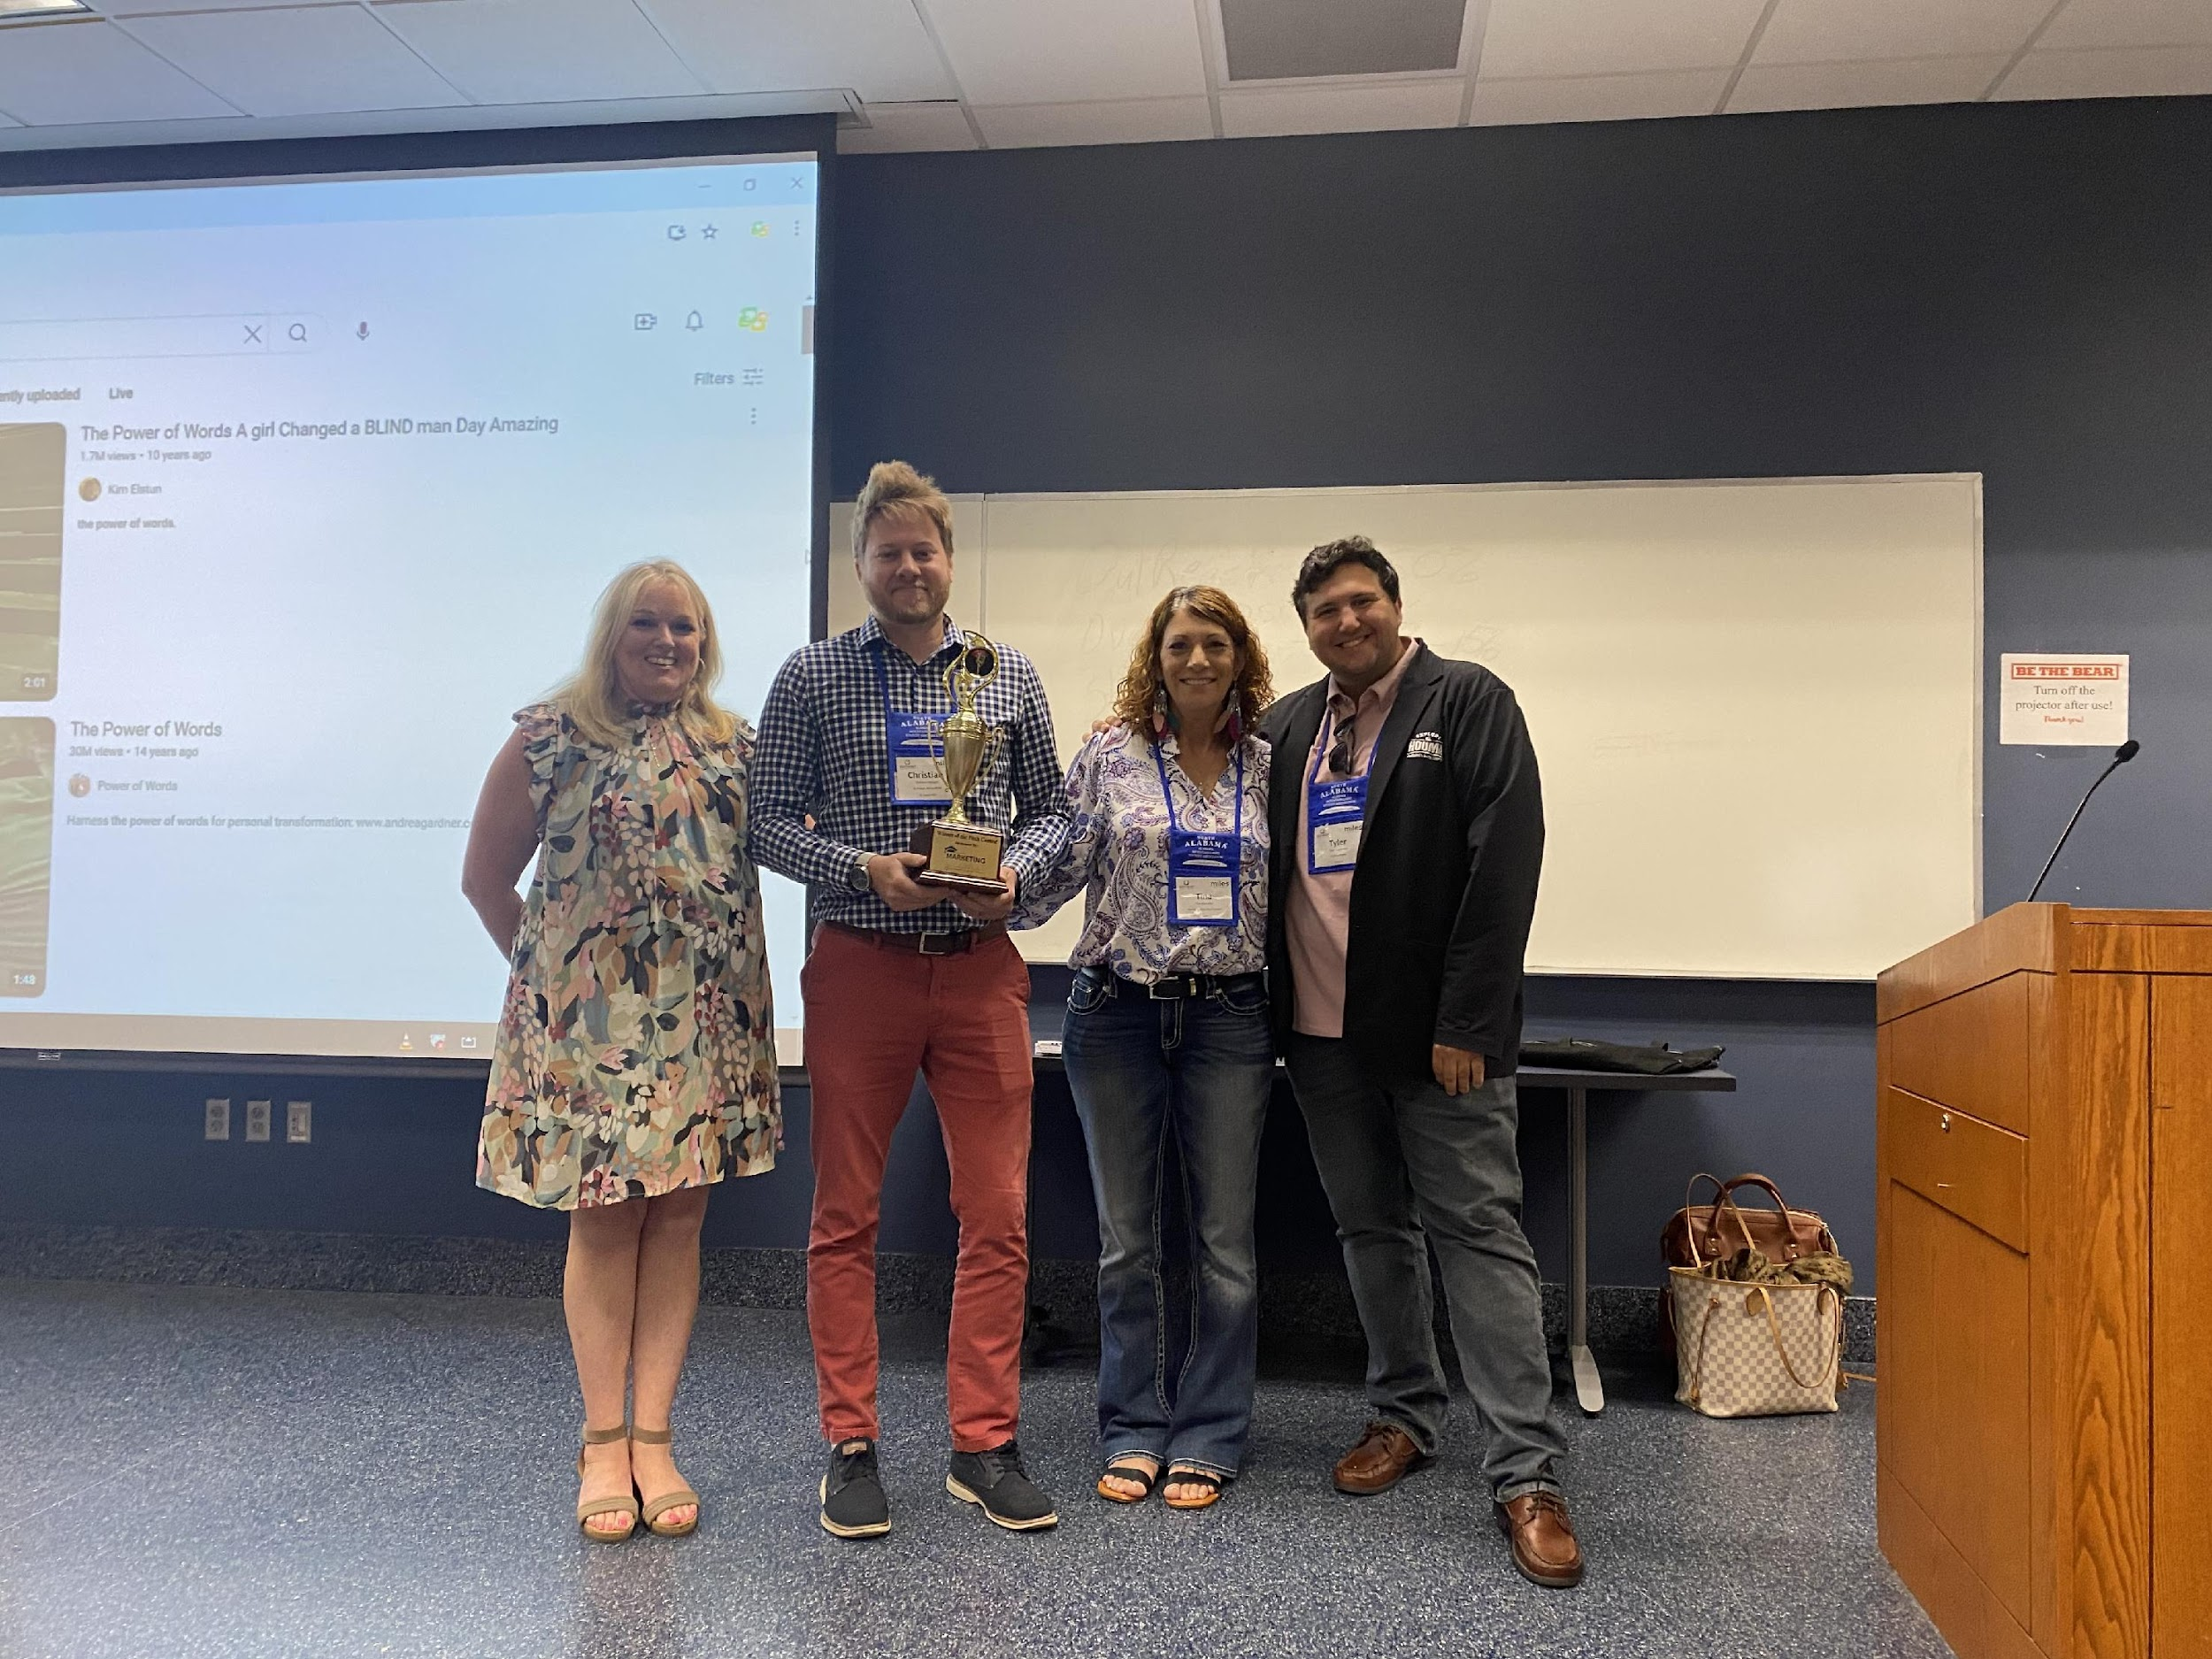
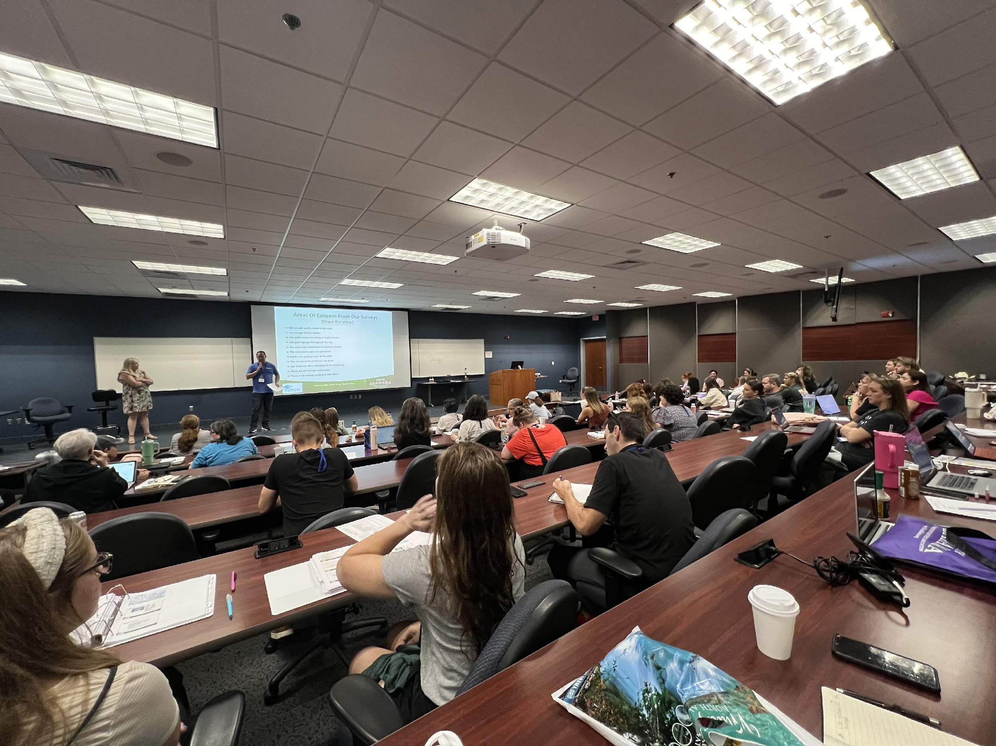
LOCATION MARKETING
AMLA President and CEO, Tami Reist teaches at STS Marketing College
Mercer College in Macon, Georgia
June 2 - 7, 2024
ALABAMA MOUNTAIN LAKES TOURIST ASSOCIATION

Slide 26
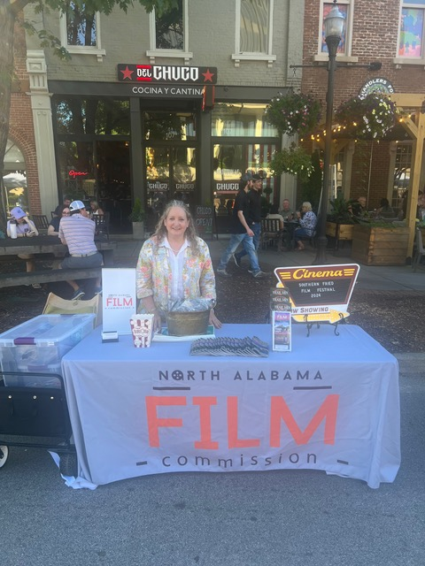
LOCATION MARKETING
Thereasa set up at the Southern Fried Film Festival Street Party
June 6-9, 2024
ALABAMA MOUNTAIN LAKES TOURIST ASSOCIATION

Slide 27
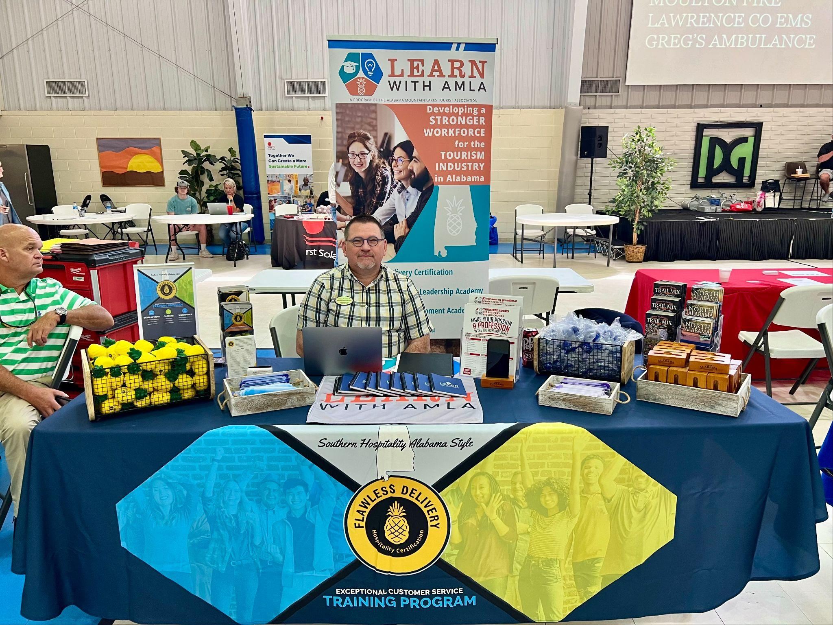
LOCATION MARKETING
Lawrence County Job Fair, sponsored by WOW
June 11, 2024, Moulton, AL
ALABAMA MOUNTAIN LAKES TOURIST ASSOCIATION

Slide 28
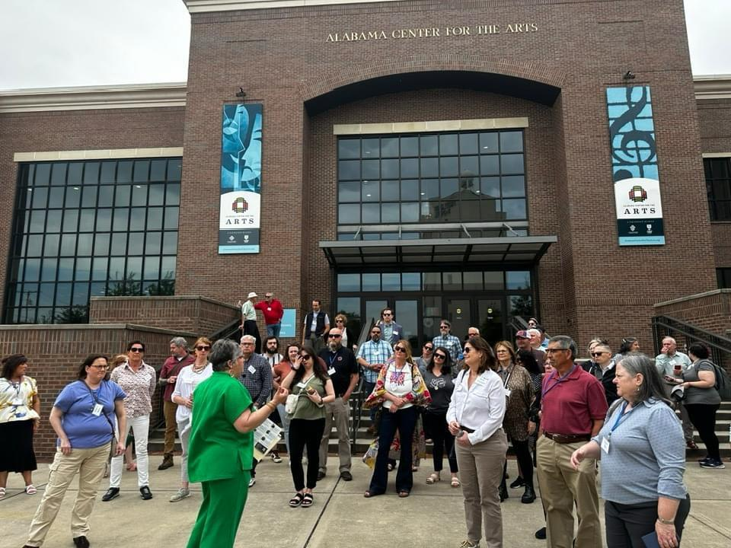
MEMBER SERVICES
APPALACHIAN GATEWAY COMMUNITIES INITIATIVE
Decatur, Alabama
ALABAMA MOUNTAIN LAKES TOURIST ASSOCIATION

Slide 29
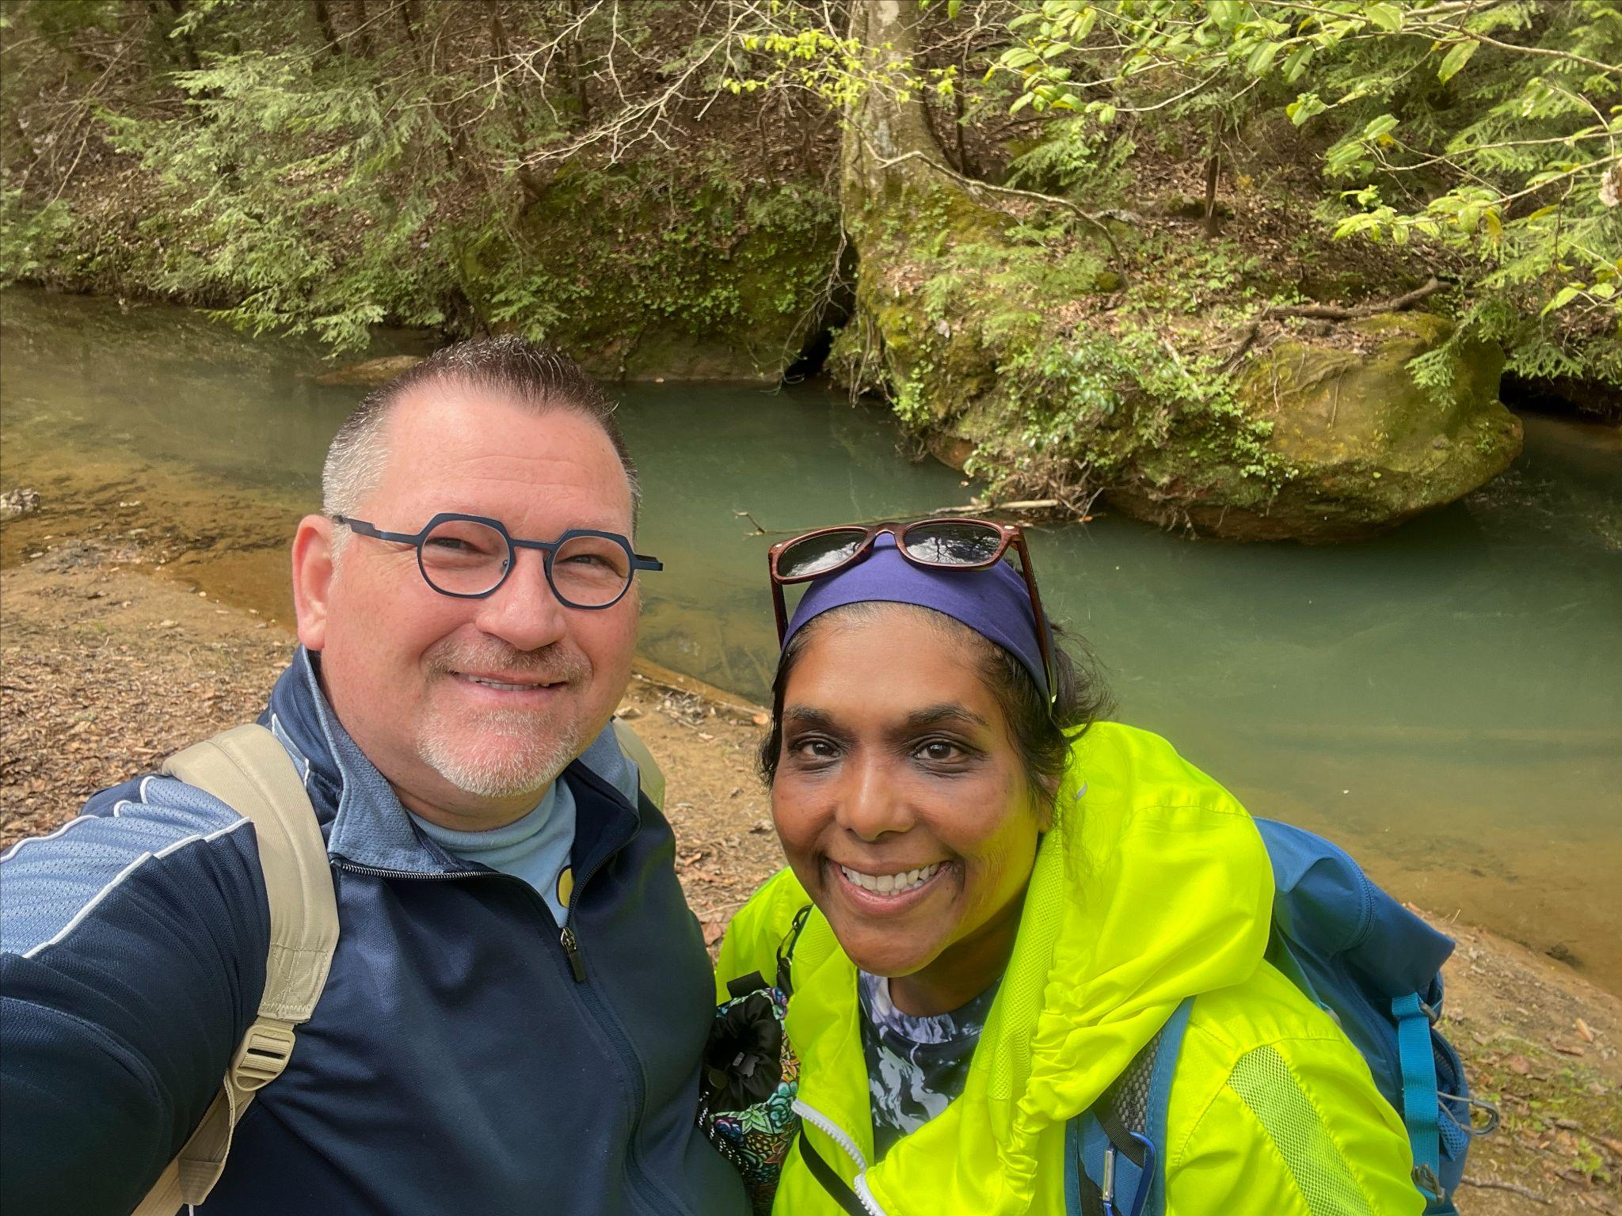
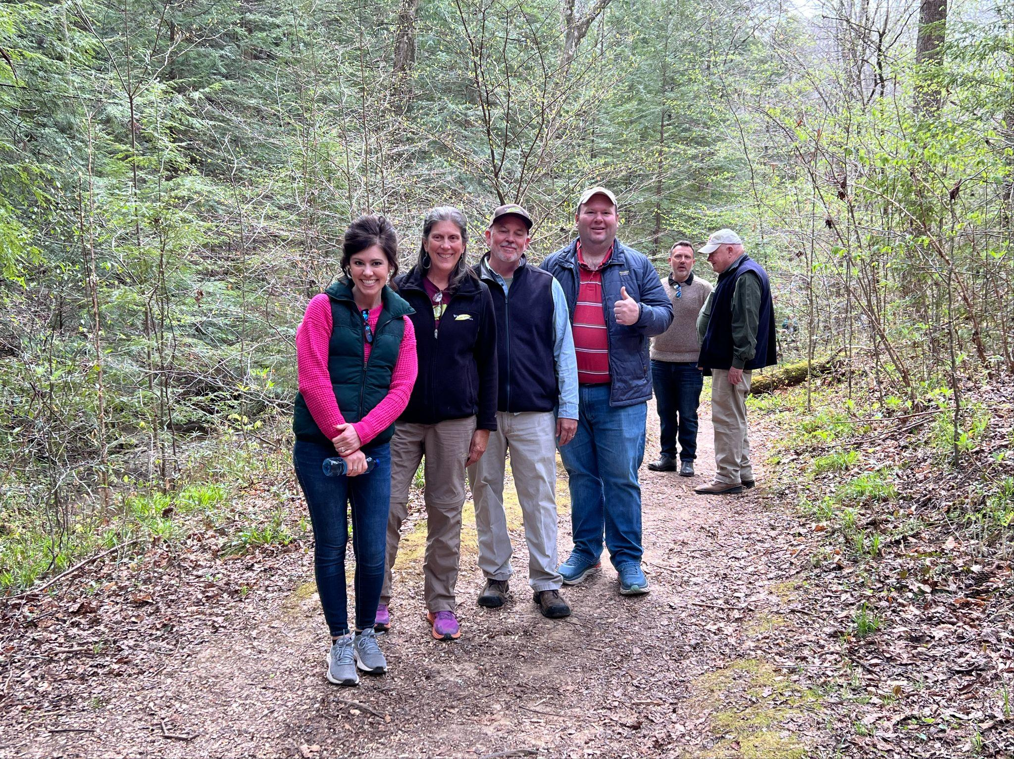
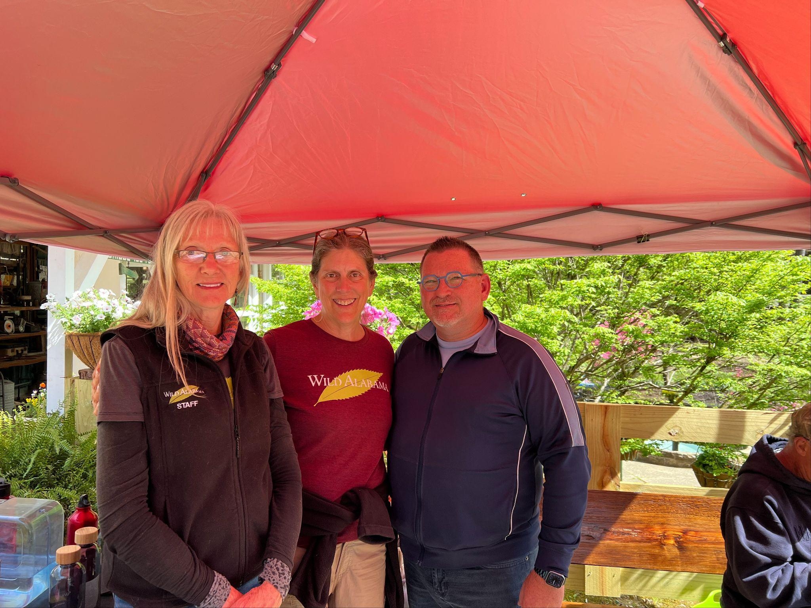
MEMBER SERVICES
Natural Bridge Membership Event
April 6, 2024
ALABAMA MOUNTAIN LAKES TOURIST ASSOCIATION

Slide 30
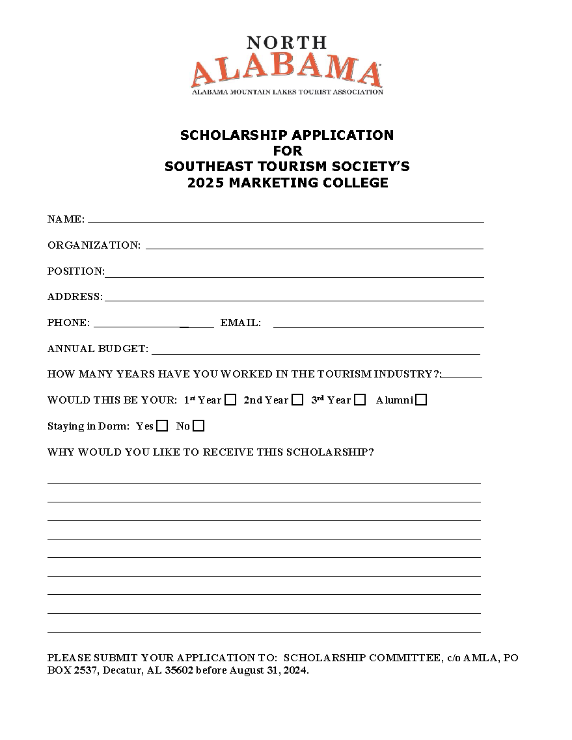
MEMBER SERVICES
STS SCHOLARSHIP APPLICATION TO STS 2025 MARKETING COLLEGE DUE AUGUST 31, 2024
ALABAMA MOUNTAIN LAKES TOURIST ASSOCIATION

Slide 31
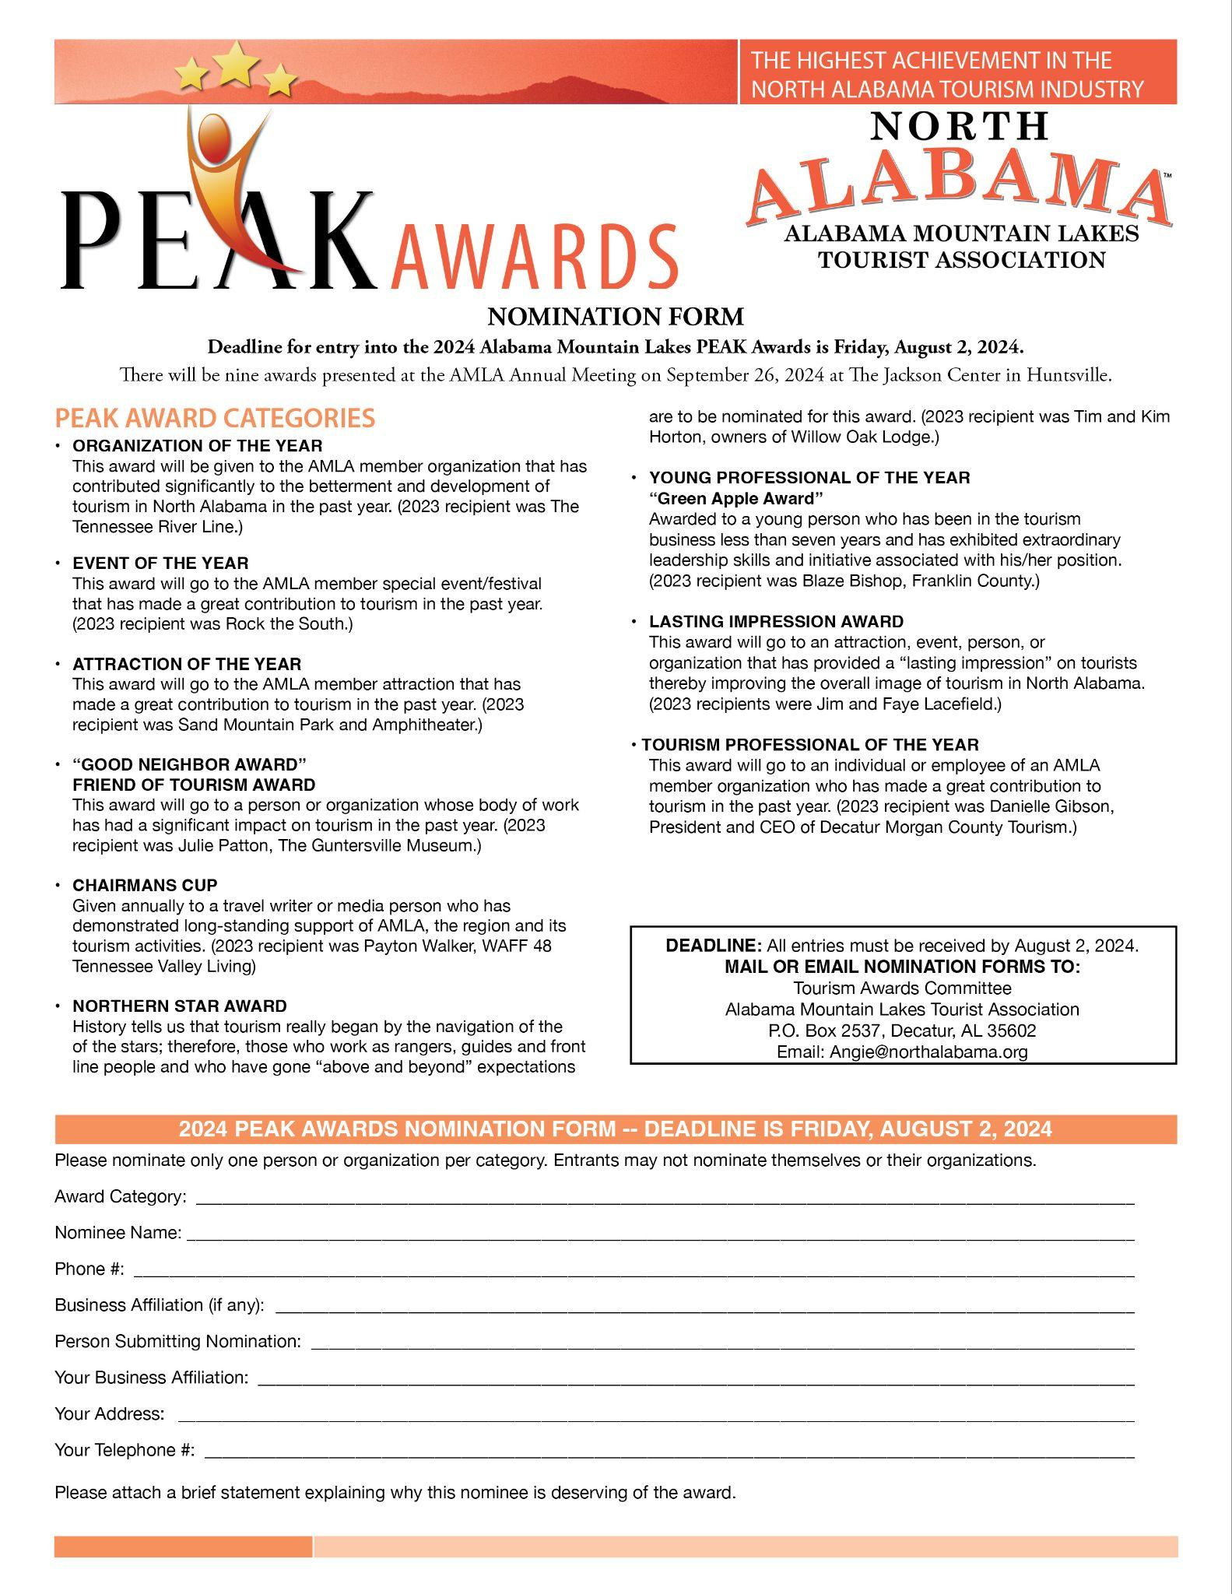
MEMBER SERVICES
2024 PEAK AWARD NOMINATIONS
DUE AUGUST 2, 2024
ALABAMA MOUNTAIN LAKES TOURIST ASSOCIATION

Slide 32
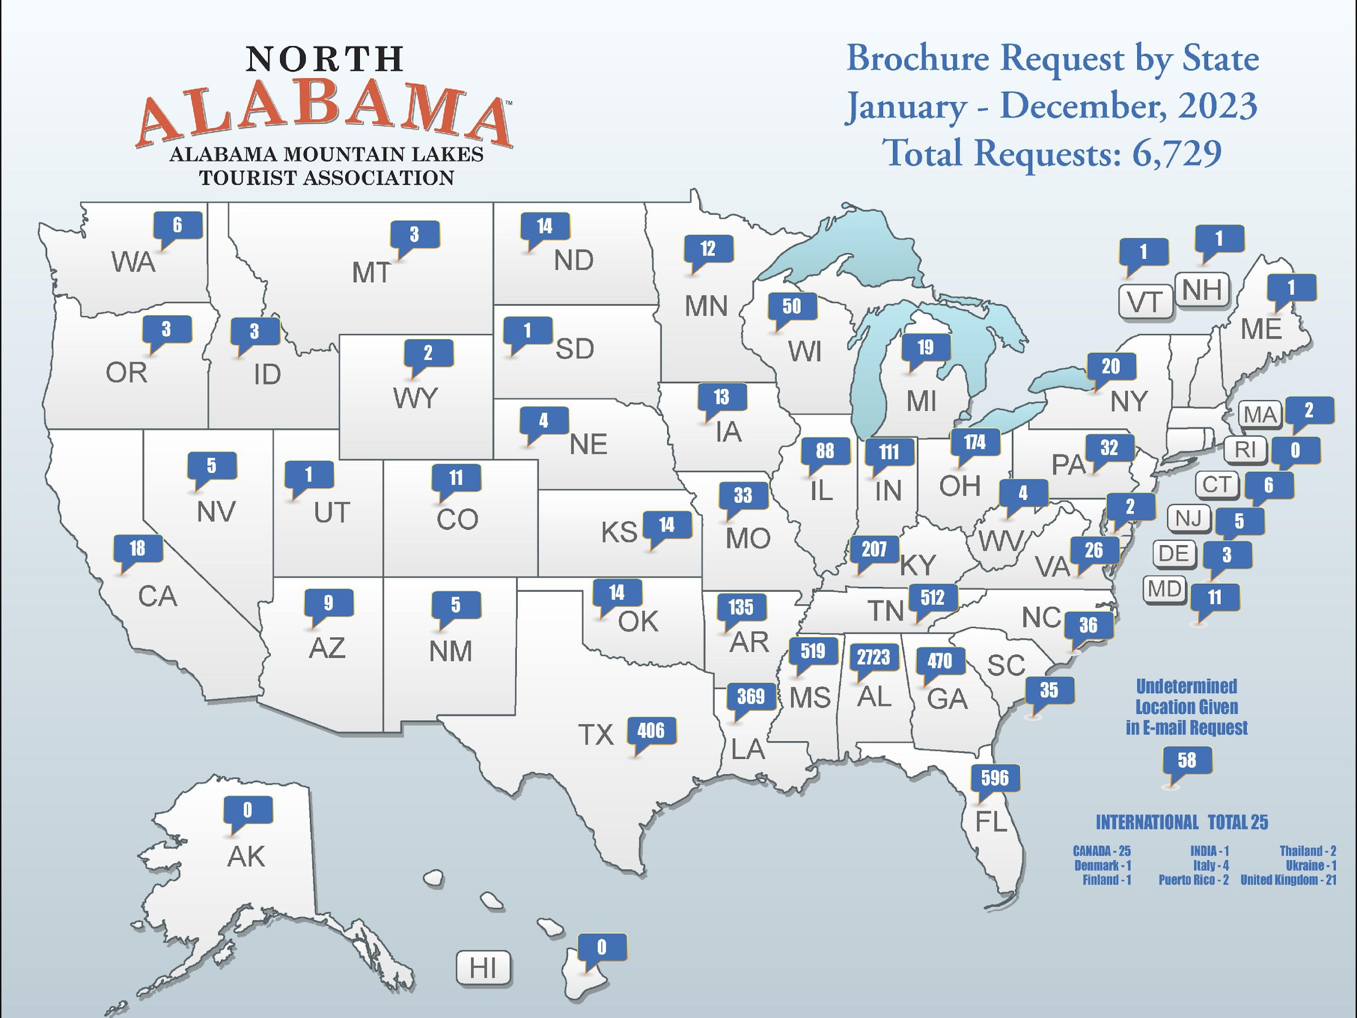
MEMBER SERVICES
RESEARCH TRACKING BROCHURE REQUESTS IN 2023
ALABAMA MOUNTAIN LAKES TOURIST ASSOCIATION

Slide 33
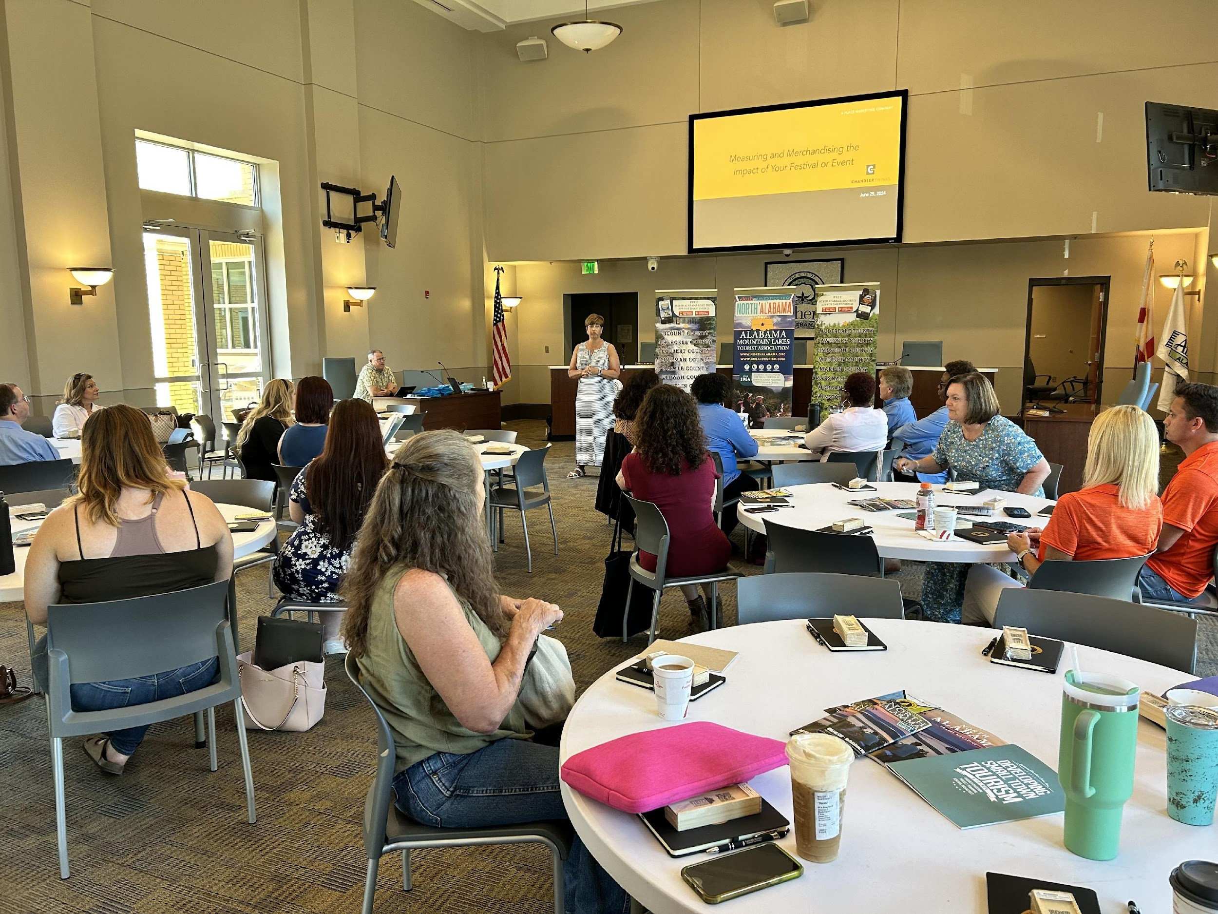
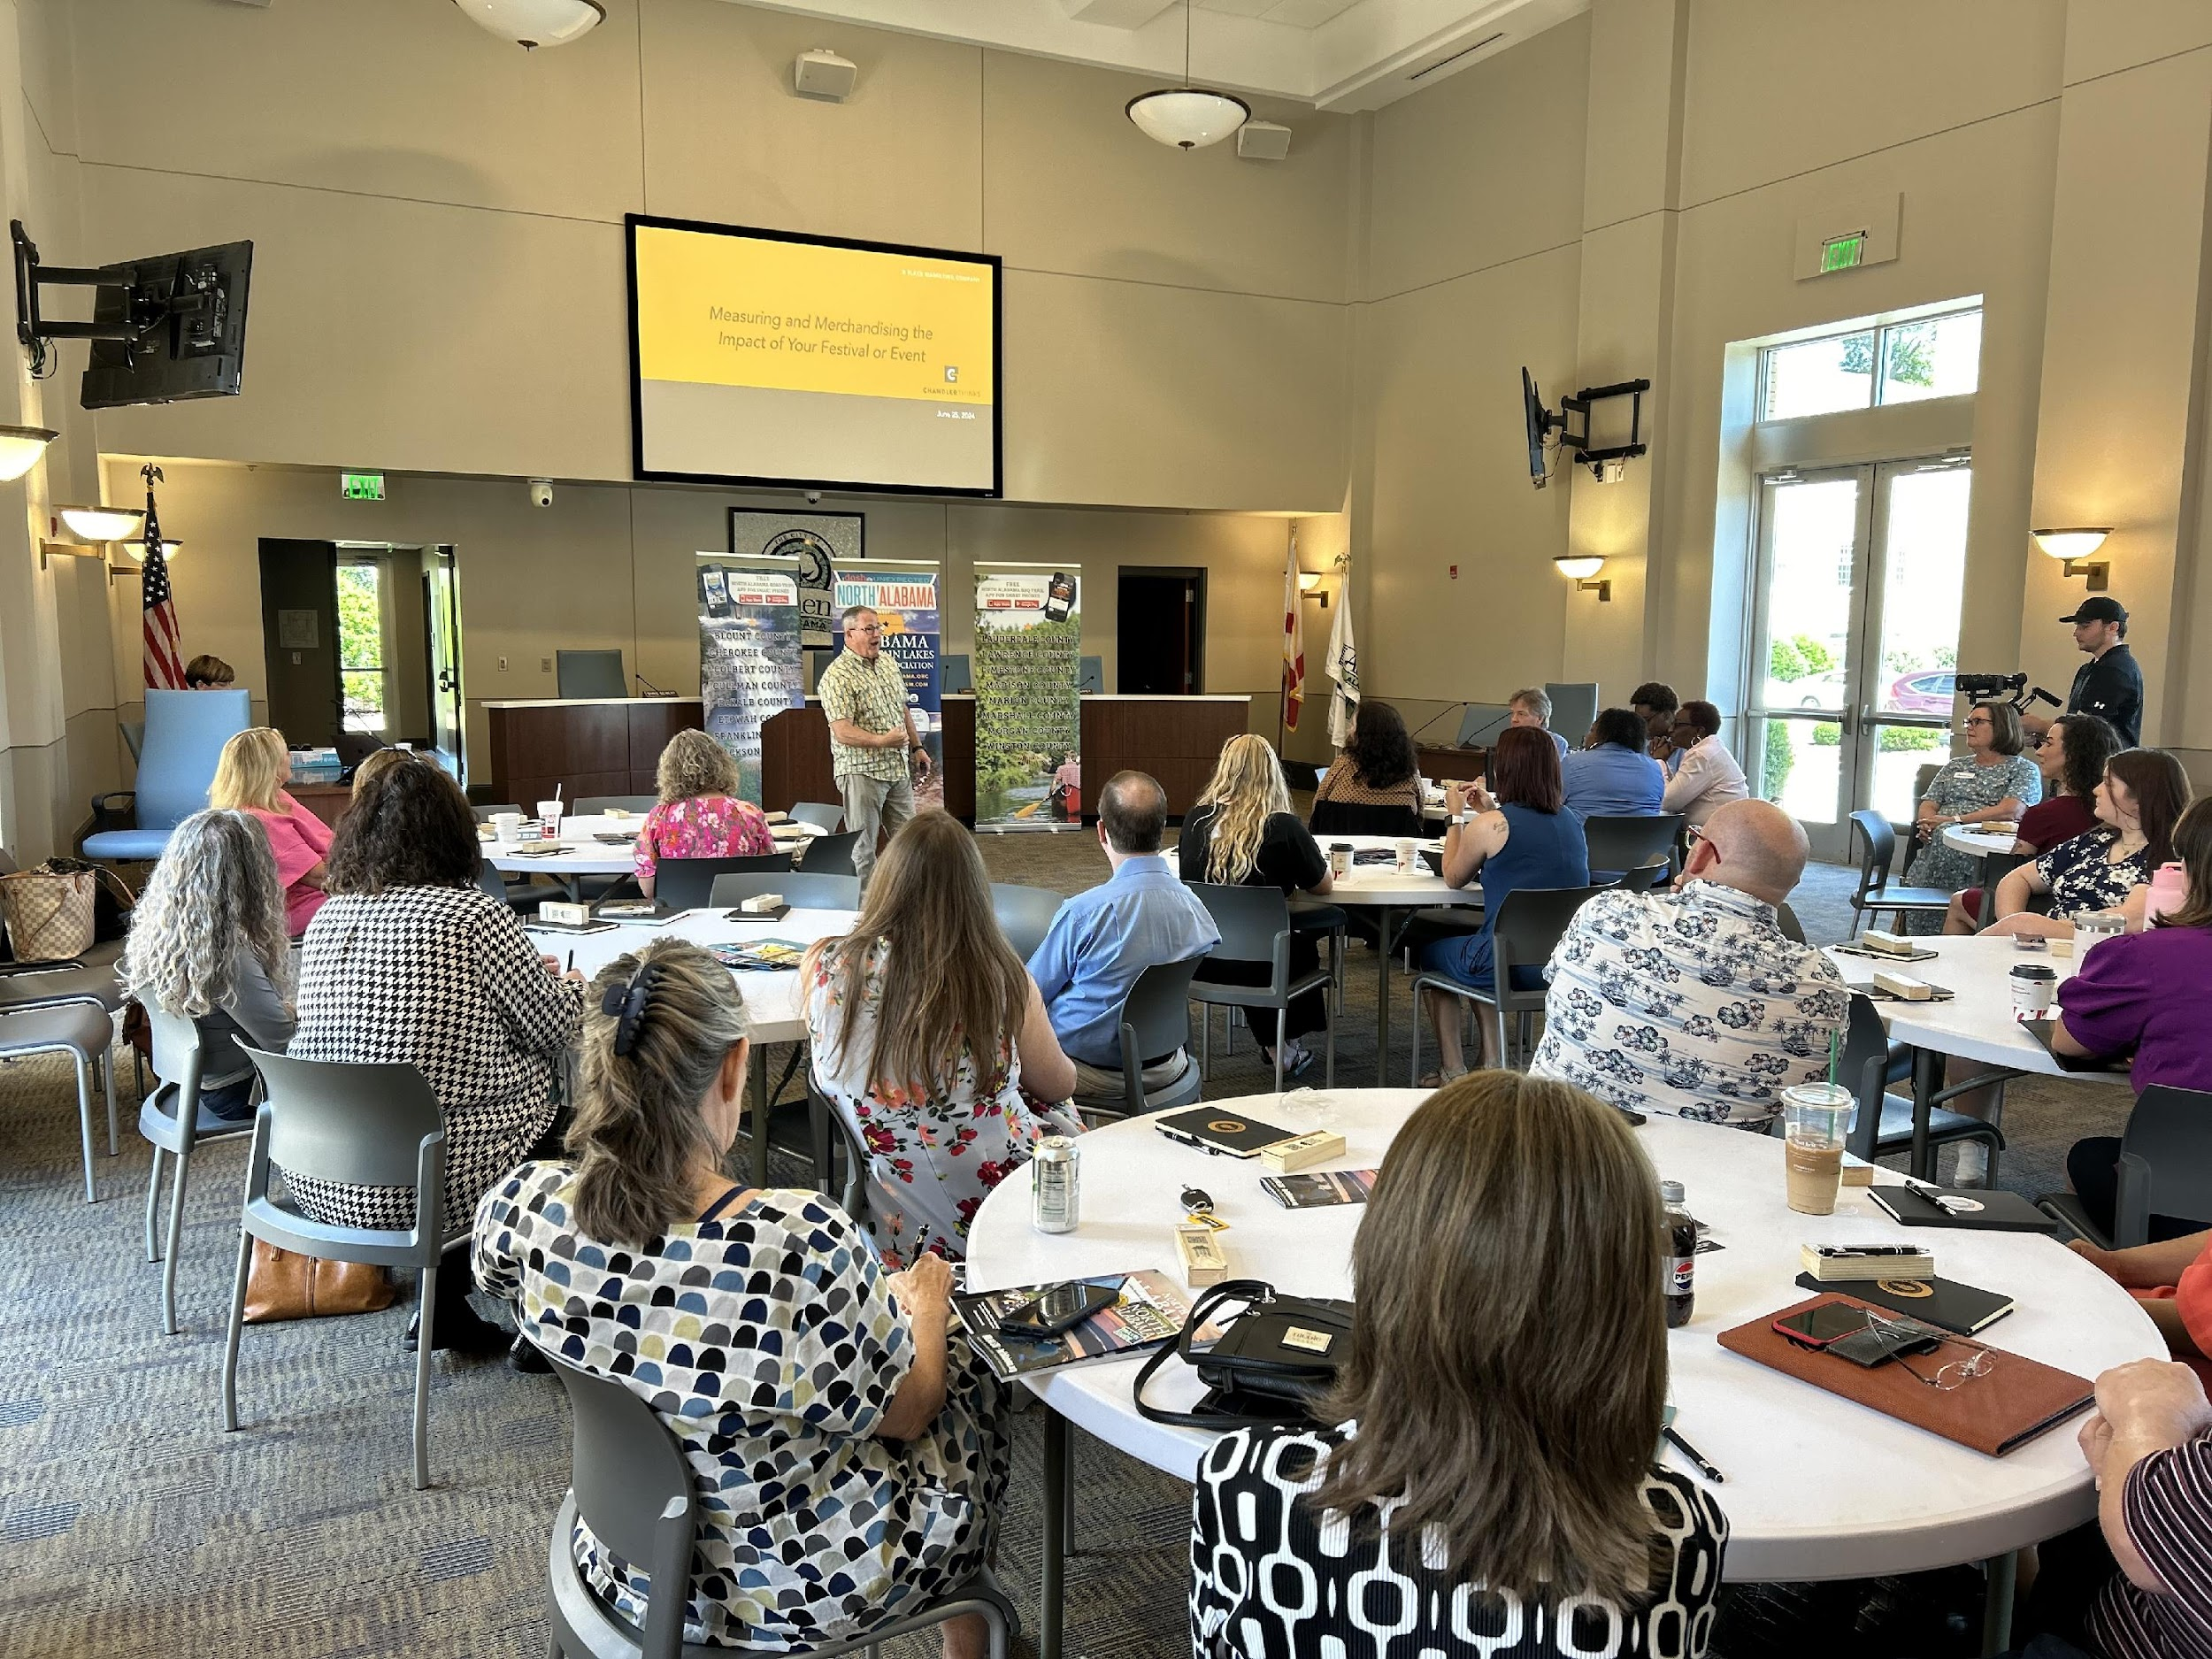
MEMBER SERVICES
Special Event & Festival Seminar
June 25, 2024
10 a.m. - 2 p.m.
Athens City Hall
200 West Hobbs Street, Athens, AL
ALABAMA MOUNTAIN LAKES TOURIST ASSOCIATION

Slide 34
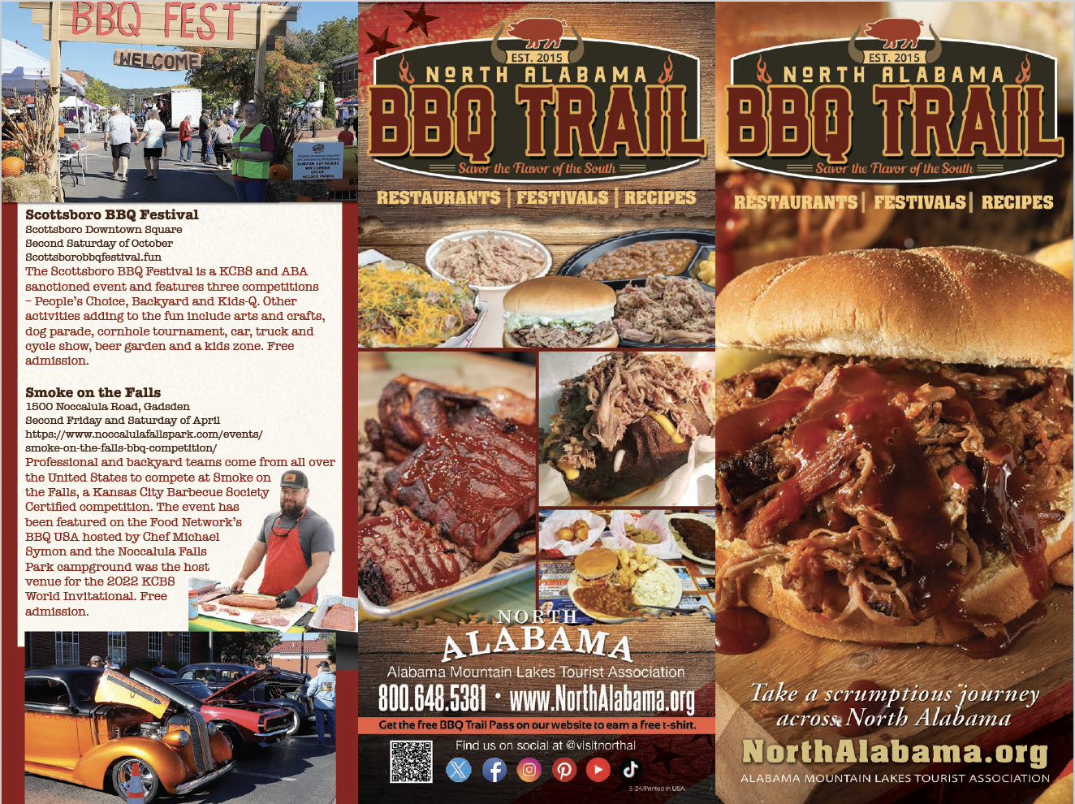
MARKETING
NEWLY UPDATED BBQ TRAIL BROCHURE
ALABAMA MOUNTAIN LAKES TOURIST ASSOCIATION

Slide 35
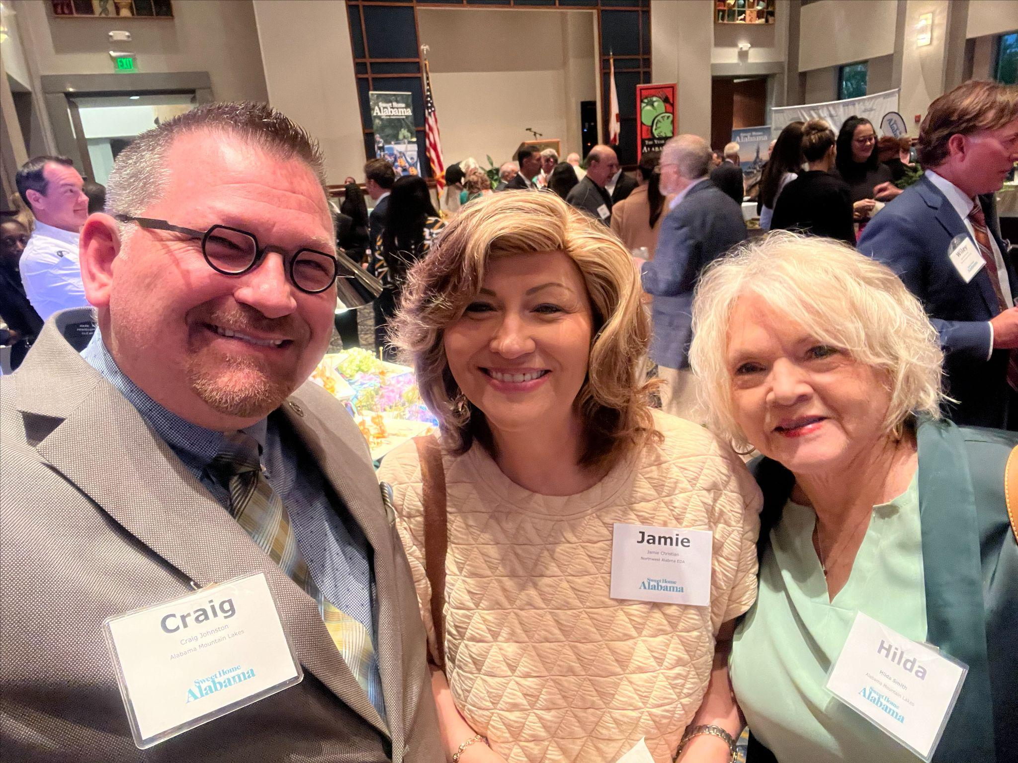
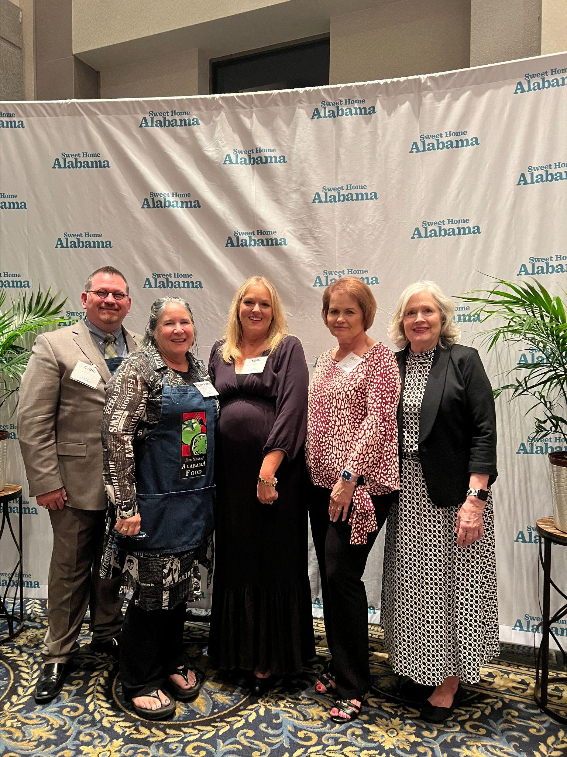
ADVOCACY
Sweet Home Alabama Tourism Bash
April 10, 2024
ALABAMA MOUNTAIN LAKES TOURIST ASSOCIATION

Slide 36
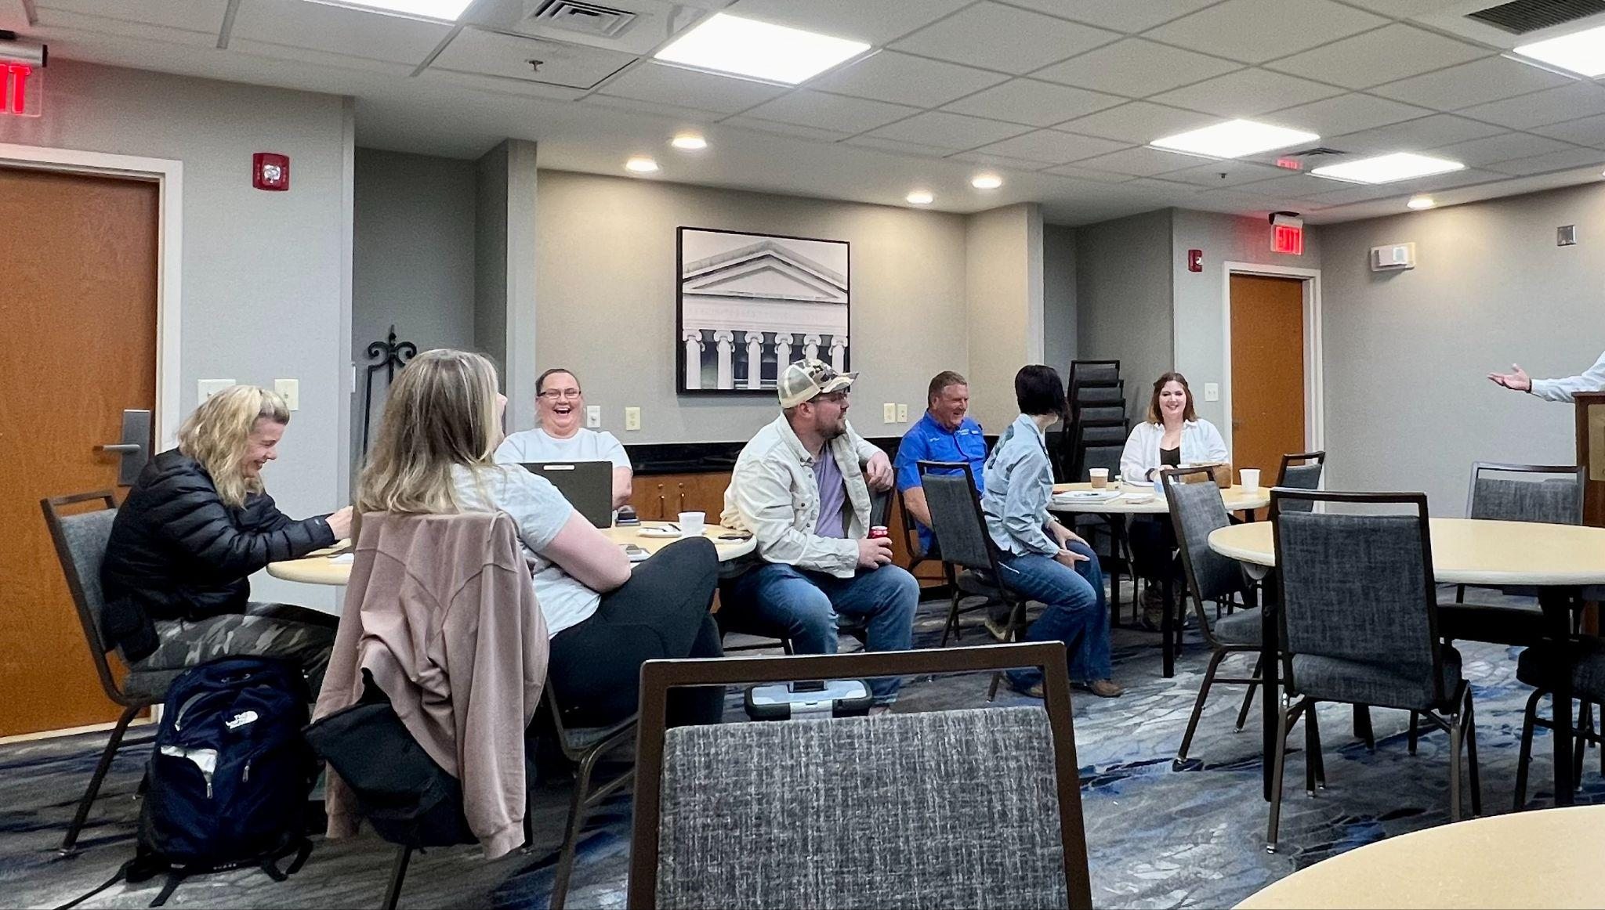
ADVOCACY
Craig spoke on Marketing and Advocacy for
National Association of RV parks and campgrounds Group 20
April 22, 2024, Gadsden Alabama
ALABAMA MOUNTAIN LAKES TOURIST ASSOCIATION

Slide 37
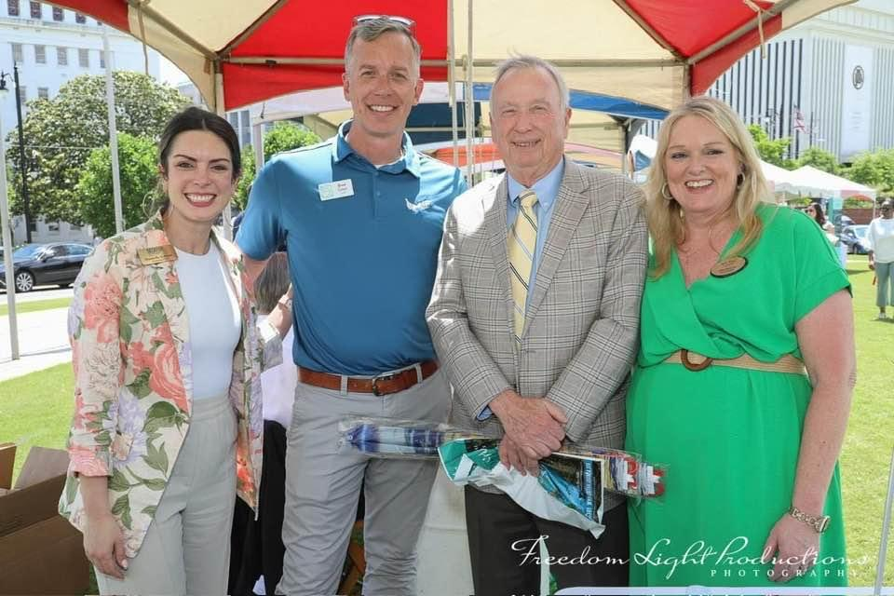
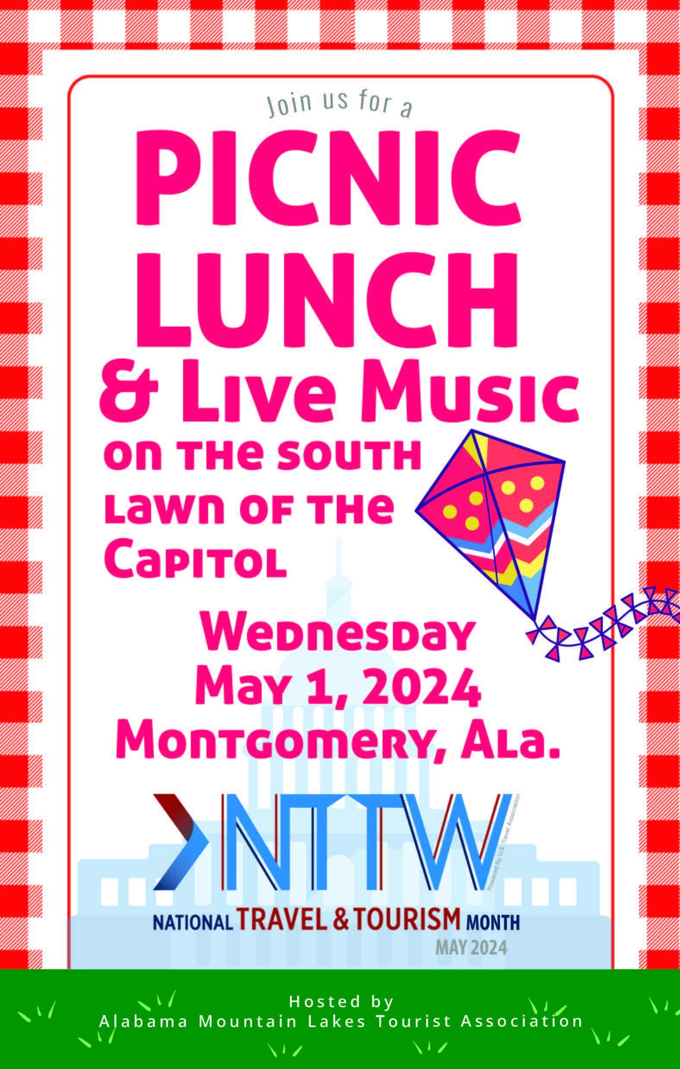
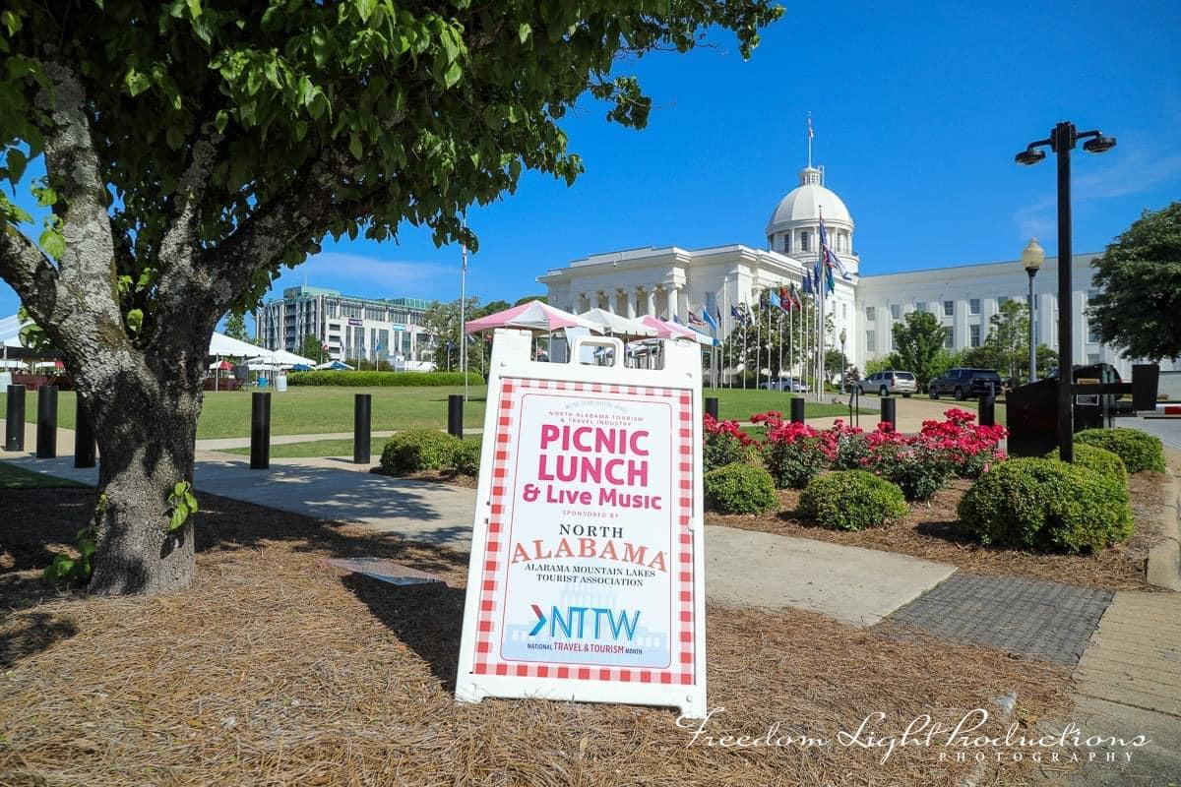
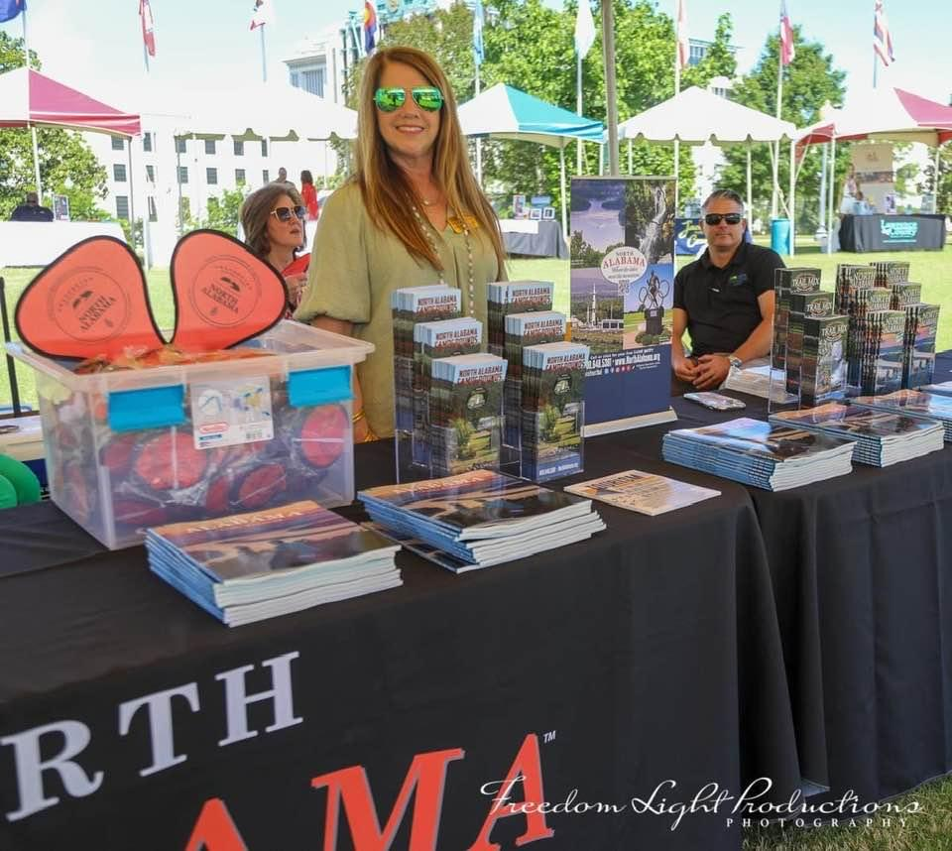
LOCATION MARKETING
Picnic on the Lawn
May 1, 2024, Montgomery, AL
ALABAMA MOUNTAIN LAKES TOURIST ASSOCIATION

Slide 38
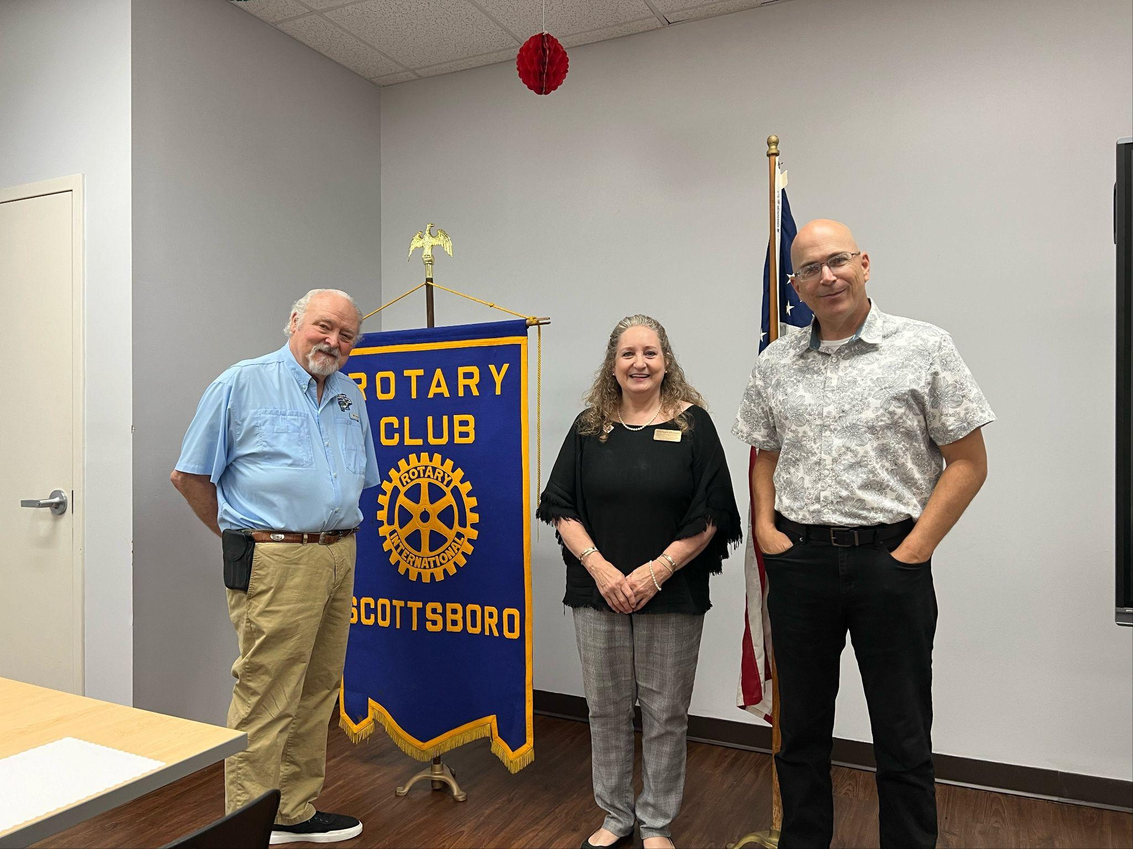
ADVOCACY
Thereasa spoke to Scottsboro Rotary Club
June 5, 2024, Scottsboro, Alabama
ALABAMA MOUNTAIN LAKES TOURIST ASSOCIATION

Slide 39
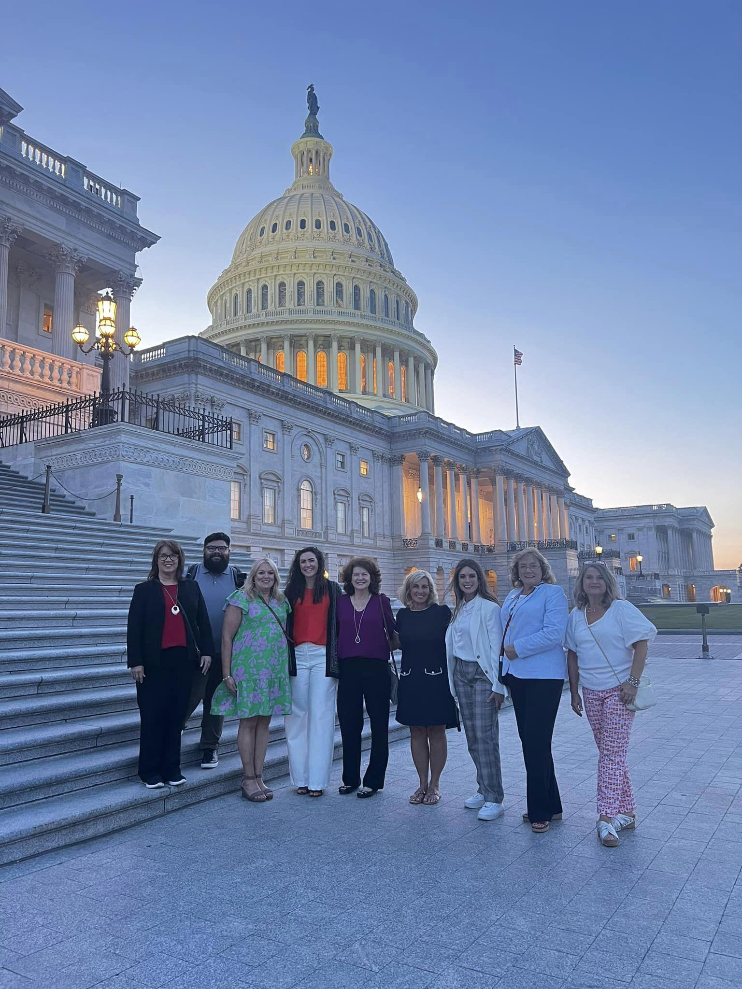
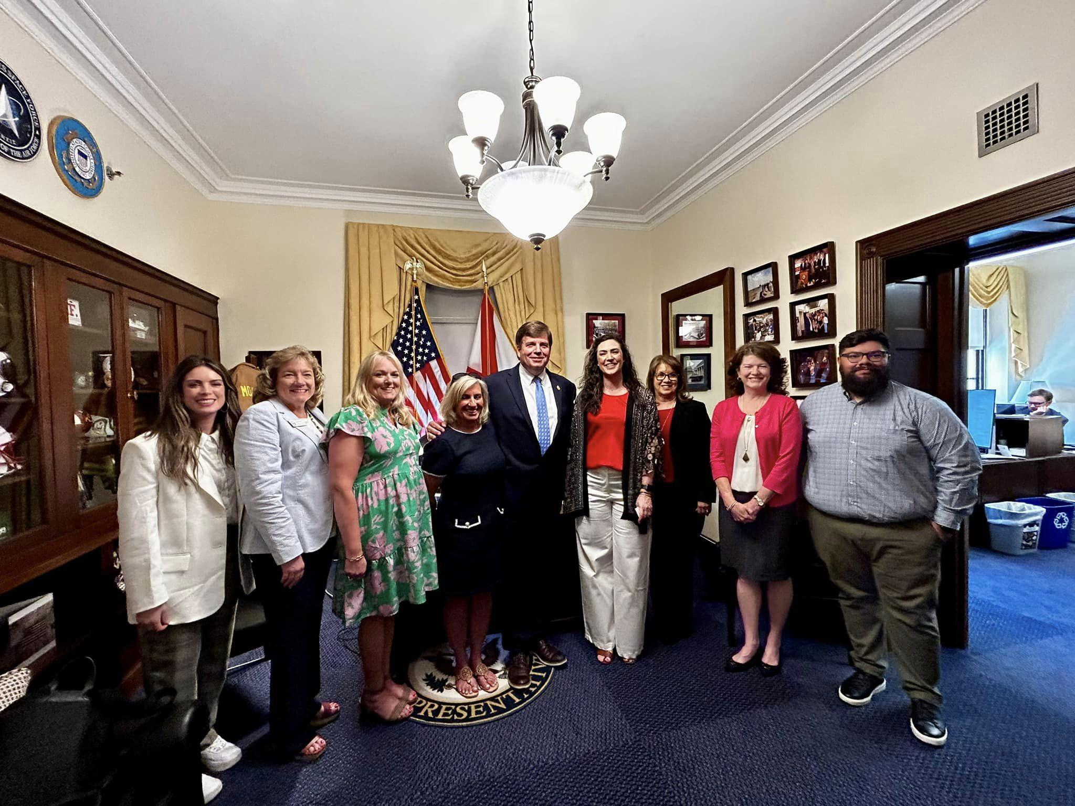
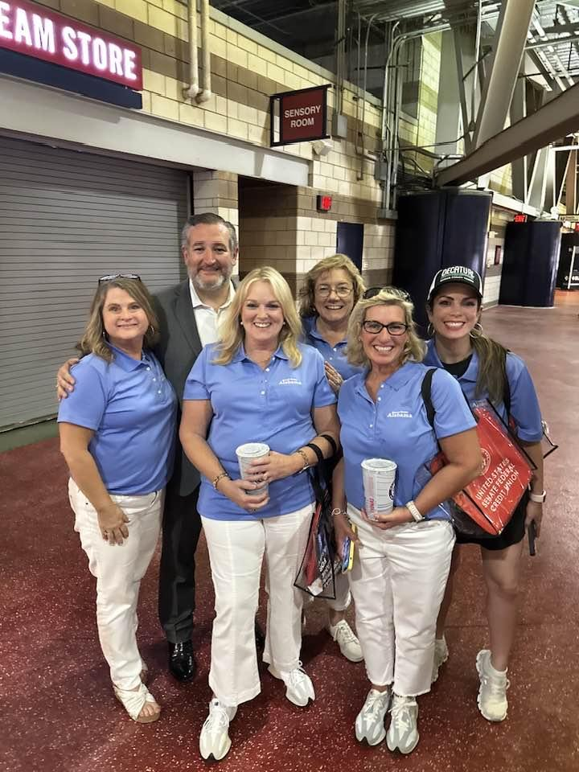
ADVOCACY
“Team Alabama” Visits Washington DC
for Tourism Advocacy
June 10-14 2024, Washington, D.C.
ALABAMA MOUNTAIN LAKES TOURIST ASSOCIATION

Slide 40
ADVOCACY
Check given to Good Culture on behalf of
Alabama Lakes Tourist Association & Flawless Delivery
ALABAMA MOUNTAIN LAKES TOURIST ASSOCIATION

Slide 41
AROUND THE REGION
Florence, AL Invests in the Future of Tourism
Civitas announced the establishment of the Florence Tourism Improvement District (FTID)
The FTID will have an assessment rate of 4%, which will bring in an additional $1,030,539 annually for Florence/Lauderdale Tourism
The FTID will deliver a variety of services aimed at promoting Florence as a prime destination, including the creation of festivals and events to attract visitors, the production of tourist-related marketing materials, and destination development projects
ALABAMA MOUNTAIN LAKES TOURIST ASSOCIATION

Slide 42
AROUND THE REGION
Tami Reist featured in Alabama Magazine
“If there was a cheerleading squad for all things North Alabama, Tami Reist would be the leader. In a way, she already is, in her capacity as president and CEO of the Alabama Mountain Lakes Tourism Association, which represents 16 counties in the northern half of the state and generates more than $4.3 billion in travel expenditures annually. The Decatur native has 40 years of experience in the tourism and hospitality industry.”
Scan for article:
ALABAMA MOUNTAIN LAKES TOURIST ASSOCIATION

Slide 43
AROUND THE REGION
AMLA attends Athens-Limestone Chamber’s Black and White Gala
April 25, 2024, Athens, AL
ALABAMA MOUNTAIN LAKES TOURIST ASSOCIATION

Slide 44
APRIL PRESIDENT’S REPORT
MEMBER SERVICES
Met with our Membership Services Team (drivers) and discussed several topics about their job. Thereasa, Angie and Penne also attended the meeting.
The ARC and The Appalachian Gateway Communities Initiative 2024 Training and Funding event was amazing. We worked with the event planner on the meeting which was held in Decatur, Alabama at The Doubletree by Hilton April 15th – 18th. We incorporated Morgan, Lawrence and Limestone counties in our excursions. We had 55 people attend the meeting. We have received great feedback on the event.
Finalized the agenda for the Association of Tennessee Valley Government Planners . This conference will be held in Florence June 18th-20th. Joe Ritch, Chairman of the TVA Board, will be speaking at the meeting.
Attended our state quarterly board meeting in Montgomery. We celebrated Lee Sentell’s 80th Birthday. Alabama Mountain Lakes Tourist Association purchased a cake and made a donation to Auburn’s Hospitality Program in his name.
Thereasa Hulgan has finalized the North Alabama Film Commission board. The first meeting with be April 23rd following the AMLA quarterly board meeting to be held in Scottsboro.
We are working with Pam Shaheen on our upcoming Golf Fam. We have it scheduled for September 16th-20th. We will be playing at The General at Joe Wheeler State Park, RTJ Golf Trail at The Shoals, Gunter’s Landing in Guntersville, Goose Pond Colony Course in Scottsboro and RTJ at Hampton Cove in Huntsville.
Continue working on our Welcome Center Fam. We have it scheduled for August 26th – 30th.
Reviewed the membership report.

Slide 45
APRIL PRESIDENT’S REPORT
MARKETING AND PUBLIC RELATIONS
Spoke to the Morgan County Farmers at their quarterly board meeting at the Extension Office. I presented our Agri-Tourism powerpoint presentation and discussed our Agriculture Adventures Trail. We received great feedback on the program and there were several of our members present at the meeting.
Melea attended the Domestic Media Domestic Showcase. She had very good calls and had 50 appointments. They did not announce where the conference would be for 2025.
Craig worked the Dallas Adventure Show. This is the first time we have worked this show. According to Craig and Katy Norton it was a good show.
Attended the Tenn-Tom Waterway Spring Board Meeting in the Shoals.
Attended the Destination International CEO Summit in Boston. This was a great conference and one of the topics they spoke on was Travel Accessibility. This is one of the main items we will be adding to our 2024/2025 Program of Work Budget.
Attended the Main Street Alabama Board Meeting. We will be sponsoring the t-shirts at the Main Street Conference being held in Birmingham May 5th-8th.
Melea attended STS
Karen and Melea attended the Travel South Summit in Charleston. They had 19 International appointments.
We are reviewing our story board and working on script for a video we will produce on the success of North Alabama to share at our 60th Annual Meeting.
We received our 2023 State Economic Impact Report. And North Alabama reflected a 10.1% increase compared to 2022. Travelers in North Alabama spent 4.7 billion, up from 4.3 billion in 2022. A press release was sent out and we have received several media outlets to post the release.
We placed an ad in Alabama Magazine for the April/May issue. We are showcasing our mural trail.
I was asked by Alabama Living Magazine if I would like to be one of the “Alabama People” that will be featured in the June issue. Lenore Vickrey – VP and Editor of Alabama Living will be at our legislative picnic to take pictures to put in the Magazine.
We are working on a story titled “They Say There’s Music in the Water”.
Video Strategist/Producer Chris Flores is still working on updating our North Alabama Videos for each of our counties and adding our annual events.
Continue to receive updates from Janin Nachtweh, Germany, Austria and Switzerland representative.
Reviewed the podcast report from Relic. Unexpected Adventures in North Alabama continues to grow in listenership.
Reviewed stats for the Alabama Ambassador Program. This is a report generated from Klear.
Reviewed the Google Analytics report.
Reviewed advertising responses by month.
Received the Smith Travel report for the month of March.

Slide 46
APRIL PRESIDENT’S REPORT
WORKFORCE TRAINING
Met with Danielle and Maegan Schwindling, Facilitator for the Decatur Morgan County CEO Students. We are trying to find a way to partner with them. This would be a great partnership through Flawless.
Attended our weekly call with The Holistic Performance Group and our staff that works on the Flawless Delivery Team.
We have been contacted by the FCCLA (Family, Career and Community Leaders of America) to start allowing the Hospitality and Tourism students go through our Flawless Delivery Program. This would give us the opportunity for a future workforce in our industry.
Angie and I met with Daphne Baker, a CPA with Byrd, Smalley & Adams, P.C. She is going to start handling all the books on the Alabama Bass Trail. We have spoken with Doug Logan regarding this and he will continue to do the Alabama Bass Trail’s annual audits.
Met with Hannah Kirby with the Tennessee Riverline she is going to assist us with a grant for Flawless Delivery.
I am working on updating my STS Marketing College presentation. I will be teaching at Mercer College.
Craig emailed information to all our STS Marketing Scholarship recipients making them aware of the upcoming event.
Craig has worked several job fairs and giving them information on our tourism industry.
Our Flawlessal.com website is now live. We have also added a place on the website to add any job openings available in the tourism industry. This will be a statewide initiative and we will be breaking the jobs down by regions to review.
Craig will be speaking at the Alabama League of Municipalities annual conference in Huntsville. The dates of this conference is May 15th-18th.

Slide 47
APRIL PRESIDENT’S REPORT
NEW PRODUCT DEVELOPMENT
Met with Trevor Hixson, a student with the University of Georgia Hospitality & Food Industry Management and the team working on our I-65 Project. They presented a great presentation focusing on a strategy starting from Indianapolis to Mobile. We are going to tweak the brochure and share with the other states listed and see if we can get some buy-in. We would like to have these brochures at all the welcome centers, create billboards and have throughout I65. Our main goal is to create something similar to route 66.
We have completed the Patriot Trail brochure. We have sent it to the printers. We will be putting a press release out on the new brochure and mailing out to those on the trail.
We continue to work on the “Get Social” Book for the Tennessee RiverLine. This will be a guidebook sharing how to use the social platforms they use to promote the Tennessee RiverLine. At the Tennessee RiverLine Summit, we worked in teams to develop goals for the organization. Ours was to work on this piece and give as part of our partnership for the Tennessee RiverLine. North Alabama has several River Towns that are partners with the Tennessee RiverLine: The Shoals, Decatur, Huntsville, Guntersville, Jackson County and Bridgeport.
Neville Bhada with Applied Strategies and Principles are working with Julie Graham and myself. We are creating a case study related to the work we have done with the Tennessee River Valley Geo Tourism group. We will be presenting this information to the TVA Board of Directors at their upcoming meeting being held in Huntsville.
Working with William Hargrove with Alta Planning + Design on the Sweet Trails Alabama project.
We have created a video to share what ALL-a-Bama is and how you can participate. We are trying to build up our partners so we can use the information on our new accessible website mini-site we will be adding in our next years budget.
We will be working on the Economic Health books. Please submit information to Abby so we can get all our counties completed.
We have updated the 2024 Lodging tax recap for the entire state

Slide 48
MAY PRESIDENT’S REPORT
MEMBER SERVICES
Chris Flores completed our video on the ARC and the Appalachian Gateway Communities Initiative 2024 Training and Funding event. The Appalachia Regional Commission is going to share this video on their website as part of National Tourism Month.
We are hosting a free education seminar at the Alabama Veterans Museum on June 25th – 10am-2pm. This seminar will be put on by the Southeast Festival and Events Association. The topic will be “How to Create Volunteers for your Event,” “Data Gathering to Show Results,” “How to get sponsors” and “How to Use AI to Help Market your Events.”
We are currently working on the 2024 North Alabama Economic Health Books for our 16 counties.
We had a successful North Alabama Film Commission board meeting. We are going to work with several of film festivals throughout North Alabama. We are a sponsor of the Southern Fried Film Festival which will be held in Huntsville on June 6-9, 2024.
I met with Meghann Bridgeman, President/CEO for Create Birmingham and Film Birmingham. She had asked if we could meet to discuss the film opportunities throughout the state of Alabama.
There are several members I am training on “Who we are at AMLA” and what we do to help your tourism organization.
We are finalizing our Welcome Center FAM Tour event. This is scheduled for August 26th- 30th.
We are finalizing our upcoming golf fam scheduled for September 16th-20th. Sights on the fam include The General at Joe Wheeler State Park, RTJ Golf Trail at The Shoals, Gunter’s Landing in Guntersville, Goose Pond Colony Course in Scottsboro and RTJ at Hampton Cove in Huntsville.
Karen and Penne attended Huntsville/Madison County CVB’s 2024 Tourism Summit at the U. S. Space and Rocket Center in celebration of National Tourism Month
Reviewed the membership report.

Slide 49
MAY PRESIDENT’S REPORT
ADVOCACY
We were approved in the EFB for one million dollars to offer the Flawless Delivery certification program statewide. It is listed as Hospitality Training under the Education Fund. We cut $100,000 out of the Flawless budget and Lee Sentell approved a grant for $200,000, the additional funds needed for the 2024/2025 budget. AMLA will be handling both grants and budget for the Alabama Flawless Training statewide.
I will be speaking to Mayor Craig Ford and his Council on STR so they can finalize their compliance efforts.
We have a meeting scheduled with all those participating in the Flawless training on June 14th. The training will be held at the Decatur Morgan County Tourism office.
I met with Dr. Hodges, president of Calhoun Community College, Diane Peck, and Doug Brazier regarding Flawless Delivery. We were able to get the Flawless certifications reduced in order to help with budget shortfall.
The Alabama Tourism Tax Protection Act introduced by Senator Gudger (SB 150 )regarding the collections of STR taxes passed. It has been given to Governor Ivey to sign into law. This will go into effect October 1, 2024. We should see a substantial increase in our lodging taxes due to this bill.
We had a successful Legislative Picnic on May 1st. Members loved the table pull-ups we ordered for all of our 16 counties.
The film bill HB 325 was introduced by Representative Kiel passed. This requires Secretary of Commerce to appoint and establish the salary for a director of the Alabama Film Office. Kathy Faulk has been an interim for the past 10 years.
Karen sent a survey to those who participated in the event. Please see the results from the surveys.
I received several notes regarding the picnic and an email from Senator Orr.
Craig and I attended the Alabama League of Municipalities Annual Convention. Craig spoke to the group about the Flawless Delivery Training. We had a booth representing North Alabama and gave out visitor information to the 900 attendees.
We finalized the Alabama Congressional Fly-In appointments. The date of the fly-in will be June 9th – 12th. In addition to making calls on the Alabama delegation, we will visit the following offices on Monday: Brand USA, Appalachian Regional Commission (ARC), U.S. Travel, US Department of Transportation and The National Parks Service. Video Strategist/Producer Chris Flores will be accompanying us and creating a video on “How to build Advocacy in our Tourism Industry.”

Slide 50
MAY PRESIDENT’S REPORT
MARKETING AND PUBLIC RELATIONS
Craig, Angie, Karen and I attended the Athens-Limestone County Chamber of Commerce 60th Annual Meeting. I was honored to have been a finalist in the 2024 Executive Leadership Award.
Alabama Living did a feature story on me for the “Alabama People” portion that will be featured in the June issue.
I attended the Alabama Main Street Meeting in Birmingham. This was a great event and the Alabama Main Street Team put on a wonderful event. I will roll off the Alabama Main Street Board in October.
We received our second story board to review for a video we will showcase at the 60th Annual Meeting in September.
Karen attended IPW in Los Angeles, California. She was asked by Grey Brennan to manage one of four appointment books in the trade booth. Over the course of three days, she met with 42 different tour operators, receptive tour operators and travel companies from Australia, Netherlands, Italy, France, Vietnam, Japan, Canada, India, Mexico, UK, Bulgaria, Peru, Brazil and China during 20 minute one-on-one appointments.
AMLA hosted a table for the 5th Anniversary of the Cook Museum of Natural Science event. We asked Senator Orr and his wife Amy, Tami Allen and her husband John Allen, Representative Terri Collins and her daughter Tricia and Danielle Gibson to join us for this event.
I was asked to speak at the Appalachian Leadership Institute held at Berea College in Kentucky. I spoke on a panel and the focus was on Fostering Tourism Using Natural and Cultural Assets. I have had several emails and LinkedIn messages following the panel discussions.
Attended the Limestone County EDA 70 years luncheon.
I have been asked to speak at the Mississippi Excellence Program via zoom on June 27th.
I have been asked to speak on September 9th at STS Connections in Auburn. I will be speaking to the TMP alumni on The Balancing Act: Work-Life Balance in Hospitality & Tourism.
I have been asked to speak at the Intensive Course 40th Anniversary Alumni Reunion Event in Auburn scheduled for October 28-30th.
We placed ads showcasing the new North Alabama Patriot Trail in Alabama Magazine and Alabama Living for the May/June issue.
We placed a two-page spread in Alabama Living featuring North Alabama’s 8 great lakes to fish.

Slide 51
MAY PRESIDENT’S REPORT
MARKETING AND PUBLIC RELATIONS (CONTINUED)
SoulGrown will do a story on the new North Alabama Patriot Trail.
Continue to receive updates from Janin Nachtweh, Germany, Austria and Switzerland representative.
Reviewed the podcast Unexpected Adventures report from Relic.
Reviewed stats for the Alabama Ambassador Program. This is a report generated from Klear.
Reviewed the Google Analytics report.
Reviewed advertising responses by month.
Received the Smith Travel report for the month of April.
WORKFORCE TRAINING
Met with Danielle Gibson and Maegan Schwindling, Facilitator for the Decatur Morgan County CEO Students. We are trying to find a way to partner with them with the Flawless Delivery training program. I have reached out to Maegan to offer her some assistance with this program.
Attended our weekly call with The Holistic Performance Group and our staff that works on the Flawless Delivery Team.
We have been contacted by the FCCLA (Family, Career and Community Leaders of America) to start allowing hospitality and tourism students to complete the Flawless Delivery Program. This would also give us access to the future workforce in our industry.
I met with Hannah Kirby with the Tennessee Riverline who is going to assist us with an ARC grant for Flawless Delivery.
I have updated my STS Marketing College presentation. I have emailed out questions to the students on what are issues they need assistance with? I have incorporated those topics into my presentation. STS Marketing College is from June 2nd to the 7th and will be held at Mercer College.
Updated our Flawless Delivery budget and our Program of Work that coordinates with the Budget.

Slide 52
MAY PRESIDENT’S REPORT
NEW PRODUCT DEVELOPMENT
We have a new intern starting end of May. Annalaura Swinea is a graduate of Austin High and is majoring in Economics, International Studies and Spanish from the University of Mississippi. Karen will directly work with her while she is with us until August. One of the items she will be working on is our Take the Drive on I-65 project.
Randa Hovater will join our team as the new Graphic Designer/Community Engagement employee. She will be training with Roland on all brochures and creative pieces he is currently work on for our organization. He is getting ready for retirement. She will work in-house and mostly remotely. We had offered the previous intern Abby Cook the job after graduating college. She has accepted another offer but has agreed to complete the 2024 economic health books.
The new North Alabama Patriot Trail brochure has been delivered and will be in brochure racks soon. Karen has prepared and distributed a press release announcing the new trails and announcements on social media are planned by Melea. Melea also has a podcast to be released soon regarding the new Trail. Penne will be mailing a copy to each attraction listed as well as to member CVBs, chambers and municipalities.
Karen and Melea continue to work on a “Get Social” Book for the Tennessee RiverLine as part of AMLA’s partnership with the organization. This will be a guidebook sharing how to use the social media platforms to promote the Tennessee RiverLine. North Alabama has several River Towns that are partners with the Tennessee RiverLine: The Shoals, Decatur, Huntsville, Guntersville, Jackson County and Bridgeport.
Neville Bhada with Applied Strategies and Principles is working with Julie Graham and myself to create a case study related to the work we have done with the Tennessee River Valley Geo Tourism group. We will be presenting this information to the TVA Board of Directors at their upcoming meeting in Huntsville.
Chris created a video to share information on ALL-a-Bama and how members can participate. We hope to establish partners so we can use the information on a new accessible webpage within the North Alabama website which will be incorporated in next year’s budget.

Slide 53
JUNE PRESIDENT’S REPORT
MEMBER SERVICES
Adam Vaden is working on our 60th Anniversary video. This video will highlight the success our organization has encountered over the years.
We are hosting a free Education Seminar at the Athens City Hall on June 25th – 10am-2pm. This seminar will be put on by the SE Festival and Events group. The topic will be “How to Create Volunteers for your event”, Data Gathering to show results from your event, How to get sponsors for your event and How to use AI to help market your events.
Randa Hovater is currently working on our North Alabama Economic Health Books for our 16 counties. We have five that have not reached out to us for the booklets. We are giving them to June 25th for the final deadline. The counties are Lauderdale, Madison, Cullman, Winston and Marion. Lawrence county we are waiting for a quote from the Chamber of Commerce President.
We were a sponsor for the Southern Fried Film Festival which was held in Huntsville on June 6-9, 2024. Thereasa and Sandra Lafferty worked the festival representing the North Alabama Film Commission. Our logo for both AMLA and the Film Commission was on all the t-shirts.
The Alabama Department of Commerce released the job description for the Alabama Film Office Director position. One of our North Alabama Film committee members is applying for the position.
I have several members I am training on “Who we are at AMLA” and what we do to help your tourism organization. Annalaura Swinea - AMLA Intern, Delaine Van Dyke – Cullman Tourism, Randa Hovater – AMLA Graphic Designer/Community Engagement, Leslie Clines – Blount County Tourism.
We have received a lot of requests for our Patriot Trail and Waterfall Trail this month.
I have been asked to speak at the Mississippi Excellence Program via zoom on June 27th .
I have been asked to speak with Gadsden Mayor Craig Ford and his City Council on Short Term Rentals. They are working on their compliance efforts.
Continue working on our Welcome Center FAM Tour event. This is scheduled for August 26th- 30th.
I have been asked to speak on September 9th at STS Connections in Auburn. I will be speaking to the TMP Alumni’s on The Balancing Act: Work-Life Balance in Hospitality & Tourism.
I have been asked to speak on October 28-30th at The Intensive Course 40th Anniversary Alumni Reunion Event in Auburn.
We are making changes to the upcoming Golf Fam. We have it scheduled for September 16th-20th. We will be playing at The General at Joe Wheeler State Park, RTJ Golf Trail at The Shoals, Gunter’s Landing in Guntersville, Goose Pond Colony Course in Scottsboro and RTJ at Hampton Cove in Huntsville.
Thereasa continues to contact our members and make sure we have the correct information on our members.
Met with Susann regarding a new mural project they are getting ready to start in the Colbert County area.
Angie and I worked on the 2024/2025 budget. We will present to the Executive Committee at the July Board Meeting.
Attended Decatur Morgan Counties legislative meeting.
Reviewed the membership report.

Slide 54
JUNE PRESIDENT’S REPORT
ADVOCACY
Our Alabama Congressional Fly-In was a huge success. We met with the entire Alabama delegation and had great appointments. In addition to making calls on the Alabama delegation, we visited the following offices Brand USA, Appalachian Regional Commission (ARC), U.S. Travel, US Department of Transportation, we were given a night time tour of the capitol by Congressman Van Orden. We attended the Congressional Baseball game and got our picture made with Senator Ted Cruz. Chris Flores our videographer attended all our meetings and he is creating a video on “How to build Advocacy in our Tourism Industry.
Working on our follow-up letters to the Alabama Delegation and others we met with in DC.
Our Flawless partners and trainers met to discuss our new grant we are getting from the State Education Fund and ATD. This grant will be for the entire state and we want everything to be the same throughout the state. We have scheduled a meeting with all of our Flawless Delivery partners to discuss the program of work for our 2024/2025 Flawless Training.
I received a bill that was introduced by Senator Orr that could harm the Alabama Film Office as it relates to union workers (SB 231). I shared the concerns with Senator Gudger who is working with Alabama Department of Commerce on the Alabama Film Office. He said he could make the changes so our Film Industry would be protected.
Angie and I have met with Attorney David Canupp with Lanier Ford Attorney at Law to discuss the FSLA potential changes.
Congressman Aderholt is going to do a Congressional Record for our celebrating 60 years at AMLA.
Congressman Aderholt did an interview on the importance of advocacy and it will be included in our Advocacy video.

Slide 55
JUNE PRESIDENT’S REPORT
MARKETING AND PUBLIC RELATIONS
Alabama Mountain Lakes Tourist Association is going to be a sponsor for the 2025 American Bus Association Marketplace. The event will be held in Philadelphia February 1st-4th.
I had the opportunity to speak at STS Marketing College held at Mercer College. We had 92 participants in the 2nd year class. This is my 15th year to teach for STS and I received great feedback from the students
We received our second story board to review for our video we will be showcasing at our 60th Annual Meeting in September.
I was asked to speak at the Appalachian Leadership Institute held at Berea College in Kentucky. I spoke on a panel and our focus was on Fostering Tourism Using Natural and Cultural Assets. I have had several emails and link-in messages following the panel discussions.
We placed an ad in Alabama Magazine for the May/June issue. We showcased our “new” Patriot Trail.
We placed an ad in Alabama Living featuring our “new” patriot trail.
We received a front page story for our Patriot Trail in the Gadsden Times.
We have joined the Accessibility Playbook/Destination A11Y Club Membership. This allows us to receive the playbook and registration for the upcoming conference in November.
Working on judging the Alabama Governor’s Conference Scholarship’s.
Continue to receive updates from Janin Nachtweh, Germany, Austria and Switzerland representative.
Reviewed the podcast Unexpected Adventures report from Relic.
Reviewed stats for the Alabama Ambassador Program. This is a report generated from Klear.
Reviewed the Google Analytics report.
Reviewed advertising responses by month.
Received the Smith Travel report for the month of May.

Slide 56
JUNE PRESIDENT’S REPORT
WORKFORCE TRAINING
Angie and I have met with Attorney David Canupp with Lanier Ford Attorney at Law to discuss the FSLA potential changes.
Attended our weekly call with The Holistic Performance Group and our staff that works on the Flawless Delivery Team.
We have been contacted by the FCCLA (Family, Career and Community Leaders of America) to start allowing the Hospitality and Tourism students go through our Flawless Delivery Program. This would give us the opportunity for a future workforce in our industry.
Met with Hannah Kirby with the Tennessee Riverline she is working on an ARC grant for Flawless Delivery. This will be the second phase for Flawless Delivery.
Zoomed with Kay Donaldson and Angela Cross a potential new hire for the Alabama Bass Trail.
Craig Johnston attended the Lawrence County Job Fair to showcase our tourism industry. He also gave out information on our Flawlessal.com website that will soon have job postings available.
NEW PRODUCT DEVELOPMENT
Annalaura Swinea our intern started in May. She is working on our Accessible Travel Project. Karen will directly be working with her while she is with us until August.
Will be working with Jenifer Green with JSU on a program comparable to Zartico. She will geo-fence areas of visitation and use credit card data to gather information for us to review. I would like to mirror an event that Zartico does and compare the data to JSU.
Neville Bhada with Applied Strategies and Principles completed the case study for the Tennessee River Valley Geo Tourism Council. We will present this case study to the TVA Board of Directors at their upcoming meeting being held in Huntsville on August 22, 2024.
Chris Flores our videographer attended our DC Trip and is working on an Advocacy video to share with our members. The Importance of Advocating for our Tourism Industry.
Working on developing our new Accessibility website.
Working with Leslie Walker on getting influencers with accessibilities to visit North Alabama once we have our website up and going. They will help us with content such as blogs and stories we can use to share our website and social channels.
We are working on Veteran’s event to showcase our new Patriot Trail. We will have it on the Thursday prior to Veteran’s Day.

Slide 57
Welcome New Members.
Thank-you renewing members.
Motel 6 Scottsboro
Estes Field PCA Rodeo
Comfort Suites Cullman
Fairfield Inn by Marriott Albertville
Slick Whiskey Customs Performance Motorcycles
The Venue at Oak Place
Relic
Fairfield by Marriott Downtown Decatur
Seidr Brewing
Old Black Bear Brewing Company
Lake Guntersville Bed and Breakfast
Total Members: 524
ALABAMA MOUNTAIN LAKES TOURIST ASSOCIATION

Slide 58
SAVE THE DATES
STATE & REGIONAL TOURISM EVENTS
Governor’s Conference
July 26-30, 2024, Tuscaloosa, AL
AMLA MEMBER EVENTS
VIRTUAL LUNCH & LEARN
September 19, 2024, 10am -12 pm
SOCIAL NETWORKING
August 7 at 10am
Leslie Walker
Artificial Intelligence and Social Media
September 26, 2024
AMLA Annual Meeting
The Jackson Center
6001 Moquin Dr NW
Huntsville, AL
ALABAMA MOUNTAIN LAKES TOURIST ASSOCIATION

Slide 59
Partner with the Economic Development Association of Alabama
Partnership with Alabama County Commission
Alabama Restaurant & Hospitality Association Board of Directors
Supporting partner of Tennessee Valley Stewardship Council
Supporting partner for Leave No Trace Outdoor Ethics
Alabama State Parks Advisory Board
Instructor for Southeast Tourism Society Marketing College
Supporters of U.S. Travel Association
Supporter of Chamber of Commerce Association of Alabama
Supporting Member of Harvest Hosts
Platinum partner with Alabama League of Municipalities
Supporting partner for TVA Community Development Surveys
Supporter of Appalachian Regional Commission
Supporter of Tennessee RiverLine

Slide 60
GUEST PRESENTER
David Thornell, CEcD Emeritus, EDFP, IOM, SEDC HLM
Founder, Small Town Solutions Consulting
Author, Small Town Solutions
ALABAMA MOUNTAIN LAKES TOURIST ASSOCIATION

Slide 61
3rd QUARTER 2023-2024
PRESIDENT’S REPORT TO THE AMLA BOARD OF DIRECTORS
Thank you for attending.
ALABAMA MOUNTAIN LAKES TOURIST ASSOCIATION

