Slide 1
2nd QUARTER 2022-2023
PRESIDENT’S REPORT TO THE
AMLA BOARD OF DIRECTORS
(Time span covered January through March 2023)
April 25, 2023
Double Tree by Hilton
Decatur, AL
ALABAMA MOUNTAIN LAKES TOURIST ASSOCIATION

Slide 2
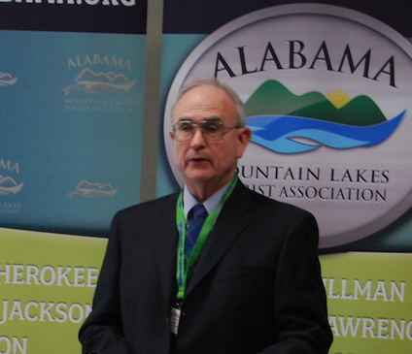
ACCOUNTANT REPORT
Douglas Logan
Owner, W. Douglas Logan, CPA, PC
ALABAMA MOUNTAIN LAKES TOURIST ASSOCIATION

Slide 3
PRINT AND INTERNET ADVERTISING
YELLOWHAMMER
Digital Marketing, February 2023
ALABAMA MOUNTAIN LAKES TOURIST ASSOCIATION

Slide 4
PRINT AND INTERNET ADVERTISING
BUSINESS ALABAMA MAGAZINE
Full-page display ad
February-March issue
ALABAMA MOUNTAIN LAKES TOURIST ASSOCIATION

Slide 5
PRINT AND INTERNET ADVERTISING
ALABAMA RESTAURANT AND HOSPITALITY ASSOCIATION
Digital Marketing, March-May, 2023
ALABAMA MOUNTAIN LAKES TOURIST ASSOCIATION

Slide 6
PRINT AND INTERNET ADVERTISING
HARTSELLE LIVING
NEWSPAPER INSERT MAGAZINE
Half-page display ad
February issue
ALABAMA MOUNTAIN LAKES TOURIST ASSOCIATION

Slide 7
PRINT AND INTERNET ADVERTISING
ALABAMA
MAGAZINE
Third-page display ad,
March-April issue
ALABAMA MOUNTAIN LAKES TOURIST ASSOCIATION

Slide 8
PRINT AND INTERNET ADVERTISING
ALABAMA LIVING
MAGAZINE
Full-page display ad
May-June issue
ALABAMA MOUNTAIN LAKES TOURIST ASSOCIATION

Slide 9
PRINT AND INTERNET ADVERTISING
SAND MOUNTAIN REPORTER NEWSPAPER
Half-page, Special Outdoor Edition, February, 2023
ALABAMA MOUNTAIN LAKES TOURIST ASSOCIATION

Slide 10
PRINT AND INTERNET ADVERTISING
SMALL TOWNS AND DOWNTOWNS MAGAZINE
Half-page, March-April issue
ALABAMA MOUNTAIN LAKES TOURIST ASSOCIATION

Slide 11
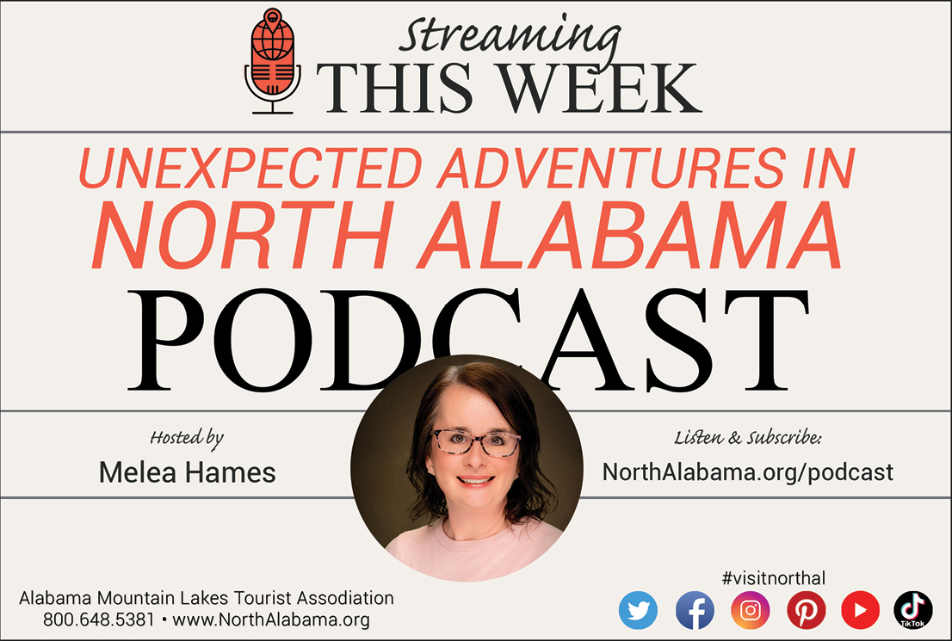
PRINT AND INTERNET ADVERTISING
HYDROFEST PROGRAM
Half-page, Event in June, Guntersville, Ala.
ALABAMA MOUNTAIN LAKES TOURIST ASSOCIATION

Slide 12
PRINT AND INTERNET ADVERTISING
PADDLING MAGAZINE
Half-page, Summer Issue
ALABAMA MOUNTAIN LAKES TOURIST ASSOCIATION

Slide 13
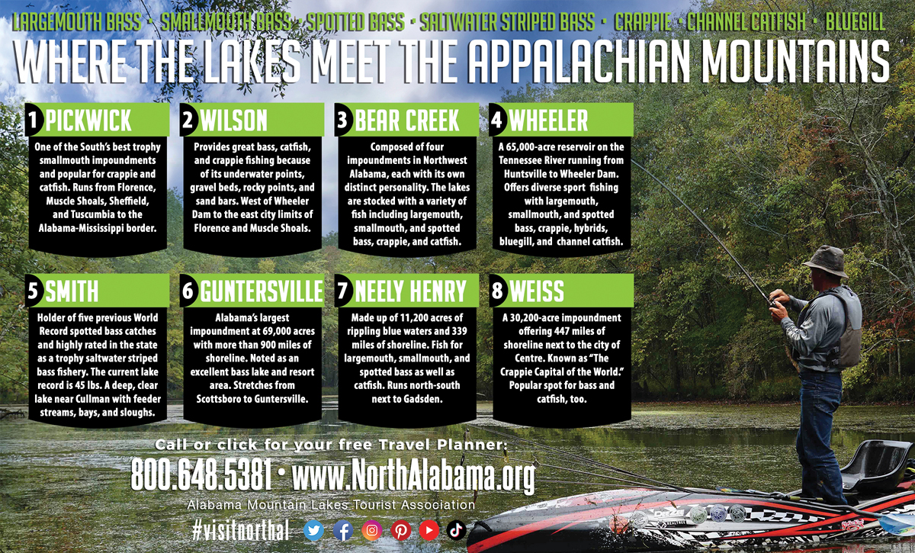
PRINT AND INTERNET ADVERTISING
KAYAK ANGLER MAGAZINE
Half-page, Summer Issue
ALABAMA MOUNTAIN LAKES TOURIST ASSOCIATION

Slide 14
INTERNET MARKETING
TIM HORTON OUTDOORS
AMLA has an on-going marketing campaign with pro fisherman Timmy Horton of The Shoals area. North Alabama gains extensive exposure via his Timmy Horton Outdoors television show, YouTube channel, Facebook pages, and Instagram posts.
According to analytics, during January and February North Alabama destinations received more than 90 minutes of broadcast time on his television shows. In addition, North Alabama destinations was showcased to more than 400,000 of his social media followers during the same time period.
ALABAMA MOUNTAIN LAKES TOURIST ASSOCIATION

Slide 15
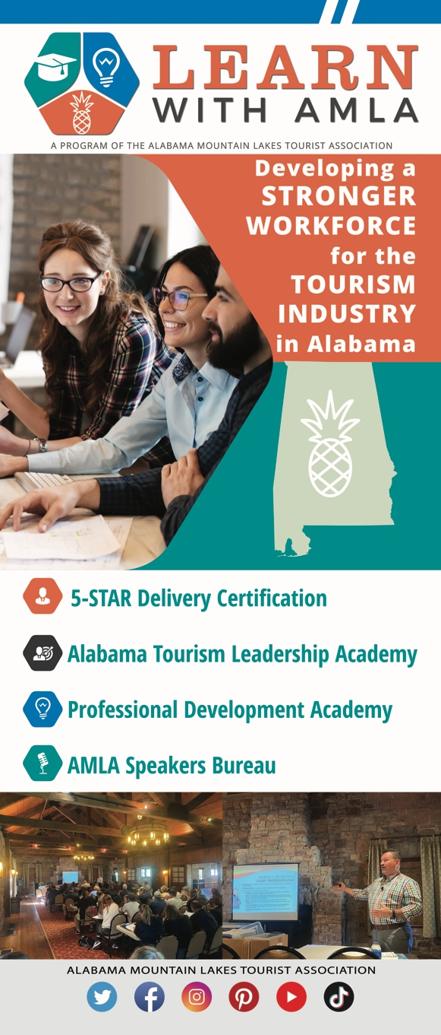
EDUCATION/WORKFORCE
LEARN WITH AMLA PULL-UP BANNER
ALABAMA MOUNTAIN LAKES TOURIST ASSOCIATION

Slide 16
EDUCATION/WORKFORCE
FLAWLESS DELIVERY EDUCATIONAL PROGRAM PULL-UP BANNERS DEVELOPED
ALABAMA MOUNTAIN LAKES TOURIST ASSOCIATION

Slide 17
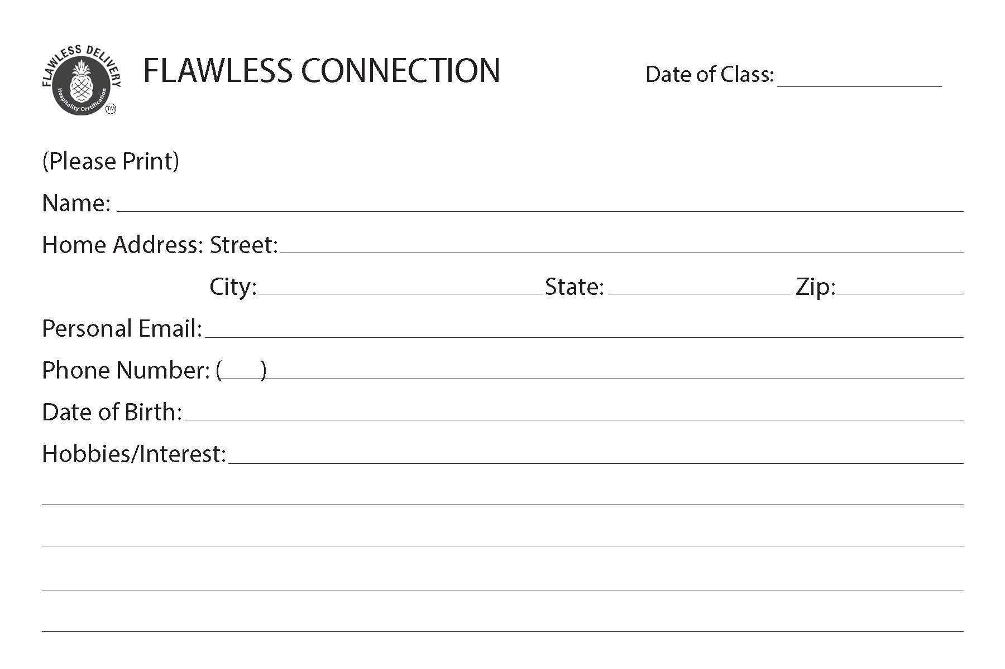
EDUCATION/WORKFORCE
FLAWLESS DELIVERY EDUCATIONAL PROGRAM ATTENDEE SURVEY CARD DEVELOPED
ALABAMA MOUNTAIN LAKES TOURIST ASSOCIATION

Slide 18
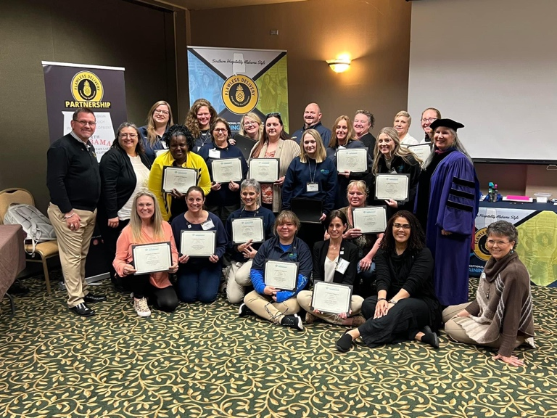
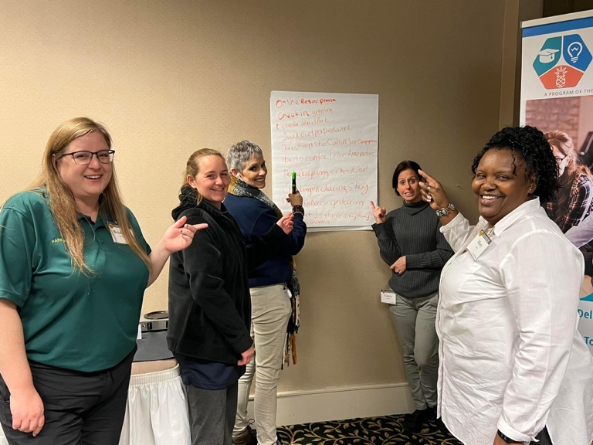
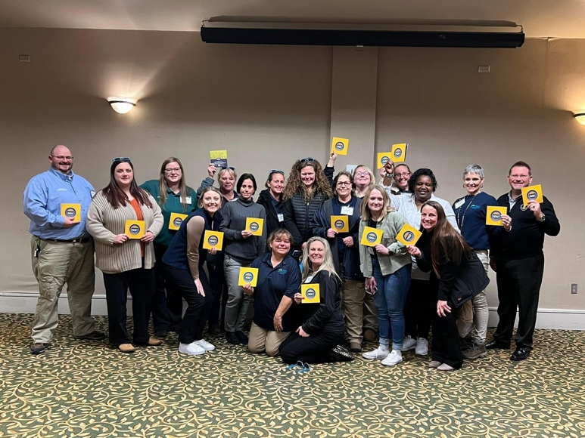
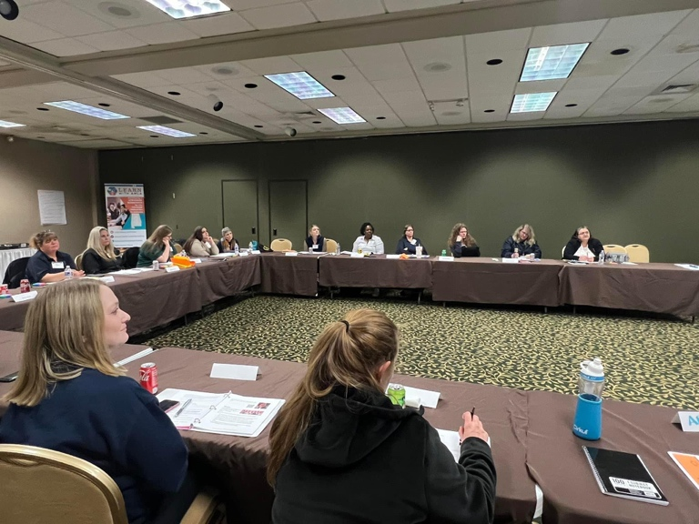
EDUCATION/WORKFORCE
AMLA HAS HOSTED SEVEN TWO-DAY FLAWLESS DELIVERY CLASSES YEAR TO DATE AND CERTIFIED 86 STUDENTS.
ALABAMA MOUNTAIN LAKES TOURIST ASSOCIATION

Slide 19
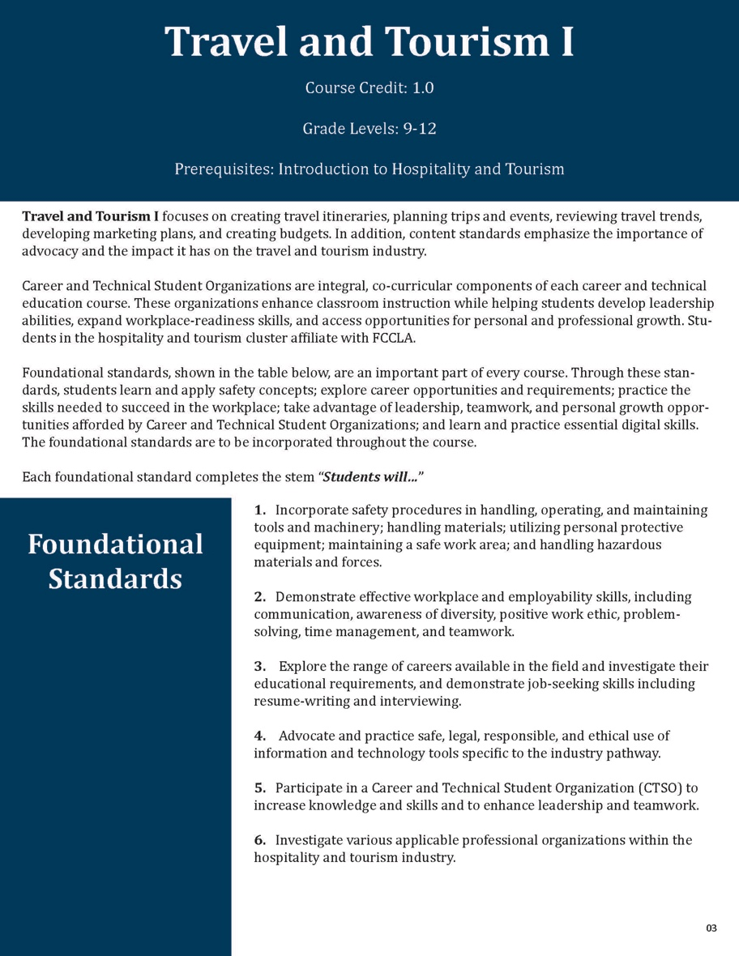
EDUCATION/WORKFORCE
NORTH ALABAMA TOURISM CURRICULUM DEVELOPED
ALABAMA MOUNTAIN LAKES TOURIST ASSOCIATION

Slide 20
EDUCATION/WORKFORCE
ALABAMA MOUNTAIN LAKES TOURIST ASSOCIATION

Slide 21
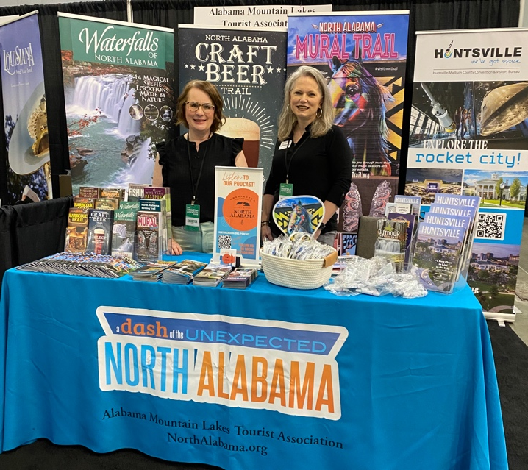
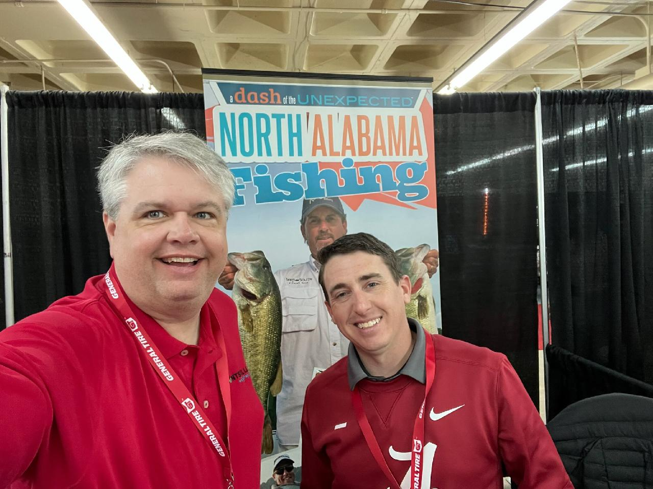
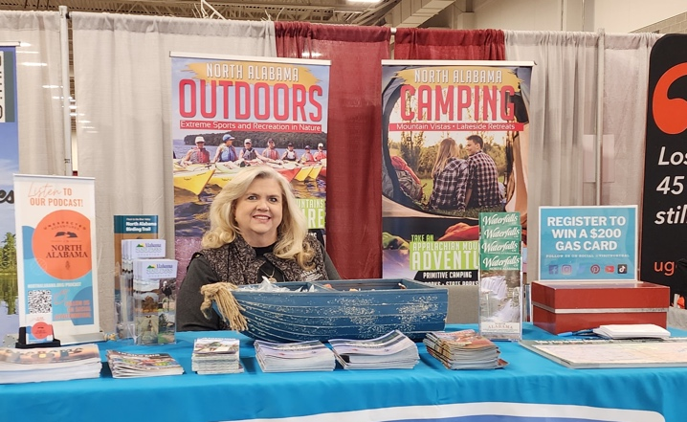
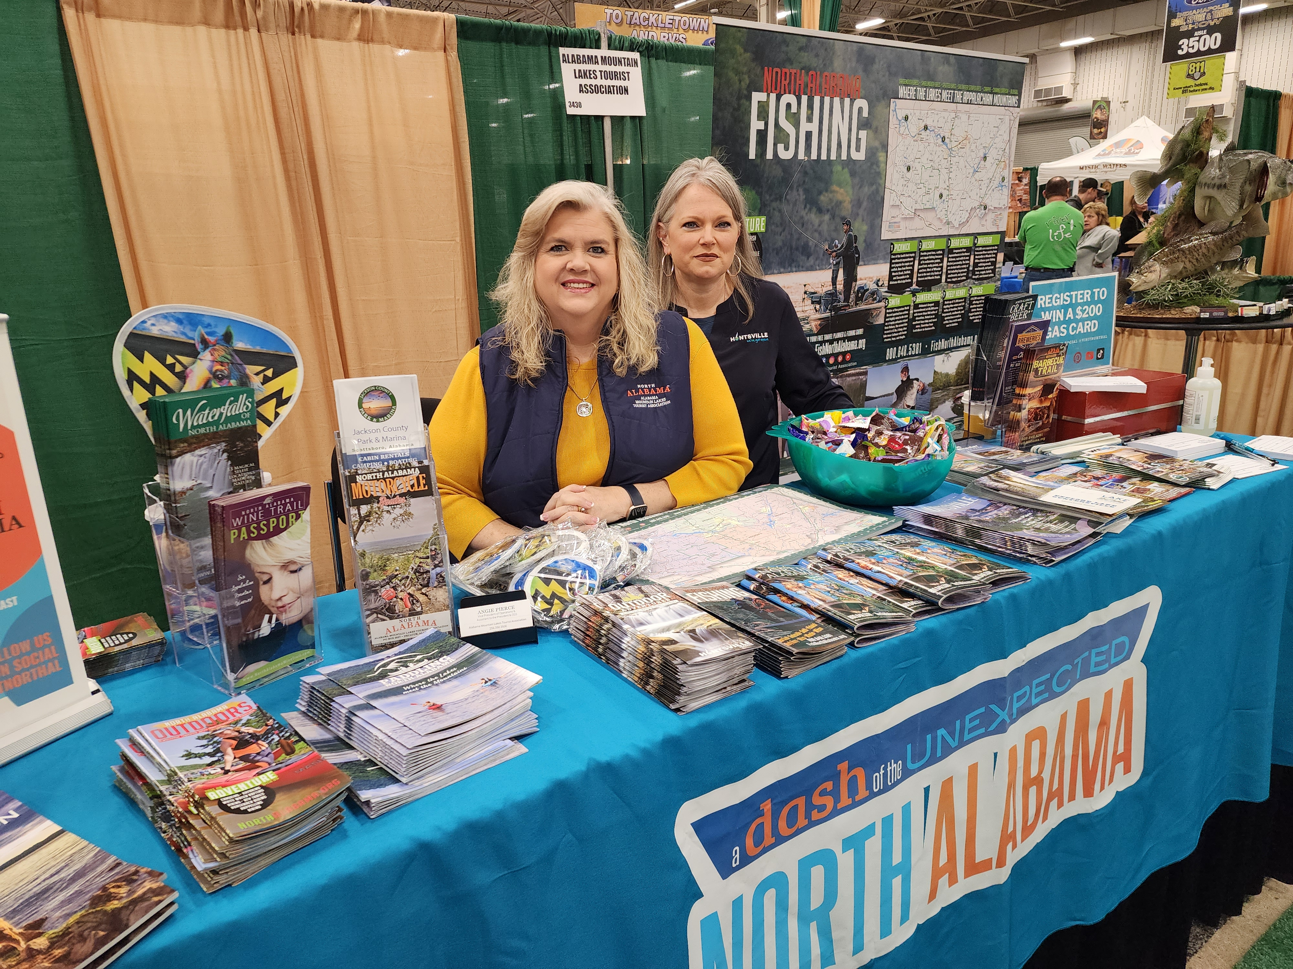
LOCATION MARKETING
TRAVEL / TRADE SHOW SEASON UNDERWAY
Atlanta Travel Show
Major League Fishing
Canoecopia 2023
Indianapolis Boat, Sport & Travel Show
ALABAMA MOUNTAIN LAKES TOURIST ASSOCIATION

Slide 22
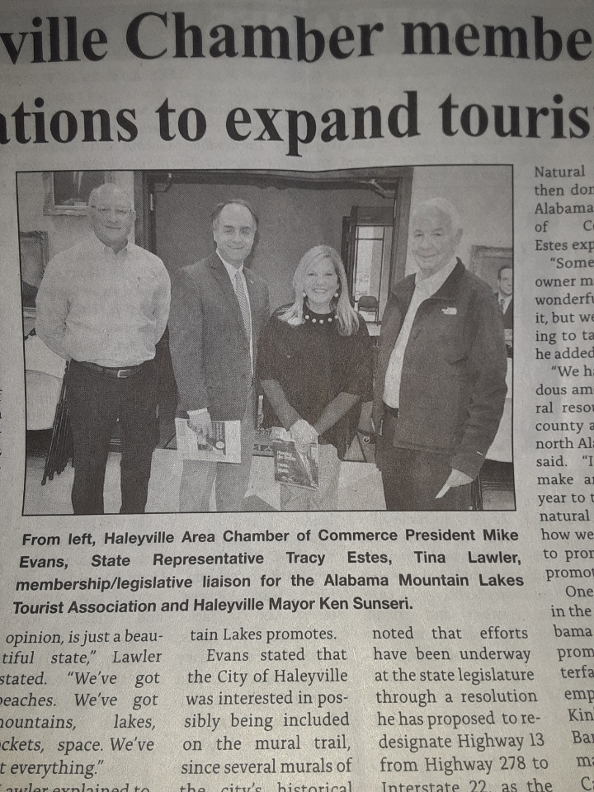
MEMBER SERVICES
AMLA MEMBER SERVICES DIRECTOR TINA LAWLER SPOKE AT THE MARCH HALEYVILLE AREA CHAMBER OF COMMERCE MEETING
ALABAMA MOUNTAIN LAKES TOURIST ASSOCIATION

Slide 23
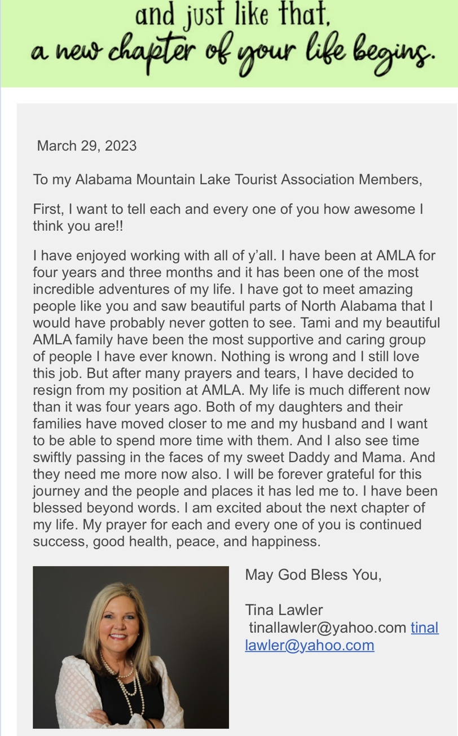
MEMBER SERVICES
ALABAMA MOUNTAIN LAKES TOURIST ASSOCIATION

Slide 24
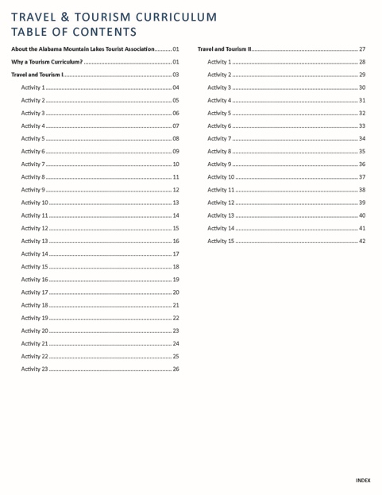
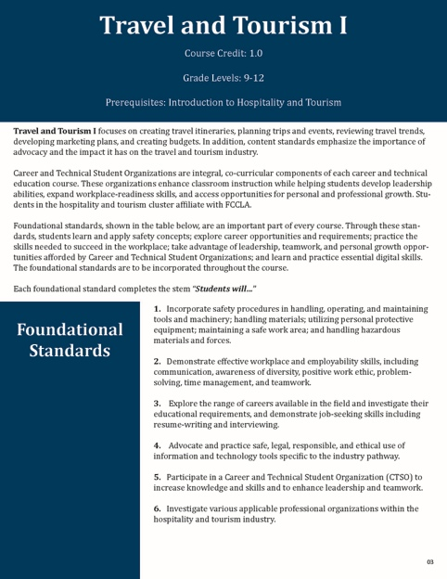
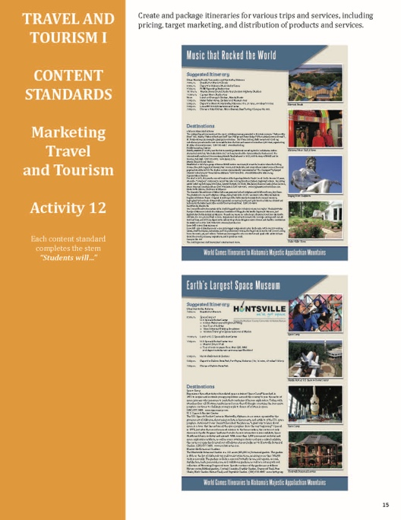
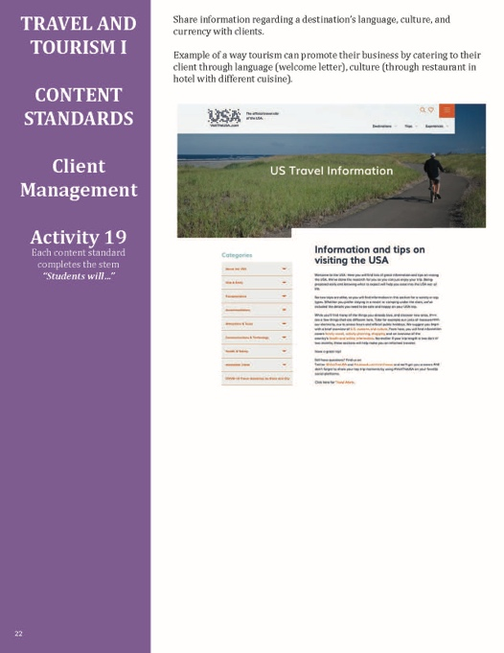
RESOURCES
50-PAGE NORTH ALABAMA TRAVEL AND TOURISM HIGH SCHOOL CURRICULUM MANUAL COMPLETED
ALABAMA MOUNTAIN LAKES TOURIST ASSOCIATION

Slide 25
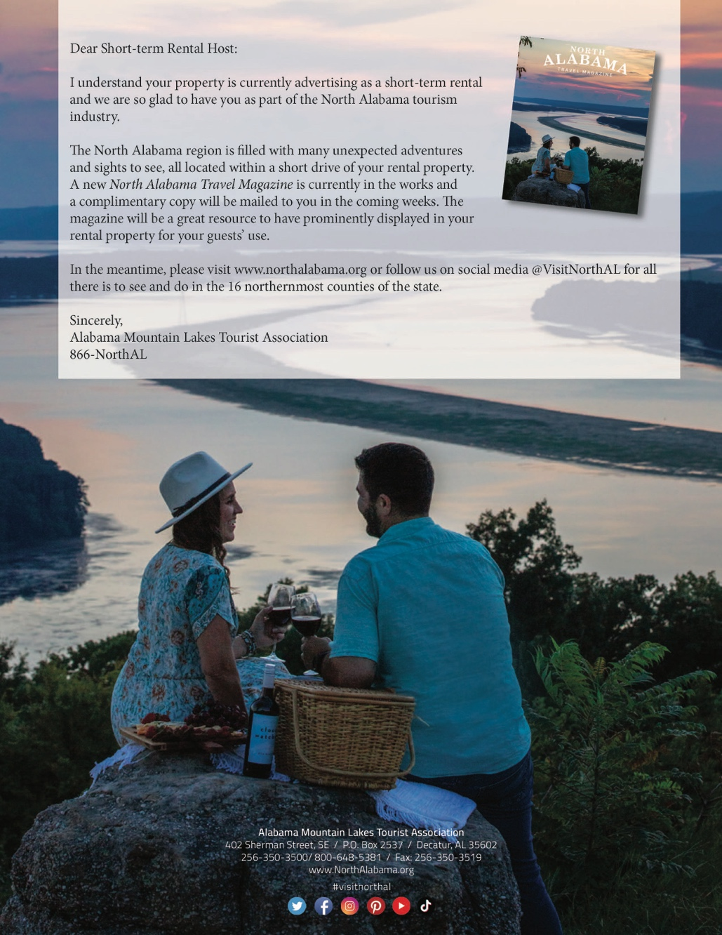
RESOURCES
NEW NORTH ALABAMA TRAVEL MAGAZINE BEING DEVELOPED FOR PLACEMENT IN SHORT-TERM RENTAL PROPERTIES IN THE REGION
ALABAMA MOUNTAIN LAKES TOURIST ASSOCIATION

Slide 26
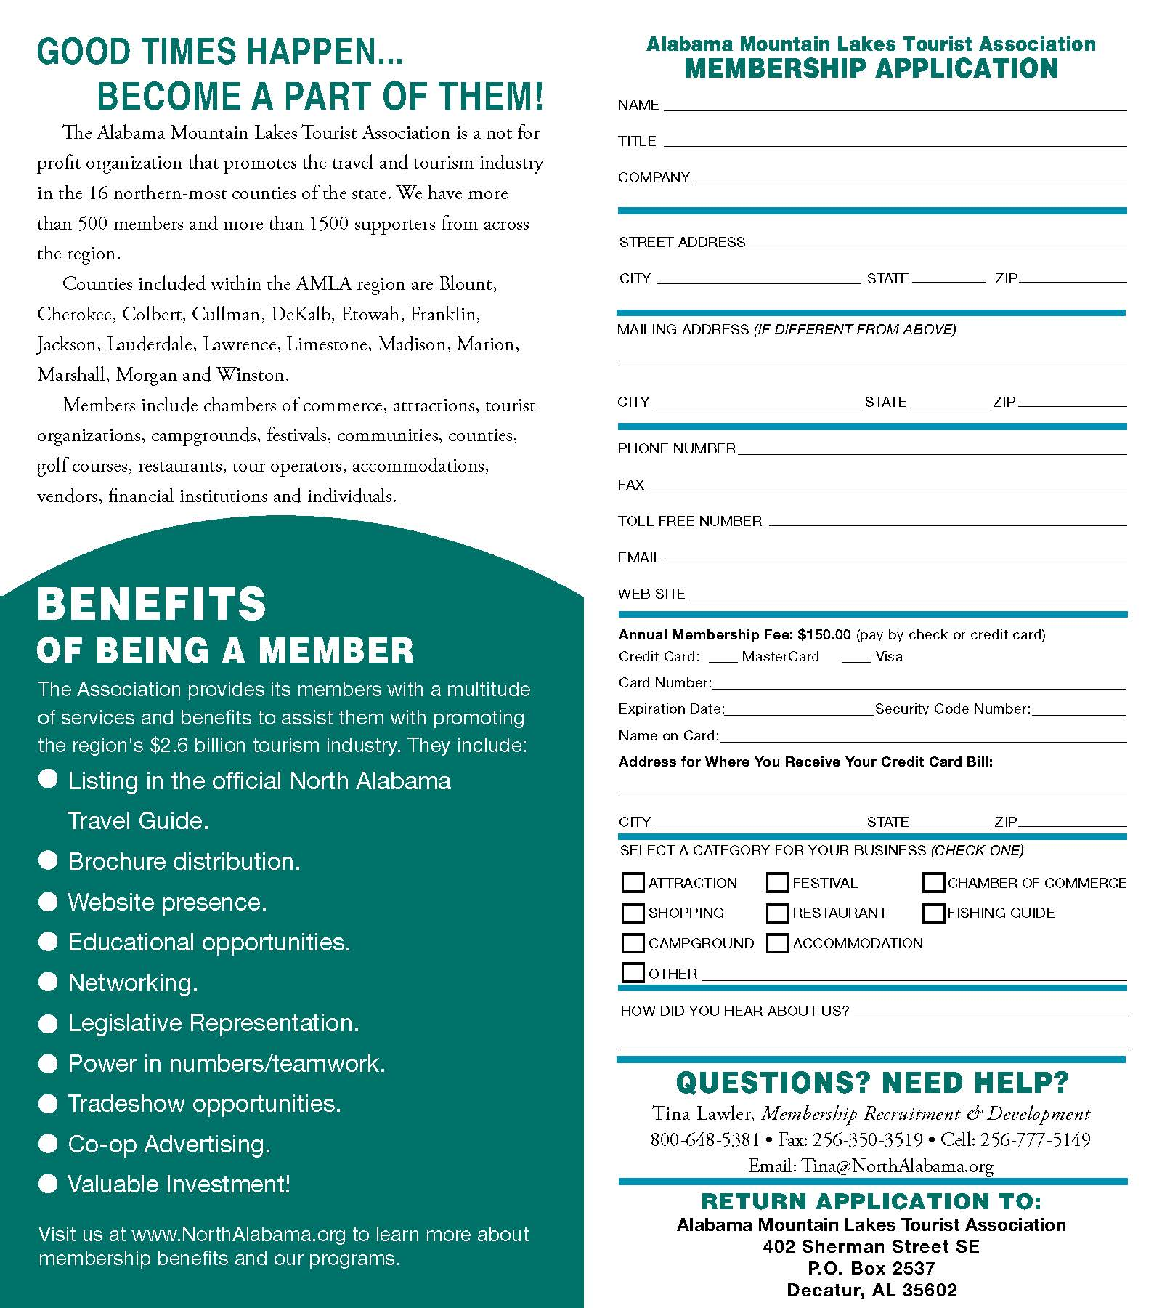
RESOURCES
AMLA MEMBER APPLICATION BROCHURE REPRINTED
ALABAMA MOUNTAIN LAKES TOURIST ASSOCIATION

Slide 27
RESOURCES
RETIRE TO NORTH ALABAMA RACK CARDS PRODUCED
ALABAMA MOUNTAIN LAKES TOURIST ASSOCIATION

Slide 28
RESOURCES
NORTH ALABAMA GROUP ITINERARIES BOOKLET UPDATED
ALABAMA MOUNTAIN LAKES TOURIST ASSOCIATION

Slide 29
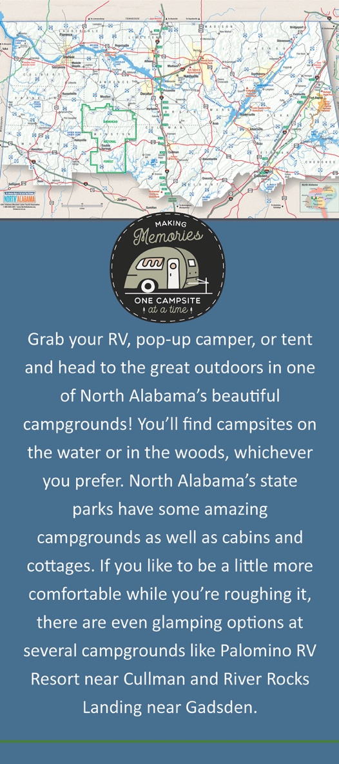
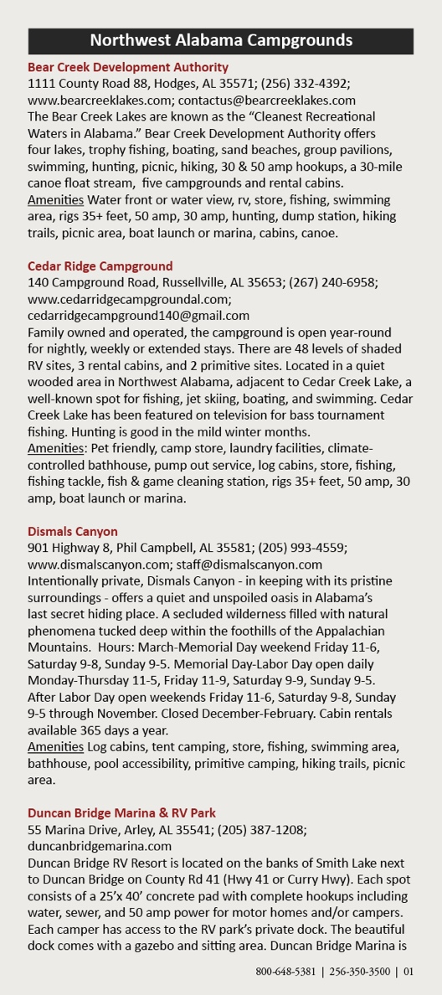
RESOURCES
NORTH ALABAMA CAMPGROUNDS BROCHURE COMPLETED
ALABAMA MOUNTAIN LAKES TOURIST ASSOCIATION

Slide 30
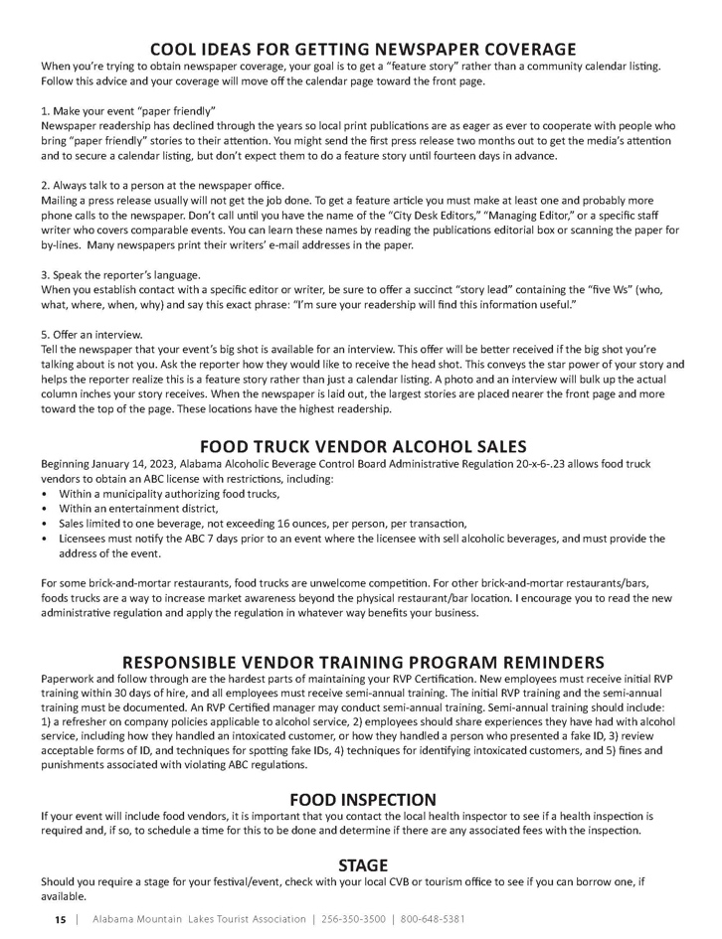
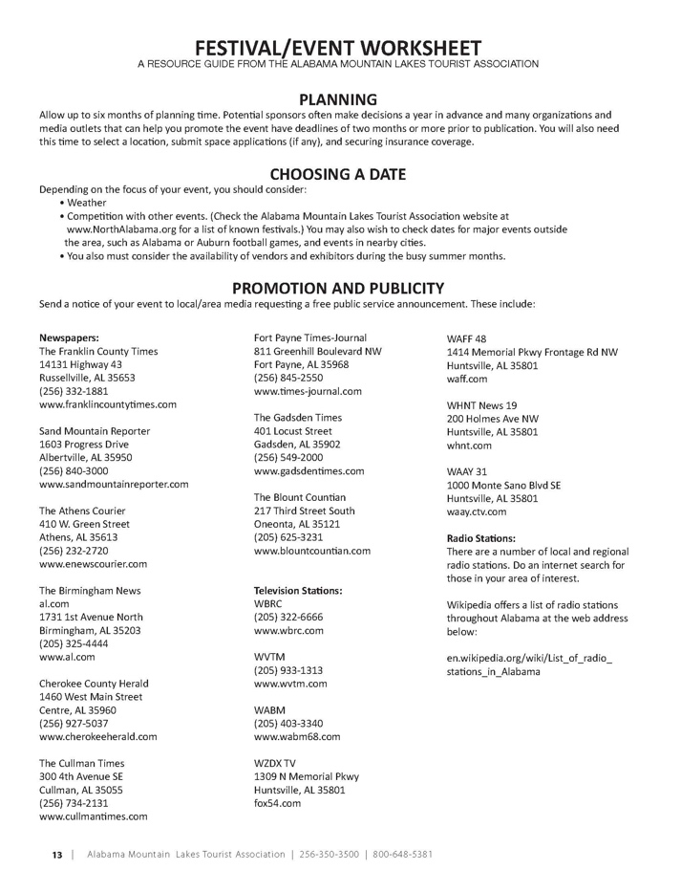
RESOURCES
SMALL TOWN EVENT PLANNER UPDATED AND REPRINTED
ALABAMA MOUNTAIN LAKES TOURIST ASSOCIATION

Slide 31
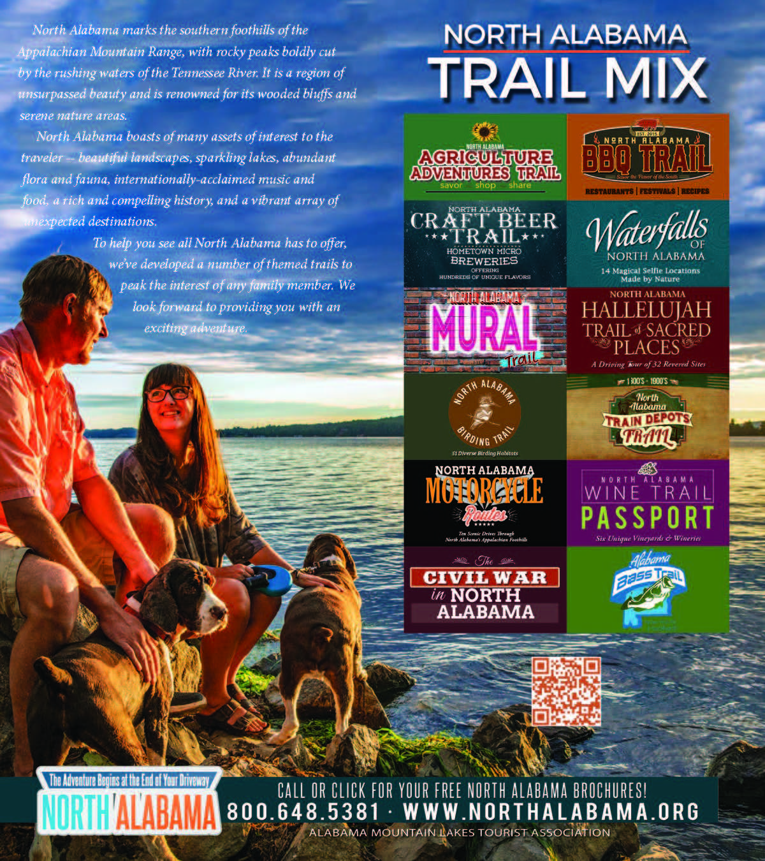
RESOURCES
DIGITAL VERSION OF TRAIL MIX BROCHURE DEVELOPED FOR DOWNLOAD ON NORTHALABAMA.ORG
ALABAMA MOUNTAIN LAKES TOURIST ASSOCIATION

Slide 32
RESOURCES
NORTH ALABAMA GOLF GUIDE PRINTED
ALABAMA MOUNTAIN LAKES TOURIST ASSOCIATION

Slide 33
RESOURCES
NORTH ALABAMA WATERFALLS BROCHURE UPDATED AND DIGITAL DOWNLOAD ADDED TO NORTHALABAMA.ORG WEBSITE
ALABAMA MOUNTAIN LAKES TOURIST ASSOCIATION

Slide 34
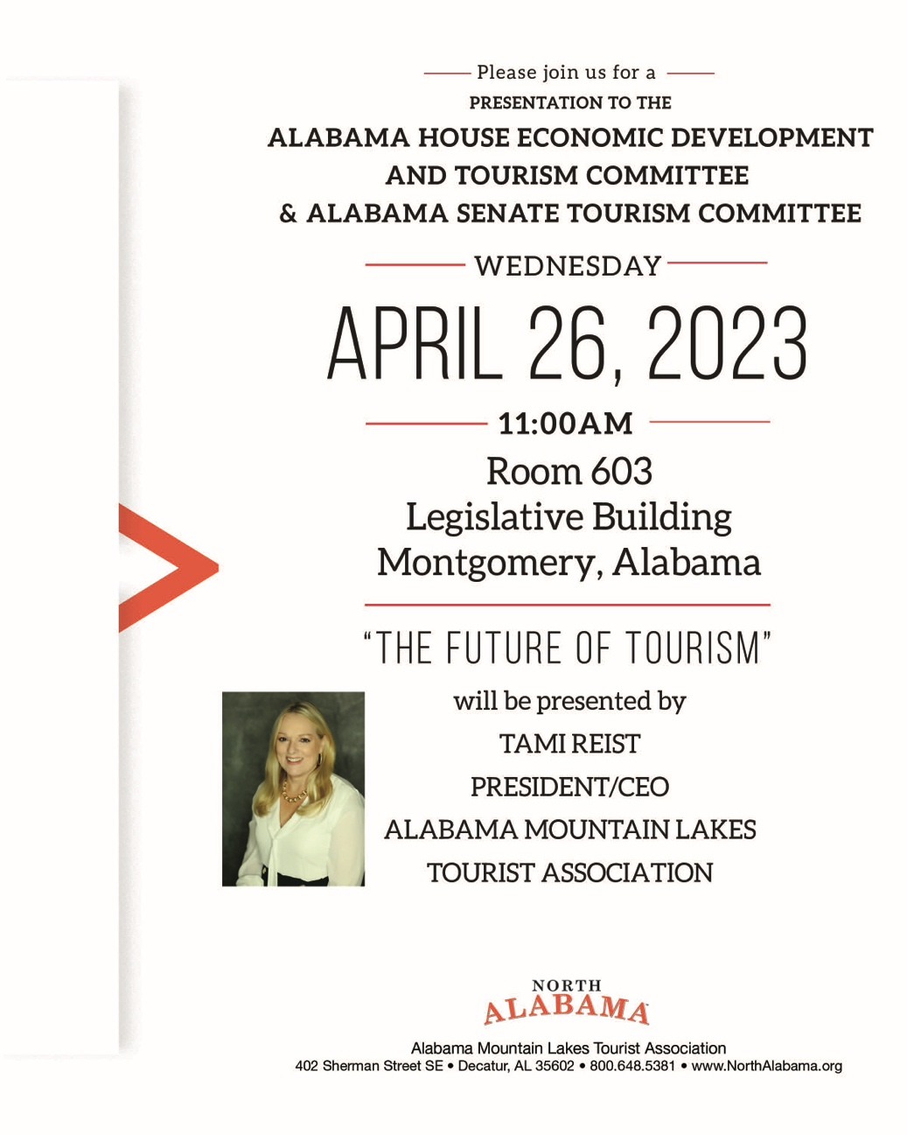
ADVOCACY
ALABAMA MOUNTAIN LAKES TOURIST ASSOCIATION

Slide 35
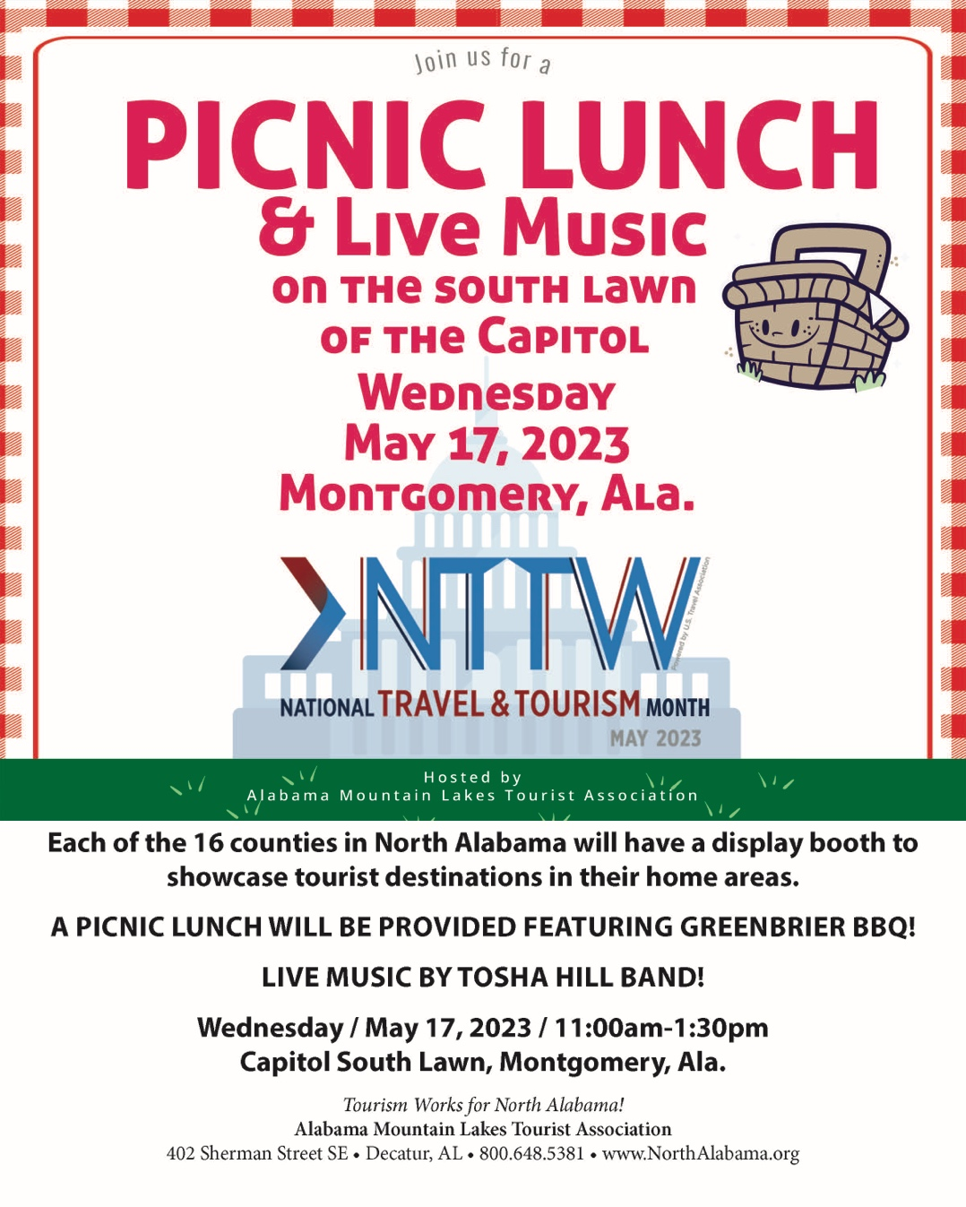
ADVOCACY
ALABAMA MOUNTAIN LAKES TOURIST ASSOCIATION

Slide 36
ADVOCACY
PRESIDENT TAMI REIST SPOKE AT THE EDAA WINTER CONFERENCE
ALABAMA MOUNTAIN LAKES TOURIST ASSOCIATION

Slide 37
JANUARY PRESIDENT’S REPORT
Ms. Reist met with Brandi Hardcastle and the Granicus team regarding the short-term rentals for North Alabama. AMLA will start billing all of the short-term rentals effective February 1st, 2023. Granicus is making changes to the letter that will be sent out reflective of how the Alabama State Revenue wants it to read. They are also developing a method that AMLA does not bill the counties that are being paid through the state and are currently receiving Air BNB revenues.
Ms. Reist spoke with Joel Lamp with the Huntsville/Madison County CVB regarding a potential opportunity to help sponsor a large event.
Ms. Reist is working with Alabama Mainstreet Board regarding the 2024 meeting to be held in Birmingham. JoJo Terry and she will be displaying at the Mainstreet Conference being held in Boston 2023. The goal is to promote the North Alabama Mainstreet communities.
Completed our working manual and budget for Flawless Delivery. We have hosted 5 training events and have four more on the books. After each class we send a letter to the Governor along with a picture of the class thanking her for the grant. Ms. Reist will speak with Senator Orr about getting this added into the Education Fund and using Calhoun College as the conduit institution for these funds.
Ms. Reist attended the VOICES board meeting via zoom. She will be serving on the Advocacy committee.
Ms. Reist attended the Marshall County Tourism and Sports open house. The tourism office is beautiful and in a great location.
Tina Lawler and Ms. Reist attended the ALFA annual meeting in Montgomery. It was a great show to display the Ag Adventures Trail and the farmers loved us being there. We will continue this partnership and share the Trail. Several of our members who are on the trail thanked us for being there. We had two more farms interested in joining.
Met with Brenna Shultz with paddling magazine to discuss a promotion using footage from Chad Hoover’s video b-roll to create mini videos to be showcased on the paddling magazine’s website and in its newsletter. The videos will feature our different lakes that you can put in and paddle. We have also developed a new Outdoors Brochure with the help of Greg Wingo.
Craig Johnston and Ms. Reist continue to have monthly zoom meetings with Dr. Ryan Cate Gibson and Thea Harvey-Barratt with the Holistic Performance Group where they discuss the progress of the Flawless Delivery Training classes and how we can improve the outcomes.
AMLA hosted a roundtable discussion meeting and brought in Chris Cavanaugh with the Magellan Strategy Group. We discussed niche audiences, changes in consumer behavior & preferences, attracting and retaining staff, how to build customer loyalty and creating regional tourism product development.
AMLA met with Jesse Owens’ granddaughters when they came in for a tree planting ceremony held at the Jesse Owens Museum in Oakville. The seedling was from the original English Oak tree presented to Jesse Owens by Master Arborist John Palmer following the 1936 Olympics.
Ms. Reist traveled to Auburn to speak at the State Revenue Commissioner’s Conference. She received word her father-in-law and brother passed away before she got to speak.
Ms. Reist attended a Zoom meeting with TARCOG regarding their five-year economic development strategy. The five goals include Business Development, Resilient Growth, Workforce & Education, Tourism & Outdoor Recreation and Health & Wellness.
Sent out letters regarding AMLA’s ARC video to our North Alabama Economic Development Directors and our Centers of Government offices.

Slide 38
JANUARY PRESIDENT’S REPORT
Sandra Fuller and Ms. Reist completed work on the Teacher Curriculum Training Guide. They will be presenting it at the CTE Convention to be held in Mobile on July 26th & 27th.
Ms. Reist attended the Alabama Mississippi Tennessee Rural Tourism meeting.
Ms. Reist will be serving her last year on the Tennessee-Tombigbee Waterway Board.
AMLA’s Hallelujah Trail was featured in “Mornings with Jesus 2023,” a daily devotion book. The trail was mentioned on January 5 by local author and travel planner Becky Alexander. We received several inquiries for the Hallelujah Trail from this mention.
We are subscribing to the STR Report and receiving an overview on all our counties that have the lodging data to support the report.
We continue to get updates from Janin Nachtweh, our Germany, Austria and Switzerland representative.

Slide 39
FEBRUARY PRESIDENT’S REPORT
Ms. Reist attended the 6th Annual Tennessee RiverLine Summit, held at Lake Guntersville State Park. AMLA received the Organizational Partner of the Year Award. This award recognizes those who have made exemplary contributions to advancing the Tennessee RiverLine Partnership.
Ms. Reist spoke at the Tennessee RiverLine Summit. She served on a panel and discussed Best Practices for Sustainable Destination Management. The topics included Short Term Rentals, AMLA’s different trails and creation of the Ingall’s Harbor development.
Ms. Reist spoke with Neville Bhada, owner of Tourism Skills Group. He interviewed her regarding what AMLA does for advocacy. He is doing a study on this topic and needed feedback from our organization.
Ms. Reist spoke with Lee Sentell regarding the ten year’s of success of the Alabama Bass Trail. He suggested she send a letter and ask for additional funds to help with our administrative costs. The costs are primarily attributed to the accounting duties and the time taken to maintain their four accounts.
We hosted three two-day Flawless Delivery classes in the month of January. The classes have been a great success. We are working with Senator Orr on trying to get in the education fund for the 2024-25 budget.
Ms. Reist attended the EDAA Winter Conference in Montgomery. She was asked to speak on a panel regarding the “Future of Tourism”, along with Hans van der Reijen, Founder & CEO of Ithaka Hospitality and Cody Williamson, President/CEO of Creek Indian Enterprises. The panel was a huge success, and she received several calls regarding the discussion following the meeting.
Ms. Reist attended a dinner in Lawrence County regarding the new Industry First Solar. They are building a $1.1 billion dollar facility to be located in Lawrence County and will employee 700 people. The plant is scheduled to open late 2024. Ms. Reist sent out information to Karmen Blanco-Hartfield regarding our region and relocation packages.
AMLA will be sending Don Dukemineer to work our booth at the Major League Fishing REDCREST IV exhibit. The event will take place on Lake Norman in Charlotte, NC. Joel Lamp from Huntsville/Madison County will also be in attendance.
The staff continues to zoom with Thea Harvey-Barratt and Dr. Ryan Cate Gibson regarding the Flawless Delivery program.
We are working on putting the final touches of the new North Alabama Travel Magazine, a publication for the short-term rental market. We have chosen the front cover, proofed the stories, and laid out the design for the magazine. The goal is to have ready to print in May and mailed to short-term rentals in North Alabama.
Ms. Reist attended the American Bus Association (ABA) “Sweet Home Alabama” reception for the tour operators. AMLA was one of the sponsors for the event. The event was held in Detroit, Michigan and we brought in Taylor Hicks to perform. The event was a great success.
Ms. Reist met with Renee Sides, Executive Director with the Cordova Economic & Industrial Development Authority. She met her at the EDAA Conference and asked if Ms. Reist would speak with them about tourism for their community.

Slide 40
FEBRUARY PRESIDENT’S REPORT
We mailed out our first round of short-term rental letters. 1800 letters were mailed to the STR property owners (except those counties who have the state administer their taxes) listed on Airbnb and other platforms such as VRBO, Flipkey, etc.
We updated our Alabama Mountain Lakes Tourist Association Employee Handbook.
Karen Beasley will attend the Global Marketplace and have one-to-one business meetings in the U.K. and Europe. We are partnering with Huntsville/Madison County CVB on these appointments.
Ms. Reist has been asked to speak March 9th via zoom for the Government & Economic Development Institute. She will be speaking on “The Future of Tourism.”
We emailed a letter to all North Alabama Economic Development Directors, Center of Government Organizations, ADECA, Commerce, ARC and others informing them of AMLA’s new video promoting funding and investment opportunities available from the Appalachian Regional Commission, and asked them to place it on their websites and social media channels.
We were asked by ADECA Director Kenneth Boswell to write a letter of support for Looney’s Tavern in Winston County to help them get a grant from the Appalachian Regional Commission.
We sent a letter to the Appalachian Regional Commission to share a success story on the Hallelujah Trail. This Trail was produced from an ARC grant we received in 2006, and we keep receiving great coverage on the Trail.
We produced ads for the Golf Alabama Magazine and our North Alabama Golf Guide.
We received our statistics report on AMLA’s ads running in Business Alabama.
Ms. Reist attended the Appalachian Leadership Institute class in Birmingham. We gave out Lee Sentell’s U.S. Civil Rights books to the class and shared the ARC investment video we produced.
As part of Black History month, we will be sharing on Yellowhammer News the story of Jesse Owens and the video produced regarding the tree planting ceremony at the Jesse Owen Museum.
We just completed our North Alabama Paddling Guide. We will be taking these to the Indy Show and Canoecopia.
Our podcast continues to grow – Melea Hames is doing an outstanding job with the Unexpected Adventures in North Alabama. We are getting close to hitting 10,000 listeners.
Ms. Reist shared plans for a picnic on the grounds of the state capitol instead of a Legislative Prayer Breakfast.

Slide 41
MARCH PRESIDENT’S REPORT
Ms. Reist met with Jennifer Green, Executive Director of JSU Economic Development. Lee Sentell asked that we do a ten year study on the impact of the Alabama Bass Trail to share data with legislators. We applied for a $50,000 grant to offset the cost of the study and for the accounting that AMLA is handling for the Trail. This request has been signed by the Governor and we are waiting on the paperwork.
Ms. Reist submitted a letter of request to Lee Sentell regarding funding for Granicus. This data has been very beneficial to our industry. We are seeing an increase in short -term rentals across the State of Alabama. According to Randy Winkler with ADOR they are seeing more STR owners signing on to the portal and paying their lodging taxes.
Ms. Reist met with Brandi Hardcastle and Mike Bozich from Granicus regarding a postcard mailed to STR operators with announcement of AMLA’s new magazine. We have chosen the front cover, adding new stories and laying out the design for the magazine. Goal is to have ready to print and mailed to North Alabama STR operators in May.
Ms. Reist attended the Outdoor Adventure Show in Toronto, Ontario Canada with the Alabama Tourism Department. The show was much busier than last year. We met Sherry McKeown with Wanderful. She is interested in Huntsville bidding on the WITS conference for 2026. Information has been forwarded to Huntsville/Madison County CVB VP of Conventions Jamie Koshofer.
Angie Pierce worked the first week and Melea Hames worked the second week of the Indianapolis Boat Show. Both reported it busy and handed out lots of brochures on North Alabama.
Tina Lawler worked the Mid-South Farm & Gin Show in Memphis where she gave out all ag trail brochures brought with her. This show was extremely busy and she recommended keeping it in the budget.
Angie Pierce attended Canoecopia and reported good attendance. She met a gentleman who put together an itinerary – Fork in the Road: A Five-Day Active Getaway along the North Alabama Barbecue Trail. Lots of people stated they had been to our area and others who have made plans to go.
Ms. Reist spoke to the EDAA Leadership Institute – the program was “Tourism as an Essential Economic Development Strategy.”
Ms. Reist was asked to speak on “Building a Strong/Regional Tourism Program” and received positive feedback regarding the topic. We are getting the message out that “Tourism is Economic Development.” She will also be speaking in person to this group on September 12th in Auburn.
Ms. Reist will be speaking in Gadsden on Monday, May 15th on the topic of regional tourism. Greg Canfield, Director of Commerce and Ed Castile, Director of Workforce Development for the State of Alabama, will also be speaking at the event.
Ms. Reist attended the Alabama Committee in Credentialing and Career Pathways (ACCCP) Meeting and Technical Advisory Committee (TAC) Orientation via zoom. Governor Ivey appointed her to this board four years ago to work with The Hospitality & Tourism Group.
Ms. Reist met Jenny Stubbs who is from Wetumpka and was the Main Street Director when HGTV’s premiere season of Hometown Takeover changed downtown Wetumpka. Stubbs has been asked to start a tourism bureau in Wetumpka and we provided her information like the one we helped Cullman to form. She is the wife of Representative Stubbs, one of our newly elected officials.

Slide 42
MARCH PRESIDENT’S REPORT
Ms. Reist was contacted by Dr. Martha Lavender regarding a new Challenger Learning Center being proposed for Northeast Alabama and was asked to write a letter of support to Governor Ivey. Ms. Reist also put her in contact with Johnny Stephenson who is the Strategic Planning Chief at NASA’s Marshall Space Flight Center. They spoke and it looks promising for funding from NASA to help with this center. She also received word from Senator Andrew Jones that Governor Ivey has put $8 million in her fund to help with the Challenger Learning Center.
Karen Beasley has been updating our amla4tourism.com website for our members and she is getting ready to start a monthly e-newsletter for our members.
Ms. Reist spoke with Neville Bhada, owner of Tourism Skills Group who is doing a study on how ‘The Shoals Documentary” has impacted the North Alabama region. This study will be used to help our Alabama Film & Music Incentive. Our intent is to show legislators the return on investment can mean to our state by investing in films or documentaries.
We have hosted 2 two-day Flawless Delivery classes in the month of February. These classes were held in Madison at the Hampton and at the Residence Inn Florence. We trained a total of 19 in the month of February.
We will be hosting a Flawless Delivery training class in Birmingham June 11th-June 13th for our CVB directors and those who attend the State Meetings. The goal is to have tourism leaders reach out to hoteliers and get them to go through this FREE training program.
We have joined the Alabama Hospitality and Restaurant Association for Flawless Delivery. We are running ads promoting the training program on their weekly on-line newsletter and will be placing a full-page ad in their magazine.
Continue to meet via zoom with Thea Harvey-Barratt and Dr. Ryan Cate Gibson regarding the Flawless Delivery program.
As part of National Tourism Month, we will host a Legislative Picnic on the grounds of the Capitol May 17th. We will give each of our 16 counties a table so they can display about their area. We will have a table for Flawless Delivery sharing and thanking the legislators for the grant given for this training.
We are working with Fred Hunter on an exclusive television and YouTube show. The show will be the Unexpected Adventures in North Alabama.
We are working on a new rack card for our Retirement and Relocation Guide. We are also looking at shows where we can display the North Alabama area.
We are working on appointments for Washington DC and talking points for our Team Alabama group. This event will take place July 9th – 12th.
We mailed letters to newly elected officials and to Alabama State Senators serving on the Tourism Committee and Representatives serving on Economic Development and Tourism Committee introducing AMLA and thank you for serving.

Slide 43
MARCH PRESIDENT’S REPORT
Ms. Reist spoke with Representative Whitt and Senator Gudger on doing a presentation to both Caucus’s on the ‘Future of Tourism”. We are working on the dates that will work for both committees.
Ms. Reist has been working with Senator Gudger on the forming of a new Tourism Bureau. They hired Chris Cavanaugh with the Megellan Group, and he is consulting with the new board. They will be conducting interviews for hiring an Executive Director this Wednesday.
Ms. Reist has been working with Shawna Faniel – Domestic Travel Group Sales Manager for the ATD. She connected her with the CVB’S and attractions that are participating in the North Alabama Domestic Showcase Fam Tour.
We are working with Joe Watts and Alabama Economic Development on updating our North Alabama Birding Trail information. We are going to use Bandwango to create The North Alabama Birding Trail passport. We are going to have Adam our videographer, produce a video for our website regarding our birding trail. We will hi-light the “Festival of the Cranes” and “Eagle Awareness” in the video.
We will be working on uploading our Hallelujah Trail and featuring our video content to go along with this trail.
AMLA continues to work with John Riley who is working on a tourism development project in Lawrence County. We are excited that Barnwood is looking to do a show around Ravenwood.
We have proofed our final copy of the North Alabama Campgrounds brochure. We will be using the great outdoors as our theme for The Alabama League of Municipalities and the Alabama County of Commission Association Conference.
We received a statistics report from Compass Media on our campaigns we retargeted.
AMLA’s Unexpected Adventures podcast exceeded over 10,000 listeners and WHNT Channel 19 interviewed Melea Hames regarding this milestone.
We have submitted content for The Rick & Bubba Show. The campaign will showcase and direct listeners to AMLA’s podcast.
We received our statistics from the Timmy Horton Outdoor Show (THO).

Slide 44
SAVE THE DATES
AMLA TRAVEL SHOWS
Alabama League of Municipalities
May 10-12, 2023, Birmingham, AL
IPW
May 20-24, 2023, San Antonio, TX
STS Marketing College
June 4-9, 2023, Macon, GA
Alabama Press Association
June 22-24, 2023, Gulf Shores, AL
POMA
June 12-15, 2023, Broken Arrow, OK
Hydrofest
June 24-25, 2023, Guntersville, AL
Southeast Tourism Society
Congressional Summit
July 10-13, 2023, Washington, DC
ICAST
July 11-14, 2023, Orlando, FL
DEI Training – Aisha Adams Media
June 27, 2023
Jackson Center, Huntsville, AL
10am-2pm
AMLA BOARD & MEMBERSHIP MEETINGS
AMLA Board & Membership Meeting
Joe Wheeler State Park, Rogersville, AL
July 25, 2023
ALABAMA MOUNTAIN LAKES TOURIST ASSOCIATION

Slide 45
Supporting partner for Leave No Trace Outdoor Ethics
Alabama State Parks Advisory Board
Supporting partner for TVA Community Development Surveys
Alabama representative to the Appalachian Regional Commission
Instructor for Southeast Tourism Society Marketing College
Supporting partner of Tennessee River Valley Stewardship Council
Supporting member of Harvest Hosts

Slide 46
ALABAMA MOUNTAIN LAKES TOURIST ASSOCIATION

