Slide 1

1st QUARTER 2022-2023
PRESIDENT’S REPORT TO THE
AMLA BOARD OF DIRECTORS
(Time span covered October through December 2023)
January 24, 2023
Cherokee County Chamber of Commerce
Centre, AL
ALABAMA MOUNTAIN LAKES TOURIST ASSOCIATION

Slide 2
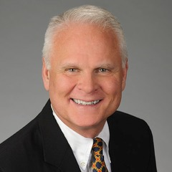
GUEST SPEAKER
DAVID KEMP
STS team in 2022 as the Membership & Partnership Manager
ALABAMA MOUNTAIN LAKES TOURIST ASSOCIATION

Slide 3
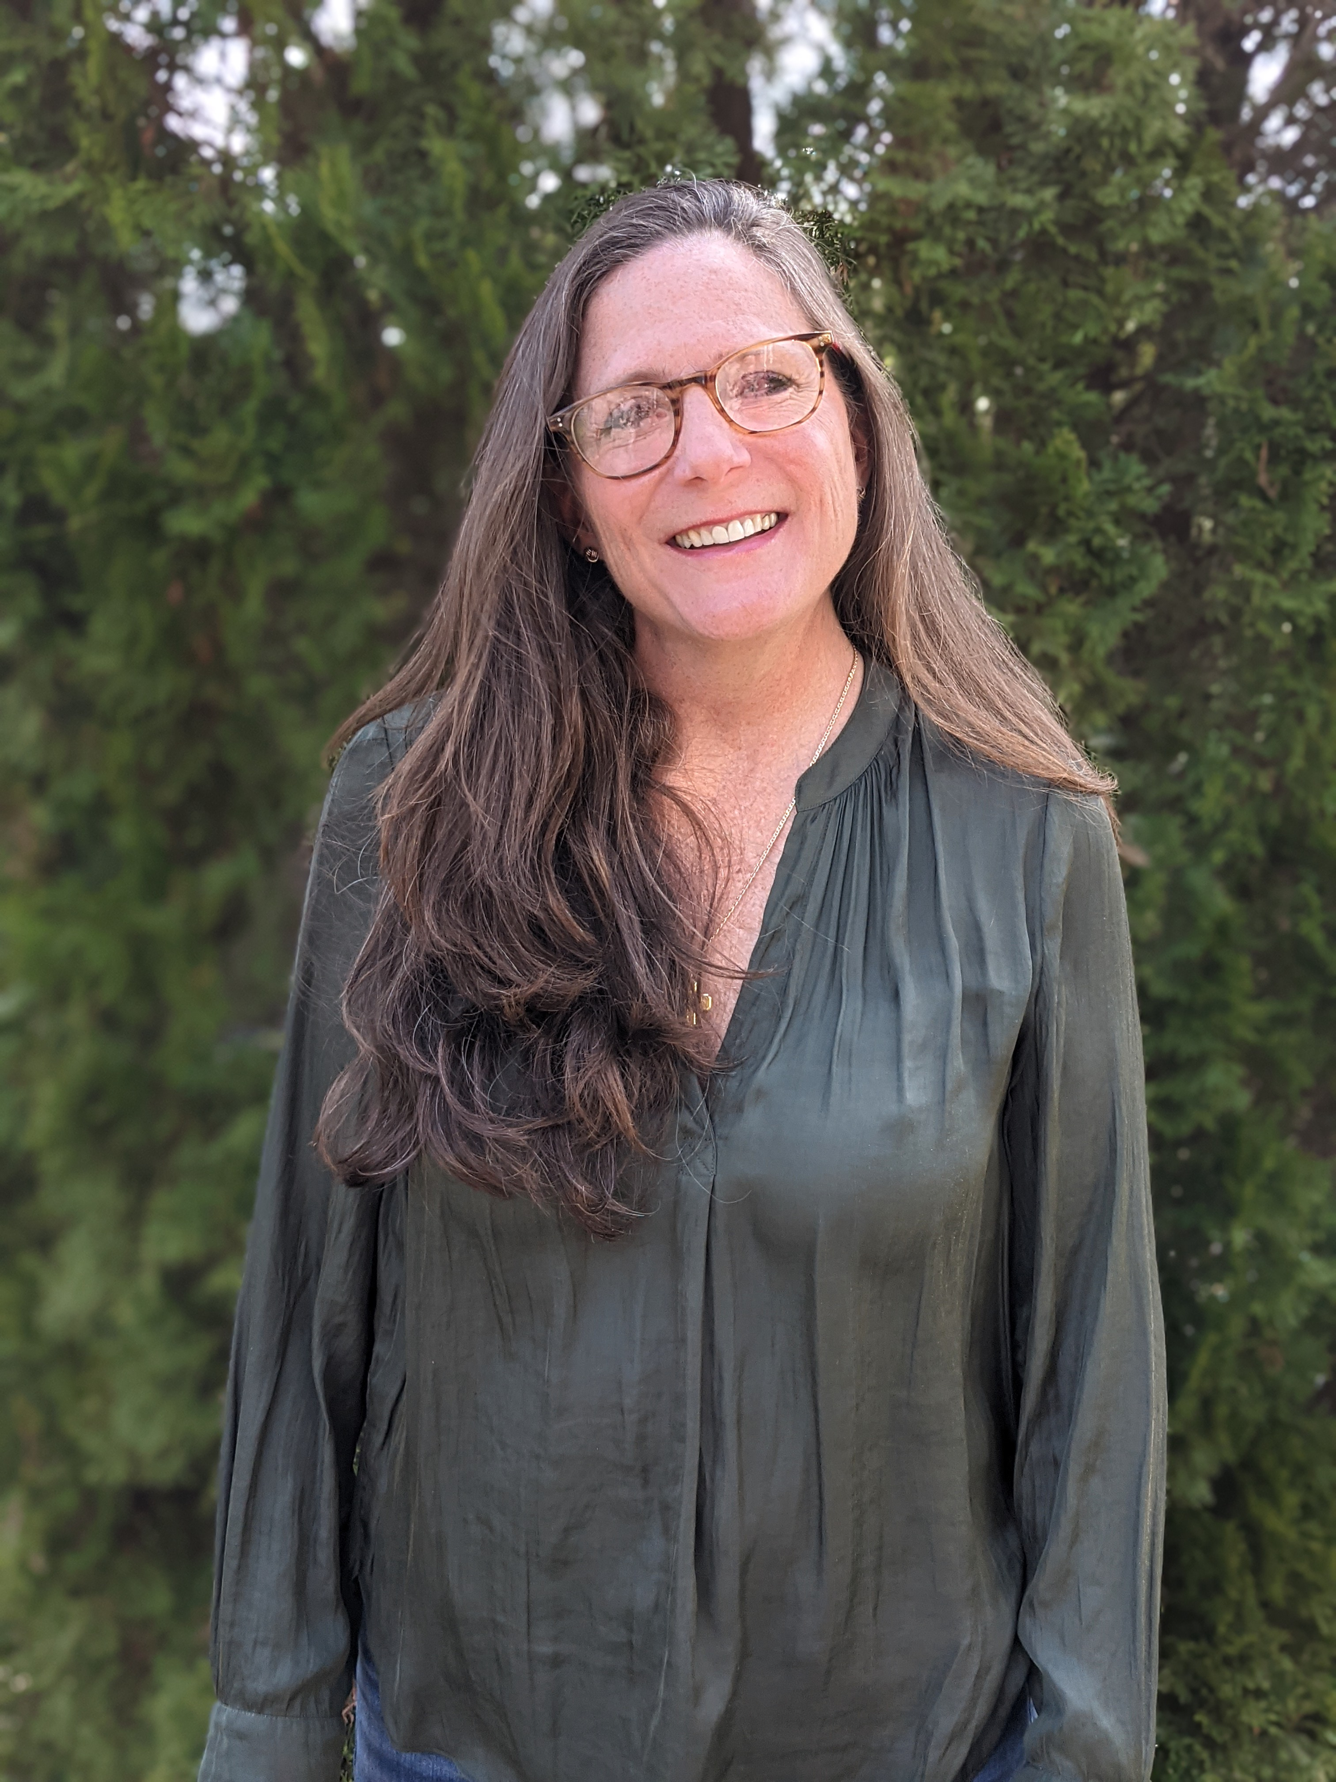
GUEST SPEAKER
RUTH SYKES
Director of Media Relations, Laurie Rowe & Company
ALABAMA MOUNTAIN LAKES TOURIST ASSOCIATION

Slide 4
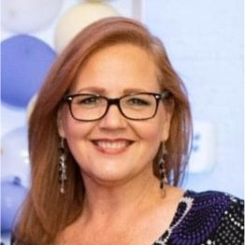
GUEST SPEAKER
LESLIE WALKER
Tourism & Destination Marketing Consultant, Tourism All-a-Bama
ALABAMA MOUNTAIN LAKES TOURIST ASSOCIATION

Slide 5


PRINT AND INTERNET ADVERTISING
ALABAMA COUNTY COMMISSION MAGAZINE
Quarter-page page display ad, November-December issue
ALABAMA MOUNTAIN LAKES TOURIST ASSOCIATION

Slide 6
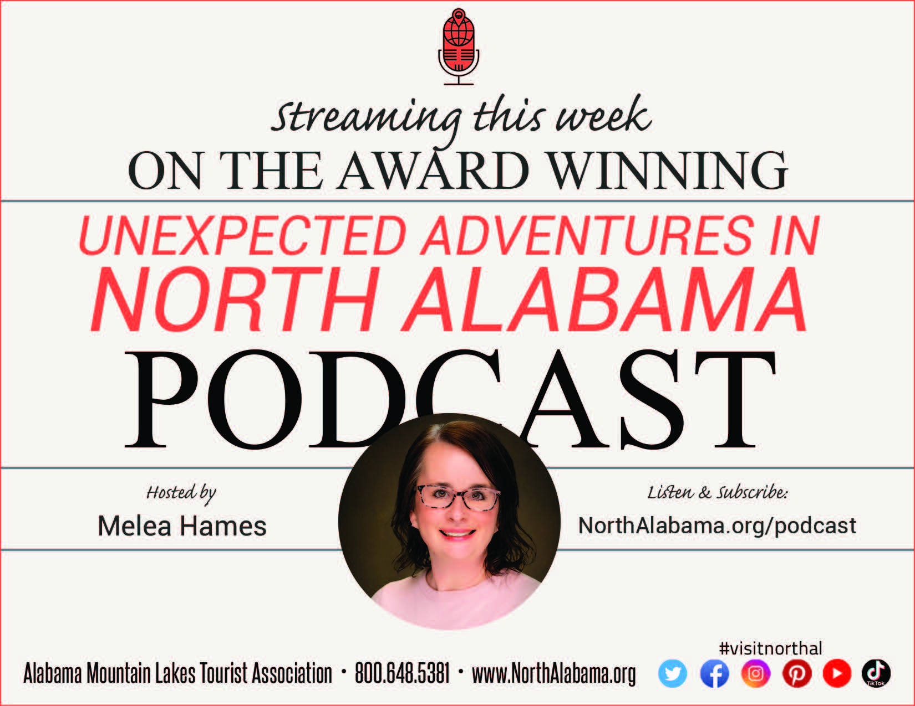
PRINT AND INTERNET ADVERTISING
ALABAMA-MISSISSIPPI-TENNESSEE RURAL CONFERENCE ON TOURISM
Half page display ad in Conference Program, November 2022
ALABAMA MOUNTAIN LAKES TOURIST ASSOCIATION

Slide 7

PRINT AND INTERNET ADVERTISING
AMLA ALSO COORDINATED A PITCHING FOR PROMOTION DOLLARS AT THE
ALABAMA-MISSISSIPPI-TENNESSEE RURAL CONFERENCE ON TOURISM
November 2022
ALABAMA MOUNTAIN LAKES TOURIST ASSOCIATION

Slide 8

PRINT AND INTERNET ADVERTISING
STS DOMESTIC SHOWCASE
CONFERENCE PROGRAM AD
Quarter-page display ad, April 2023
ALABAMA MOUNTAIN LAKES TOURIST ASSOCIATION

Slide 9

PRINT AND INTERNET ADVERTISING
AUBURN UNIVERSITY GEDI CONFERENCE
One-Half page display ad, November
ALABAMA MOUNTAIN LAKES TOURIST ASSOCIATION

Slide 10

PRINT AND INTERNET ADVERTISING
ALABAMA
MAGAZINE
Third-page display ad, Jan-Feb issue
ALABAMA MOUNTAIN LAKES TOURIST ASSOCIATION

Slide 11

PRINT AND INTERNET ADVERTISING
COMPASS SPRING NEWSPAPER INSERT
Quarter-page, Spring
ALABAMA MOUNTAIN LAKES TOURIST ASSOCIATION

Slide 12

PRINT AND INTERNET ADVERTISING
NEW VISION MAGAZINE CHEROKEE COUNTY
Half-page ad, Two Year Publication
ALABAMA MOUNTAIN LAKES TOURIST ASSOCIATION

Slide 13


PRINT AND INTERNET ADVERTISING
BUSINESS ALABAMA WEBSITE ADS
Spring
ALABAMA MOUNTAIN LAKES TOURIST ASSOCIATION

Slide 14
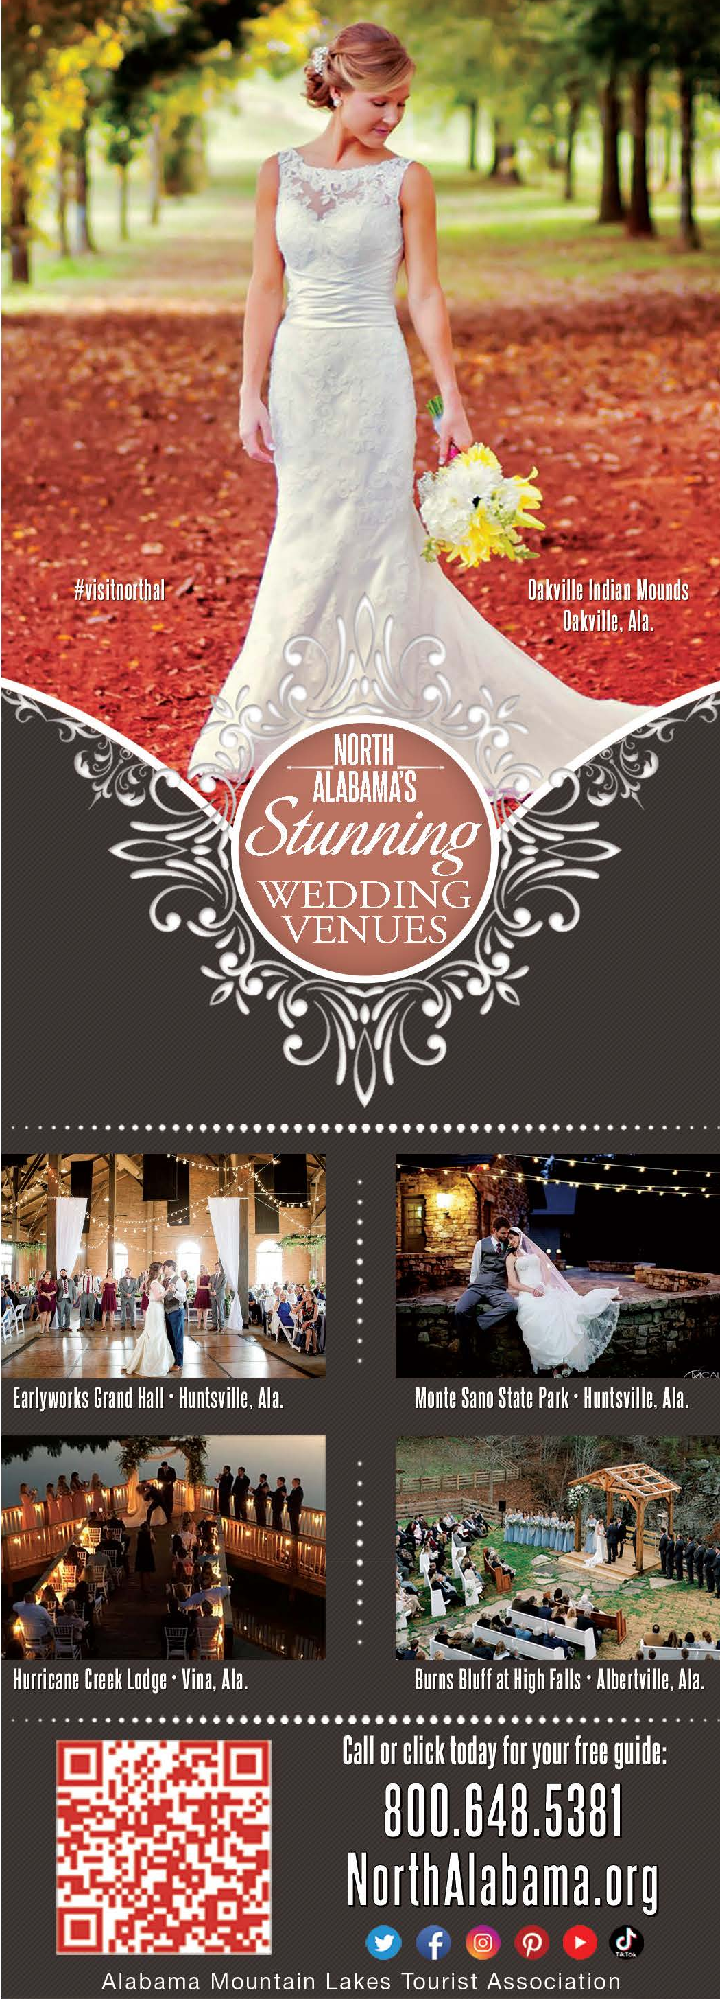
PRINT AND INTERNET ADVERTISING
HARTSELLE LIVING MAGAZINE
Half-page, March-April issue
ALABAMA MOUNTAIN LAKES TOURIST ASSOCIATION

Slide 15

PRINT AND INTERNET ADVERTISING
NORTH ALABAMA BRIDAL DIRECTORY
Full-page, Spring-Summer issue
ALABAMA MOUNTAIN LAKES TOURIST ASSOCIATION

Slide 16
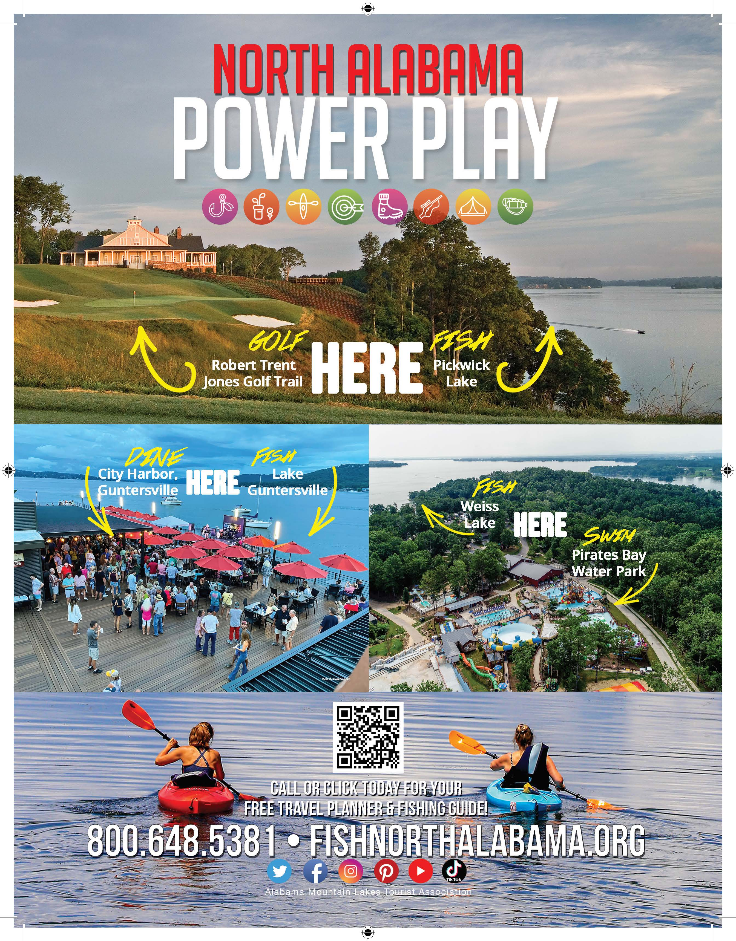
PRINT AND INTERNET ADVERTISING
HOOK & BARREL
MAGAZINE
Full-page, March-April issue
ALABAMA MOUNTAIN LAKES TOURIST ASSOCIATION

Slide 17
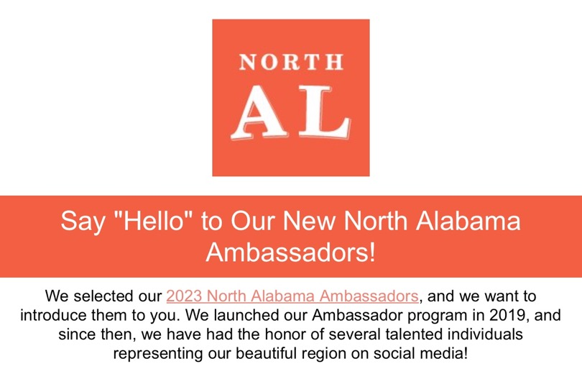
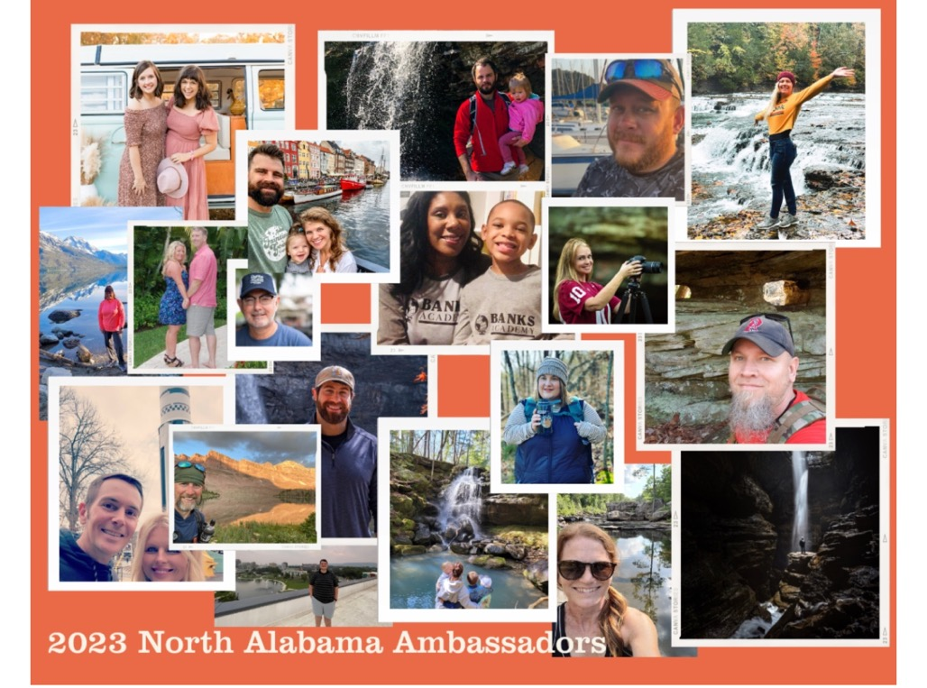
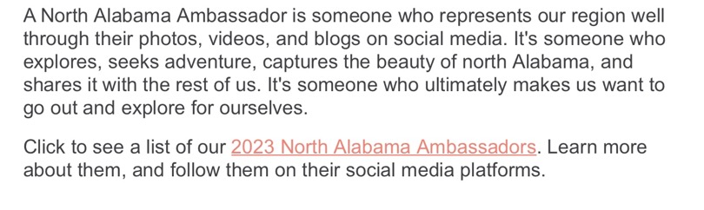
INTERNET MARKETING
21 POPULAR BLOGGERS SELECTED FOR 2023 NORTH ALABAMA AMBASSADOR PROGRAM
ALABAMA MOUNTAIN LAKES TOURIST ASSOCIATION

Slide 18
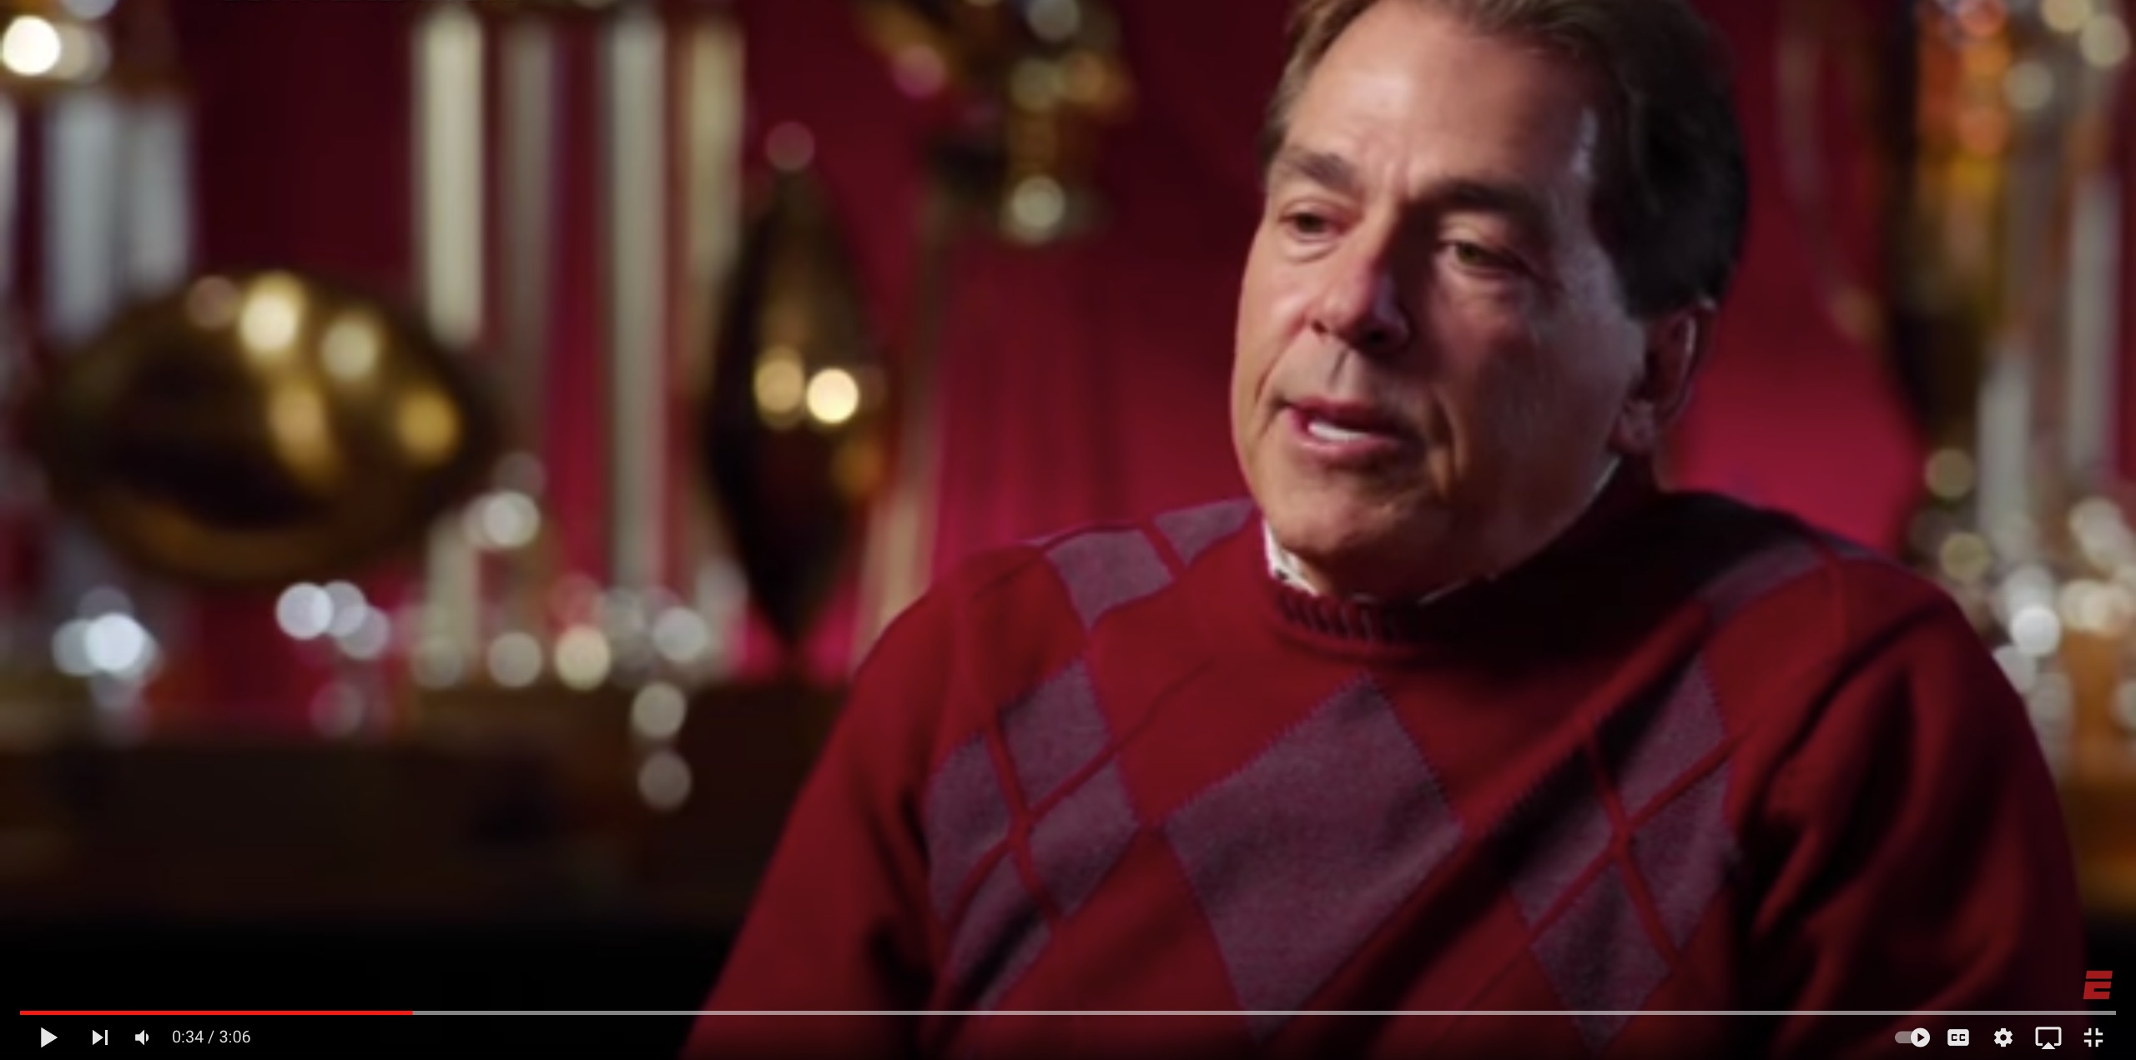
INTERNET MARKETING
AMLA WORKING IN PARTNERSHIP WITH THE APPALACHIAN REGIONAL COMMISSION TO DEVELOP VIDEO SERIES WITH UNIVERSITY OF ALABAMA FOOTBALL COACH NICK SABAN TO PROMOTE THE QUALITY OF LIFE AND HERITAGE OF THE NORTH ALABAMA REGION.
ALABAMA MOUNTAIN LAKES TOURIST ASSOCIATION

Slide 19

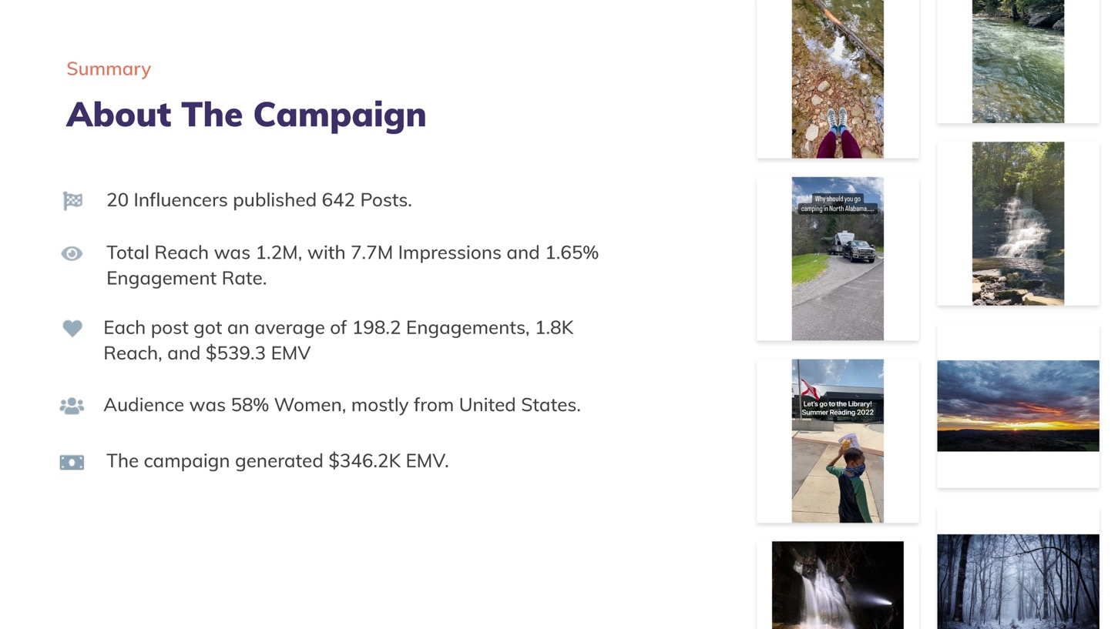
INTERNET MARKETING
ALABAMA MOUNTAIN LAKES TOURIST ASSOCIATION

Slide 20
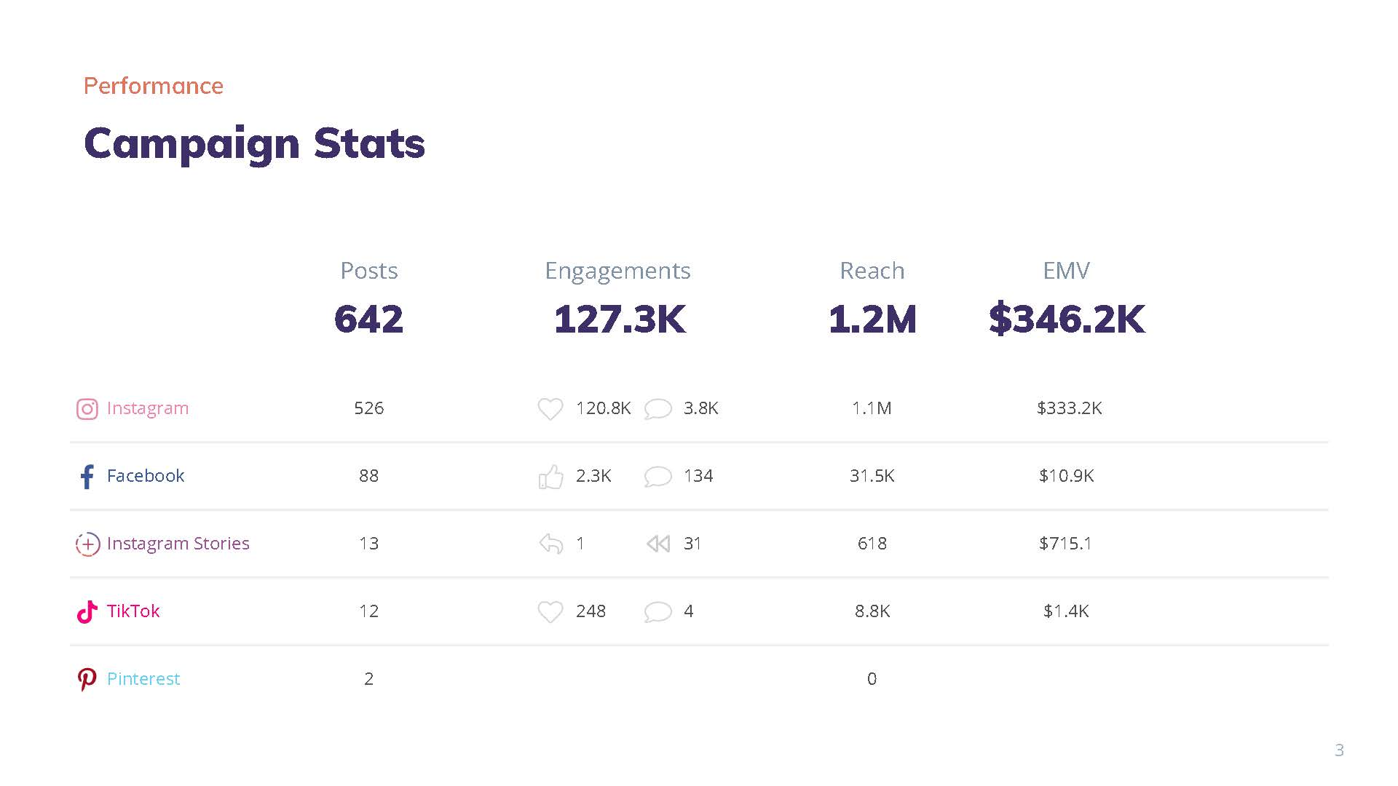
INTERNET MARKETING
ALABAMA MOUNTAIN LAKES TOURIST ASSOCIATION

Slide 21
INTERNET MARKETING
UNEXPECTED ADVENTURES IN NORTH ALABAMA PODCAST
ALABAMA MOUNTAIN LAKES TOURIST ASSOCIATION

Slide 22
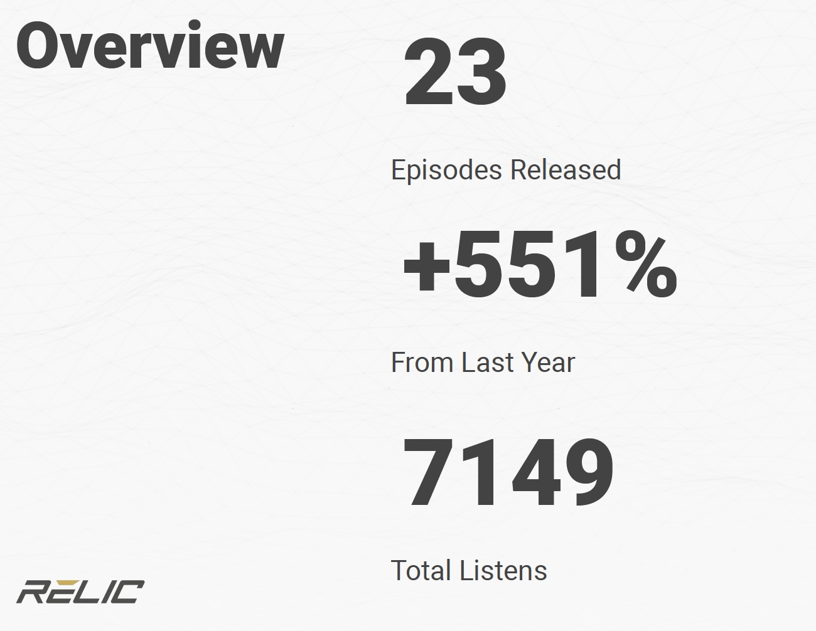
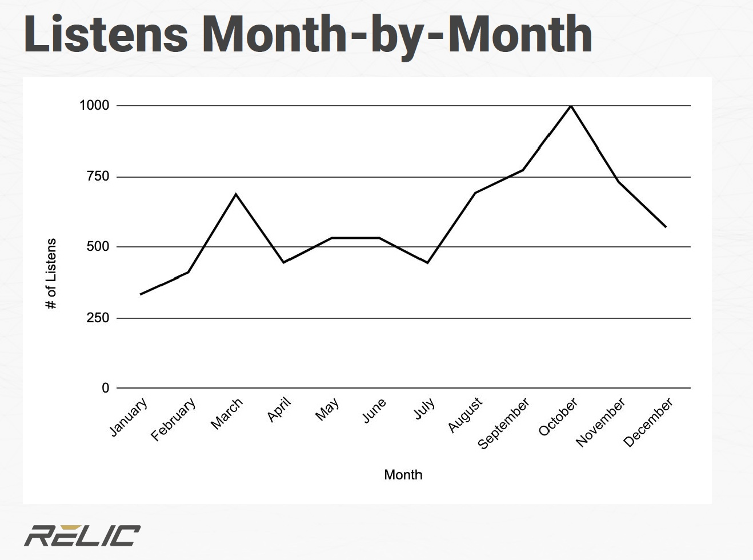
INTERNET MARKETING
UNEXPECTED ADVENTURES IN NORTH ALABAMA PODCAST
ALABAMA MOUNTAIN LAKES TOURIST ASSOCIATION

Slide 23
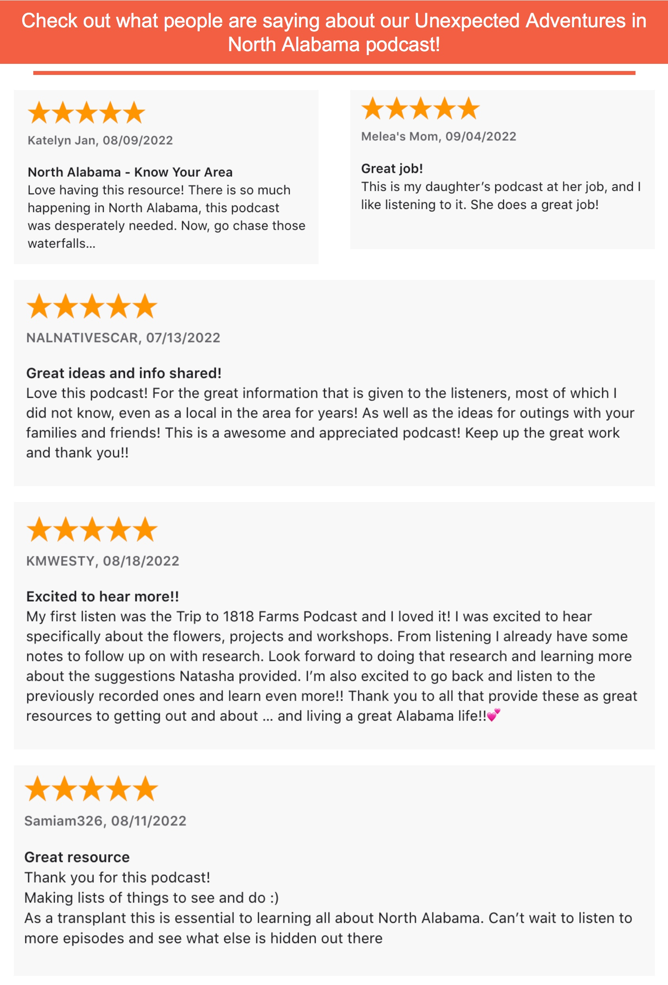
INTERNET MARKETING
ALABAMA MOUNTAIN LAKES TOURIST ASSOCIATION

Slide 24
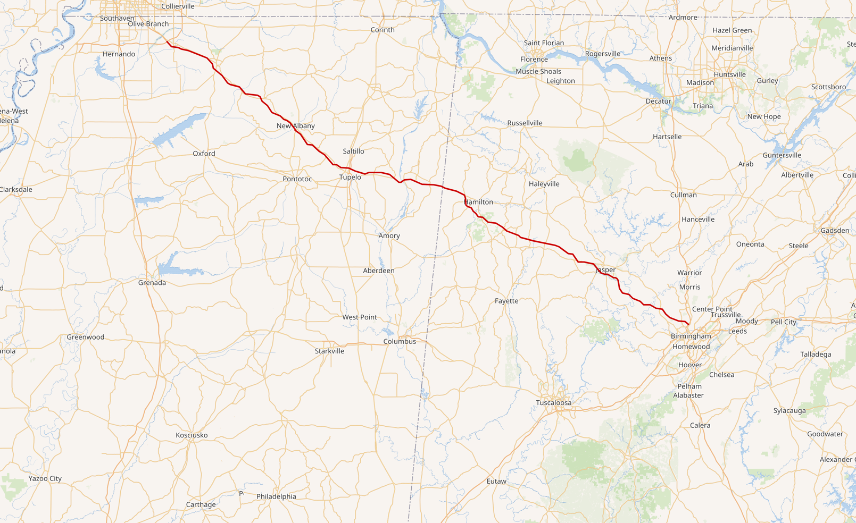

PRINT MARKETING
I-22 DESTINATIONS BROCHURE BEING DEVELOPED
ALABAMA MOUNTAIN LAKES TOURIST ASSOCIATION

Slide 25

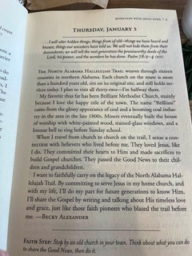
PRINT MARKETING
Our Hallelujah Trail made a devotion book and we have had around 50 requests for this trail.
ALABAMA MOUNTAIN LAKES TOURIST ASSOCIATION

Slide 26
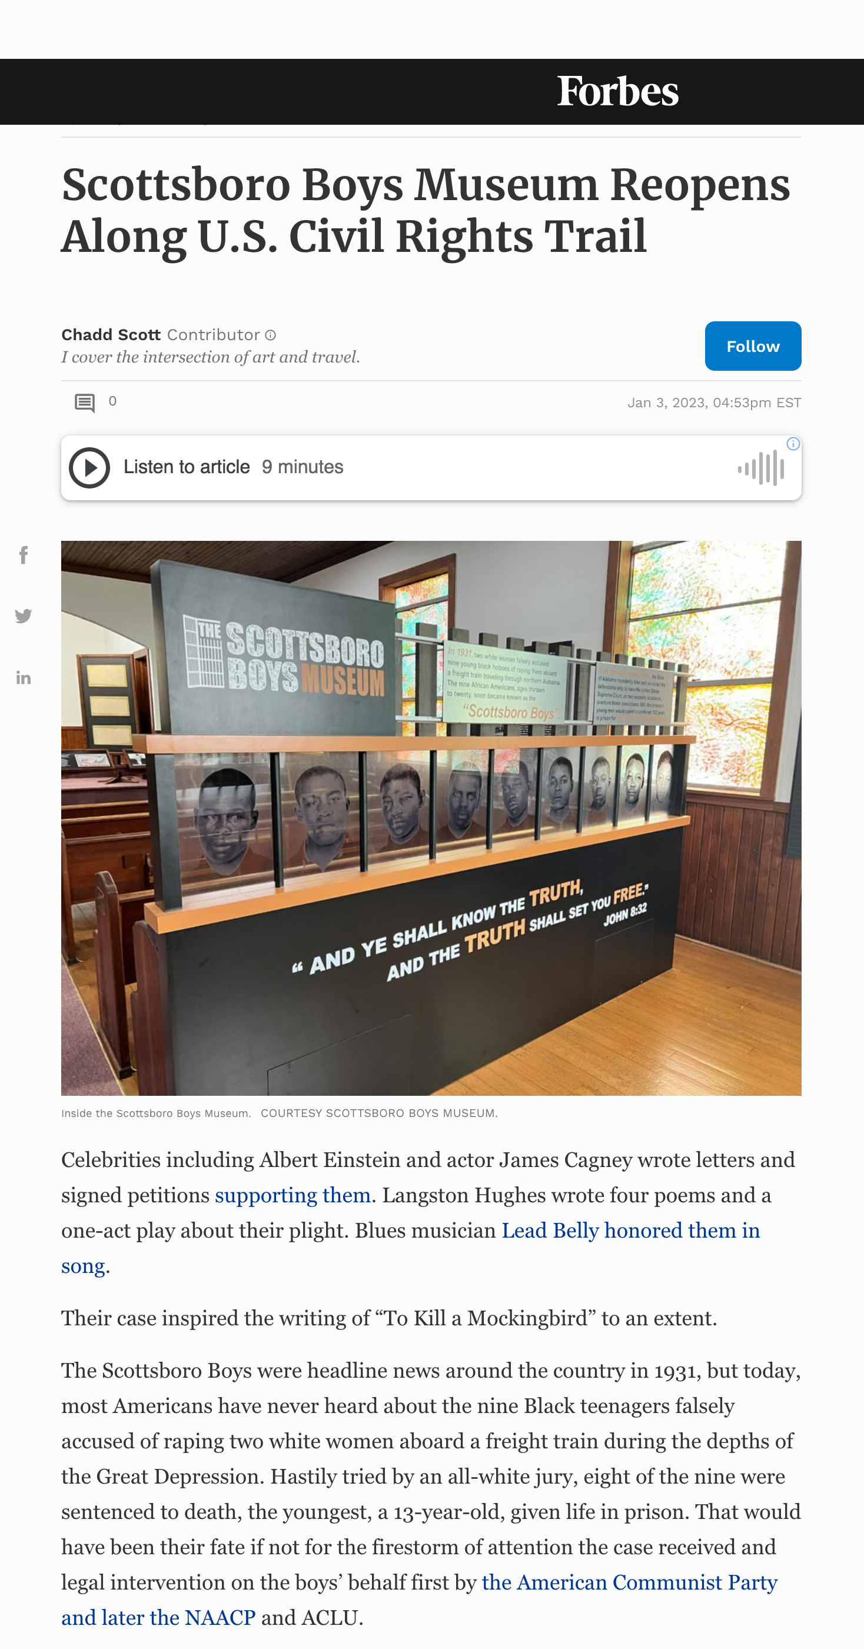
PRINT MARKETING
ALABAMA MOUNTAIN LAKES TOURIST ASSOCIATION

Slide 27

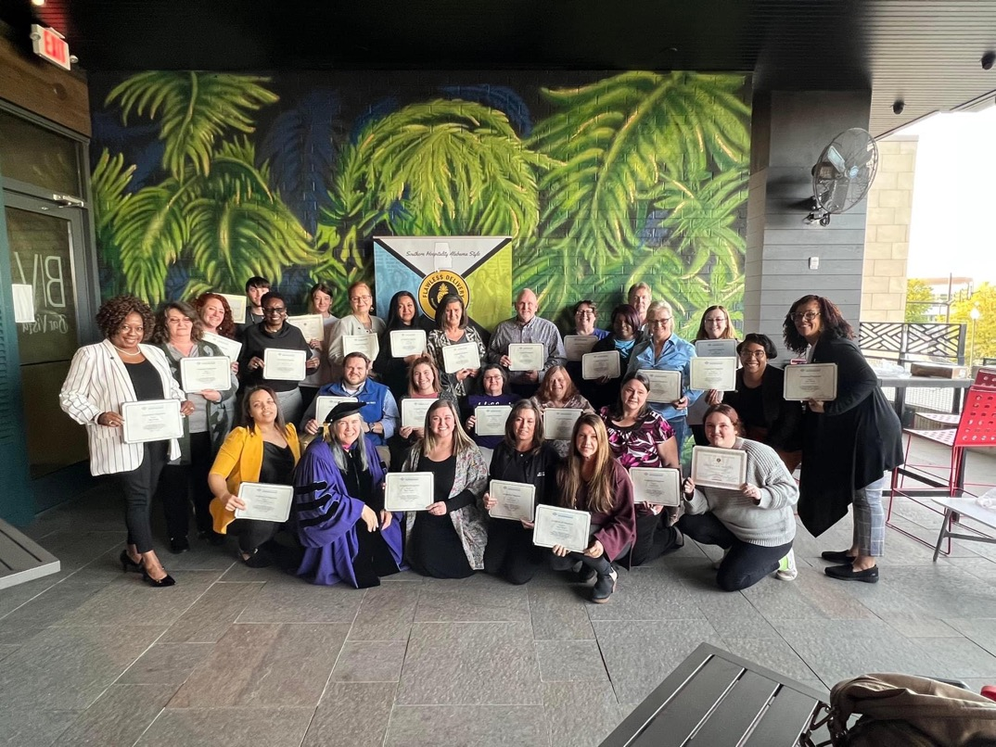
EDUCATION/WORKFORCE
FLAWLESS DELIVERY CUSTOMER SERVICE TRAINING PROGRAM CONTINUES
ALABAMA MOUNTAIN LAKES TOURIST ASSOCIATION

Slide 28
EDUCATION/WORKFORCE
Basic Details on First Five Flawless Classes:
*We have trained 5 classes to date, with 1 scheduled the week of the meeting on Wed/Thu. (20 more participants are scheduled for this class)
*We’ve trained a total of 76 hospitality and tourism professionals/front line workers to date.
*We have trained Front Desk, Housekeeping Managers, Housekeepers, Maintenance Supervisors, Maintenance, GMs, AGMs, Supervisors, Sales Directors, Hosts/Hostesses, Sales Administrators, Banquet Managers, Inspectors, Welcome Center Staff, and varied Tourism Professionals throughout the region so far.
*We are partnering with hotels and hospitality professionals throughout the region, including the Hospitality and Culinary Arts team from UNA, to deliver this training throughout the North Alabama region to AMLA members and non-members alike to ensure the most memorable experience for our visitors throughout the region.
*We have received top ratings on all our evaluations with most participants thanking us for the training and letting us know that this has inspired them, re-energized them and their team, and they are excited to get back to work and implement these new techniques, skills, and ideas. Most have never been able to attend any professional development training ever in their past. This has been a tremendous difference in their overall moral, commitment and determination to grow their career in tourism!
ALABAMA MOUNTAIN LAKES TOURIST ASSOCIATION

Slide 29
EDUCATION/WORKFORCE
• What are the program goals?
Flawless Delivery is a customer service training program designed for frontline housekeeping, front desk personnel and sales coordinators that incorporates a strong foundation of empathy, communication and engagement in order to demonstrate the quality of service necessary to retain guests in today’s competitive environment. The training consists of 20 hours over the course of two days and one evening and uses gamification, small group projects, role play, team building exercises and lecture to engage participants.
The main goal of the program is to equip frontline workers with the skills needed so they can communicate and engage with guests as well as with coworkers in order to deliver the quality of service the traveling public has come to expect.
Goals of Flawless Delivery Customer Service Training:
- To equip frontline workers with the basics of customer service
- To improve customer service skills to reflect authenticity and engagement
- To improve verbal and nonverbal communication skills and how to become an active listener
- To increase employee motivation
- To increase employee emotional intelligence and how to manage emotions in the workplace
- To demonstrate effective stress management techniques and how to manage work-related stress and build resilience
- To improve conflict management and resolution skills and how to negotiate positive outcomes
ALABAMA MOUNTAIN LAKES TOURIST ASSOCIATION

Slide 30

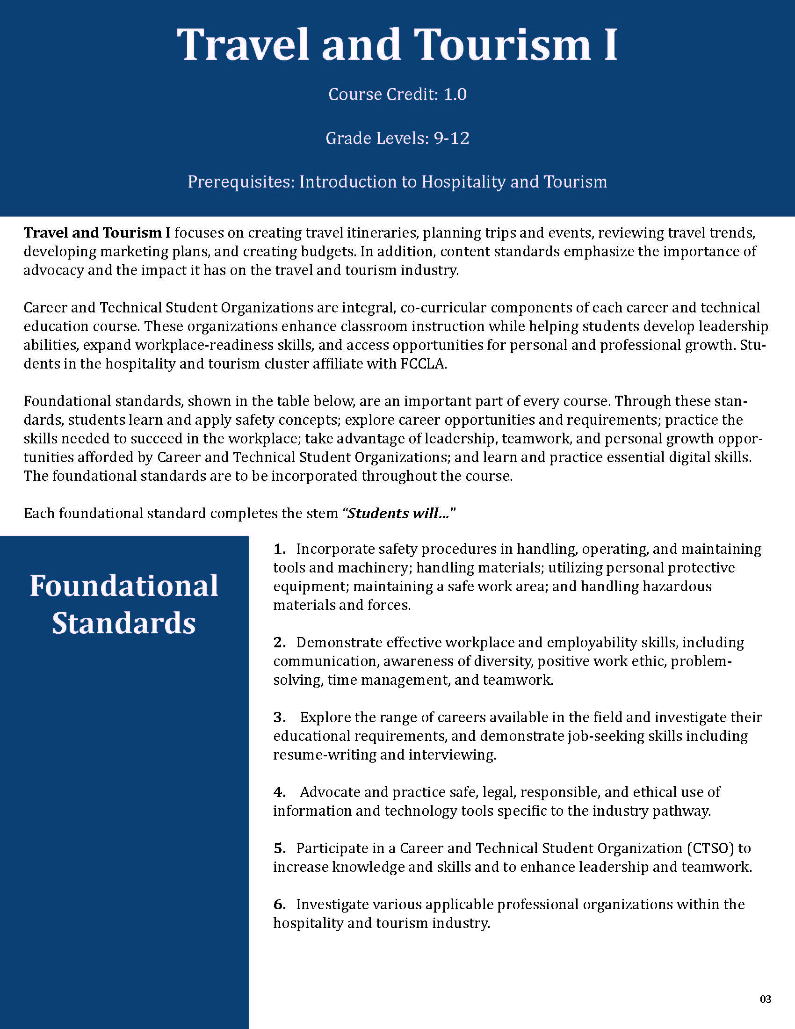
EDUCATION/WORKFORCE
NORTH ALABAMA TOURISM CURRICULUM DEVELOPED
ALABAMA MOUNTAIN LAKES TOURIST ASSOCIATION

Slide 31

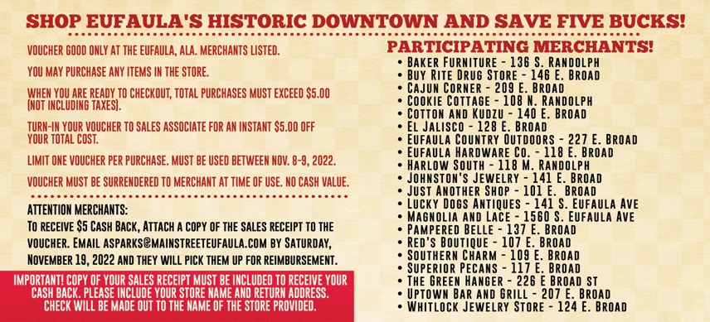
EDUCATION/WORKFORCE
Green Hanger $1018.35 6
Superior Pecans $431.11 7
Cajun Corner $577.97 9
Just Another Shop $338.85 10
Red's Boutique $869.67 8
Magnolia & Lace $267.69 2
Johnston Jewelry $138.5 2
Buy Rite Drug Store $237.74 3
Southern Charm $1111.11 17
Pampered Belle $443.64 6
Cookie Cottage $95.30 4
El Jalisco $154.98 5
GRAND TOTAL $5,684.91
79 Vouchers redeemed x $5 = $395 cost of program
TRACKING TOURISM DOLLARS EXERCISE
ALABAMA MOUNTAIN LAKES TOURIST ASSOCIATION

Slide 32
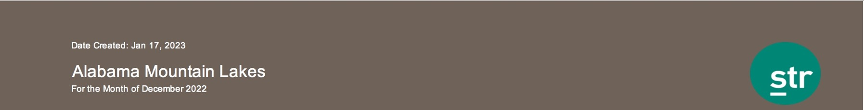
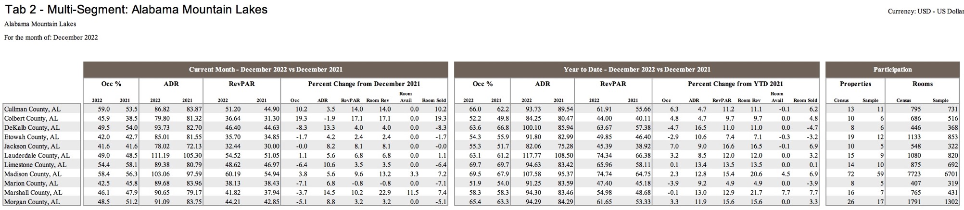
EDUCATION/WORKFORCE
TRACKING TOURISM DOLLARS EXERCISE
ALABAMA MOUNTAIN LAKES TOURIST ASSOCIATION

Slide 33
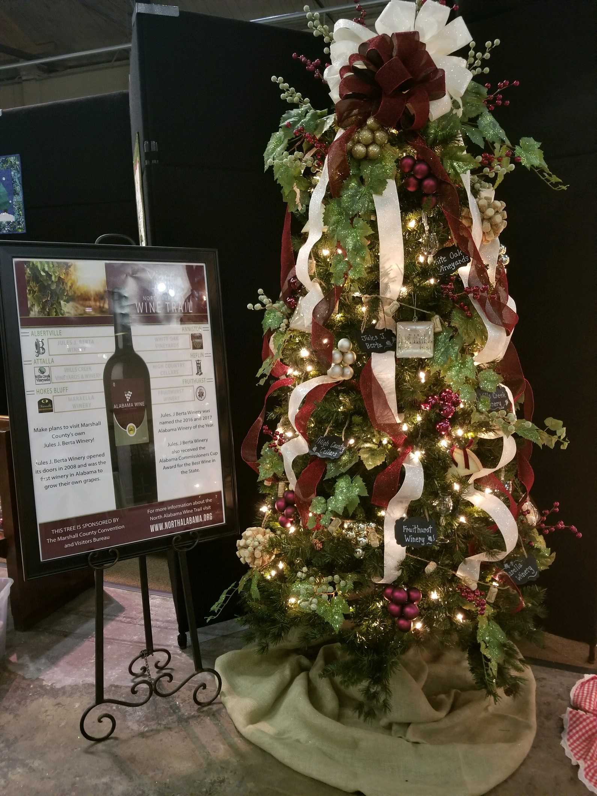
LOCATION MARKETING
ALABAMA WINE TRAIL PROMOTION NOVEMBER-DECEMBER
MARSHALL COUNTY
ALABAMA MOUNTAIN LAKES TOURIST ASSOCIATION

Slide 34
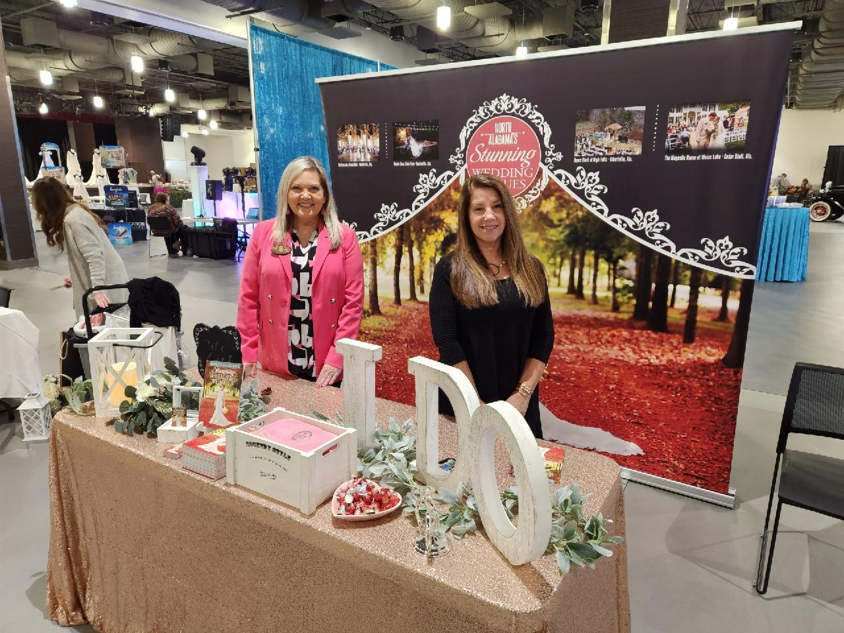
LOCATION MARKETING
AMLA Exhibit at the Gadsden Bridal Show
ALABAMA MOUNTAIN LAKES TOURIST ASSOCIATION

Slide 35
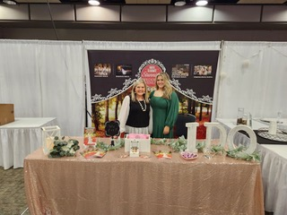
LOCATION MARKETING
AMLA Exhibit at Modern Bride Show at VBC Huntsville
ALABAMA MOUNTAIN LAKES TOURIST ASSOCIATION

Slide 36
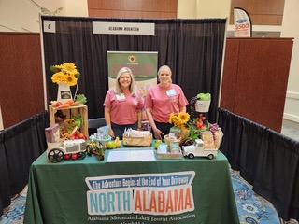
LOCATION MARKETING
ALFA Annual Conference in November in Montgomery
ALABAMA MOUNTAIN LAKES TOURIST ASSOCIATION

Slide 37
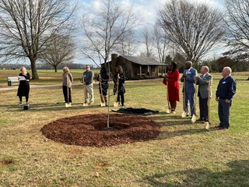
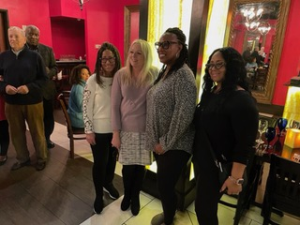
LOCATION MARKETING
Granddaughters of Olympic Star Jesse Owens on Hand for Planting of Memorial Tree
ALABAMA MOUNTAIN LAKES TOURIST ASSOCIATION

Slide 38
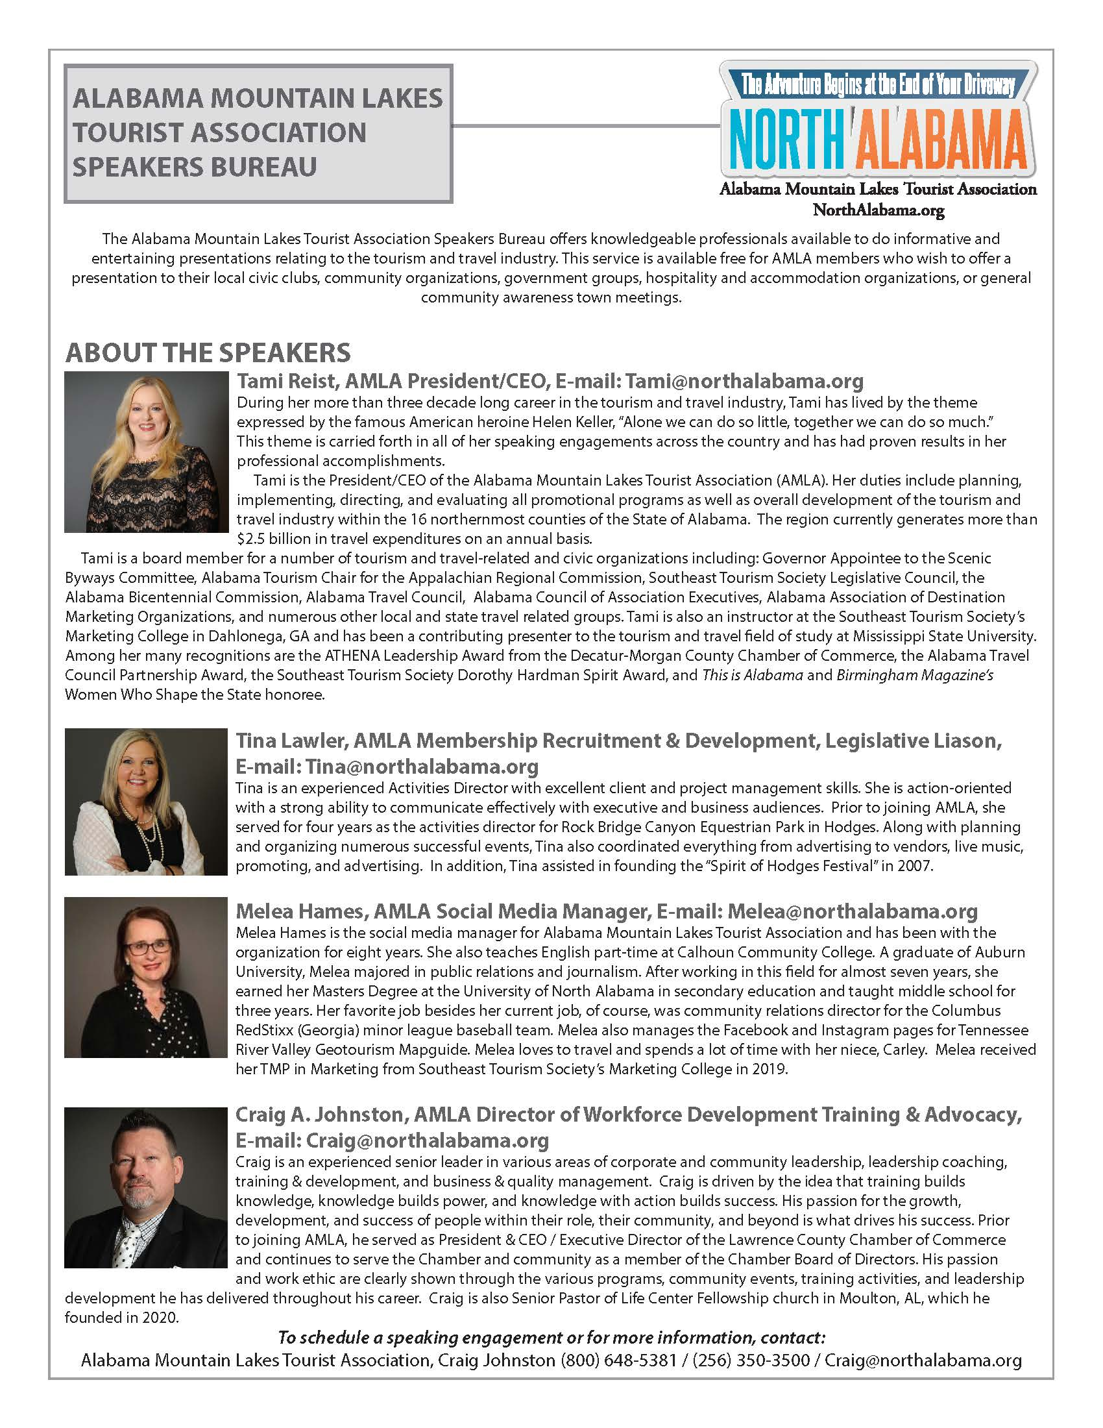
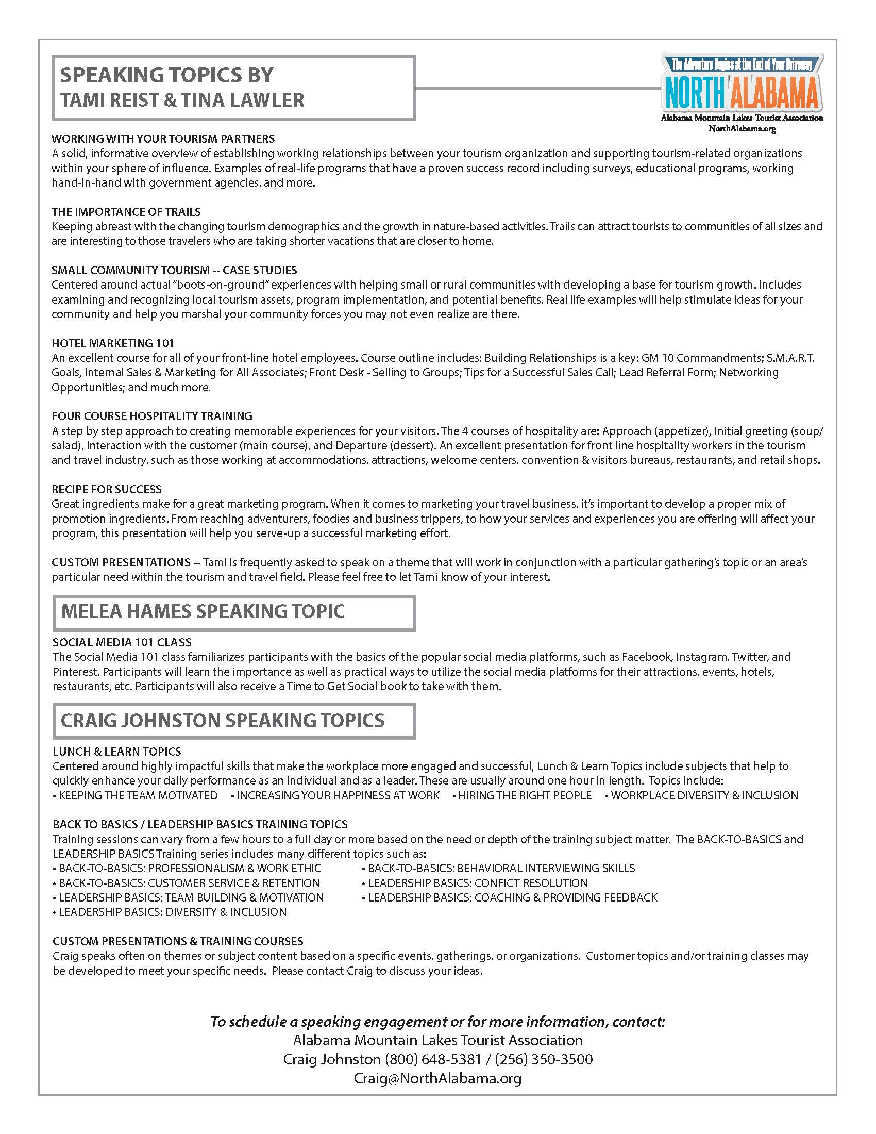
MEMBER SERVICES
Topic Offerings Expanded in the Updated AMLA Speakers Bureau
ALABAMA MOUNTAIN LAKES TOURIST ASSOCIATION

Slide 39
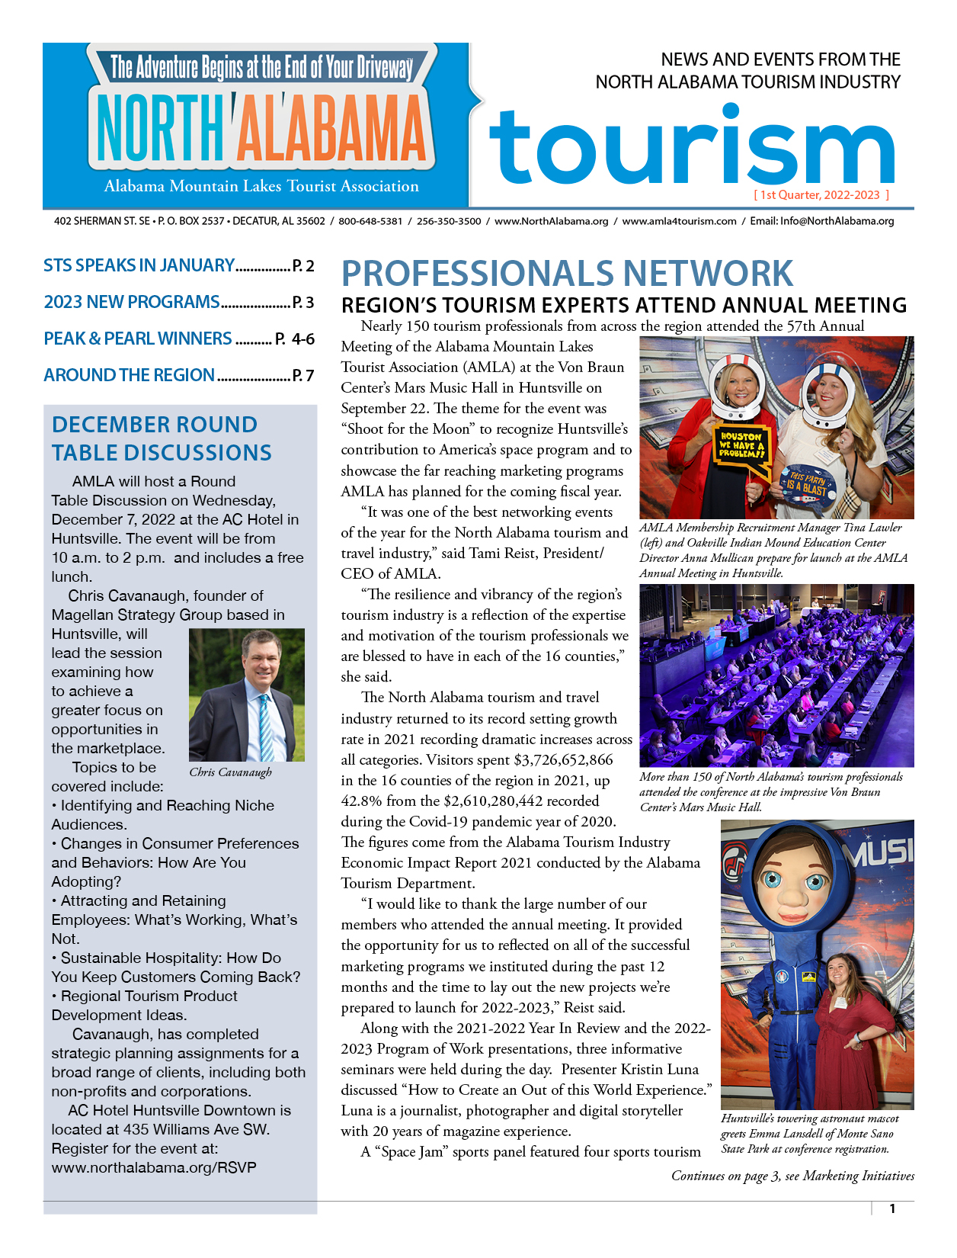
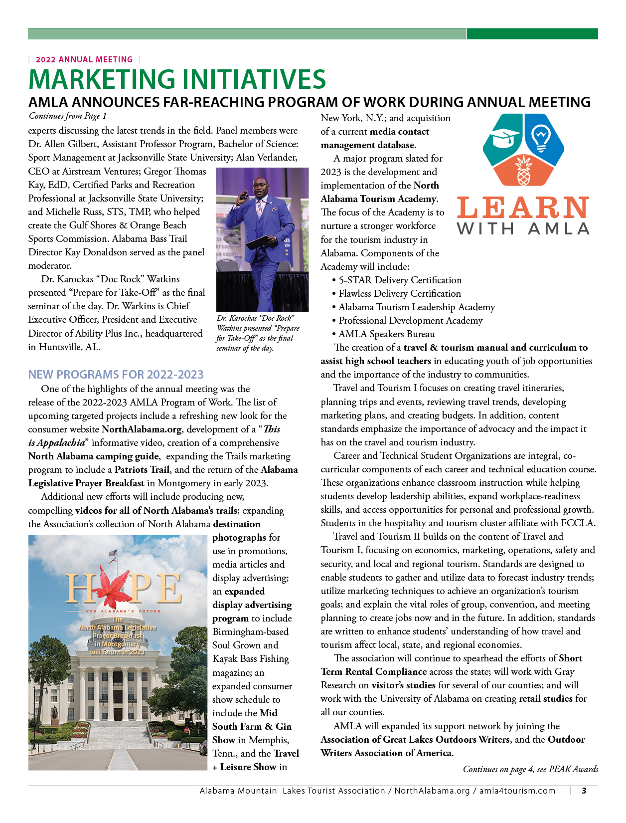
MEMBER SERVICES
1ST QUARTER NEWSLETTER PRODUCED IN DECEMBER
ALABAMA MOUNTAIN LAKES TOURIST ASSOCIATION

Slide 40
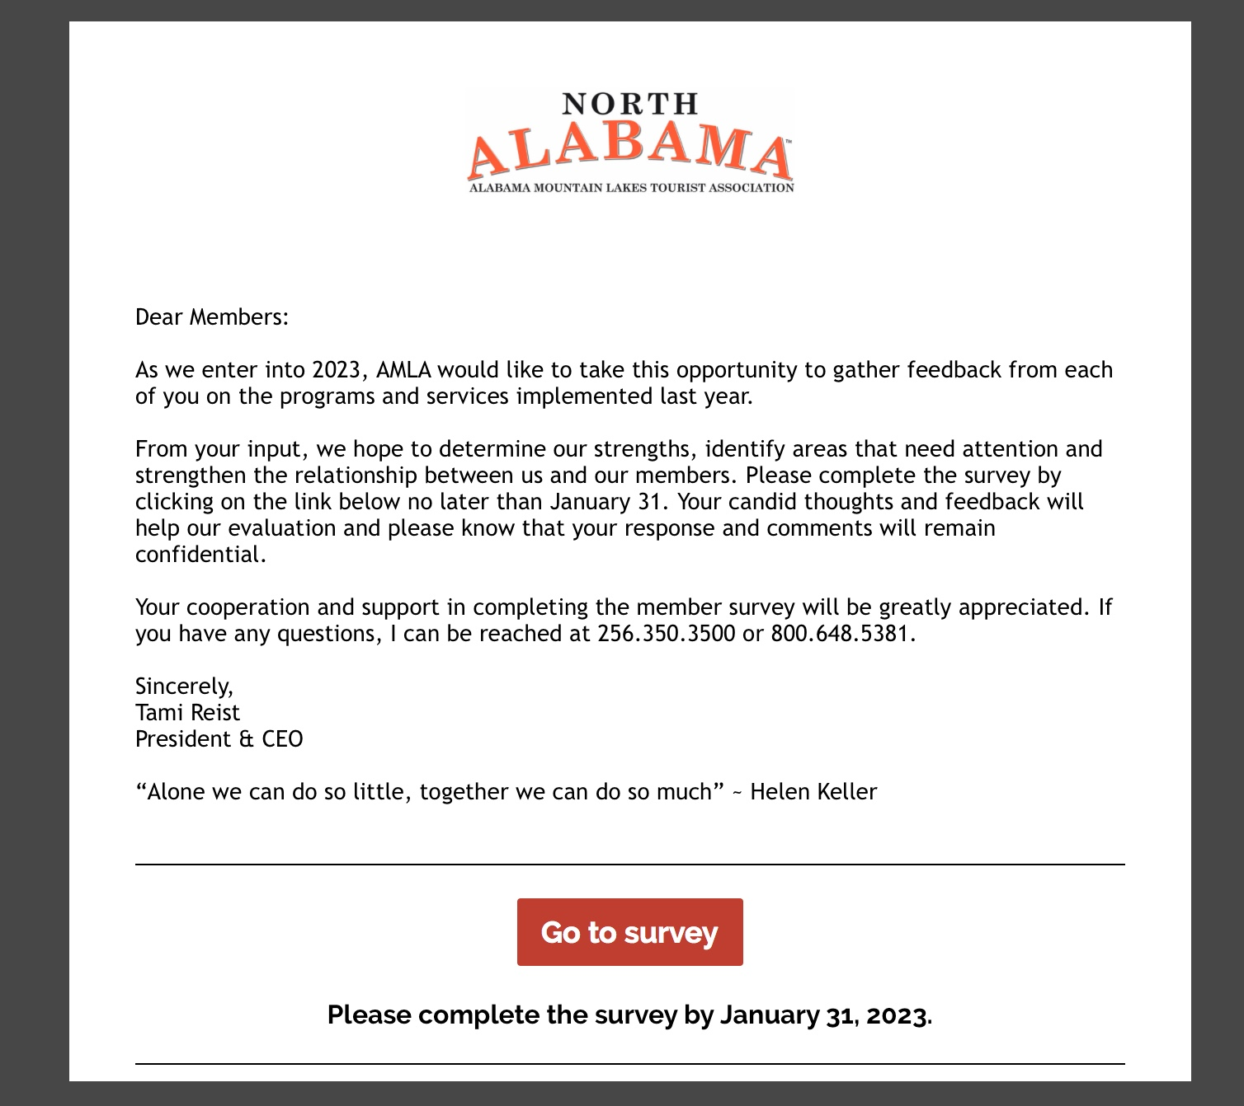
MEMBER SERVICES
AMLA MEMBER SURVEY UNDERWAY. RESPONSE DUE JAN. 31, 2023.
ALABAMA MOUNTAIN LAKES TOURIST ASSOCIATION

Slide 41
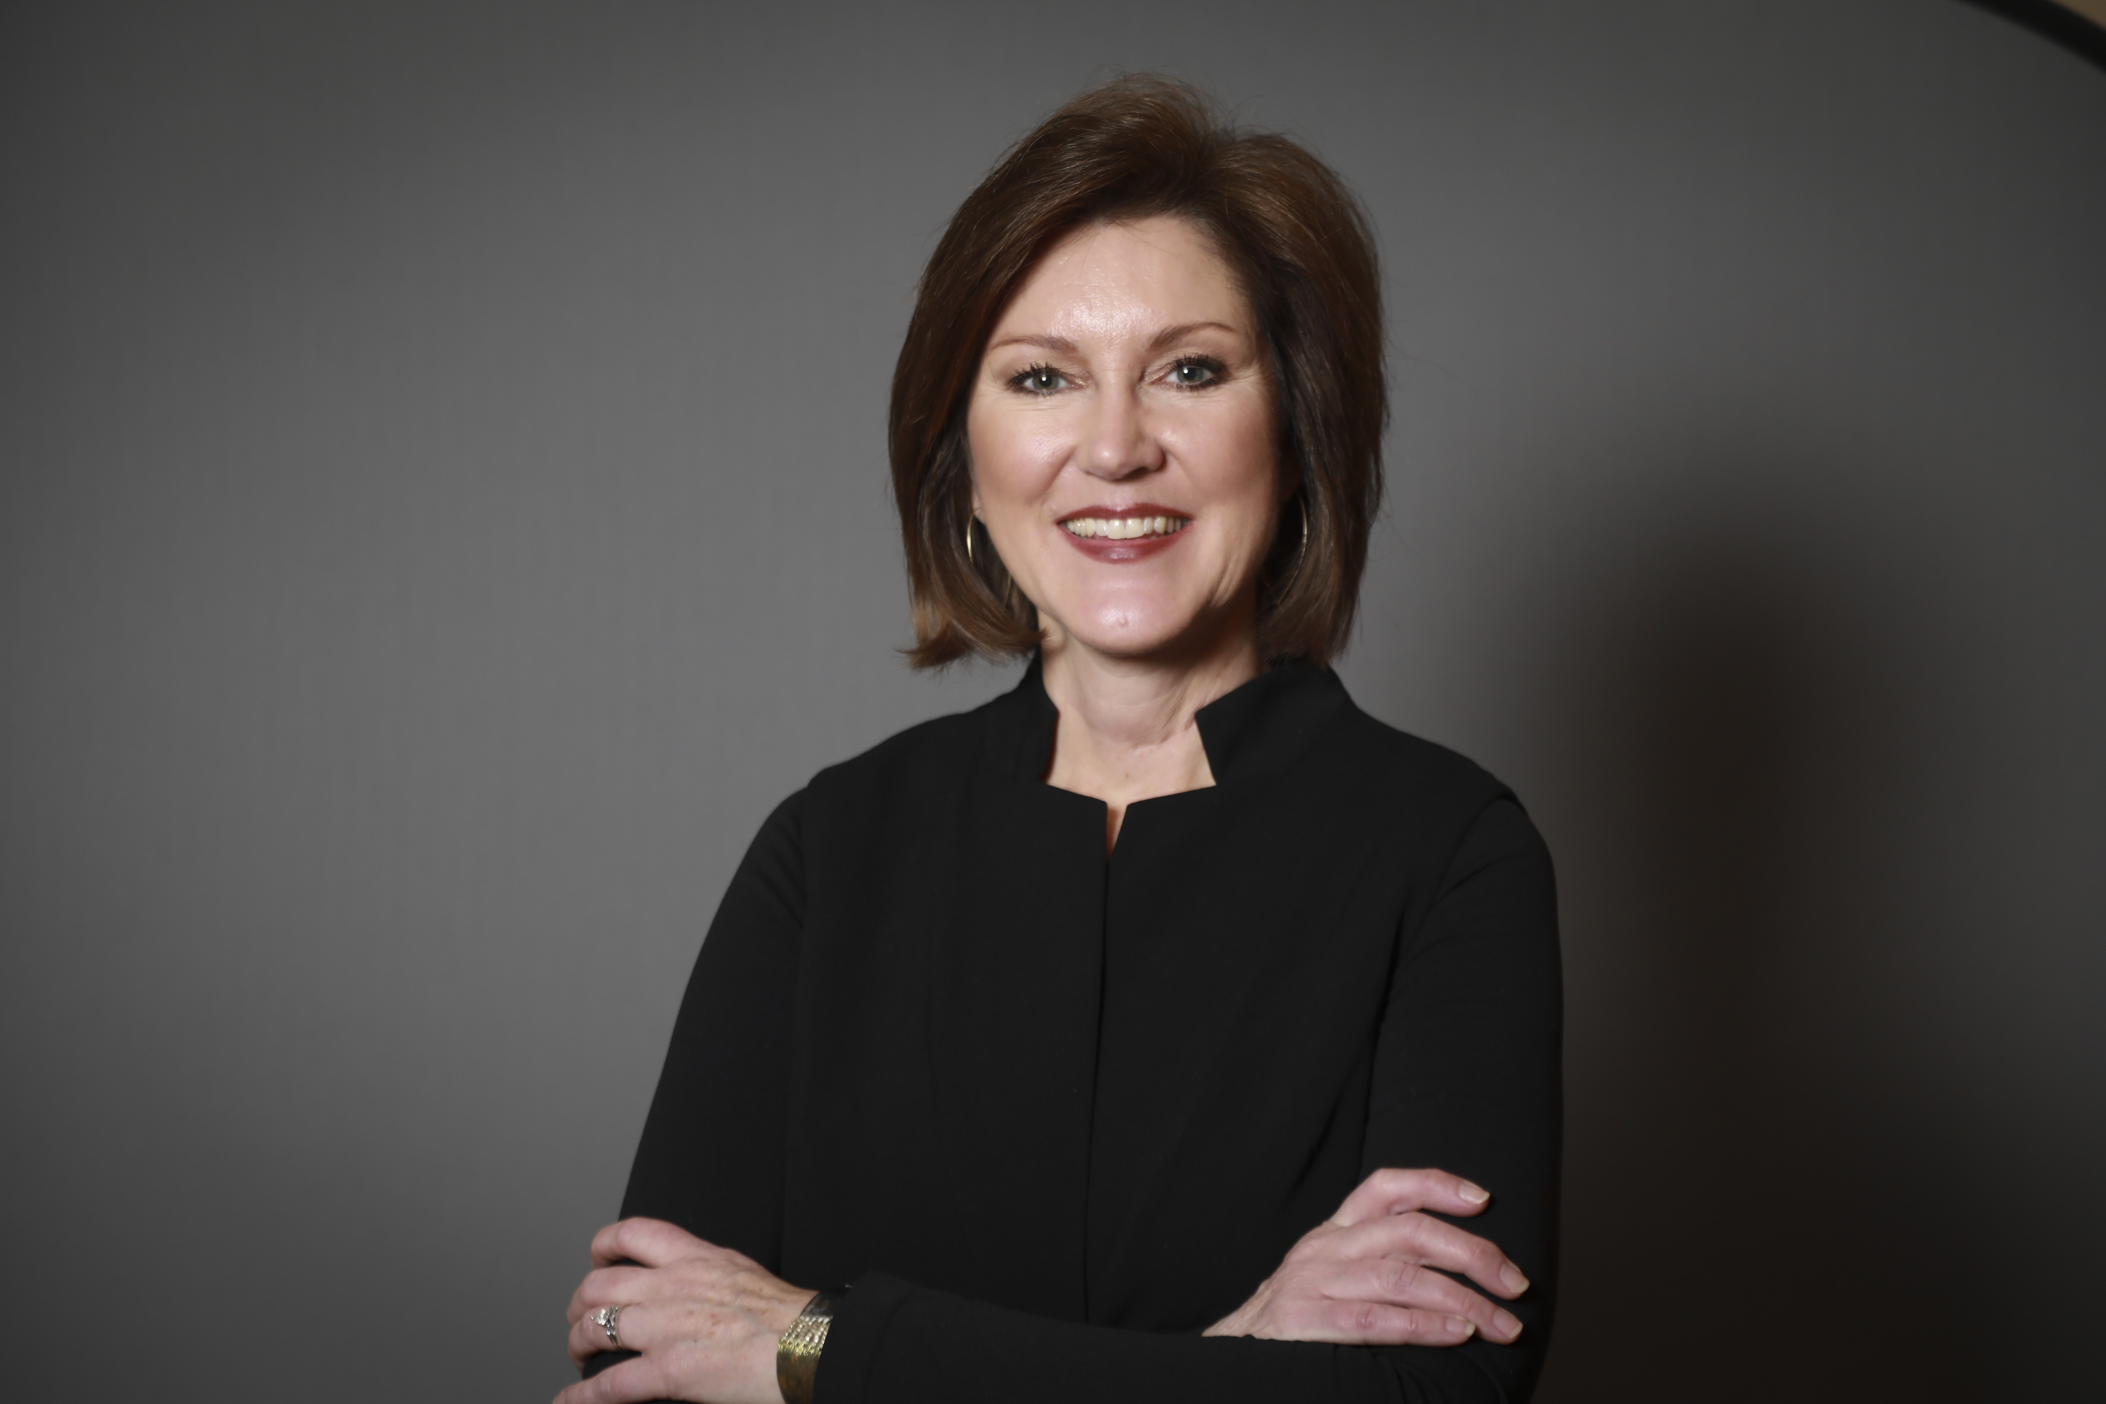
MEMBER SERVICES
Hired Karen Beasley as AMLA
Director of Marketing and Communications
ALABAMA MOUNTAIN LAKES TOURIST ASSOCIATION

Slide 42
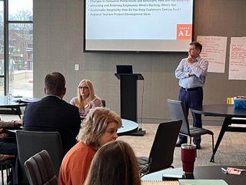
MEMBER SERVICES
Chris Kavanaugh of Magellan Strategy Group at AMLA Roundtable Meeting at AC Hotel, Huntsville, in December
ALABAMA MOUNTAIN LAKES TOURIST ASSOCIATION

Slide 43


MEMBER SERVICES
REQUEST FOR FESTIVAL INFORMATION SENT TO MEMBERS
ALABAMA MOUNTAIN LAKES TOURIST ASSOCIATION

Slide 44


RESOURCES
LAPEL STICKERS PRODUCED FOR GIVEAWAY
TO CHILDREN AT AG TRAVEL SHOWS
ALABAMA MOUNTAIN LAKES TOURIST ASSOCIATION

Slide 45

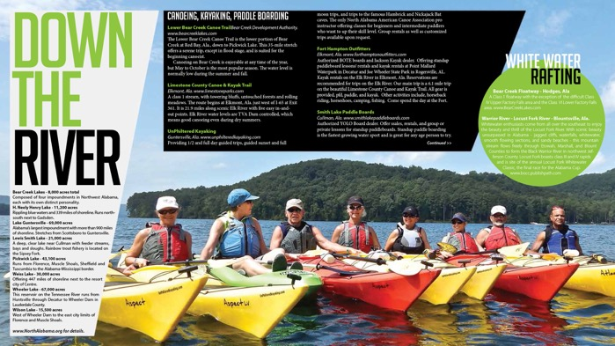
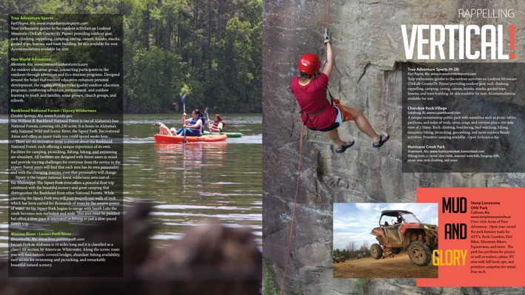
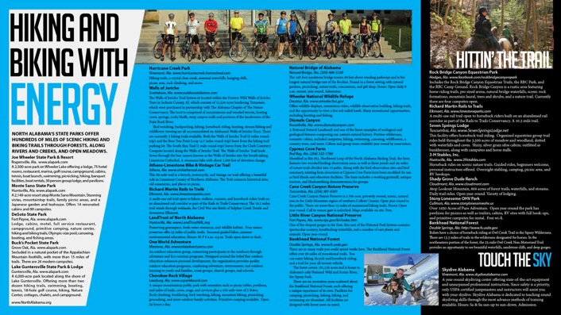
RESOURCES
NORTH ALABAMA OUTDOORS BROCHURE UPDATED AND PRINTED
ALABAMA MOUNTAIN LAKES TOURIST ASSOCIATION

Slide 46

RESOURCES
NORTH ALABAMA SCENICE MOTORCYCLE ROUTES BROCHURE UPDATED AND PRINTED
ALABAMA MOUNTAIN LAKES TOURIST ASSOCIATION

Slide 47

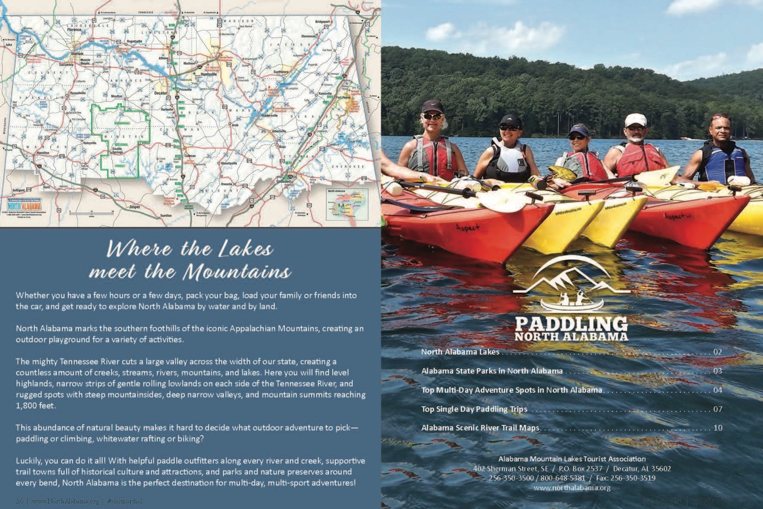
RESOURCES
NEW PADDLING NORTH ALABAMA BOOKLET DEVELOPED FOR USE AT PADDLING/KAYAK SHOWS
ALABAMA MOUNTAIN LAKES TOURIST ASSOCIATION

Slide 48


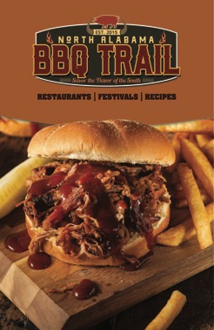


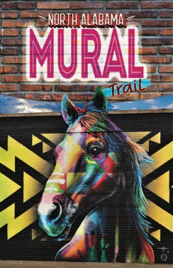
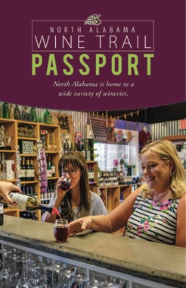

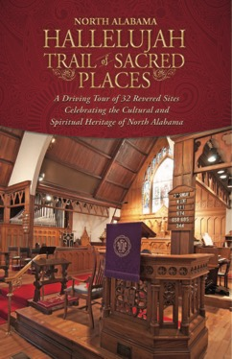




RESOURCES
48-PAGE TRAIL MIX BOOKLET PRODUCED
ALABAMA MOUNTAIN LAKES TOURIST ASSOCIATION

Slide 49
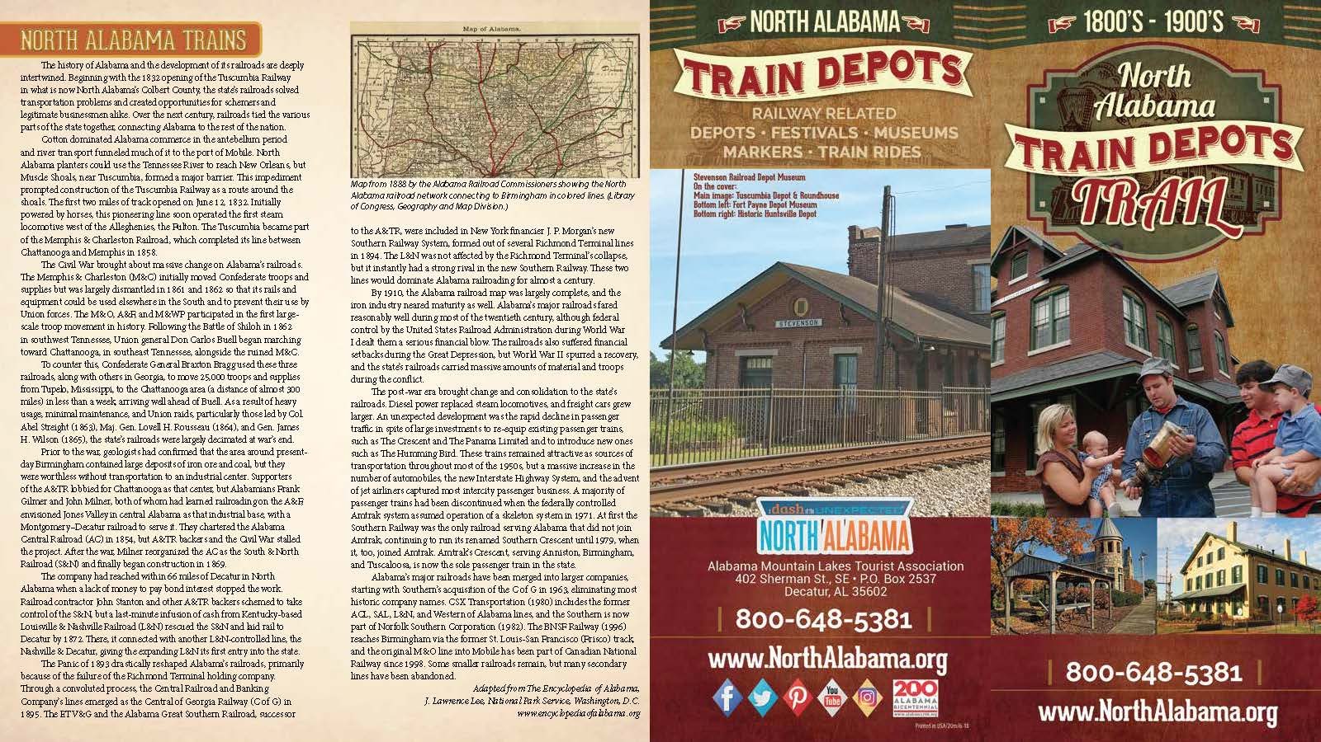
RESOURCES
NORTH ALABAMA HISTORIC TRAIN DEPOTS TRAIL BROCHURE UPDATED AND PRINTED
ALABAMA MOUNTAIN LAKES TOURIST ASSOCIATION

Slide 50
RESOURCES
I-22 DESTINATIONS BROCHURE BEING DEVELOPED
ALABAMA MOUNTAIN LAKES TOURIST ASSOCIATION

Slide 51
RESOURCES
NORTH ALABAMA TRAIL MIX PULL UP DISPLAY
ALABAMA MOUNTAIN LAKES TOURIST ASSOCIATION

Slide 52
RESOURCES
LEARN WITH AMLA
PULL UP DISPLAY
ALABAMA MOUNTAIN LAKES TOURIST ASSOCIATION

Slide 53
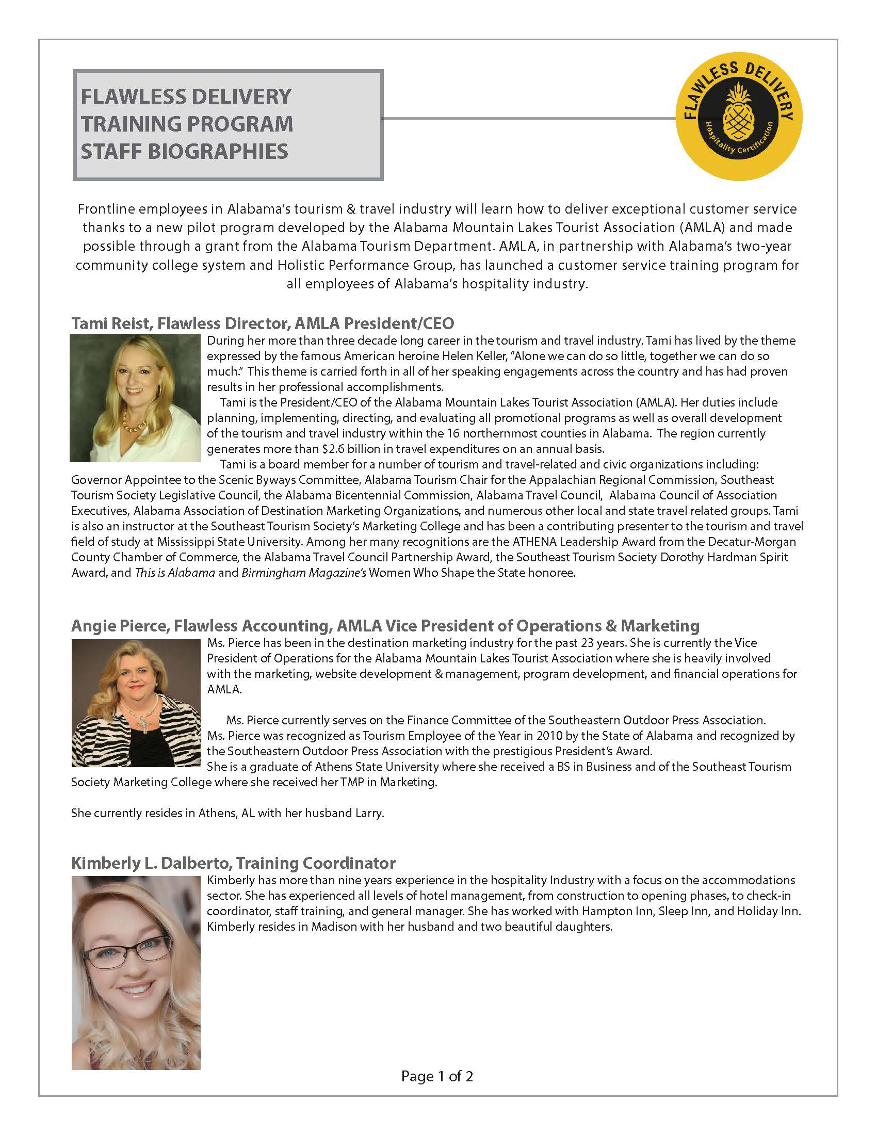
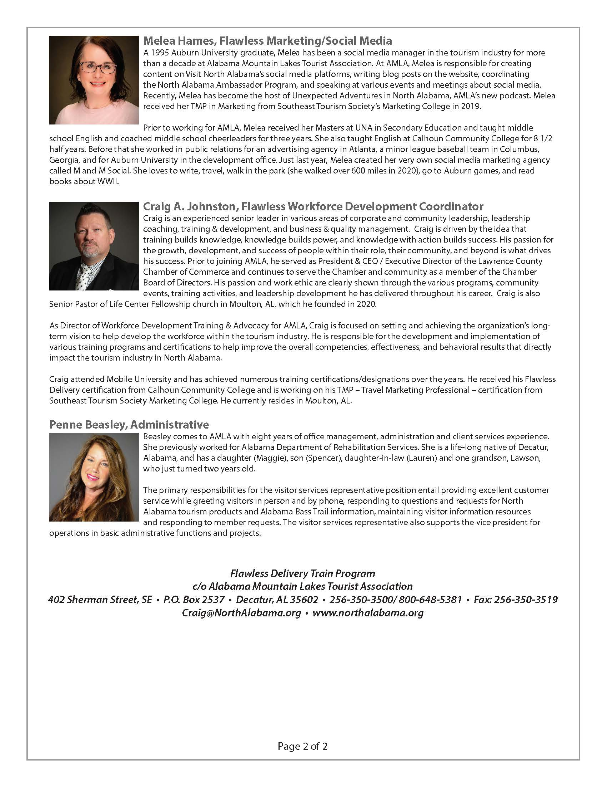
RESOURCES
FLAWLESS DELIVERY STAFF BIOS PRODUCED
ALABAMA MOUNTAIN LAKES TOURIST ASSOCIATION

Slide 54




RESOURCES
5 COURSE HOSPITALITY INFORMATION PIECE PRODUCED
ALABAMA MOUNTAIN LAKES TOURIST ASSOCIATION

Slide 55

RESOURCES
FLAWLESS DELIVERY NAME BADGES PRODUCED
ALABAMA MOUNTAIN LAKES TOURIST ASSOCIATION

Slide 56

RESOURCES
FLAWLESS DELIVERY BROCHURE DEVELOPED
ALABAMA MOUNTAIN LAKES TOURIST ASSOCIATION

Slide 57
RESOURCES
FLAWLESS DELIVERY
PROGRAM SPONSORS
PULL UP DISPLAY
ALABAMA MOUNTAIN LAKES TOURIST ASSOCIATION

Slide 58
RESOURCES
FLAWLESS DELIVERY PULL UP DISPLAY DEVELOPED
ALABAMA MOUNTAIN LAKES TOURIST ASSOCIATION

Slide 59

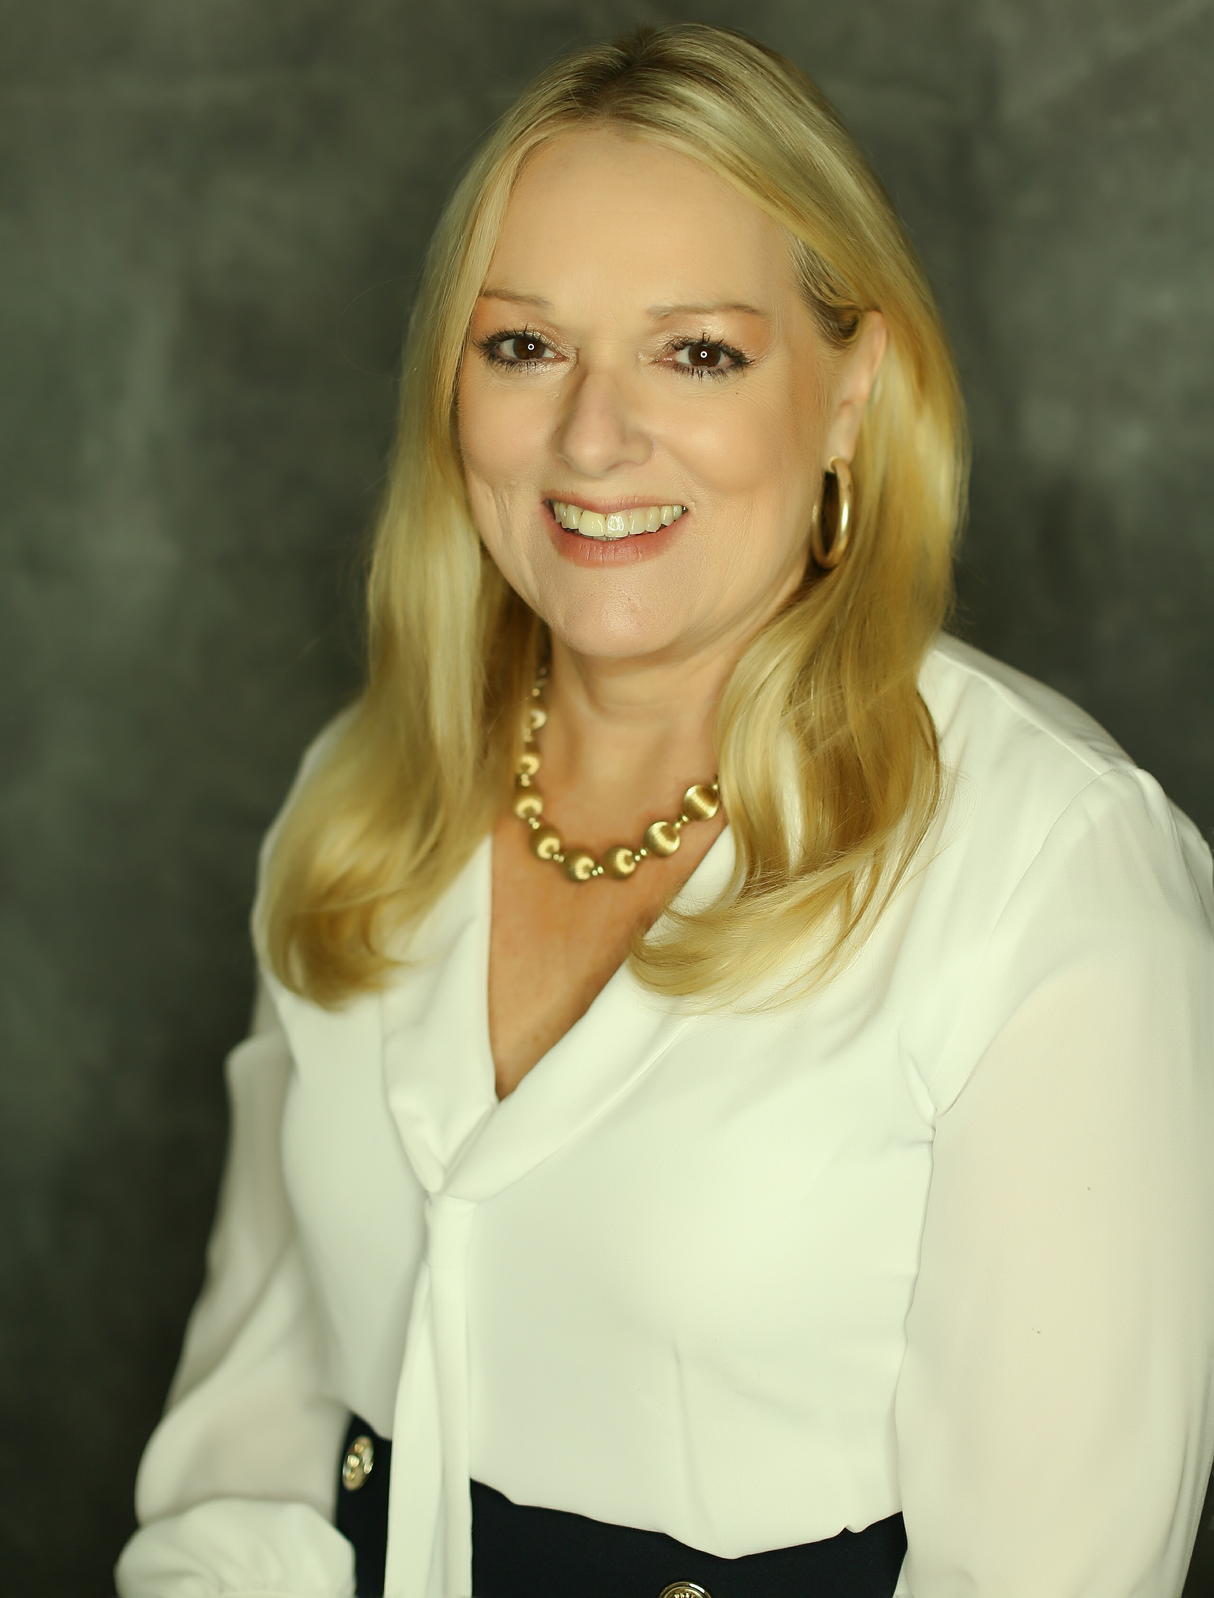
ADVOCACY
TAMI REIST APPOINTED TO TENNESSEE-TOMBIGBEE WATERWAY COUNCIL BOARD
ALABAMA MOUNTAIN LAKES TOURIST ASSOCIATION

Slide 60
ADVOCACY
Legislative Round Up
Final Session of the 117th Congress
Approved Policy Priorities | Advocacy Road Trip Talking Points
National Heritage Area Act, S. 1942: Establishes a standard criterium for the funding, management, and designation for national heritage areas and set an annual authorization of $1 million for each national heritage area. In additional, specifically for the Southeast, S. 1942:
o Authorize a feasibility study for the Great Dismal Swamp National Heritage Area in Virginia and North Carolina.
o Designate three new National Heritage Areas in the Southeast: Alabama Black Belt NHA, Southern Campaign of the American Revolution National Heritage Corridor in South Carolina and North Carolina, and the Northern Neck National Heritage Area in Virginia.
o Reauthorize 45 National Heritage Areas for 15 years, including 13 in the Southeast.
o Lift the funding cap for three Southeast National Heritage Areas: Blue Ridge, South Carolina National Heritage Corridor, and Wheeling.
o Final passage vote in the House, Roll Call #540: https://clerk.house.gov/Votes/2022540?Title=National%20Heritage%20Area%20Act
Visit American Act: Creates an assistant secretary position within the Department of Commerce focused on coordinating travel and tourism policy across federal stakeholders and formally authorizes the U.S. Travel and Tourism Advisory Board (TTAB) to serve as the advisory body to the Secretary and help develop a 10-year travel and tourism strategy that sets goals for international visitation and travel exports, and ensures domestic policy is optimal for achieving these priorities. (Currently the TTAB operates on a discretionary basis.)
National Scenic Byways Program funding: $20 million, an increase of $14 million over FY22.
National Park Service Operations Budget: $2.9 billion for the Operations, an increase of $156 million above FY22, which will restore 500 positions of the 3,000 lost over the last decade.
U.S. Forest Service Operations Budget: $3.91 billion for the Forest Service’s non-wildland fire management responsibilities, an increase of $222 million over FY22. These funding increases are expected to radically improve fire restoration and fire risk reduction efforts and to increase year-round staffing to increase this work.
Pro-Tourism Provisions in FY23 Omnibus Appropriations Bill
Agriculture & Rural Development
$455 million for rural broadband to expand service to provide economic development opportunities and improved education and health care services. Included in this appropriation is $348 million for the ReConnect program, which offers loans, grants, and loan grant combinations to facilitate broadband deployment to rural communities that do not have sufficient access to broadband.
Energy, Water Development and Related Agencies
• Appalachian Regional Commission: $200 million in funding, an increase of $5 million above FY22.
Southeast Crescent Regional Commission: $20 million in funding, an increase of $15 million over FY22. The funding targets the economic development needs of distressed communities in Alabama, Florida, Georgia, Mississippi, North Carolina, South Carolina, and Virginia.
ALABAMA MOUNTAIN LAKES TOURIST ASSOCIATION

Slide 61
SEPTEMBER PRESIDENT’S REPORT
Ms. Reist attended the fifth Career & Tech meeting in Montgomery regarding the new Course of Study (CTE) for Education & Hospitality Training. The training consisted of educators and those in the tourism industry. We completed the updates necessary for the Travel & Tourism I & II and have started working on the Sports and Tourism content. This will be included as part of the Travel & Tourism course of study.
Ms. Reist met with Pete Conroy with JSU to discuss the development planned for Little River Canyon. We met via zoom with the RM Woodworth group who handled Phase I Findings and Conclusions for Little River Canyon Center’s Proposed Lodge. We are planning to visit Bill Donohue, Executive Director for North Georgia Mountains Authority. RM Woodworth assisted with the development at Brasstown Valley Resort & Spa located in North Georgia.
Ms. Reist met with Senator Gudger regarding legislation passed to start a tourism program for the Cullman area and recommended they hire someone to do a strategic plan and help with the hiring process. Two companies are preparing proposals.
An email containing information on Alabama’s Short-Term Rentals was sent to state tourism partners. The email featured a video link on how to navigate the Granicus host compliance website. We received great feedback from our tourism partners. Jamie Smith, Revenue Director from Foley, requested to share the information at the Alabama Revenue’s Conference. Lorie Lein, General Counsel for the Alabama League of Municipalities, attended the conference. She sent a text stating the Municipal Revenue Officers were singing AMLA’s praises.
Ms. Reist attended a Zoom meeting with the Alabama Tourism Department regarding the American Bus Association’s Tour Operator Reception. AMLA is one of the sponsors for this event.
Ms. Reist met with Tina Morrison from the Athens-Limestone County Tourism Office. We shared with her and Penne our AMLA story and showed a presentation on how AMLA supports this region.
Angie and Ms. Reist attended and displayed at the Lake Guntersville Symposium event. Attendance was great and we hired Brad Wiegmann to take pictures and write a story on the event. Through our partnership with the TRV Stewardship Council, we brought in Mark Engler, an outdoor writer to cover a story on Guntersville State Park, Buck’s Pocket and River Ridge, a tourism development that was made possible due to the Opportunity Zone.
Angie attended the Association of Tennessee Valley Government Meeting held in Oxford, Mississippi.
Ms. Reist received an invitation from Mayor Battle to be a partner in what they are calling the North Alabama 40. The goal is to foster greater regional cooperation by having a prominent speaker, dinner and networking to discuss issues and ways to help our region. The plan is to meet quarterly and continue the conversations.
Ms. Reist met with Mary Ila Ward from Horizon Point Consulting. She wanted her to meet one of their employees who had been hearing about our organization while visiting some of their clients. They are also interested in purchasing our office if and when we get ready to sell.
Ms. Reist attended the Alabama Main Street Board Meeting in Birmingham. Birmingham has submitted bid to host the Annual Main Street Conference in 2024. Bid awards should be announced by mid-September. Birmingham is competing against Philadelphia.

Slide 62
SEPTEMBER PRESIDENT’S REPORT
Ms. Reist attended the Tennessee-Tombigbee Waterway Annual Conference and board meeting. Brad Collett with the Tennessee RiverLine spoke at the conference. She was able to meet with Katie Britt and Representatives Jerry Carl and Barry Moore.
Ms. Reist has been asked to speak about the Short-Term Rental (STR) market movement at the STS Connections on a panel with Shannon Gray and Renee Areng.
Ms. Reist will also be speaking at the Governor’s Conference, along with Granicus, regarding Short Term Rentals.
Lee Sentell asked Ms. Reist to represent the tourism industry on the Alabama Workforce Development panel discussion. Alabama Power will be hosting the event.
Jeremy Arthur asked Ms. Reist to speak at the Government & Economic Development Institute (GEDI). He wanted her to do a presentation titled “Tourism is Economic Development”. She will be speaking to 60 participants, mainly chamber and economic development professionals. The event will take place at the Hotel at Auburn.
Ms. Reist will be meeting with Senator Albritton next week in Montgomery. He is interested in creating a regional tourism organization in South Alabama.
Our ARC Video project is progressing along. They finished filming in Tuscaloosa at the Mercedes Plant. We hope to have the video ready mid-September.
Ms. Reist spoke with Janet Stathopoulos, State Department of Revenue - Deputy Director. Her team is getting Alabama’s Short Term Rental Identification through Granicus. They will be collecting state lodging tax on all STRs in Alabama.
Angie and Ms. Reist have been working on the Annual Meeting details. We have sent out our Peak Awards, STS Marketing Scholarship Applications, Invitations, Agenda and working on Sponsors.
We are working with Hotelbeds through the Travel South USA co-op. We will showcase our region and have the opportunity to place our content in both the domestic and international markets. The campaign will run for seven months featuring our main website and three of our trails.
Craig attended a Job Fair held at Athens State College. The event focused on the Hispanic population. We had Francisco Osorio, one of the YLAI fellows translate our job piece into Spanish. He also attended the event and was able to communicate with those interested in the tourism industry.
Craig and Halle made calls in DC to discuss issues facing our Tourism Industry. Craig also attended the graduation for our YLAI Fellows while in DC.
Craig and Ms. Reist will be attending the County Commissions meeting in Orange Beach. We have mailed out post cards to the North Alabama County Commissioners inviting them to visit our booth. Our booth is themed around our Agri-Trail.

Slide 63
SEPTEMBER PRESIDENT’S REPORT
Ms. Reist spoke with Jill Denny, Travel Policy Director for GSA in DC. She said they have changed the way they measure the counties for obtaining per diems. Each county is looked at individually and she recommended that we have a Federal Agency write a letter stating we need to look into the reimbursement rates for Madison County. On GSA.gov, the FAQ item #6 would give the instructions on how to start the process. Ms. Reist spoke with Marie Arighi and asked if she could obtain a letter from some of the federal agencies they work with and she said absolutely. We emailed her the instructions and asked if she would also send a copy of the letter to send to Jill Denny at the GSA office in DC.
Our Podcast numbers continue to increase and we are looking into ways to continue this movement. One is working with Chad Hoover with KBF and being a guest on his show and sharing our podcast. Chad and Ms. Reist spoke about the North Alabama project. He will start to film our area the first of September. We will be featured on his podcast, YouTube channel and television show. We will cover the eight lakes, then look at areas that have no lakes and highlight other outdoor activities such as hiking, trails, birding, ATV etc.
We are excited that Huntsville will have another movie filmed in their area. The name of the movie is Space Cadet and will feature the U.S. Space and Rocket Center. We continue to work with the Film Commission on incentives to help bring more films to our North Alabama area.
We continue to get updates from Janin Nachtweh, our Germany, Austria and Switzerland representative.

Slide 64
OCTOBER PRESIDENT’S REPORT
We completed our 60th Annual Meeting in Huntsville. We sent out surveys to those in attendance to gather feedback and see if any changes are needed to further annual meetings.
We mailed out the Annual Report and Program of Work to the board members who did not attend the meeting.
Angie and Ms. Reist worked on the booklets and presentation for the new member orientation training.
Ms. Reist was asked to speak at the pre-opening for the Museum of Information Explosion (MIE). The museum is scheduled to open fall 2023. Dr. Marc Bendickson, retired CEO and former Chairman of the Board of Dynetics, is the owner of the museum. He has the one of the largest collections of vintage and valuable communication artifacts. The museum allows people to explore the history of communication and computing innovation and some of the major figures who contributed to today’s technology.
Ms. Reist did a Podcast for Relic and spoke about several of the projects we are working on to improve the tourism industry.
The staff attended the Alabama Bass Trail quarterly zoom meeting. We approved the 2022/2023 Budget and Program of Work.
Craig and Ms. Reist spoke to the Limestone County Delegation regarding Short Term Rentals. Mayor Marks called a meeting with the Athens City Council to start the compliance for STR.
Ms. Reist has been asked to coach at the Conservation Fund sponsored by the Appalachian Regional Commission (ARC). She will be working with Polk County, Tennessee. The meeting will be held at Lake Junaluska in November.
Ms. Reist spoke at the Scottsboro Rotary Club.
We received word that our ATD grant was approved. Ms. Reist spoke with Nathan Lindsay, Governor Ivey’s Assistant Chief of Staff. He had a few questions regarding the grant and once she answered his questions, he approved the grant for $1.2 million for Flawless Delivery Training.
Ms. Reist spoke with Brandi at Granicus to begin the process of sending letters to the STRs in North Alabama. Our goal is to have the collection for our region in place and start bringing in more revenue for our region.
Ms. Reist worked the NATR EXPO show that took place in Decatur at Point Mallard. The show was steady until football games started then it slowed down. There were approximately 70 booths from the state and region set up showcasing things to do in the outdoors.
Ms. Reist attended the CTE training in Montgomery. They are finalizing the course of study and practicing for the pitch. She and Sandra Fuller are working on a teacher’s training manual.
Ms. Reist spoke at the ACAE Annual meeting in San Destin. The event went well and there are several people from North Alabama serving on the board. Misty Williams from the Huntsville/Madison County CVB will be serving a 2-year term on the board.

Slide 65
OCTOBER PRESIDENT’S REPORT
Ms. Reist met with Mayor Silcox of Leighton and muralist Missy Miles to work on a mural project for this area. The mural will contain a music playing component to it.
Ms. Reist spoke with Monica Smith of STS, and at our January Board Meeting we will have David Kemp from STS speak about Domestic Showcase. We will also be drawing for a free registration. She asked Judy Ryals if Pam Williams could share how attending Domestic Showcase is working for the Huntsville/Madison area.
We have updated the Outdoor Guides, Agriculture Adventure Trail brochures and Trail Mix Booklets for reprinting.
We continue to work on the Alabama, Mississippi, Tennessee Rural Tourism Conference.
We are working on ads for Taste of the South, ALABAMA Magazine and Paddling Magazine.
Bedsonline, a booking engine for travel agents, completed AMLA’s online marketing piece that will run for several months. This is a co-op through Travel South International.
AMLA received surveys back from the presentation Ms. Reist gave at the Intensive Economic Development Training Institute.

Slide 66
NOVEMBER PRESIDENT’S REPORT
Ms. Reist attended an event at the home of Duane and Alice Evans who owns Ravenwood, a home located in Bankhead National Forest. At the event, Senator Gudger introduced John Riley, owner of Cullman Savings Bank. John and his wife purchased Ravenwood from the Evans and are going to invest in creating more trails, yurts, tiny homes and a welcome center at the entrance to Bankhead National Forest. Senator Gudger said this was the best gift he could leave to Lawrence County due to redistricting and him losing Lawrence County as part of his district.
Angie and Penne attended the 2nd Annual Alabama Wine Festival. This event allows other wineries to attend and sell their wines. The three bills that we supported allows for these events to take place. We sponsored the wine bags, brochures and set up a booth at the event.
Thereasa Hulgan and Ms. Reist attended the Sunbelt Ag Show in Moultrie, Georgia. This was a great event and allowed us to showcase the new Agriculture Adventure Trail. At the event Ms. Reist spoke with the ALFA group and they suggested we attend their annual conference and showcase the Agriculture Adventure Trail. AMLA will attend this event December 3rd in Montgomery.
Craig attended the Welcome Center Retreat in Daphne. We co-sponsored the dinner and entertainment for the retreat. We have received several thank you notes for the waterfall hammocks we gave as gifts to the welcome center associates.
Ms. Reist attended the ARC Conservation Fund Gateway Training Initiative at Lake Junaluska, North Carolina. She was asked to coach Polk County, Tennessee and assist them with a project. We were able to help them get a seed grant as well as a match for the grant from Tennessee Tourism.
Angie attended the ATVG Meeting in Gatlinburg. Ms. Reist was asked to serve as the Alabama Representative on the Association of Tennessee Valley Governments. Angie will be able to attend when Ms. Reist is not available.
Ms. Reist attended The Travel + Leisure International Travel Show in New York. Grey Brennan had asked if we would attend and provide feedback on the show.
Ms. Reist met with Mayor Battle regarding the Alabama Film Commission. He had a study that was done and wanted AMLA to look over the study. He thought it would make sense for North Alabama to have a film commission. She told him she would review the study and get back with him. She also made him aware we were going to be very busy due to the grant we received for the Flawless Delivery Training.
Ms. Reist met with John and Rhonda Riley in Cullman regarding a development they are pursuing in Lawrence County. They have encounterd a few issues, and we have connected them with The Taft Company who can assist them with ALDOT.
Adam Vaden, our videographer, has completed the Anthem Film for ARC. We will be presenting it to ARC’s Communications Director and Federal Co-Chair Gayle Manchin. We want to get their approval so we can start promoting the video.

Slide 67
NOVEMBER PRESIDENT’S REPORT
Craig attended the luncheon hosted by Yedla Hospitality and was able to meet Prema Monteiro from UNA’S Hospitality/Culinary program. He met several of the students and we are looking at bringing them into the Flawless Training sessions. ALMA also presented a check to the Good Culture Board for $1500.
Ms. Reist attended and spoke at the Alabama, Mississippi, Tennessee Rural Tourism Conference on Small Town Rural Tourism and shared several case studies. We ran out of the “Small Town Primer” workbooks and had to mail five to people who wanted a copy.
Jerome Thompson and Ms. Reist met with Judy Ryals and Jamie Koshofer with the Huntsville/Madison County CVB. Jerome is a past President for the Lion’s Club. He gave a RFP for Huntsville to bid on hosting the International Conference in 2027.
Angie attended the veteran’s event in Athens at the Alabama Veteran’s Museum and was able to meet dignitaries from Poland.
Angie and Ms. Reist attended the 6th Annual DIY Tourism & Local Marketing Workshop held in Asheville, North Carolina. This is the second year we have attended the event. The workshop topics included Google analytics updates, ethical marketing, tourism economic updates and many other great topics. We were presented with one of the first DIY Awards for website innovation and vision.
Tina attended the Alabama Tourism quarterly board meeting in Dothan.
We continue to get updates from Janin Nachtweh, our Germany, Austria and Switzerland representative.
Ms. Reist has been asked to speak at the EDAA Winter Conference. She will be part of a panel discussing “The Future of Hospitality & Tourism.” Stephanie Bryant, Chairwoman for PCI and Representative for Tony and Libba Rane Culinary Science Center, will also be on the panel.
Ms. Reist has been asked to serve on the VOICES for Alabama’s Children. She will begin serving in January.
Sandra Fuller and Ms. Reist finished working on the Teacher Curriculum Training Guide. We will be presenting these at the CTE Convention to be held in Mobile July 26-27.
We have signed up for STS Domestic Media Marketplace. Melea will be representing AMLA at the showcase.
Craig attended the Alabama Works job fair in Cullman.
We are preparing to host our first four Flawless Delivery Trainings in Huntsville and Decatur. We have ordered all materials needed to host the first class scheduled for November 21st.
We updated our Alabama Travel Council video featuring the Governor’s Conference. Our goal was to add more diversity to the video.
We received correspondence from Congressman Aderholt regarding a letter he received from Gina Raimondo, U.S. Department Secretary of Commerce. This was regarding the support letter he wrote for Ms. Reist to serve on the U.S. Travel and Tourism Advisory Board.
Angie arranged a fishing excursion for David Rainer, a SEOPA writer, with Lee Pitts, a north Alabama fishing guide. Crappie NOW Magazine will feature the story in the December issue.

Slide 68
DECEMBER PRESIDENT’S REPORT
Met with Brandi and the Granicus team regarding the Short-Term Rentals for North Alabama. We will start billing ALL of our Short-term rentals effective February 1st, 2023. They are making changes to the letter that will be sent out reflective of what the Alabama State Revenue wants it to read. They are also developing a method that I do not bill the counties that are being paid through the state and are currently receiving Air BNB revenues.
Spoke with Joel Lamp with the Huntsville/Madison County CVB regarding a potential opportunity to help sponsor a large event.
Working with Alabama Mainstreet Board regarding the 2024 meeting to be held in Birmingham. JoJo Terry and I will be displaying at the Mainstreet Conference being held in Boston 2023. My goal is to promote our North Alabama Mainstreet communities.
Completed our working manual and budget for Flawless Delivery. We have currently hosted 5 Flawless Training events and have four more on the books. After each class we send a letter to the Governor along with a picture of the class thanking her for the grant. I am going to speak with Senator Orr about getting this added into the Education Fund and using Calhoun College as the conduit institution for these funds.
Attended via zoom my VOICES Board meeting. I will be serving on the Advocacy committee.
Attended the Marshall County Tourism and Sports open house. The tourism office is beautiful and in a great location.
Tina and I attended the ALFA Annual Meeting in Montgomery. This was a great show to display and our farmers loved us being there. We will continue this partnership and share our Agri-trail. We had several of our members who are on the trail come up and thank us for being there. We had two more farms interested in joining.
Met with Brenna Shultz with paddling magazine we are using footage from Chad Hoover’s video b-roll to create mini video’s to be showcased on the paddling magazine website and newsletter. The video’s will feature our different lakes that you can put in and paddle. We have also developed a new Outdoors Brochure with the help of Greg Wingo.
Craig and I continue to have our monthly zoom meetings with Ryan Cate and Thea Harvey-Barratt with the Holistic Performance Group. We discuss the progress of the classes and how we can improve the outcomes.
We hosted a roundtable discussion meeting and brought in Chris Cavanaugh with the Magellan Strategy Group. We discussed Niche Audiences, Changes in Consumer Behavior & Preferences, Attracting and Retaining Staff, How to Build Customer Loyalty and Creating Regional Tourism Product Development.
Met with Jesse Owens granddaughters they came in for a tree planting ceremony held at the Jesse Owens Museum in Oakville. The seedling was from the original English Oak tree presented to Jesse Owens by master Arborist John Palmer following the 1936 Olympics.

Slide 69
DECEMBER PRESIDENT’S REPORT
Traveled to Auburn to speak at the State Revenue Commissioner’s Conference. Received word my father-in-law and brother passed away.
Attended Zoom meeting with TARCOG regarding their five-year economic development strategy. The five goals include Business Development, Resilient Growth, Workforce & Education, Tourism & Outdoor Recreation, and Health & Wellness.
Sent out letters regarding our ARC video to our North Alabama Economic Development Directors and our Centers of Government offices.
Sandra Fuller and I finished working on the Teacher Curriculum Training Guide. We will be presenting these at the CTE Convention it will be held in Mobile on July 26th & 27th.
Attended the Alabama Mississippi Tennessee Rural Tourism meeting. Included the results from our evaluations.
I will be serving my last year on the Tennessee-Tombigbee Waterway Board.
Our Hallelujah Trail was featured in Mornings with Jesus devotion book written by Becky Alexander. We have lots of inquiries for our Hallelujah Trail from this book.
We are subscribing to the STR Report and receiving an overview on all our counties that have the data to support the report.
We continue to get updates from Janin Nachtweh our Germany, Austria and Switzerland representative.
Review the stats for the Alabama Ambassador Program. This is generated from our Klear Report.
Review the Google Analytics report.
Review advertising responses by month.
Review the Membership report.

Slide 70
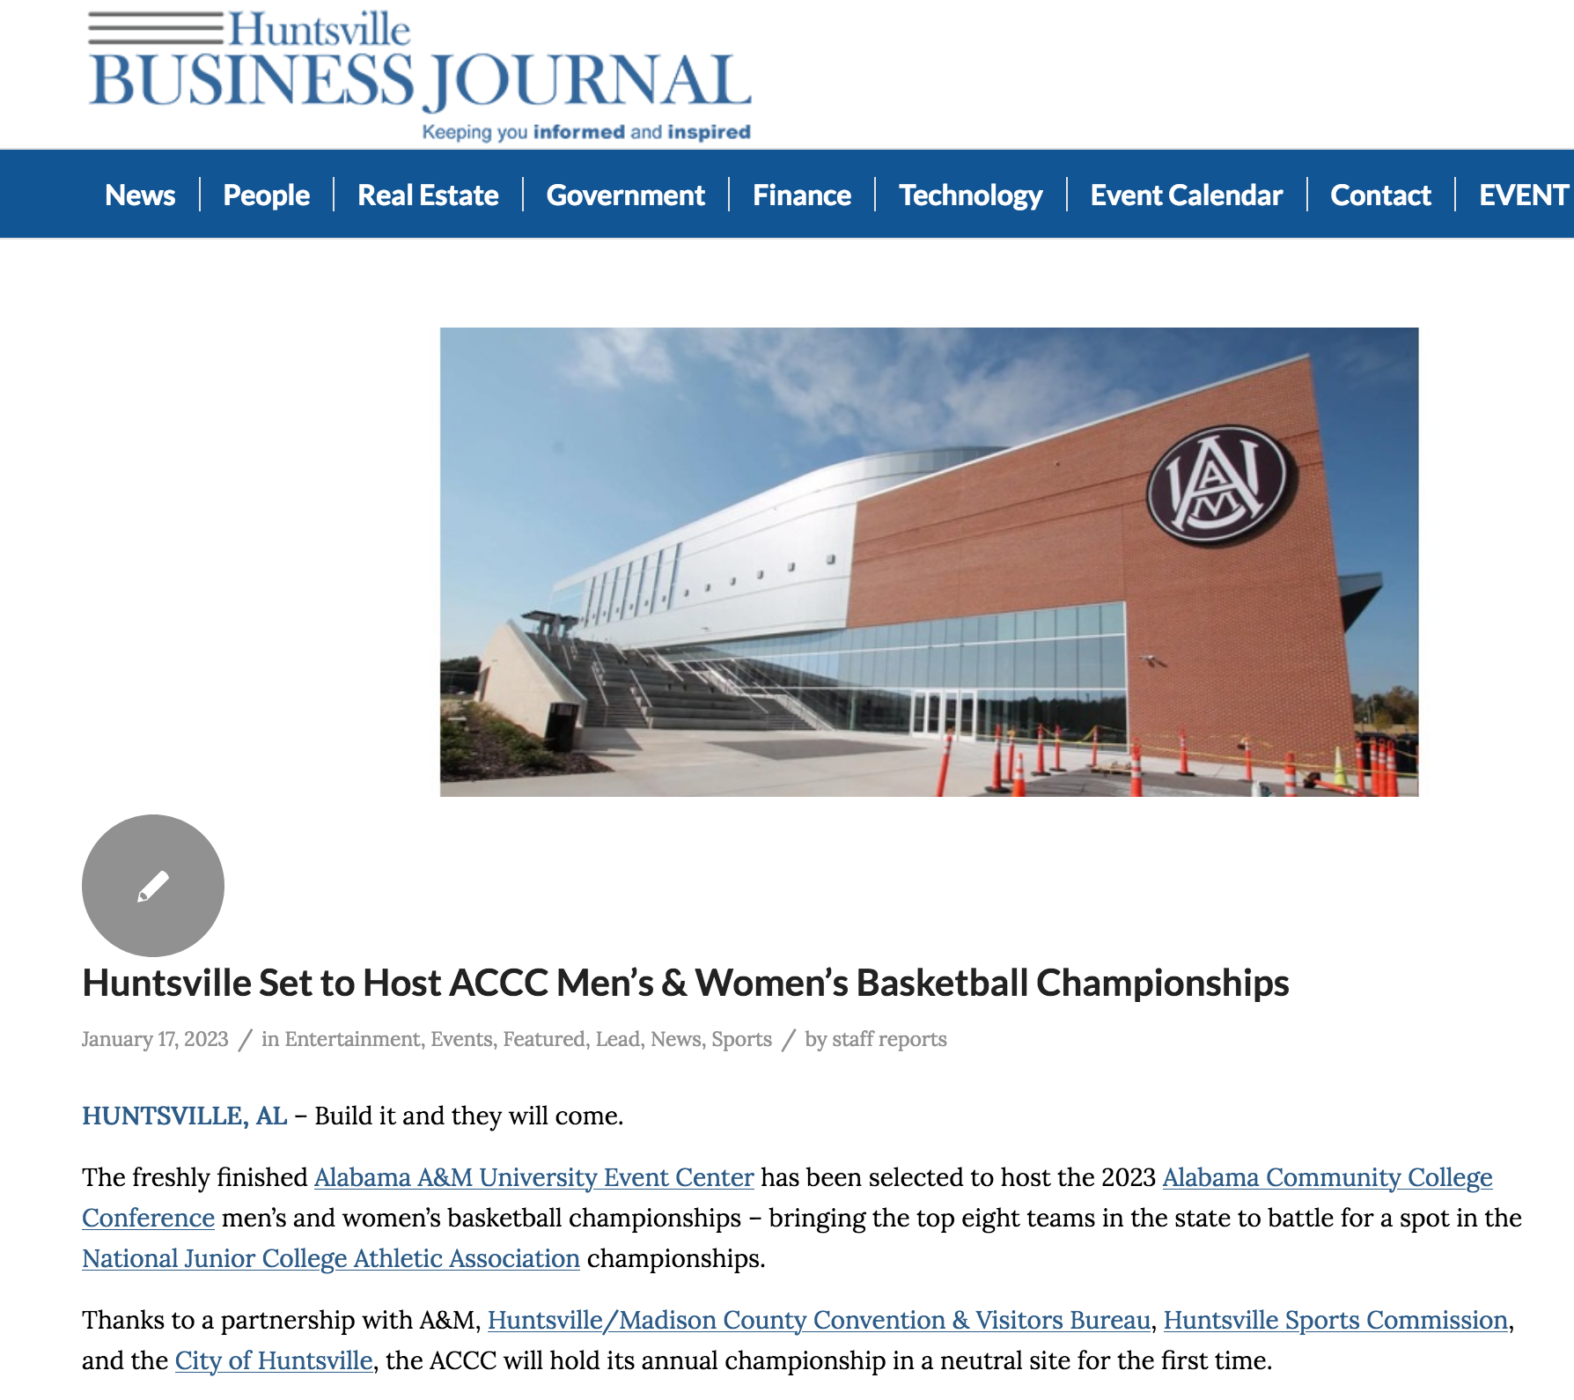
NOTES FROM AROUND THE REGION
ALABAMA MOUNTAIN LAKES TOURIST ASSOCIATION

Slide 71
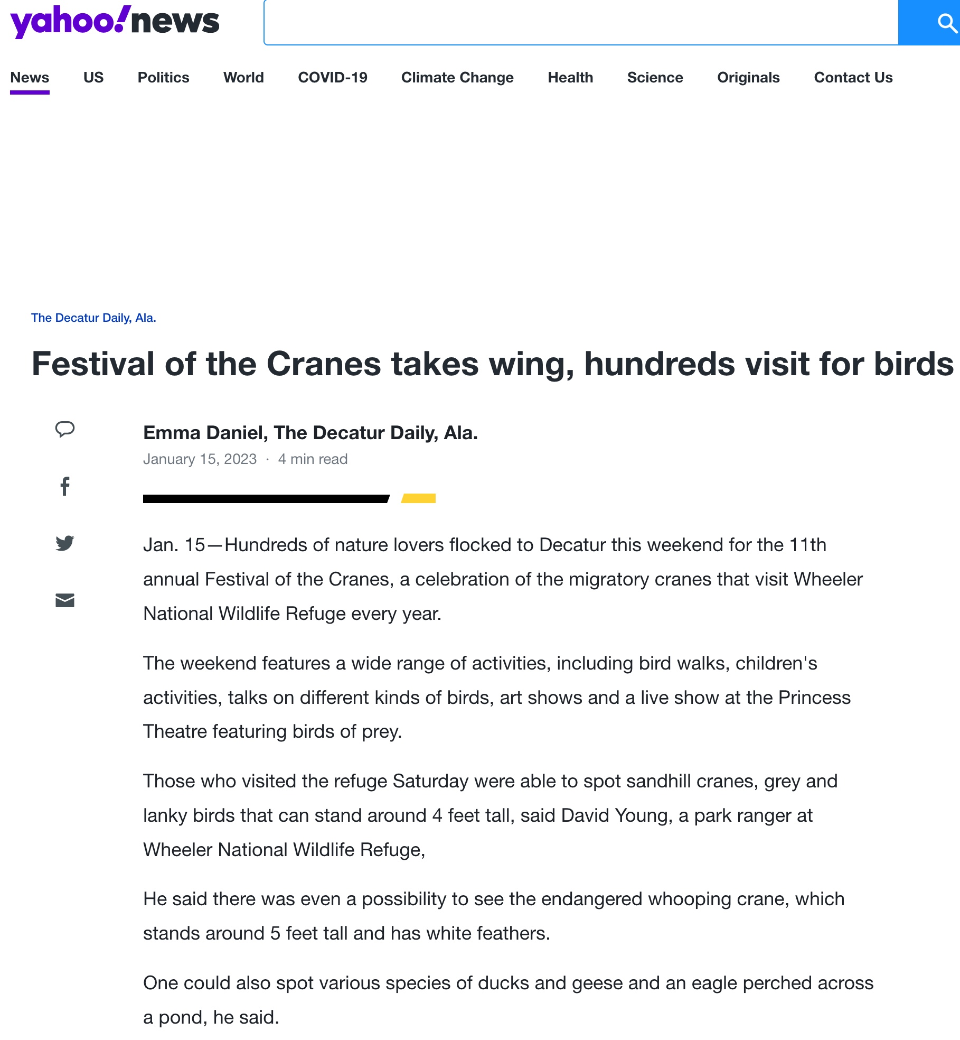
NOTES FROM AROUND THE REGION
ALABAMA MOUNTAIN LAKES TOURIST ASSOCIATION

Slide 72

NOTES FROM AROUND THE REGION
ALABAMA MOUNTAIN LAKES TOURIST ASSOCIATION

Slide 73

NOTES FROM AROUND THE REGION
ALABAMA MOUNTAIN LAKES TOURIST ASSOCIATION

Slide 74

NOTES FROM AROUND THE REGION
ALABAMA MOUNTAIN LAKES TOURIST ASSOCIATION

Slide 75


NOTES FROM AROUND THE REGION
ALABAMA MOUNTAIN LAKES TOURIST ASSOCIATION

Slide 76
SAVE THE DATES
American Bus Association
February 4-7, 2023, Detroit, MI
Indianapolis Boat, Sport & Travel
February 17-27, 2023, Indianapolis, IN
Mid-South Farm & Gin
February 24 & 25, 2023, Memphis, TN
Canoeacopia
March 10-12, 2023, Madison, WI
Atlanta Travel Adventure Show
March 25-26, 2023, Atlanta, GA
Alabama Tourism Bash
April 5, 2023, Montgomery, AL
Alabama State Meeting
April 6, 2023, Montgomery, AL
STS Domestic Showcase
April 17-20, 2023, Huntsville, AL
AMLA MEMBER SURVEY RESPONSE DUE
JANUARY 31, 2023
VIRTUAL LUNCH & LEARN
WITH AMLA
MARCH 7, 2023 @ 10AM
“YOU FEAST ON WHAT YOU SOW”
AMLA SOCIAL MEDIA NETWORKING
FEBRUARY 28, 2023 @ 10AM
THE NEW INFLUENCER MARKETING
MICHELLE STARK, RED SAGE VP OF SALES & MARKETING
AMLA BOARD AND MEMBERSHIP MEETING
APRIL 25, 2023
DOUBLETREE BY HILTON, DECATUR, AL
ALABAMA MOUNTAIN LAKES TOURIST ASSOCIATION

Slide 77







Supporting partner for Leave No Trace Outdoor Ethics
Alabama State Parks Advisory Board
Supporting partner for TVA Community Development Surveys
Alabama representative to the Appalachian Regional Commission
Instructor for Southeast Tourism Society Marketing College
Supporting partner of Tennessee River Valley Stewardship Council
Supporting member of Harvest Hosts

Slide 78


